Slide 1



Slide 2


Slide 3


Slide 4


Slide 5


Slide 6


Slide 7


Slide 8
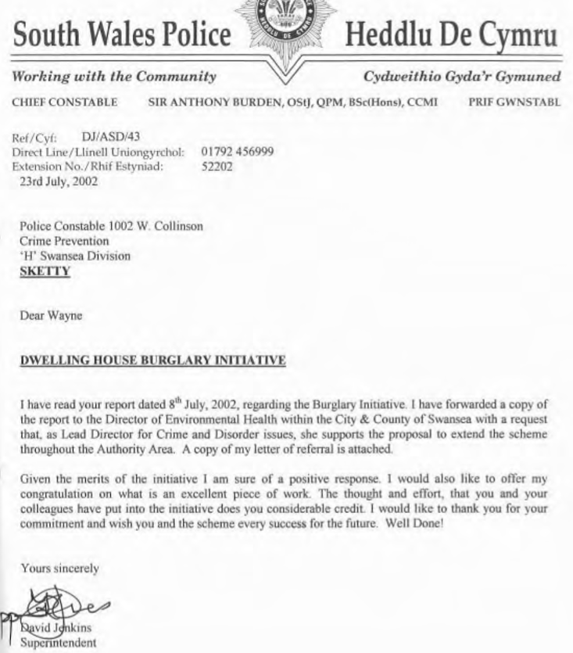

Slide 9
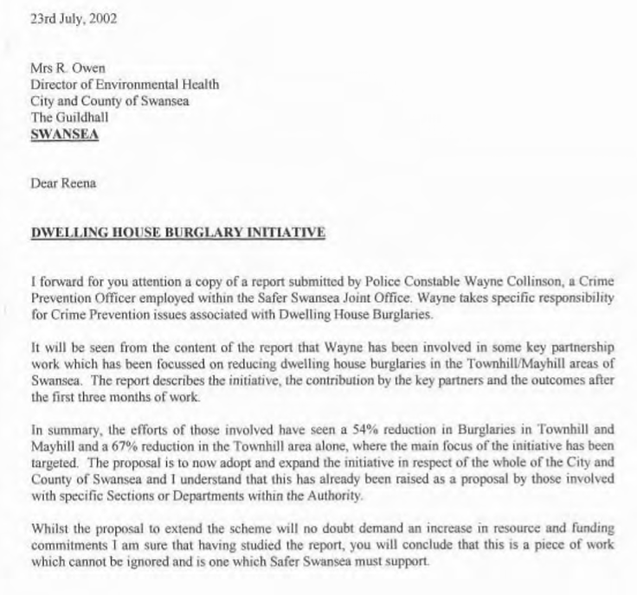


Slide 10


Slide 11
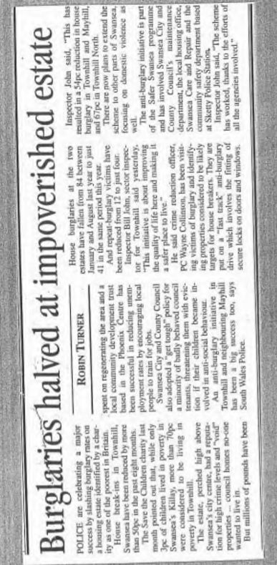

Slide 12
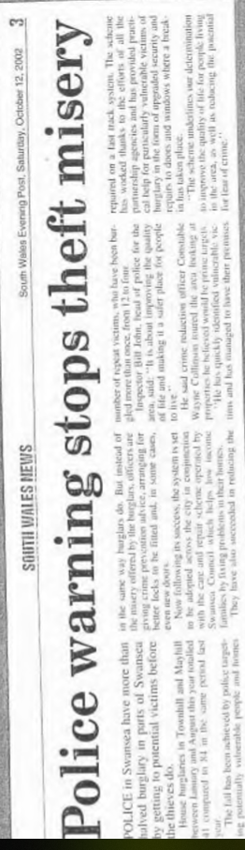

Slide 13
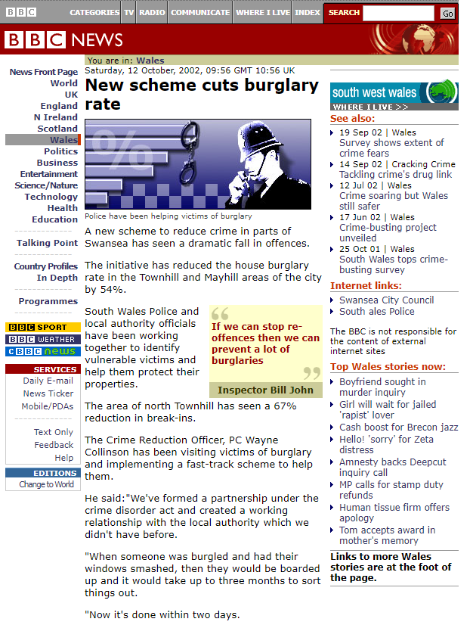
This approach saw a strong and concerted effort to:
Understand the data: what the numbers said about key issues (Hot Topics)
Understand how the data related to specific parts of the community (Hot Spots)
Focus on people who were most likely to be victims of crime
Focus on people were most likely to perpetrators of crime

Slide 14
Ends

