Slide 1
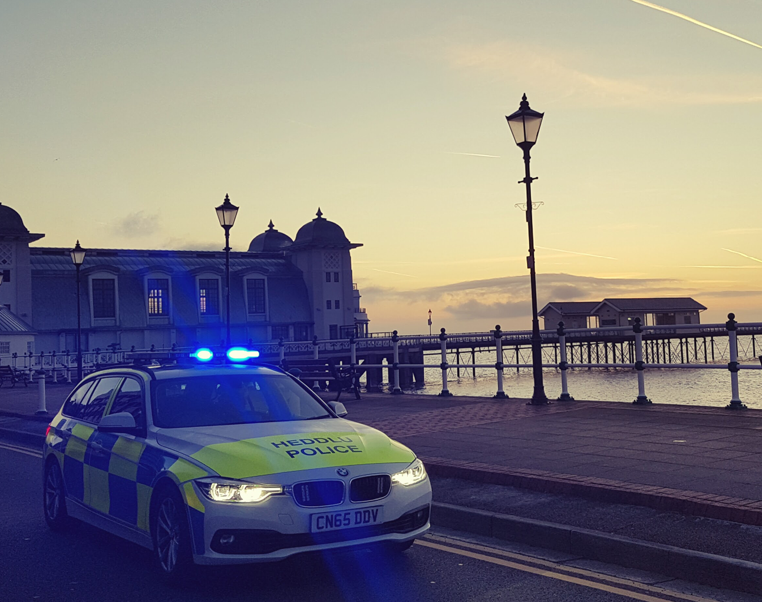
BMCP6008 Conducting Investigations – Exam revision (resit)
Workshop: Recap and Revise

Slide 2

EXAM DETAILS
Date:To be confirmed by registry (please keep a close eye on your emails)
Time: (2hrs) Time of exam to be set by registry
Location: Waterfront, IQ Campus, University of Wales Trinity, Swansea SA1 8EW (Room tbc)

Slide 3
Exam Style
Short Answer Questions
25 Questions

Slide 4

Key Topics:

Slide 5

Methods of Investigation
There are two methods of criminal investigation
Reactive
This starts with the discovery of a crime & seeks to bring offenders to justice by uncovering material that identifies suspects & provides sufficient evidence to enable a court to determine their guilt
Proactive
This usually starts with an intelligence analysis that a particular individual or group is involved in criminal enterprise
Notes:
Reactive: This starts with the discovery of a crime and seeks to bring offenders to justice by uncovering material that identifies suspects and provides sufficient evidence to enable a court to determine their guilt. The technique of reactive investigations focuses on interviewing victims, witnesses and suspects, the examination of scenes and the development of forensic links between suspects and the offence.
Proactive : The proactive method usually starts with an intelligence analysis that a particular individual or group is involved in criminal enterprise. This is often organised crime such as drug dealing, fraud or people trafficking. Individual instances of such offending are rarely reported to the police and so generally the techniques of reactive investigation cannot be used. As a result investigators generally use a range of covert surveillance techniques, which are designed to link offenders to the criminal enterprise. These techniques are often complemented by financial investigations and forensic science techniques.
At PIP level 1 It is expected that you will be involved mainly in reactive investigations.

Slide 6
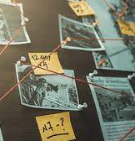
Investigations may be carried out in relation to:
Crimes that have been committed
Identifying whether a crime has actually been committed, with a view to commencing criminal proceedings
Crimes that the police believe may be committed, for example, when premises or individuals are kept under observation for a period of time, with a view to the possible institution of criminal proceedings
(College of Policing, 2021)

Slide 7


Investigative Mindset
A B C
APPROACH
Five Principles:
Understanding the source of the material
Planning and Preparation
Examination
Recording and collation
Evaluation
We will look at this in more detail over the next few weeks…

Slide 8
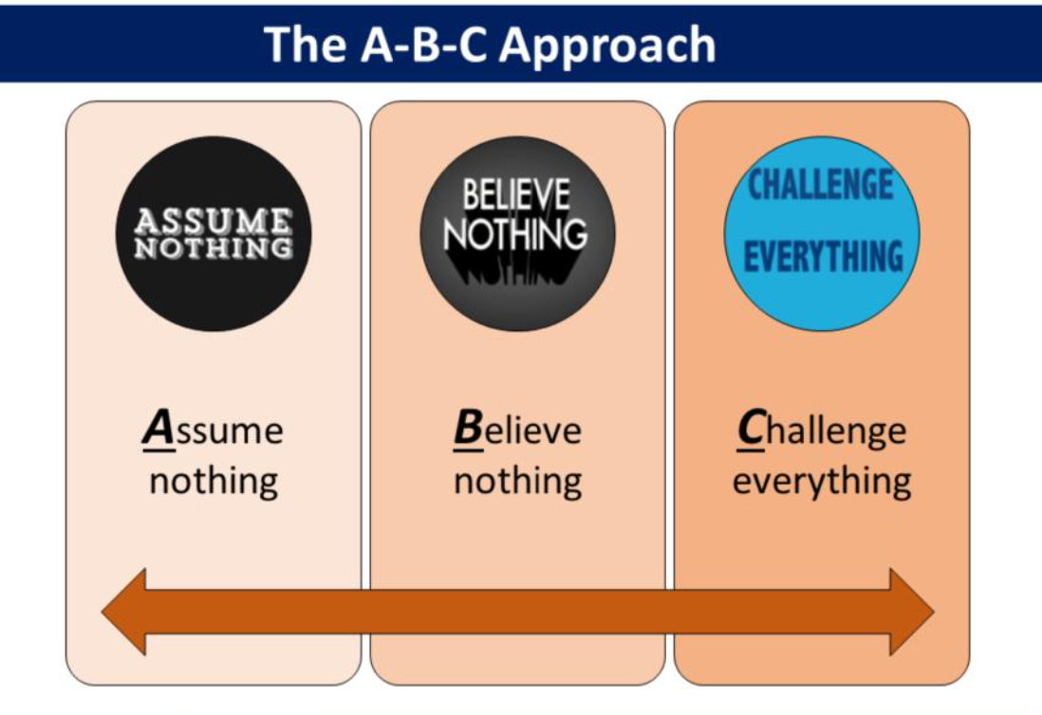

Slide 9
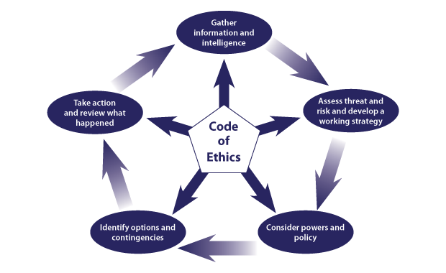
The National Decision Model (NDM)
Helps everyone in policing make decisions
Provides a framework in which decisions can be examined and challenged
Encourages officers and staff to act in accordance with the Code of Ethics and use their discretion where appropriate
Reduces risk aversion and weighs the balance of resourcing against demand, threat and risk

Slide 10
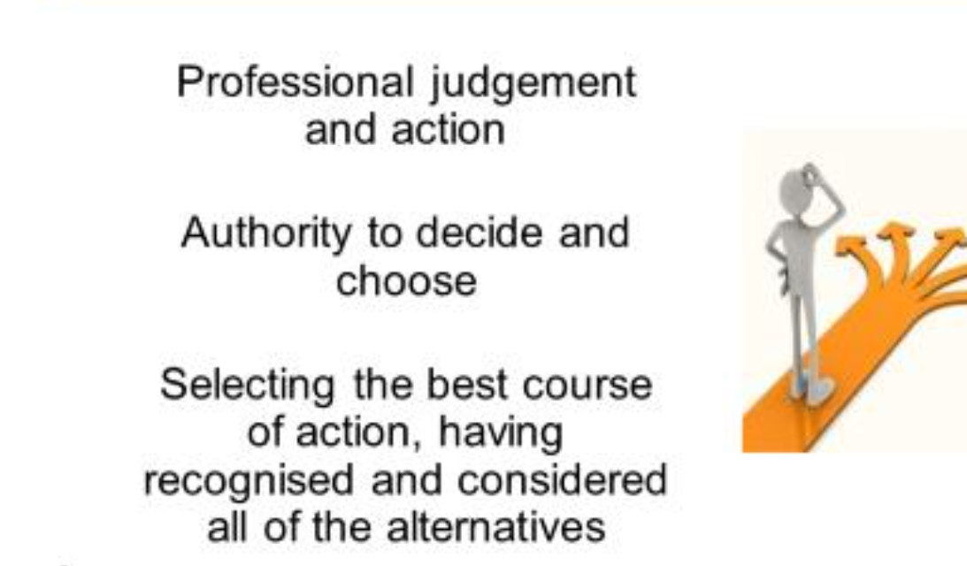
Discretion – what does it mean??
1. What does the word discretion mean to you?
2. Why do the police have discretion in dealing with persons?
(College of Policing, 2021)

Slide 11


Slide 12

What are Human Rights?
There are 16 basic rights in the Human Rights Act 1998 – all taken from the European Convention on Human Rights
They can be grouped into three broad types:
Absolute rights – such as the right to protection from torture and inhuman and degrading treatment (Article 3). The state can never withhold or take away these rights.
Limited rights – such as the right to liberty (Article 5). These rights may be limited under explicit and finite circumstances.
Qualified rights – rights which require a balance between the rights of the individual and the needs of the wider community or state interest. These include: the right to respect for private and family life (Article 8)

Slide 13
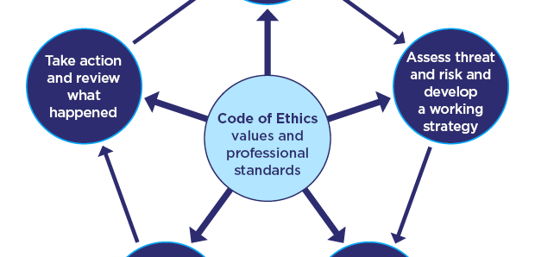
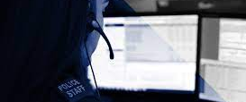
What happens when you dial 999/101?

Slide 14
THRIVE
The National Decision Model is the basis of decision making
THRIVE provides a framework to support our decision making, informing a holistic understanding of the situation.
THRIVE is an integral part of our ethical decision making.
THRIVE will be used to assess situations where decision making, and management of risk has a range of considerations and responses related to the circumstances.
All Police Officers and Staff who deal with calls for service, reports or the management of investigations from the public.
THRIVE is designed to jointly assess risk and decision making in a consistent way using the National Decision Model.
THRIVE aligns to the Code of Ethics and National Decision-Making model and helps police respond at pace. THRIVE has the values at its heart.

Slide 15
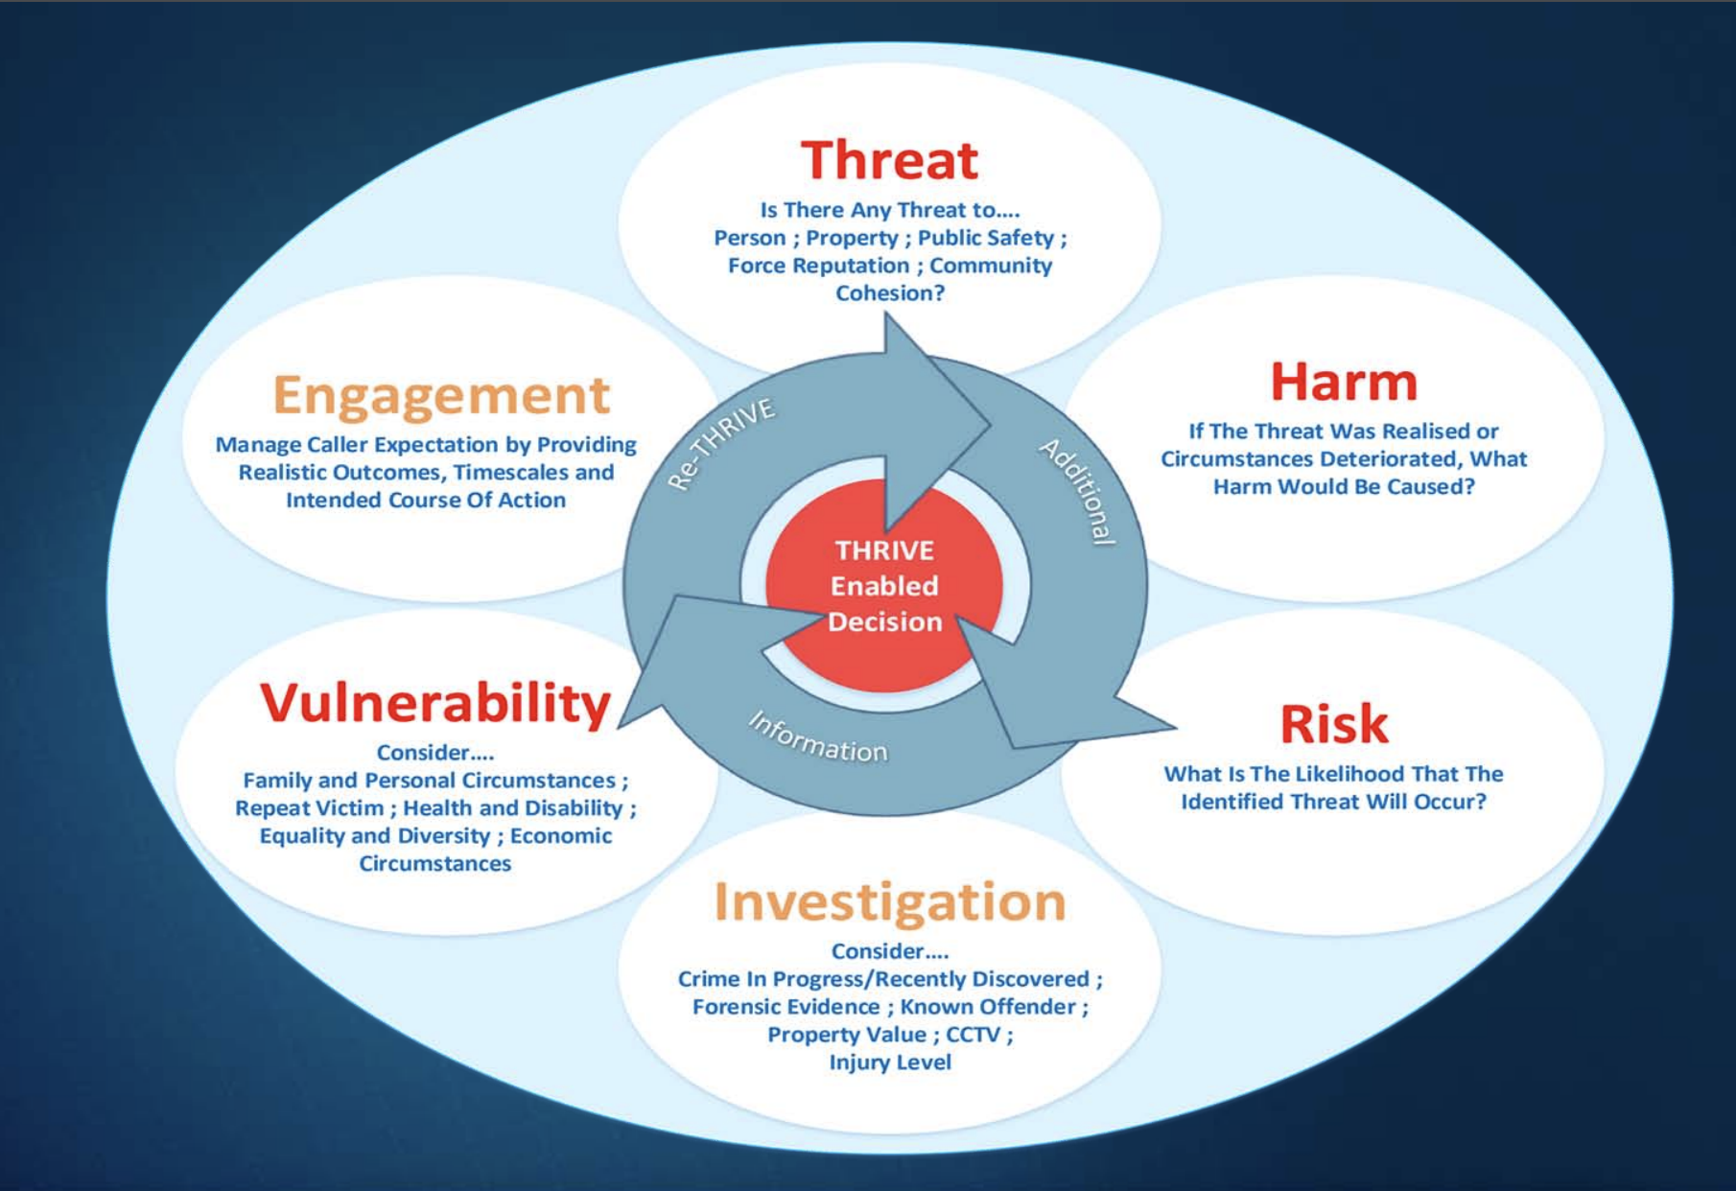

Slide 16
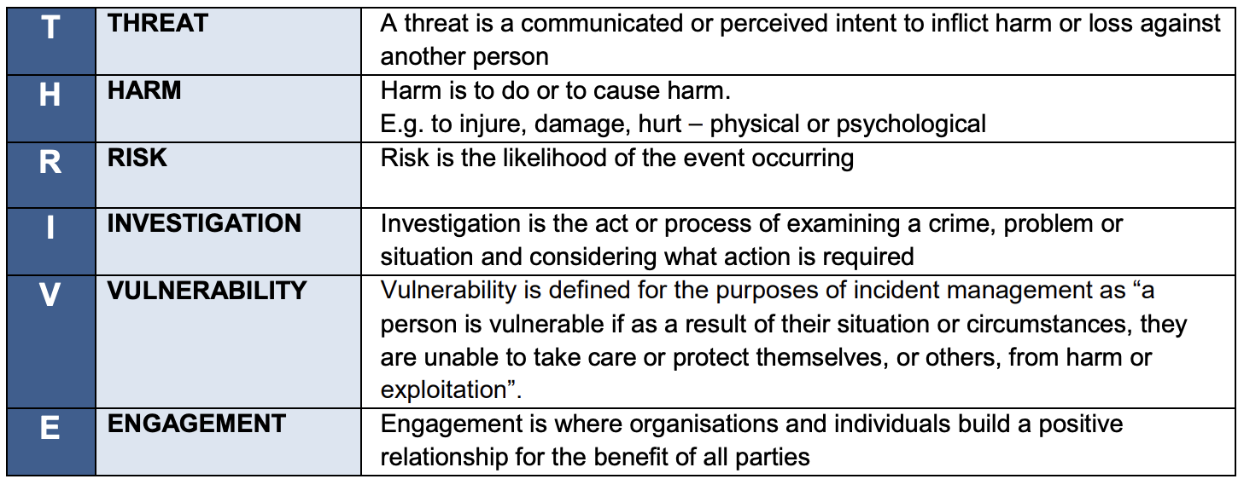

Slide 17
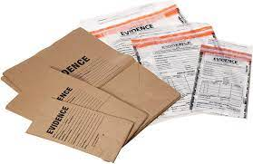
‘Material’
(Criminal Procedure and Investigations Act 1996)
Material is defined as:
‘material of any kind, including information and objects, which is obtained in the course of a criminal investigation, and which may be relevant to the investigation.’
Relevant if:
appears that it has some bearing on any offence under investigation, or
on the surrounding circumstances of the case, unless it is incapable of having any impact on the case.
Notes:
Common formats of material include:
statements
documents
reports
physical exhibits
fingerprints
images
audio or video recordings

Slide 18

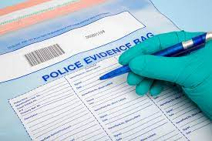
Evidence in Investigations
Physical evidence- documents, objects, etc.
Forensic evidence- fingerprints, DNA, etc.
Digital evidence- computer records, CCTV etc.
Expert witness evidence
Intelligence
…..and many more!
All Material
Notes:
Question- Where will we obtain evidence from?
All provide assistance within an investigation

Slide 19
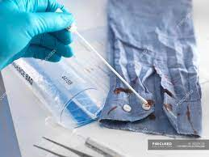
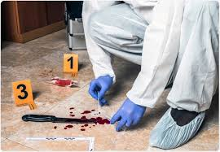
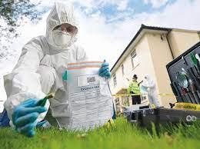
Sources of Forensic Evidence
Evidence can be collected and preserved from the following three sources
People
Item
Location
(College of Policing, 2021)

Slide 20
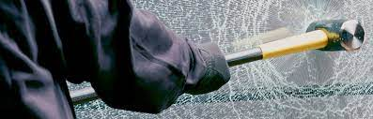
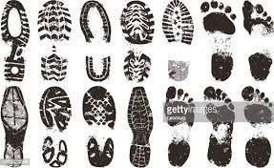

Types of Forensic Evidence
1. Trace evidence
2. Impressions or marks
3. DNA
(College of Policing, 2021)

Slide 21

“The Golden Hour”
Term used for the period immediately after an offence has been committed, when material is readily available in high volumes to the police.
Positive action in the period immediately after the report of a crime will:
minimize the amount of material that could be lost to the investigation
maximize the chance of securing the material that will be admissible in court.
Remember CLADD!
Concealed
Lost
Altered
Damaged
Destroyed
(College of Policing, 2020)

Slide 22
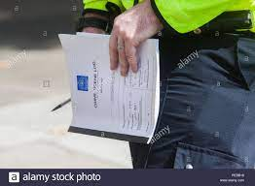
Scene Log
Commence upon arrival
Time/ Date
Who? When? Where? What?
Name
Time entered scene
Time left
Who the log is handed to
Signature

Slide 23
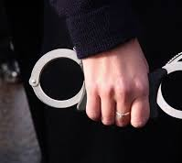
Arrest:
What does it mean?
Discuss: How do you think the growth of the digital world has changed the process of arrest?...Has it?

Slide 24
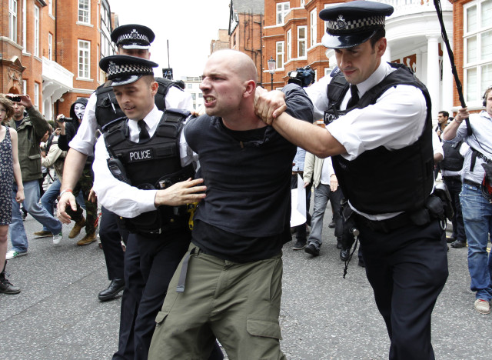

What is a ‘Lawful Arrest’? S24 PACE, Code G
A person’s involvement
or
suspected involvement
or
attempted involvement
in the commission of a criminal offence
AND
reasonable grounds for believing that the person’s arrest is ‘necessary’
Notes:
PACE Code G states that these two elements must be satisfied for a Sec 24 arrest to be lawful:
If the provisions of the Act and this Code are not observed, both the arrest and the conduct of any subsequent investigation may be open to question.
The law requires a person is informed of the 'grounds for the arrest'
(e.g. "I am arresting you on suspicion of stealing a stereo from a Ford Fiesta car in Acacia Ave yesterday").

Slide 25
Two Types of Caution
1. The ‘When Questioned’ caution
2. The ‘Now’ caution

Slide 26
The ‘When Questioned’ Caution
You do not have to say anything.
But it may harm your defence if you do not mention when questioned something which you later rely on in court.
Anything you do say may be given in evidence.

Slide 27
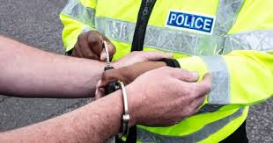
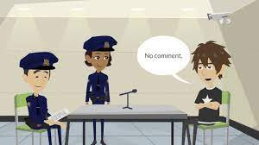
When to caution…
When you have grounds to suspect an offence has been committed
You want to ask questions regarding their involvement or suspected involvement in that offence as the offender

Slide 28
The ‘Now’ Caution
We’ll study this more later…
You do not have to say anything.
But it may harm your defence if you do not mention now something which you later rely on in court.
Anything you do say may be given in evidence.

Slide 29
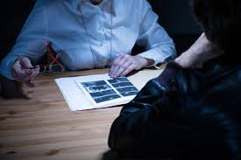
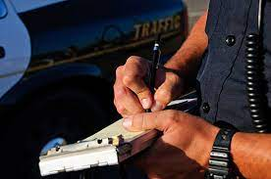
Cautions – The Difference
‘When Questioned’
Indicates an intention to ask questions about an offence
‘Now’
At the conclusion of the process, when a person is reported or charged with an offence

Slide 30
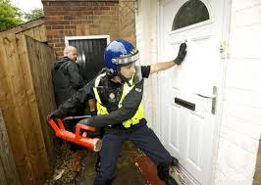

Powers of Entry, Search and Seizure

Slide 31

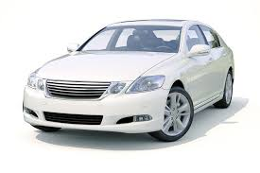
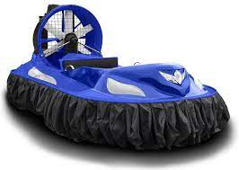
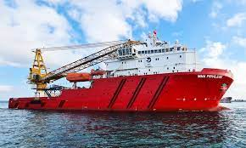


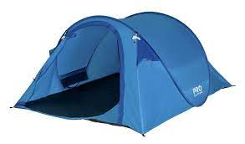
HAVVROT
What is a ‘PREMISES’?
Section 23 PACE 1984:
H
A
V
V
R
O
T

Slide 32
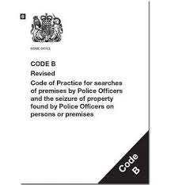
Powers of Entry, Search & Seizure without Warrant
PACE Section 17
Entry for purpose of arrest/recapture/Saving life & limb
PACE Section 32
Search of premises where arrested person is/has recently come from
PACE Section 18
Entry & search after arrest (triable either way or indictable only)

Slide 33
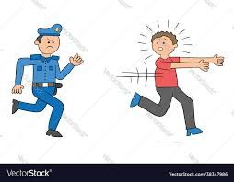
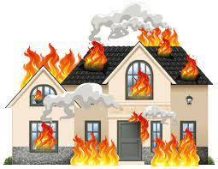
Section 17 P.A.C.E (1984)
Recapturing a person unlawfully at large & whom he is pursuing
Saving life & limb or preventing serious damage to property

Slide 34

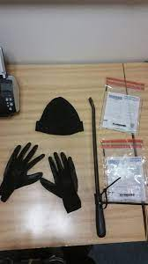
Section 19(2) P.A.C.E (1984)
A Constable who is lawfully on any premises may seize anything which is:
Covered by a warrant
Anything they have reasonable grounds for believing is evidence of an offence
Anything that has been obtained in consequence of the commission of an offence

Slide 35
Section 19 - Seizing
Necessary to seize it to prevent it being:
Concealed
Lost
Altered
Damaged
Destroyed
Section 22 of PACE 1984:
Seized property may be retained for specific reasons only.
Possible reasons for retention are that the property seized is:
For use as evidence in a trial (unless a photograph or copy would suffice)
Forensic examination
Further investigation
Establish the lawful owner.

Slide 36
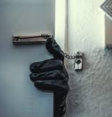
Theft Act 1968
Section 1 – Theft
Section 8 – Robbery
Section 91A/91B – Burglary
Section 10.- Aggravated Burglary

Slide 37

Section 1(1) Theft Act 1968
‘A person is guilty of theft if they
dishonestly appropriates property belonging to another
with the intention of
permanently depriving
the other of it.’

Slide 38
The basic offence of burglary…
The basic offence of burglary is set out in section 9 of the Theft Act 1968.
There are two subsections S.9(1)(a) AND S.9(1)(b) which describe the main ways the offence can be committed:
9 (1) (A)
9 (1) (B)
A person is guilty of burglary if he/she enters any building, or part of a building, as a trespasser…
(a) With the intent
(b) And carries out any of the following acts
To do unlawful damage to the building or anything in the building
To steal anything in the building or part of it, or
To inflict GBH on any person in the building
OR Attempt!!

Slide 39

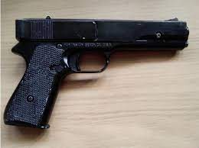
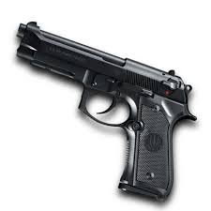
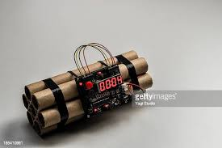
Aggravated Burglary – Section 10 Theft Act 1968
A person is guilty of aggravated burglary if he commits any burglary & at the time has with him:
WIFE
Weapon of offence OR
any Imitation firearm OR
any FIREARM OR
any Explosive

Slide 40
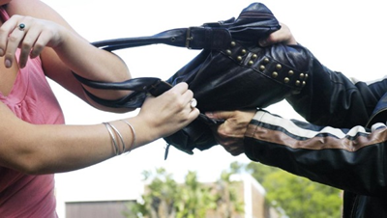
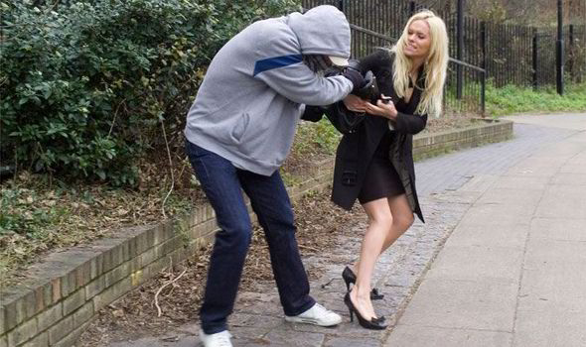
Robbery Section 8 Theft Act 1968
A person commits robbery if they steal & immediately before doing so or
at the time of doing so & in order to do so
uses force on any person or puts or seeks to put any person in fear of being then & there subjected to force
Notes:
.

Slide 41
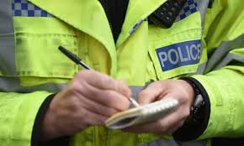
Information
Information is the very life-blood of policing. It may be original & generated by you. It may come from the public or other officers or be fed to you by partner agencies & other sources
Police information is:
All the information obtained & recorded for a policing purpose
Everyday the police collect information, but it should only be collected if deemed relevant for a policing purpose.
This provides the police a legal basis to deal with the information, i.e. recording, sharing it with other agencies or simply retaining it for a future use.
Information normally comes from a source that needs no confidentiality, constraints or protection.
A member of the public calling to report an incident would fit this definition.
All the information obtained must be recorded.
It is essential that all police information is managed lawfully, from its initial collection to its final disposal in order to ensure its lawfulness.

Slide 42
The Intelligence Cycle
Direction
Collection
Evaluation
Analysis
Dissemination
This cycle is a formal model that is a sequential process that allows information to be developed into intelligence, particularly during the analysis phase.
The collection, development and dissemination of intelligence allow decisions to be made about priorities and tactical options.
Intelligence collection is a continuous process and there may be specific requirements for its recording and use.

Slide 43

Direction
Determines the intelligence requirements and to plan the collection efforts – creating a clear focus and list of priorities for the intelligence team and ensuring that all information gathered is geared towards a clear purpose.

Slide 44
THE PLAN
What do you know?
What will you do?
How?

Slide 45

Aim to understand:
If there are any gaps in your current intelligence collection
The geographical areas you operate in and any plans for future expansion
Any properties or assets across the globe you’ll be monitoring
Where your people and employees regularly travel
If there are particular routes they take, accommodation that they stay in or places they visit
Groups of interest, including activists, terrorists and extremists
Historical threats to your business or the industry as a whole

Slide 46
Collection
Is the gathering of the raw information needed to produce finished intelligence.
There are many sources of information including open sources such as foreign broadcasts, newspapers, periodicals, and books.
It is essential that information is collected, recorded and evaluated in a consistent manner across organisational and force boundaries.
Information is collected in one of three ways: routine collection, tasked information, volunteered information

Slide 47
Evaluation
Having completed the collection plan from phase 2, the evaluation phase consists of then obtaining a measure of confidence in the data that you have collected.
It requires analysing how reliable, truthful and valid you consider the source (person or system providing the information) to be, and how the reliable the information being provided by that source is.

Slide 48
There are three significant stages to go through during the evaluation phase:
1. Source Evaluation – you need to evaluate the source to see whether they are reliable
2. Information Evaluation – you need to then evaluate the information provided by the source, using a grading matrix
3. Data Dissemination – you need to consider the handling and sharing of the data once the previous two steps have been taken

Slide 49

Analysis
To identify patterns or inconsistencies within information.
This identification enables the analyst to draw inferences from the inconsistencies or patterns.
Allows for operational decisions to be made. This might include:
1. enforcement activity.
2. additional information gathering.
3. a crime and disorder reduction strategy.

Slide 50
What Does Analysis Provide?
Provides many insights into what is happening and why.
It clarifies and details the following:
What has happened
Why this is important
Context around the bigger picture
What could happen next

Slide 51
Dissemination
The sharing of intelligence to enhance investigations.
Intelligence sharing should be proportionate and done following principles of the Human Rights Act 1998
Protocols should be in place for disseminating confidential intelligence or sensitive intelligence.

Slide 52
MOPI Guidance
The Code of Practice on the Management of Police Information states:
Information gathered by the police must be :-
For a policing purpose
And
Managed lawfully
Notes:
52

Slide 53
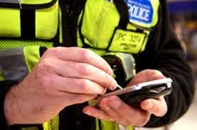
Police National Database (PND)
Allows the Police Service to share, access & search local force information on a national basis
Updated in “near real time”
Information from 3x5x2 may be entered on PND
Notes:
53

Slide 54
PND Benefits
Identify new lines of enquiry
Identify new patterns in crime
Remove the current artificial borders
Uncover bad character evidence
Make much better risk-assessments & improving decision making
Notes:
54

Slide 55
Fairness
“Investigators must act fairly when questioning victims, witnesses or suspects. They must ensure that they comply with all the provisions and duties under the Equality Act 2010 and the Human Rights Act 1998” (College of Policing, 2022)

Slide 56
Planning and Preparation
Responsibilities of the Interviewing Officer
Welfare
Security
Legal Rights

Slide 57
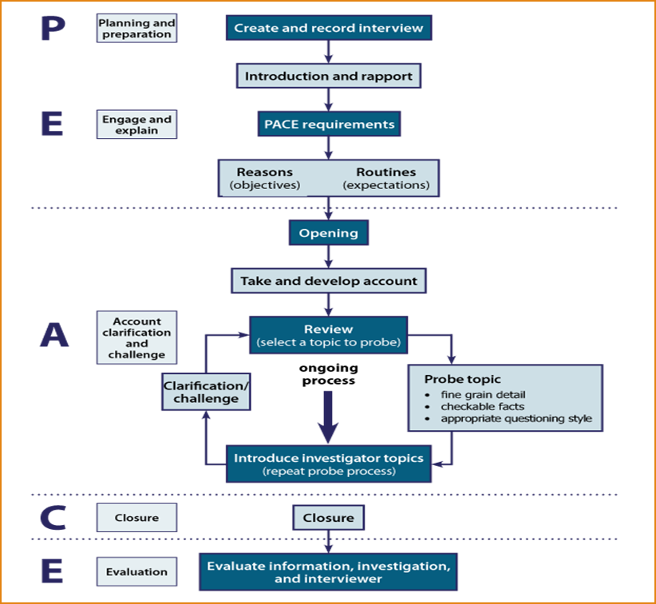

Slide 58
Appropriate Adult (AA)
AA’s are called to the police station as an important safeguard, providing independent support to detainee’s who are:
Aged 18 or under or
Maybe mentally disordered /vulnerable
They are not simply an observer. Their role is to assist the detainee to ensure that they understand what is happening at the police station during the interview & investigative stages. In particular they should:-
Support, advise & assist the detainee
Ensure that the police act fairly & respect the rights of the detainee
Help communication between the detainee, the police & others
Their role is NOT to provide the detainee with legal advice

Slide 59
Vulnerable Witnesses – S16 YJCE Act 1999
Section 16 Vulnerable
Under 18
Mental Illness
Learning Disability
Physical Disability
Section 17 Intimidated
Suffering from fear or distress

