Slide 1
IMPACT OF E-PUBLISHING DEVELOPMENT UPON PRINT JOURNALISM
NAME : DHRUVKUMAR RAMESHKUMAR SHAH
STUDENT ID : 1704816
TUTORIAL NAME : STEPHEN SOMMERVILLE
SUB CODE : SBMA7113_LON

Slide 2
INTRODUCTION
Digital Online publishing trend has become a trend of present time.
Due digital online publishing print media is getting affected and have come to an extinct.
The Times (newspaper has managed to move with time and has entered into online publishing
All the online content of The Times remain behind the paywall.

Slide 3
PRINT MEDIA
The medium that disseminates the printed matter is known as print media.
The instrumentality that help in storing or communicating the information is known as medium.
Mainly newspapers and magazines are used in print media.

Slide 4
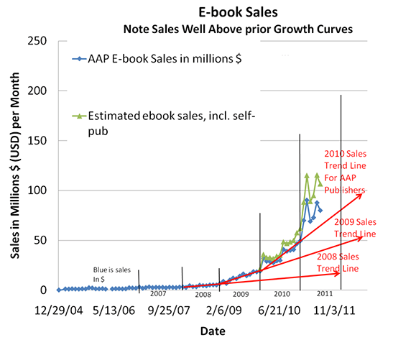

Slide 5
TREND AFFECTING DIGITAL PUBLISHERS
Print Audience which use to get the opinion and entertainment content and advertising from the newspapers and magazines are shrinking at worldwide level.
The rate of decline is growing each year
Print media is not even getting proper set of advertisements from various industries.
The newspaper publishing company Daily Mirror has faced huge loss due to digital publishing

Slide 6
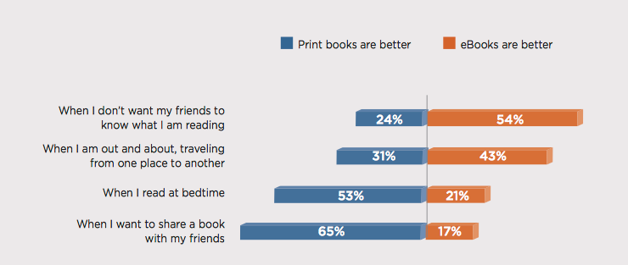

Slide 7
BENEFITS PROVIDED BY THE TIMES
Provided low cost readings for the readers available
Was easily accessible
Can be read at any time
Up to date information

Slide 8
BENEFITS OF DIGITAL PUBLISHING
Digital publishing helped The Times in providing endless possibilities of distribution
It helped the company in keeping the cost of publishing down
It was easy to monetize digital publishing for The Times
It Increased the ability to update of The Times

Slide 9
DISADVANATGES OF DIGITAL PUBLISHING
Ease of theft of the information is there in digital publishing
It provides a changed reading experience like the content gets scrolled down which disturbs the continuous reading
Lack of Respect is there
Leading affect the employment of many people

Slide 10
CONCLUSION
Digital publishing is taking over the market which is affecting the print publishing.
The Times has managed to move with time and has managed to enter into the field of digital publishing
It is beneficial because it is leading to reduce use of paper which is helping in environmental sustainability.
It is available at lower cost then the printed newspapers and magazines.
Could be accessed easily

Slide 11
REFERENCES
Barrett, K. (2013). Print and Digital Media Review. Gastroenterology, 144(7), 1569.
Jing, X., Pan, H., & McNaught, C. (2010). ELearning and digital publishing. Dordrecht: Springer.
Klein, R. (2014). Career building through using digital publishing tools. New York: Rosen Publishing.
Longstreth, G. (2014). Print and Digital Media Review. Gastroenterology, 146(2), 585-586.
Slaatta, T. (2014). Print versus digital in Norwegian newspapers. Media, Culture & Society, 37(1), 124-133.

