Slide 1
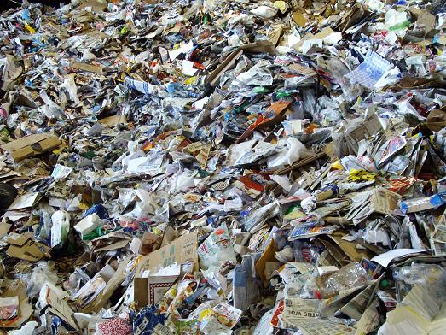
The Modern World:
Waste
Lara Hopkinson
Senior Lecturer

Slide 2
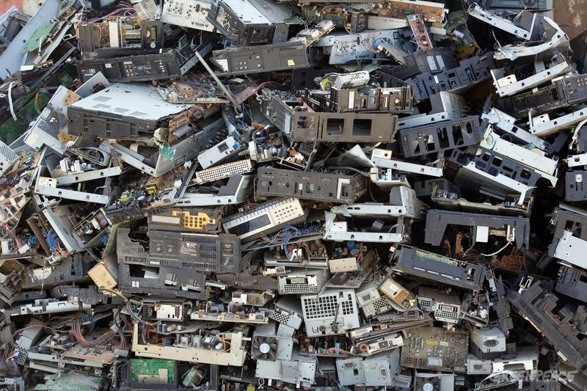
Some statistics…..
Construction sector produces the largest amount of waste (~100m tonnes / year)
Households create ~27m tonnes waste / year
15m tonnes of food waste (2013)
Roughly ⅓ all food purchased
Fly-tipping still very prevalent
Source: Digest of Waste and Resource Statistics, 2016

Slide 3
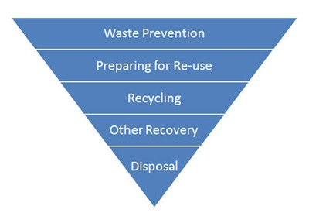
Waste hierarchy
Source: European Environment Agency

Slide 4

Why is waste an issue?

Slide 5
Some issues to consider….
Disposal methods
Wasted resource
Costs (financial, environmental, etc.)
Types of waste
Legislation / regulation
Etc.

Slide 6
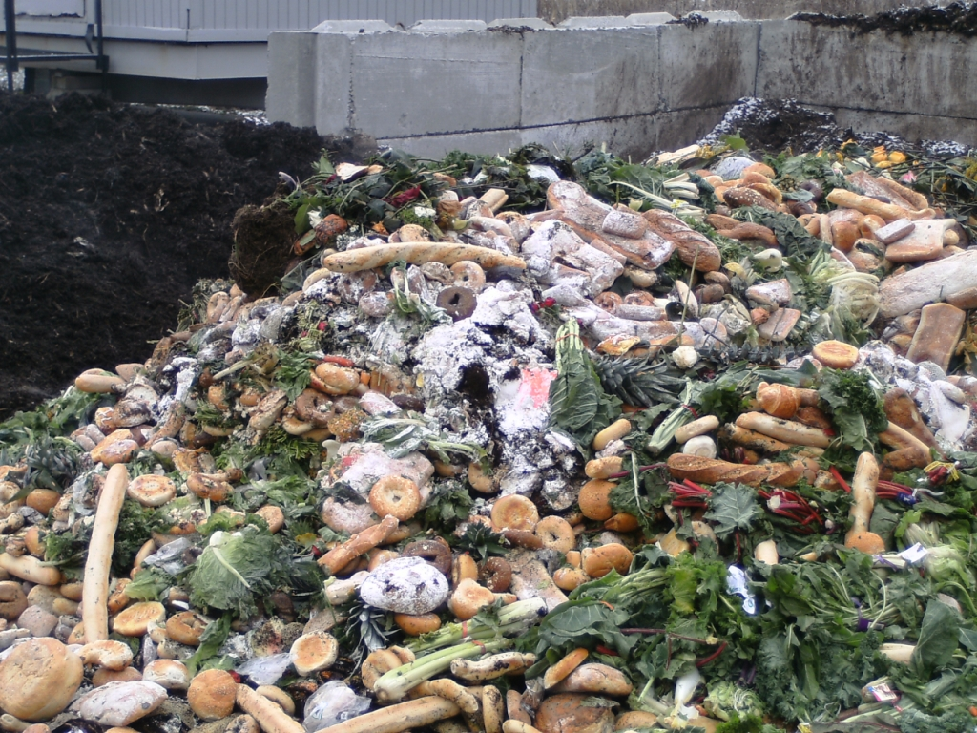
Classification of waste
Definition:
“A material is considered to be waste when the producer or holder discards it, intends to discard it, or is required to discard it”
Discarding:
“covers activities and operations such as recycling and recovery operations, which put waste material back to good use”

Slide 7
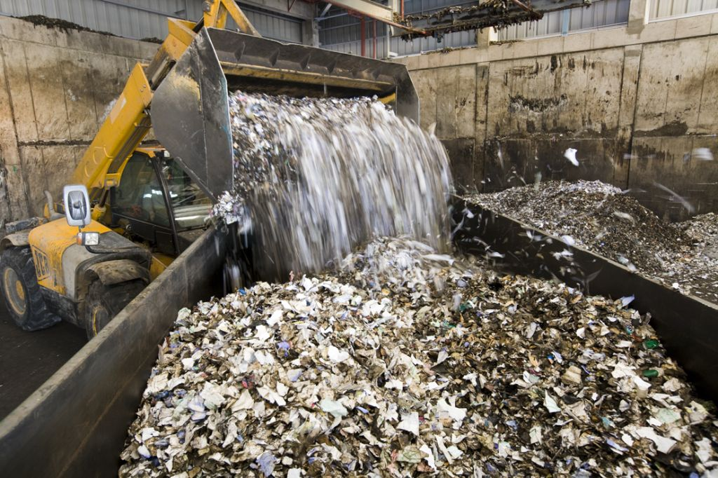
Waste types
Inert
Controlled
Hazardous

Slide 8












Hazardous waste properties

Slide 9
Importance of classification?
Do you know why?
From the Waste Framework Directive 2008:
  No co-mixing of waste
  Specifically designated landfills
  Methods to divert up the waste hierarchy
  Cost & taxes

Slide 10
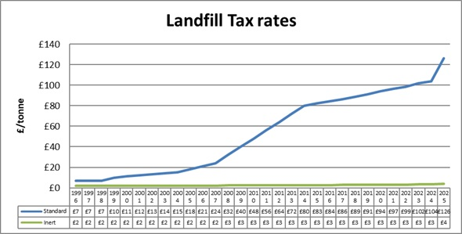
Landfill Tax
2026 rates: £130.75 (standard) / £8.65 (inert), April 2026
Source: 360 Environmental

Slide 11
Methods of disposal
Prevention
Re-use
Recycle
Energy recovery
Disposal

Slide 12

Methods of waste prevention
Reducing the amount of waste generated
Reducing its hazardous content
Reducing its impact on the environment
Therefore:
  Use less materials in design / manufacture
  Keep products longer
  Use less hazardous materials

Slide 13
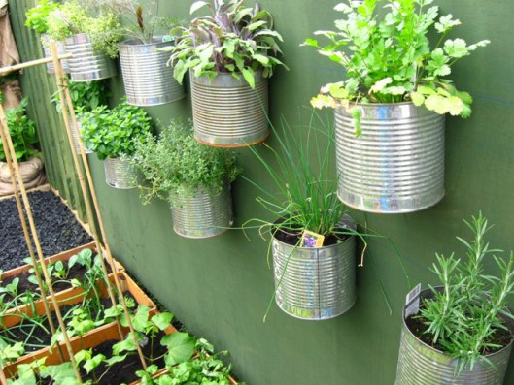
Preparing for re-use
Checking
Cleaning
Repairing
Refurbishing
Whole items or spare parts

Slide 14

Recycling
Turning products into new products
Includes composting
Upcycling:
  Turning into product of higher value
Downcycling:
  Turning into product of lower value

Slide 15
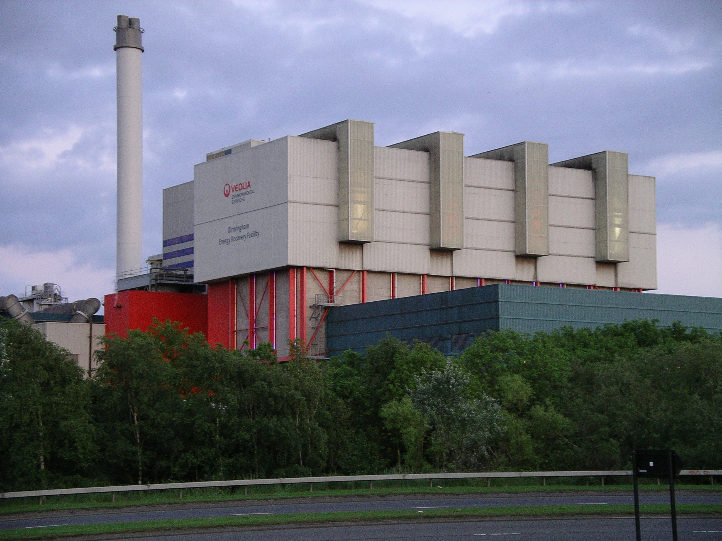
Energy recovery
Anaerobic digestion
Incineration with energy recovery
Gasification & pyrolysis
Materials from waste

Slide 16
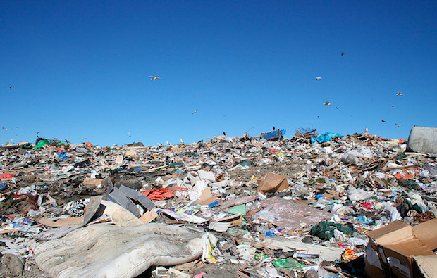
Disposal
Landfill
OR
Incineration without energy recovery

Slide 17
Landfill space in Wales (NRW, 2013)

Slide 18
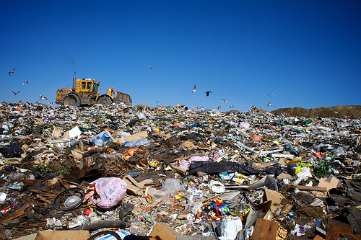
Key concerns re: landfills
Landfill gas
Leachate
Noise
Odour
Aesthetics
Management
End-of-life

Slide 19
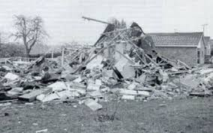
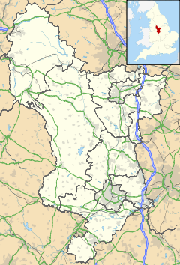
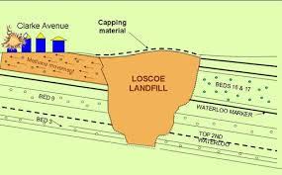
Case study: Loscoe, Derbyshire

Slide 20
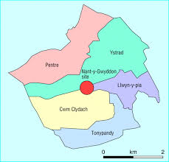
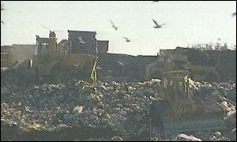
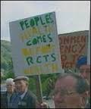
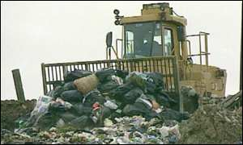
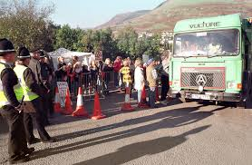
Case study: Nantygwyddon landfill

Slide 21
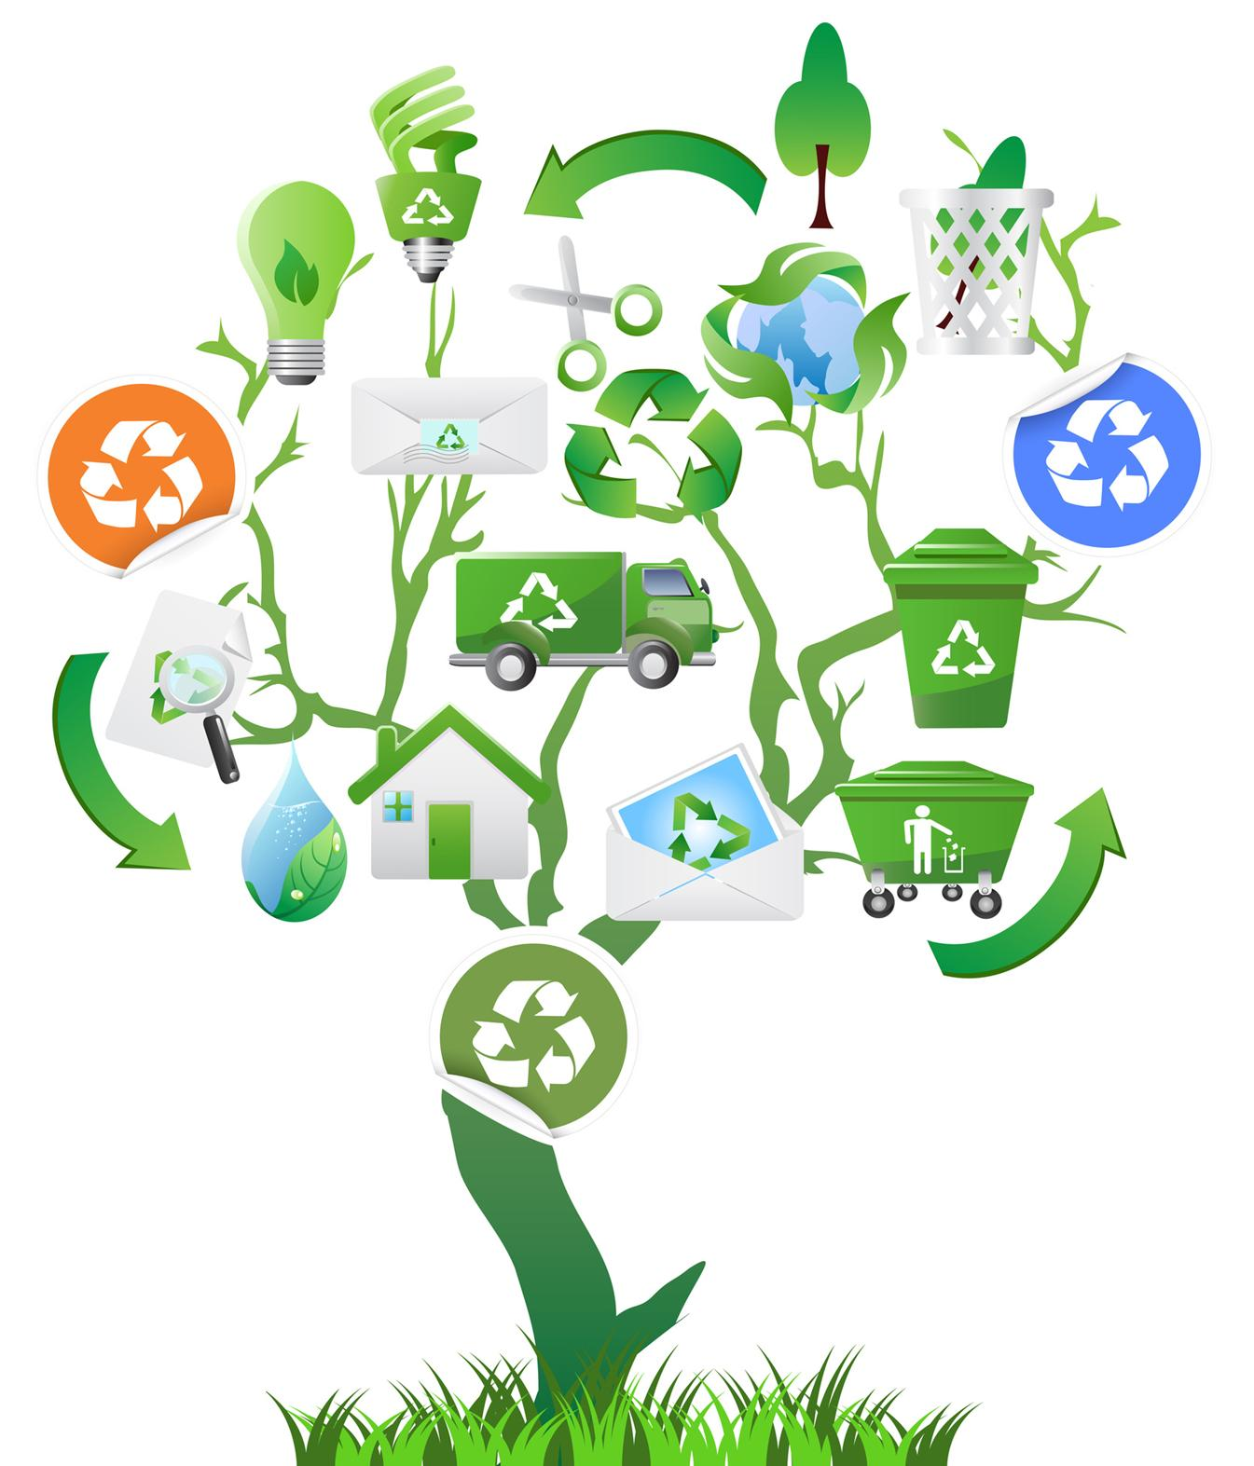
Benefits of recycling
Resource efficiency
Extending life of materials
Reduce production / energy costs
Reduce energy use
Reduce negative environmental impacts
Stimulating local economy
Picture source: www.columbiatn.com

Slide 22
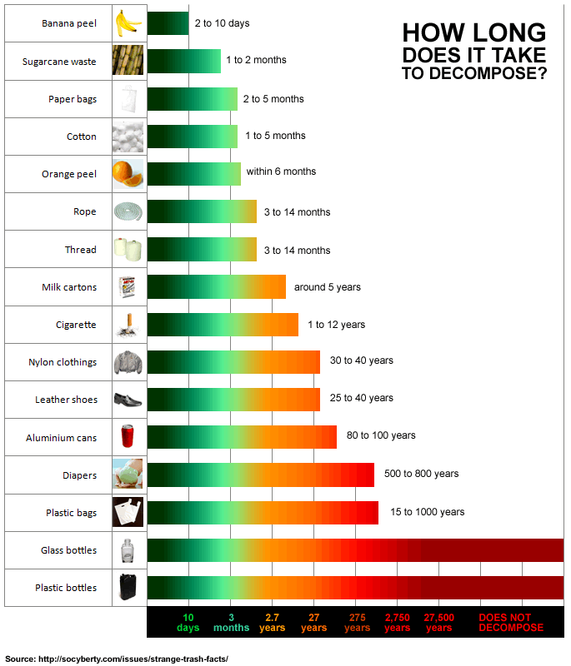
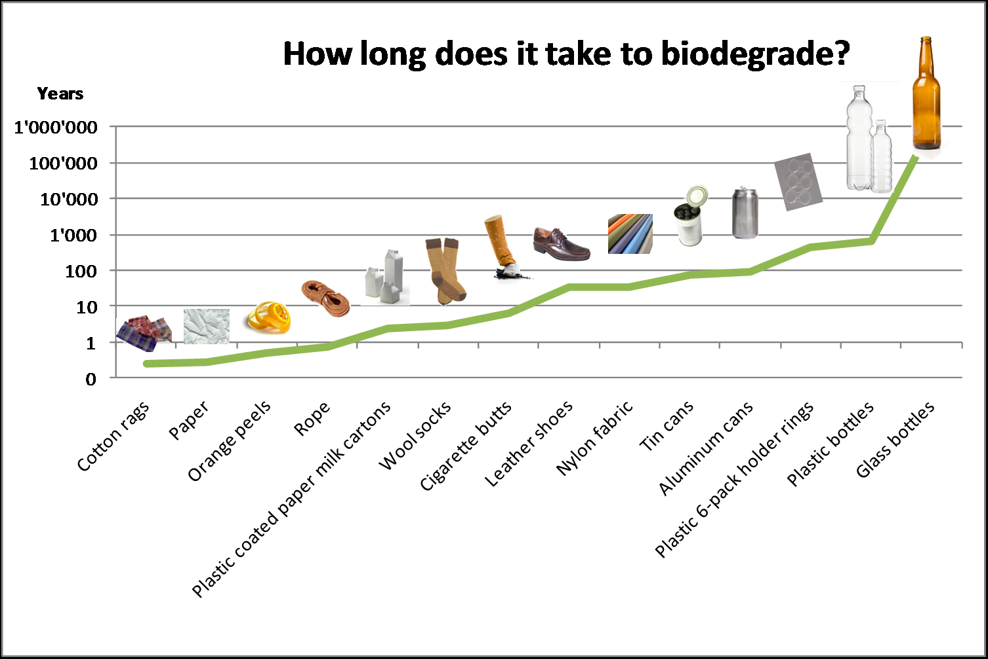

Slide 23
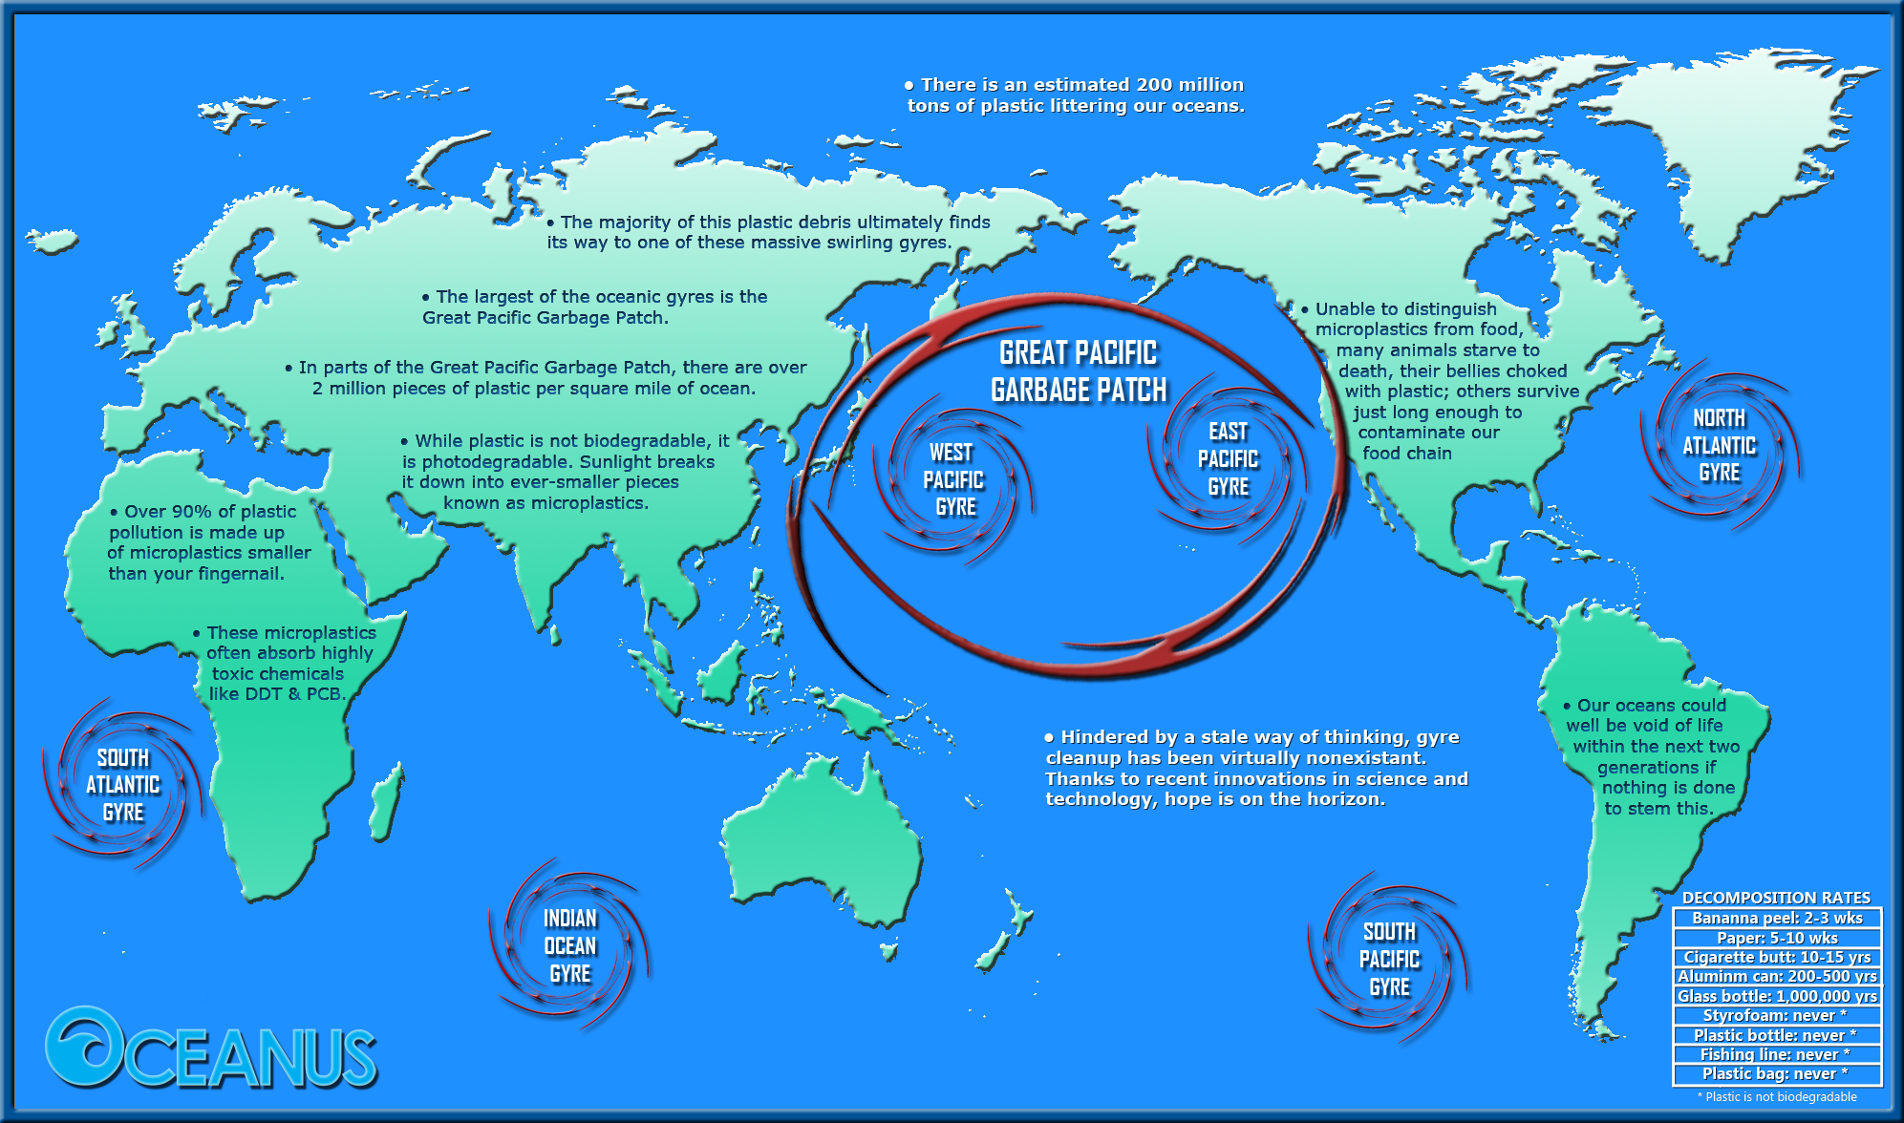

Slide 24
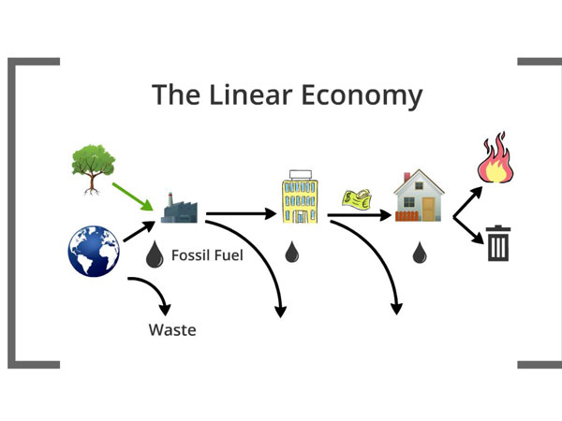
Source: http://textile-future.com/

Slide 25
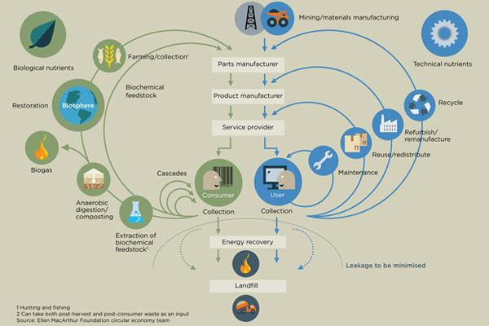
Source: Ellen MacArthur Foundation

