Slide 1
ECMH5004 – Applied Research Skills.
Session 1.
Dr Stuart Jones

Slide 2
Introduction
Dr Stuart Jones.
Room CJ214 (Carmarthen Campus)
Email: s.a.jones@uwtsd.ac.uk

Slide 3
Aims of the Module
This module aims to build upon the skills and knowledge developed in Level Four by providing students with the ability: -
  To develop a critical understanding of the ethical, practical, and theoretical issues in research in the field of mental health and provide practical experience of the steps required in planning, carrying out and analysing applied research and evaluation.

Slide 4
Learning Outcomes
Upon the successful completion of this module, the student should be able to:
Identify and evaluate appropriate research designs for exploring issues relating to mental health;
Demonstrate a strong awareness of practical issues and ethical approval processes associated with research design and evaluation in the field of mental health;
Analyse and report study data appropriately;
Take responsibility for their own learning and skill development; including effective personal planning, self-reflection and project management skills.

Slide 5
Indicative Content
Research design and ethics and the importance of forming appropriate research ideas for both qualitative and quantitative designs of relevance to the field of mental health.
Ethical approval processes.
Practical steps of planning, carrying out, analysing and reporting qualitative and quantitative research designs including interviews, case studies and focus groups, and quantitative designs ranging from basic cross-sectional evaluations to longitudinal intervention designs.
Critical evaluation of a range of research studies in order to further understanding of the importance of good quality research and evaluation in the mental health field.

Slide 6
Assessments
Coursework 100%
Assessment Component 1 – Research proposal (2,000 words): 50%
Assessment Component 2 – Study report (2, 500 words): 50%

Slide 7
Assessment Component 1
Assessment 1: 2,000 Word Research proposal (50%)
Design a hypothetical but feasible research proposal to examine the effectiveness of a treatment for a mental health disorder of your choosing

Slide 8
Assessment Component 2.
2,500 Word Report (50%)
Using the transcript provided, conduct a Phenomenologically Informed Thematic Analysis to explore the impact of a living with an eating disorder.

Slide 9
Lecture Schedule
Session 1
  Skills Session – Quantitative Applied Research Skills – Part 1.
  Skills Session – Quantitative Applied Research Skills – Part 2
  Research Ethics
  Focus on Assessment 1.
Session 2
  Continuation of first session…. Any recap, any important discussion.
  Introduction to Qualitative Research Methods.
Session 3
  Qualitative Research Methods – 2 .
  Writing up a qualitative report.
  Focus on Assessment 2.
Session 4
  Mop / Drop in – Assessment 2.

Slide 10
Recommended Reading (Essential Reading).
Coolican, H. (2014). Research methods and statistics in psychology. London: Taylor & Francis
DuBois, J.M. (2008). Ethics in Mental Health Research: Principles, Guidance, and Cases. Oxford: Oxford University Press
Harper, D. & Thompson, A.R. (2012). Qualitative Research Methods in Mental Health and Psychotherapy: A Guide for Students and Practitioners. London: Wiley.
Wallcraft, J., Schrank, B. & Amering, M. (2009) Handbook of Service User Involvement in Mental Health Research. London: Wiley

Slide 11
Recommended Reading (Background Reading)
Howitt, D., & Cramer D. (2007). An introduction to statistics in psychology: A complete guide for students (4th ed.). London: Prentice Hall. (E-book also available.)
Howitt, D. & Cramer, D. (2010). Introduction to research methods in psychology (3rd ed.) London: Pearson Prentice Hall.
Pallant, J. (2013). SPSS survival manual (5th ed.) Maidenhead: McGraw-Hill. (2010 E-book available.)
Smith, J. A., Flowers, P., & Larkin, M. (2008). Interpretative phenomenological analysis: Theory, method and research. London: Sage.
Willig, C. (2013). Introducing qualitative research in psychology: Adventures in theory and method. Maidenhead: McGraw-Hill Open University Press.

Slide 12
Part 1 – Quantitative Measures (Re-Cap and Further Development).
ECMH5004

Slide 13
Question – What is Empirical Research?

Slide 14
Empirical Research…
Empirical Research
Research based on experimentation or observation (evidence)
Such research is conducted to test an hypothesis

Slide 15
The importance of empirical research in mental health?
Find effective treatment
Aid service providers
Aid policy makers
To assess diagnostic measures
Interventions
Testing Theory

Slide 16

Approaches to Research.
Scientific Observation: A systematic empirical investigation that is structured to answer questions about the world
Research Method: Systematic approach to answering scientific questions

Slide 17

Goals of Research
Description of behaviour using careful observations
Explanation involves identifying the cause(s) of behaviour
Prediction allows for specification of the conditions under which a behaviour will occur or not
Psychological knowledge can be used to assist changes in behaviour

Slide 18
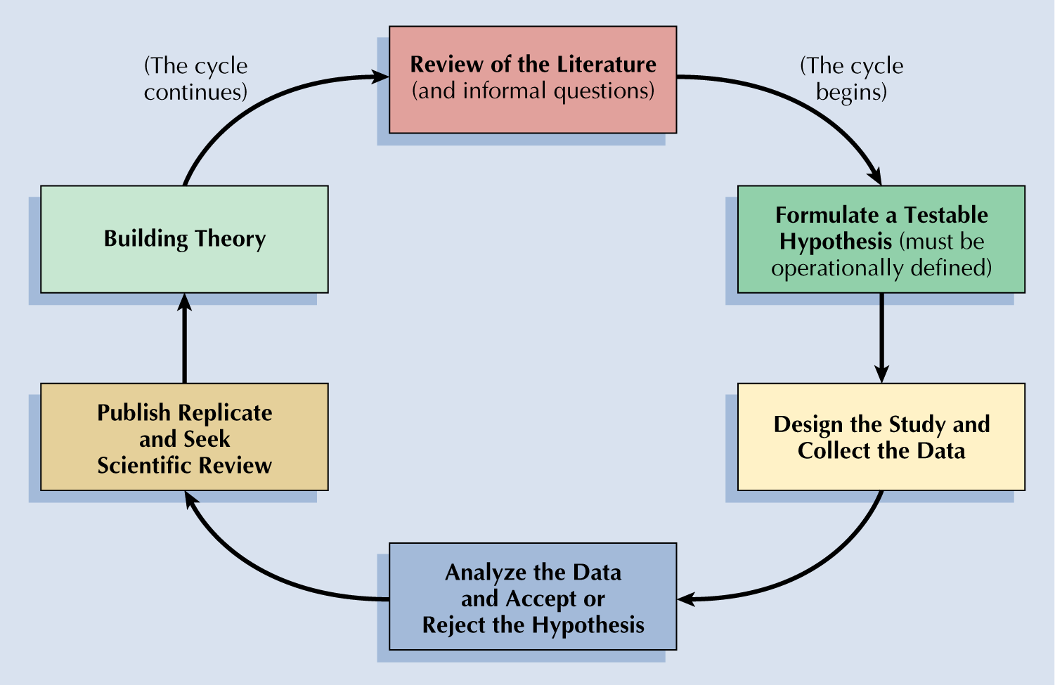
Overview of the Scientific Method

Slide 19
Where do the ideas come from?
Everyday Life
What are the most effective ways to teach about mental health?
What personal characteristics make a favorable impression in a job interview?
Practical Issues or Needs
Why do some employees have very high absenteeism rates.
Why do more car accidents happen on specific stretches of the road?
Past Research
Knowledge develops in small steps. Rarely does one study answer all the questions to the research topic.
What other questions come to mind?
Any others?
Theory
Summarize & integrate existing knowledge
Suggests new relationships between factors
Helps one make new predictions about a phenomenon based on the theory.

Slide 20
Characteristics of Scientific Research
Purposive
Rigour
Testability
Replicability
Precision and Confidence
Objectivity
Generalisation
Parsimony (Fewest Possible Assumptions)

Slide 21
What kinds of research are there?
QUANTITIVE RESEARCH
focus on numerical data to measure people’s actions, speech, attitudes and so on....
QUALITATIVE RESEARCH
focus more on analysing meaning without regard for numerical values
Both methods are forms of empirical data – that is recorded from research observation

Slide 22
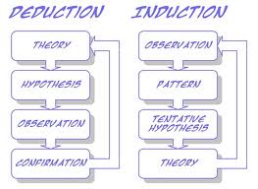
Hypothetico-deductive research
Inductive research

Slide 23
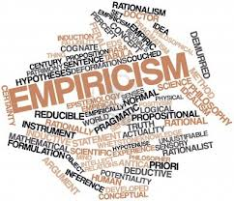
The theory that all knowledge is derived from sense-experience.
Practice based on experiment and observation.

Slide 24
Part 2 – Data Gathering
ECMH5004 – Applied Research Skills.

Slide 25
Aims of this Part…..
To consider the importance of data gathering.
To examine Data Gathering Techniques.
To define and examine populations and sampling.

Slide 26
Scenario….
You have been employed by your local education authority to monitor, evaluate and report back with evidence the effectiveness of School’s youth work service on increasing resilience and well-being in vulnerable teenagers in secondary school.
To conduct this research, what factors do you need to consider….

Slide 27


Data Gathering
One aspect that would be important before you even as you prepare your research is the method in which you choose to gather data….

Slide 28
Data Gathering Techniques
The term “nomothetic” comes from the Greek word “nomos” meaning “law”. Psychologists who adopt this approach are mainly concerned with studying what we share/have in common with others. That is to say in establishing laws or generalizations
The term “idiographic” comes from the Greek word “idios” meaning “own” or “private”. Psychologists interested in this aspect of experience want to discover what makes each of us unique/individual.

Slide 29
In nomothetic techniques it is important that the group of people who are being studied are reasonably typical of other people too. This brings us to the importance of SAMPLING…
Sampling is the process of collecting the set of research participants who will provide the data for a psychological research project.

Slide 30
Populations and Samples.
The population is the whole set of values, or individuals, you are interested in.
It is seldom possible to measure every individual in the population.
E.g. The average height of 17 year olds in Wales….
Population = Every single 17 year old in Wales will need to be measured.

Slide 31
Populations and Samples…
Sample = set of observations drawn from a population. In other words, a measure of some of the individuals from a given population.
If the sample is typical of the population, statements that are accurate for the sample are also said to be accurate for the population as a whole – known as a representative sample.
From this sample you can draw inferences about the whole population.
  Inferential statistics.

Slide 32
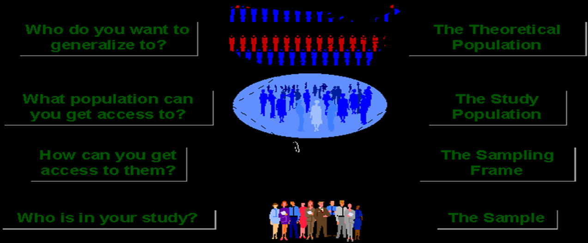
Sampling
Sampling is the process of selecting observations (a sample) to provide an adequate description and robust inferences of the population
The sample is representative of the population.

Slide 33

What is sampling?
If all members of a population were identical, the population is considered to be homogenous.
That is, the characteristics of any one individual in the population would be the same as the characteristics of any other individual (little or no variation
among individuals).
So, if the human population on Earth was homogenous in characteristics, how many people would an alien need to abduct in order to understand what humans were like?

Slide 34
What is sampling?
When individual members of a population are different from each other, the population is considered to be heterogeneous (having significant variation among individuals).
How does this change an alien’s abduction scheme to find out more about humans?
In order to describe a heterogeneous population, observations of multiple individuals are needed to account for all possible characteristics that may exist.

Slide 35
How large should a Sample Be?
Sample size depends on:
How much sampling error can be tolerated—levels of precision
Size of the population—sample size matters with small populations
Variation within the population with respect to the characteristic of interest—what you are investigating
Smallest subgroup within the sample for which estimates are needed
Sample needs to be big enough to properly estimate the smallest subgroup

Slide 36
Opportunity Sampling
Taking the sample from people who are available at the time the study is carried out and fit the criteria you are looking for i.e., choosing the first 20 students in your college canteen to fill in your questionnaire
It is a popular sampling technique as it is easy in terms of time and therefore money
Opportunity sampling can produce a biased sample as it is easy for the researcher to choose people from their own social and cultural group (not be representative of your target population)
Also participants may decline to take part and therefore the participants chosen may be an even more biased sample

Slide 37

Random Selection or Assignment
Selection process with no pattern; unpredictable
Each element has an equal probability of being selected for a study
Reduces the likelihood of researcher bias
Researcher can calculate the probability of certain outcomes
Usually names are selected from a computerised list.
Why Random Assignment?
Samples that are assigned in a random fashion are most likely to be truly representative of the population under consideration.

Slide 38
Simple Random Sampling (SRS)
The basic sampling method which most others are based on.
Method:
  A sample size ‘n’ is drawn from a population ‘N’ in such a way that every possible element in the population has the same chance of being selected.
  Take a number of samples to create a sampling distribution
What are some ways for conducting an SRS?
  Random numbers table, drawing out of a hat, random timer, etc.
Not usually the most efficient, but can be most accurate!
  Time & money can become an issue
  What if you only have enough time and money to conduct one sample?
Notes:
Researcher creates a sampling frame, numbers the elements in the frame and uses a list of random numbers to select the elements to be included in the sample (using random number tables).
Talk about marble example from the book: One sample of 100 marbles may give you a good estimate of the proportion of red versus white marbles. However, this doesn’t mean that the sample reflects the actual proportion. A number of samples of 100 marbles can be taken to see what patterns of results emerge by examining a distribution of these samples.
Central limit theorem: as the number of different random samples in a sampling distribution increases toward infinity, the pattern of samples in the distribution becomes more predictable→normal curve.

Slide 39

Systematic Random Sampling
The sample is chosen from the simple random sample (500 people taken at random from a list on a computer)
Then…every nth person is selected.
This is beneficial when the lists of names are taken from a number of different of folders within a computer system/filing system.

Slide 40
Stratified Sampling (StS)
This uses information known about the total population prior to sampling to make the sampling process more efficient.
Divide the population by certain characteristics into homogeneous subgroups (strata) (e.g., Social class - working class, middle class, upper class)
Elements within each strata are homogeneous, but are heterogeneous across strata.
A simple random or a systematic sample is taken from each strata relative to the proportion of that stratum to each of the others.
Researchers use stratified sampling
When a stratum of interest is a small percentage of a population and random processes could miss the stratum by chance.
When enough is known about the population that it can be easily broken into subgroups or strata.

Slide 41
Cluster sampling
Some populations are spread out (over a county or country).
Elements occur in clumps (towns, villages)—Primary sampling units (PSU).
Elements are hard to reach and identify.
Trade accuracy for efficiency.
You cannot assume that any one clump is better or worse than another clump.

