Slide 1
ECWB7004
Global Citizenship and
Sustainability
Lecture 09

Slide 2
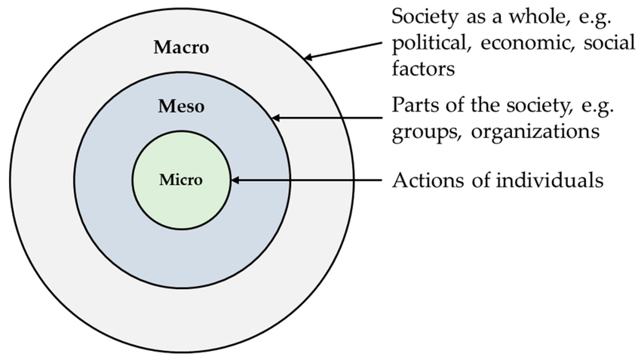
Levels of Analysis (Macro-Meso-Micro)
Bronfenbrenner (1979) –Ecological Systems Theory:
Micro: immediate interactions (e.g. classroom, supervision)
Meso: relationships between settings (e.g. programme–department links)
Macro: cultural values, institutions, ideologies
Ball, Maguire and Braun (2012) – Policy Enactment:
Macro: national/institutional policy
Meso: departments, programme teams
Micro: teachers’ everyday practices

Slide 3
Possible Levels of Analysis (Examples)
Macro Level:
UNESCO:
Meso Level:
AdvanceHE and QAA: Education for Sustainable Development Guidance (2021)
Micro Level:
UWTSD: Sustainability
Recommendation on Education for Peace, Human Rights and Sustainable Development (2024)
Education for sustainable development: a roadmap (2020)

Slide 4
Possible Levels of Analysis (Examples)
Macro Level:
UN: Global Citizenship Education
Meso Level:
OXFAM: Global Citizenship Guides
Micro Level:
Curriculum design, pedagogical approaches, value education, pupil-led social action projects…
UNESCO: Global Citizenship and Peace Education

Slide 5
Possible Levels of Analysis (Examples)
Macro Level:
Wales: ESDGC (2012)
Meso Level:
Local Council: Caerphilly County Borough Council
Micro Level:
School: Ysgol Gynradd Gymraeg Penderyn (2023)

Slide 6
Possible Levels of Analysis (Examples)
Macro Level:
The whole university/Entire school
Meso Level:
Faculties/Departments/Programme team/Course leadership groups
Micro Level:
Lectures/Teachers/Students/Classroom Interactions/Assessment Tasks

Slide 7
Assignment tips
Consider which level of analysis you want to focus on in your assignments.
Introduce clear definition(s) of key concepts/ideas and ensure consistent use of terminology.
Don’t just discuss the topic broadly; make sure you demonstrate depth of understanding and critical engagement with ideas from different sources – avoid being overly descriptive.
Ensure there is a clear logic in your work and connect themes using transition phrases or sentences.
Consider and communicate with your audience when presenting your work.
Engage with the literature; more is not necessarily better. Check the Harvard Referencing Handbook for the correct referencing format.

