Slide 1
Problem Solving and Decision Making
Week 8: Implementing decisions

Slide 2
Today we will be looking at..
What is a resilient decision?
How do you monitor and review the implementation of your solution?
How do you communicate your decision?

Slide 3

What is a Resilient Decision?
First of all, what is resilient?
Resilient:
ADJECTIVE
(of a person or animal) able to withstand or recover quickly from difficult conditions
So what is a Resilient Decision?
Form groups of 4/5 and, using the Flipchart paper and pens, Brainstorm and illustrate what you think a resilient decision is. Consider..
What does a resilient decision look like?
What makes it resilient?
Why would decisions need to be resilient?
What are the resilient to?

Slide 4
What do you need to consider when implementing a resilient decision?
What business relationships might be impacted?
What actions or tasks are required to implement the chosen solution?
Are there other decisions to be made to make the chosen solution a reality?
Does the chosen alternative have an impact on, or cause a conflict with, previously made decisions? If so, what decisions need to be revisited?
Who needs to know about the decision? Consider the stakeholders list.
What actions or tasks will be required to make the transition to the envisioned new solution when decision implementation is complete? How do you deal with moving from the current state to the new state?

Slide 5
Monitoring and Reviewing the Solution
Monitoring and evaluation (M&E) is critical to ensure the long-term success of adaptation initiatives, plans and actions. It can help to demonstrate accountability to stakeholders and communities.
Monitoring, evaluation and review design is critical to ensure that information is used to inform decision-making, make appropriate adjustments, and report to stakeholders and decision makers. Without a clear link between monitoring and decision-making, there is a risk that monitoring activities and resources will be seen as a drain on resources and discontinued.
Trigger points can be identified and monitored and, when reached, can stimulate the implementation of the next action in a sequence. In identifying trigger levels for response, it is important to consider the time required for the decision to be made and implemented. This should include acknowledging the time that may be required for effective stakeholder engagement, or for any detailed investigation, design and development of actions that may be required.
.
Notes:
Monitoring and evaluation (M&E) is critical to ensure the long-term success of climate adaptation initiatives, plans and actions. It can help to demonstrate accountability to stakeholders and communities.
Monitoring, evaluation and review design is critical to ensure that information is used to inform decision-making, make appropriate adjustments, and report to stakeholders and decision makers. Without a clear link between monitoring and decision-making, there is a risk that monitoring activities and resources will be seen as a drain on resources and discontinued.
Trigger points can be identified and monitored and, when reached, can stimulate the implementation of the next action in a sequence. In identifying trigger levels for response, it is important to consider the time required for the decision to be made and implemented. This should include acknowledging the time that may required for effective stakeholder engagement, or for any detailed investigation, design and development of actions that may be required.
Evaluation helps you to learn from what you have planned and what has been done. It helps with considering what changes need to be made to your planning approach, your plan and associated activities to get adaptation outcomes.
Your monitoring program should include a variety of measurements which enable you to report to your organisation and stakeholders about your activities.
Monitoring should include outputs, immediate and short-term outcomes, and longer term outcomes.
Stakeholder feedback is essential. People or groups who have an interest in the plan, or who are responsible for delivering various actions, must be made aware of any changes that affect them. Importantly, consideration must be given to how the plan is being amended so that the planning cycle can be continued.

Slide 6
Evaluation helps you to learn from what you have planned and what has been done. It helps with considering what changes need to be made to your planning approach, your plan and associated activities to get adaptation outcomes.​
Your monitoring program should include a variety of measurements which enable you to report to your organisation and stakeholders about your activities.​
Monitoring should include outputs, immediate and short-term outcomes, and longer-term outcomes

Slide 7
How will you Monitor the implemented decision?
Identify the resources to implement the monitoring plan:
Who will Monitor the decision? How often will this be done?
Selection of Key indicators:
What will the key indicators be? E.g. Number of Customers Retained increases. Percentage of Market Share increases.
Setting Targets:
Ensure they are SMART Targets
Establishing data sources, analysis and reporting systems
Where will you get the data from? When will this be available?
Monitoring and evaluation requires an assessment plan to measure the performance of adaptation efforts in terms of relevance, effectiveness, efficiency, results and sustainability of the results

Slide 8
Questions to ask :
Does the plan articulate a clear vision?
Are there goals and unambiguous, measurable objectives?
Are there indicators for each action that can be measured to assess performance/delivery of each action? Can changes to the indicator be attributed to the action?
Is there evidence that the plan was developed with sufficient internal or external engagement?
Does the plan identify an internal or/and external champion(s) who will help to drive the implementation of the plan?

Slide 9
​
Are there individuals/groups identified to be responsible for the delivery or next steps associated with each action?​
​
Is the plan suitably iterative and flexible to ensure it can be altered if outcomes are not achieved or as new information and technologies become available?​
​
Is the plan equitable, with no particular groups being disadvantaged?​
​
Is the plan fit for the purpose of your organisation?​
​
Does the plan contain a diverse range of options (no-regrets, short, medium and long term)?

Slide 10
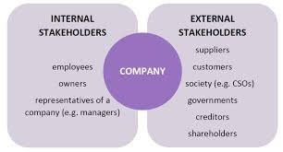
Communicating to Stakeholders
Stakeholder feedback is essential. People or groups who have an interest in the plan, or who are responsible for delivering various actions, must be made aware of any changes that affect them. Importantly, consideration must be given to how the plan is being amended so that the planning cycle can be continued.
When?
How?
Notes:
Having engaged with stakeholders and community throughout, it is essential that you report progress with adaptation actions to these groups. This is important to build political and constituent support for climate adaptation programs and projects. There is often a tendency for monitoring reports to be filled with detailed statistical data, graphs etc. However, audiences will find it easier to identify strengths and weaknesses of a given action if indicators are reported using consistent scale. Scales can be simple descriptors such as ‘very good’, ‘good”, ‘poor’, ‘very poor’, or more general statements such as ‘positive’, ‘of concern’, ‘action required’ etc. There is often good uptake with narratives or ‘stories’ about how actions are tracking and what is being achieved, and what changes are being made in response to the monitoring activities.
Internal stakeholders should not be neglected in your feedback and reporting of monitoring. They need to know what changes and why changes to plans are being made. The staff that are responsible for delivering various actions must be made aware of any changes that affect them. Importantly, consideration must be given to how the plan is being amended so that the planning cycle can be continued. It is important to bear in mind that monitoring and evaluation is not the end of the adaptation process, it is a new beginning!

Slide 11
How efficient was the strategy?
Assess the costs that were involved
How could we do it better next time?
Evaluate the Effectiveness of the strategies used:
Have he objectives been met?
Reviewing (Or Evaluating) The Implemented Decision
Has the decision impacted any other areas of the organisation?
Is there any further action to be taken?
Has the problem been resolved?

Slide 12
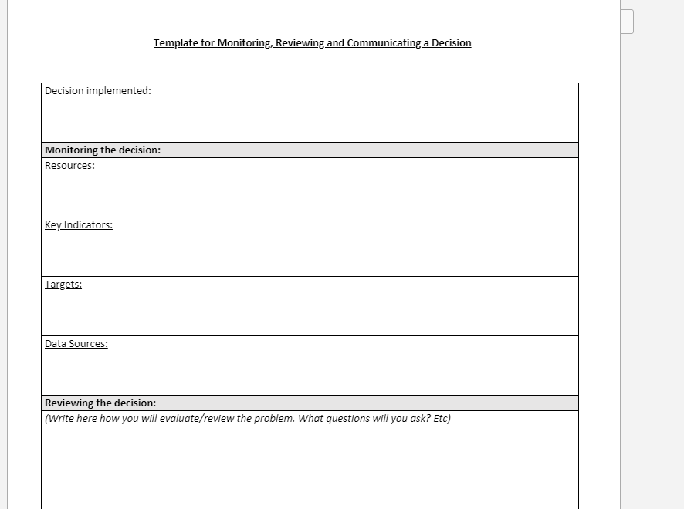
How do I record this?

Slide 13
Next Week...
Group Assessment Support sessions:
10am-10.20: Georgia Webb and Hannah Yarwood
10.20am-10.40am: Yasmin, Sanjeedah, Bilkis and Helina
10.40am-11am: Mihail, Alina, Catalina and George
11am-11.20am: Hannah Roberts-Davies, Thomas, Huseyin and Umut
11.20am-11.40am: Natalia, Martin and Mihaela
11.40am-12pm: Anita, Alexandru and Ionut
12pm-12.40pm: Saif, Ayesha and Nasima

