Slide 1
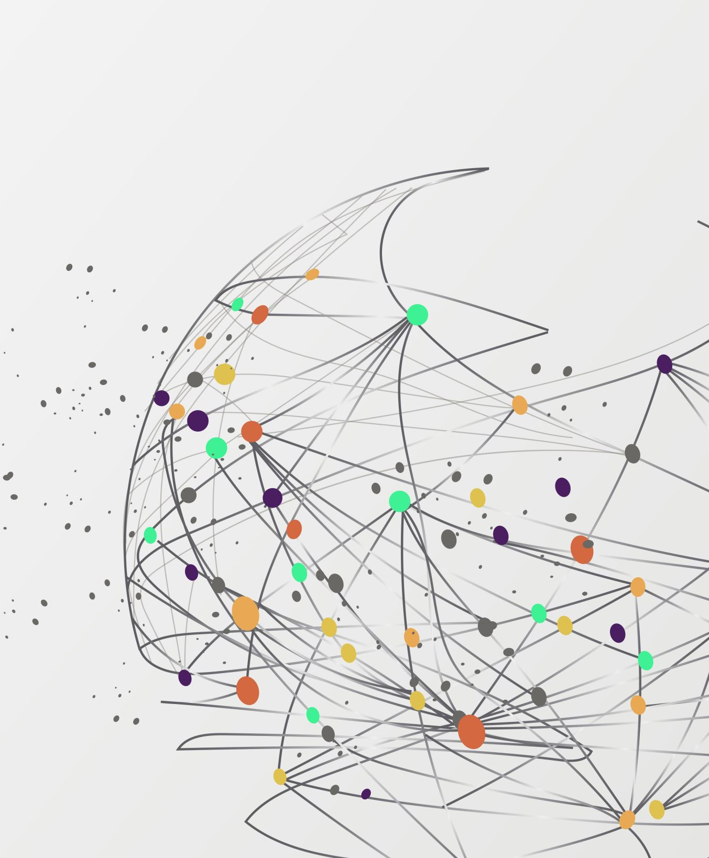
ASSESMENT TITLE
STUDENT NAME: ADELINA ANGELOVA
STUDENT NUMBER: 2132900
MODULE CODE: SOLVING AND DECISION MAKING

Slide 2


THE
PROBLEM
A RECENT SURVEY HAS SHOWN THAT THE MAJORITY OF PEOPLE (72%) ARE UNHAPPY IN THEIR ROLES. THIS SHOWS THAT JOB DISSATISFACTION IS A VERY COMMON PROBLEM.
TIGHT SCHDULE AT A WORKPLACE IS ONE OF THE BIGGEST CHALLENGES FOR STARBUCKS, THE WORLD'S LARGEST COFFEE PRODUCER.
TIGHT SCHDULING AND UNEMPLOYMENT ARE AFFECTED BY JOB DISSATISFACTION.

Slide 3



IMPACT OF THE PROBLEM
z
A tight working schedule can be exhausting, leading to a burnout, which can have a significant impact on an individual’s mental and physical health
A tight working schedule can cause individuals to make hasty decisions without considering all possible options, leading to poor decision -making skills.
A tight working schedule can lead to a sedentary lifestyle, which can cause health problems such as obesity, hypertension, and diabetes.

Slide 4

SOLUTIONS
Prioritize tasks: Prioritize your tasks based on importance and urgency by creating a list. Working down the list, start with the most important tasks.
Use productivity tools: There are various productivity tools available such as project management software, task lists, and time-tracking apps that can help you manage your time more efficiently.
Learn to say NO: Saying no to non-essential tasks or requests can help you stay focused on your critical tasks and manage your time more effectively.

Slide 5
Location
work environment
Lack of personnel
Not willing to relocate
Poor decision making
Challenges in attending important events
Decreased job satisfaction
No collaborating with colleagues
Increased transportation costs
Strained relationship with colleagues
Fatigue, stress and exhaustion
Tight Working schedule
Lack of work life-balance
Low income
Inability to meet expectations and commitments
Lack of time for family and friends
More hours
Poor salary
Inability to take on new projects
Impact of personal life
Financial
limited opportunities

