Slide 1
Individual presentation
Student name:Violeta Zisu
Student ID:2130492
Notes:
Violeta Zisu

Slide 2
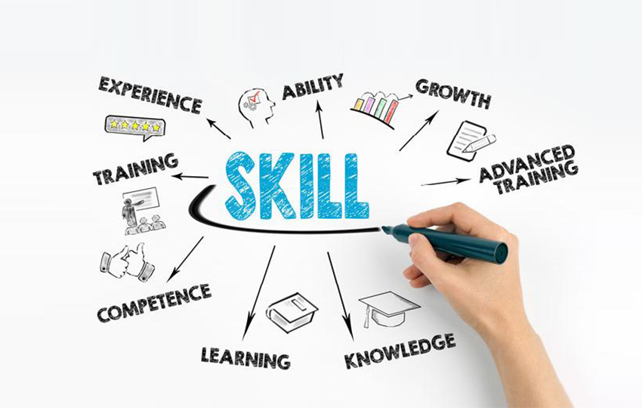
Introduction
The role of employability skills is essential for professional development (Jackson, 2015). These skills are also very effective in achieving the pre-defined goals of future career development. Employers mainly look for these skills in the individual. Moreover, employability skills are effective for achieving a successful career in terms of being appointed by a reputed organisation. This presentation is aimed to discuss my developed and lacked employability skills. A personal SWOT analysis, the importance of time management tools and PDP has also been discussed in this study.

Slide 3
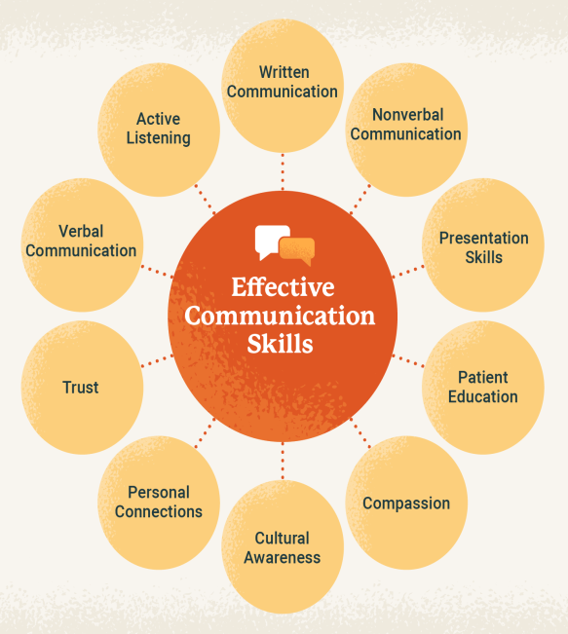
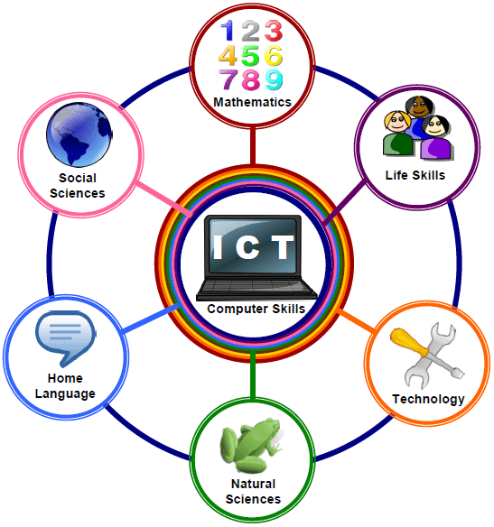
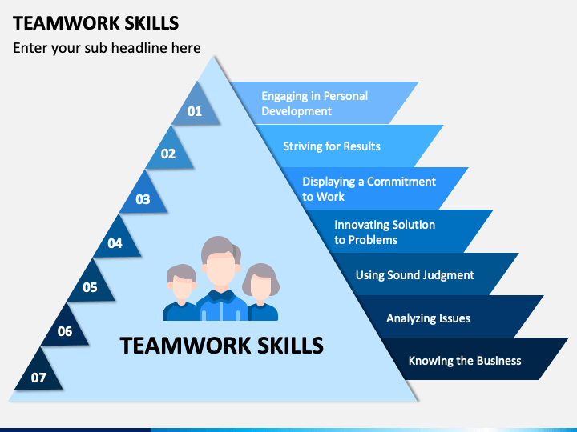
Learned skills
Effective communication skills are essential for mitigating conflicts (Almost et al., 2016).
Team working skills are effective for improving the performance of the organisation.
Research skills are effective for collecting market data of competitors (Allison et al., 2016).
ICT skills are effective for managing the operations of the organisation.
Notes:
I have developed effective communication skills during this module. The role of effective communication skills is essential for my professional development. Effective communication skills are essential for handling adverse situations created in the workplace. Communication skills are also very effective in mitigating the conflicts in my future employability. I have also developed team working skills. The role of collaboration skills is also essential for improving the performance of organisations by maintaining good relationships with others. The role of team working skills is also important for the creation of innovative ideas. The exchange of ideas is essential for innovative idea generation which could be possible in terms of using improved team working skills. On the other hand, I have improved my research skills which would be effective for my future job role. Research of the market is essential for analysing the competitors in the market which would be essential for my future employability. Apart from this, I have developed my ICT skills during this study. The role of ICT skills is essential in every organisation in the era of technological innovation. I have learned social media management and data management which could be effective for fostering the business growth of the organisation in my future job role.

Slide 4
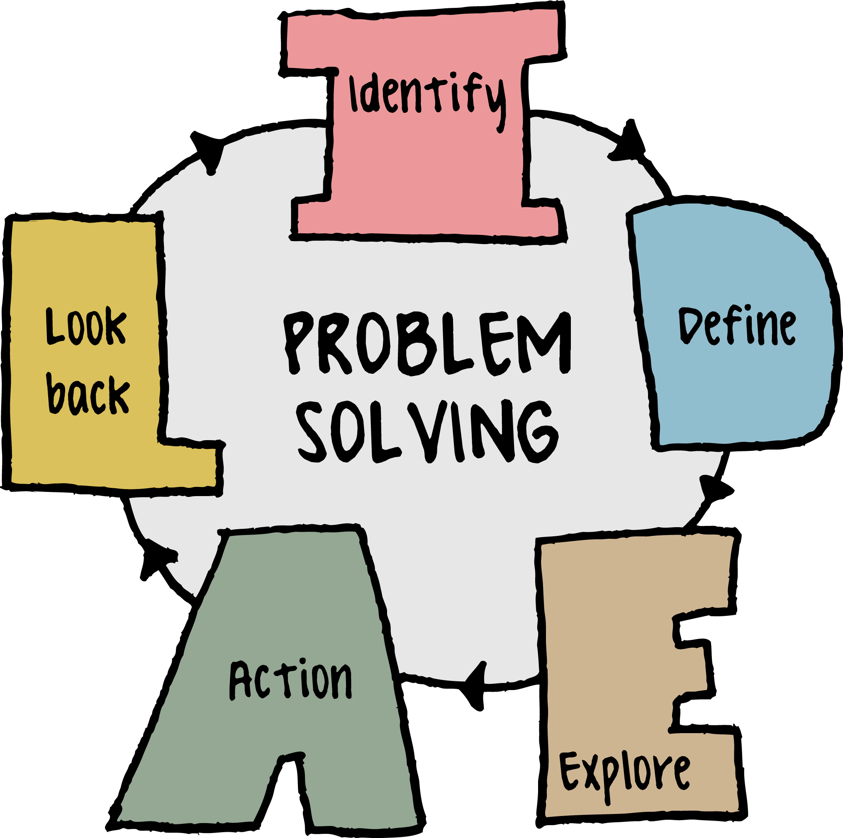

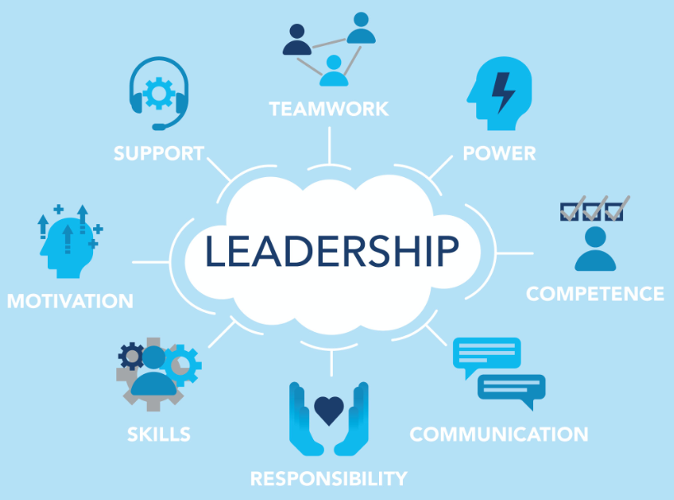
Skills to be developed
Problem-solving and critical thinking would be effective in mitigating crucial situations in the workplace (Samson, 2015).
Time management skills are effective for completing the given tasks within time.
Leadership skills are effective for motivating employees in the workplace (Fiaz et al., 2017).
Notes:
I have to develop my problem-solving skills which would be effective for my future employability. Critical thinking is essential for identifying the base causes of the problems created in the workplace. According to the analysis of the root causes, the resolution of the problem could be easy to perform. On the other hand, I found that my time management skills are very poor which I can enhance in terms of following some vital time management tools. Time management skills are essential for completing tasks within a certain boundary of time. Moreover, I have to improve my leadership skills. These skills are effective for managing employees by analysing their activities in the workplace. Employee motivation would play an essential role in boosting the performance of the organisation which could be achieved in terms of using leadership skills.

Slide 5
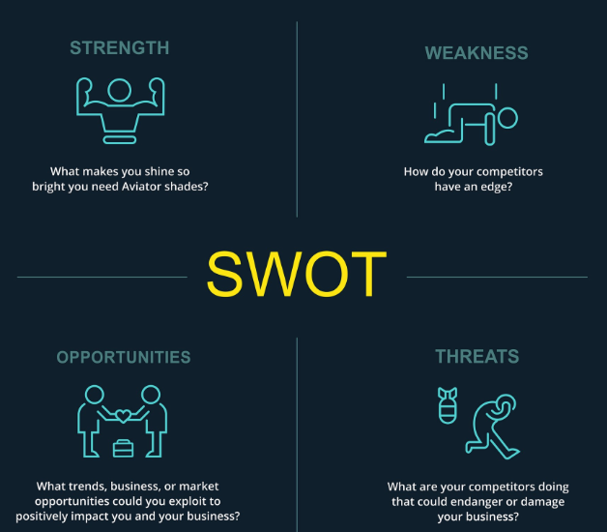
Personal SWOT
Strengths: Enhanced communication skills, team player, ICT skills and research skills.
Weaknesses: Time-management skills, leadership skills and problem-solving skills.
Opportunities: Mitigating conflicts, managing employees, finish tasks on time.
Threats: It would be hard for me to solve the problems in my future job role.
Notes:
I can develop my opportunities in terms of communicating with other teammates. This would be effective for me to generate and adopt innovative ideas. I can also solve critical technical problems by using ICT skills. I will use my research skills for competitor analysis in my future job role. I can face difficulties in solving problems created in the workplace in my future employability.

Slide 6
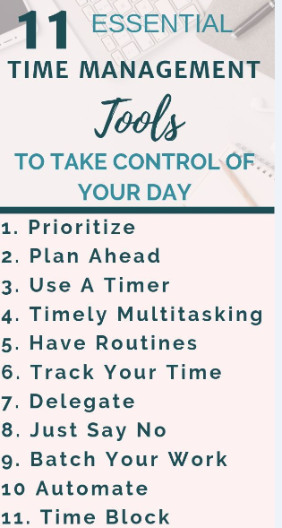
Time management tools
A schedule can be followed.
Division of the work is essential.
Prioritisation of work is also very effective.
Accomplishing the work by following a checklist.
Notes:
The role of time-management tools is essential for managing all the tasks within the stipulated period of time. I can divide my work according to priority and I can also follow a schedule which can help me to complete my tasks in the given period of time. A checklist can be filled up step-by-step after the completion of the tasks. These tools would be effective for completing the work according to the urgency.

Slide 7
PDP
Objectives | Tactics | Resources | Relevance | Time period
I have to develop the time-management skills | I can follow a routine and I can divide my work according to priority. | I can seek help from my respected faculties to enhance this skill. | This skill will be effective for me to finish the assignments within the deadline. This will be effective for improving the performance of the organisation in future. | 3 Months
I have to enhance my problem-solving and critical thinking skills | I can join a skill development seminar. I can also follow some online courses available on the internet. | Money is the prime source to join skill development seminars. | These skills will be effective for me to mitigate the issues and conflicts in my future workplace. | 4 Months
I have to improve my leadership skills | I can follow some practical examples and I can join some leadership skill development programmes. | Financial resources are effective for attaining skill development programmes. | These skills will be effective for me to manage the people in the workplace. | 6 Months

Slide 8
Conclusion
I have learned about different employability skills which are essential for my future employability. I have also identified my improved and lacked skills during this study. The importance and effectiveness of personal SWOT have also been analysed in this study. The effectiveness of time management tools has also been discussed in the study. Moreover, a professional development plan has also been developed for improving my lacked skills.

Slide 9
References
Allison, B., Hilton, A., O'Sullivan, T., Owen, A. and Rothwell, A., 2016. Research skills for students. Routledge.
Almost, J., Wolff, A.C., Stewart‐Pyne, A., McCormick, L.G., Strachan, D. and D'Souza, C., 2016. Managing and mitigating conflict in healthcare teams: an integrative review. Journal of advanced nursing, 72(7), pp.1490-1505.
Fiaz, M., Su, Q., Ikram, A. and Saqib, A., 2017. LEADERSHIP STYLES AND EMPLOYEES’MOTIVATION: PERSPECTIVE FROM AN EMERGING ECONOMY. The Journal of Developing Areas, 51(4), pp.143-156.
Jackson, D., 2015. Employability skill development in work-integrated learning: Barriers and best practice. Studies in higher education, 40(2), pp.350-367.
Samson, P.L., 2015. Fostering student engagement: Creative problem-solving in small group facilitations. Collected essays on learning and teaching, 8, pp.153-164.

Slide 10


