Slide 1

University Presentation
Why I chosen to come to university

Slide 2

Why I chosen to come to university
I have chosen to attend university to future my education and expand my opportunities. I believe that a university will provide me with the knowledge and skills necessary to purse my career goals. I am excited about the chance to learn from experienced professors.

Slide 3


I chose the professional policing course because I am passionate about law enforcement and making our communities safer. I want to be a part of a profession where I can actively contribute to maintaining peace and order, helping those in need and ensuring a better future for everyone.

Slide 4
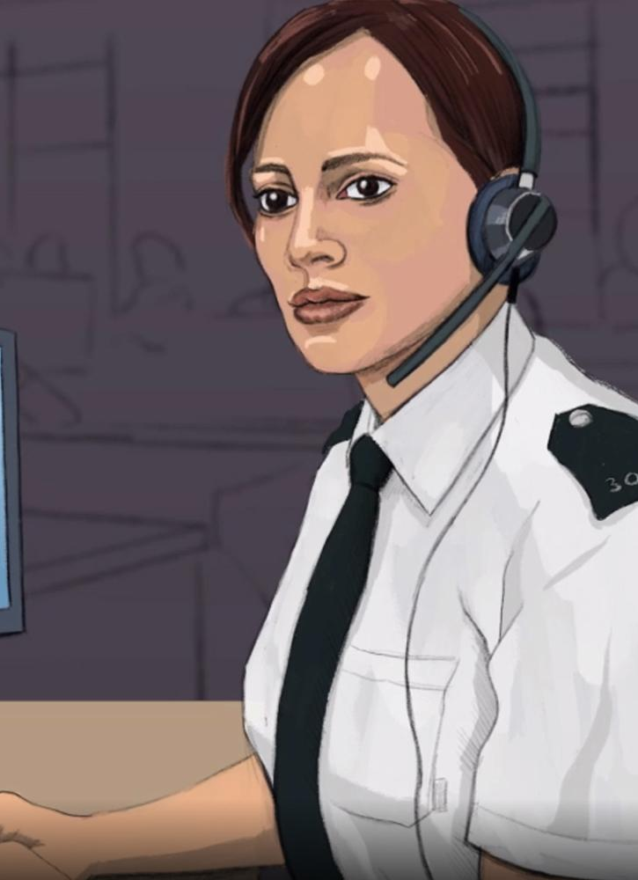
Obtaining a qualification in professional policing offers career advancement, job security, and the opportunity safety. It also provides valuable skills in conflict resolution, leadership and communication.

Slide 5

I hope to be become a skilled and compassionate police officer who contributes to safer communities, upholds justice, and builds trust between law enforcement and the public.

