Slide 1

Sustainability in Terms of Food Waste and its Efficacy in the Hospitality Industry
Student name: Mihaita Ionut Manda
Student ID number: 2232074
Lecturer: Dr Ernest Balutie Wavei

Slide 2

Introduction
Food wastage, particularly the quantity of waste generated in hotels, is a major sustainability issue. The pressure on the hospitality business is growing to the point where the business is obliged to adopt powerful measures that allow it to decrease wastage and improve efficiency, as well as see to the company completing environmental and regulatory obligations (Lee and Huang 2023).
(Source: Shapiro, 2026)
Notes:
Introduction
Food waste has become a significant concern for sustainability in the hospitality industry, with areas of concern being hotels where they prepare and serve food in large volumes on a daily basis. There are also unproductive events, too much production and buffet services, that have also contributed to a significant amount of waste (Lee and Huang 2023).

Slide 3

Industry Context: Food Waste in Hospitality
Hotels are also great contributors of food waste.
Environmental and economic effects.
The enhanced levels of sustainability requirements (Abdelmawgoud, 2023).
Notes:
Industry Context: Food Waste in Hospitality
The hospitality sector has been noted to be among the highest contributors of waste related to food since it is a service-oriented sector and is oriented towards the satisfaction of the guests. Such wastage makes a contribution towards additional carbon emissions and loss of preventable funds. At the same time, hotels are facing mounting pressure from regulators and customers prove (Abdelmawgoud, 2023).

Slide 4

Research Aim and Focus
Aim: Respond to the efficacy of the food waste strategy.
Focus: Target: Hotels and hospitality sector.
Notes:
Research Aim and Focus
The aim of the research was to evaluate the suitability of food waste mitigation technology in the hotel and hospitality industry. The research paper was subsequently brought down to the point of knowing the effectiveness of the current practices to achieve the sustainability objectives and the level of balance between operational effectiveness and financial viability versus the evolving guest expectations.

Slide 5

Literature Review Overview
Food waste is a significant issue of concern in the hospitality field.
Some of the main factors include buffet process, inability to predict demand, and constant size of the portions.
The three impacts that have become well known are the economic, environmental, and social.
Academic evidence indicates that prevention is superior to end-stage management.
Pay attention to staff training, creating a menu, and portion control (Monforte, 2025).
Notes:
Literature Review Overview
The cost and sustainability are the areas of impact on food waste, which are repeatedly mentioned in the literature as one of the key problems in the hospitality industry. Poor forecasting of demand quantities and predetermined portion sizes have been cited as the most frequent reasons for buffet-style eating. The studies point out that preventive measures, involving training of the members of staff, appropriate menu designing, and controlling portions. This research presents a suggestion to adopt proactive measures to reduce food waste and align the efficiency of the operations with environmental and social responsibility (Kasavan et al., 2022).

Slide 6
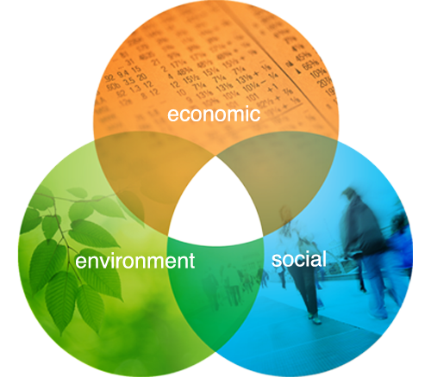
Sustainability Theories
Triple Bottom Line:
  Environmental
  Economic
  Social
Circular Economy approach
Food waste management systems that are sustainable (Nogueira et al., 2023).
Notes:
Sustainability Theories
The theory came with food waste management and the sustainability theories. The Triple Bottom Line is concerned with the aspects of survival, profitability, and social accountability. The two theories have strong applicability to hospitality food waste practices because the Circular Economy theory demands that more food waste should be reduced through re-use and the minimisation of food waste (Nogueira et al., 2023).

Slide 7
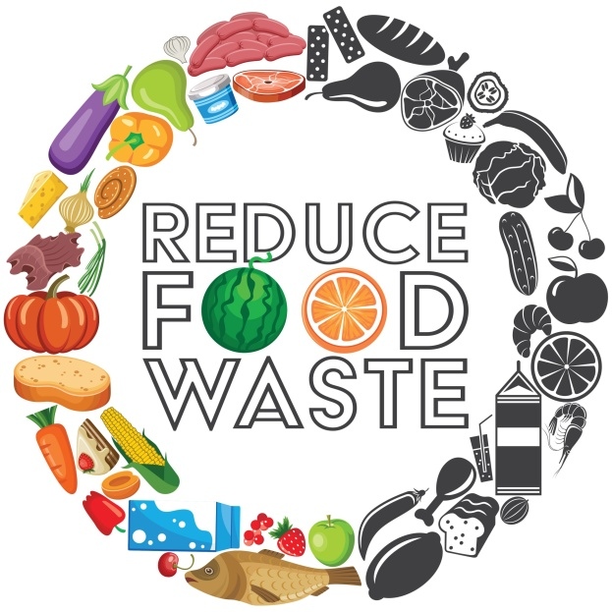
Food Waste Reduction Strategies
Wise inventory and waste management.
Menu management and portions management.
Staff training programmes
Food composting and donation (Tiwari et al., 2024).
Notes:
Food Waste Reduction Strategies
Hospitality provided the literature with a number of good food waste mitigation strategies. They used a digital inventory system to improve forecasting, menu design to avoid excessive production, employee training to change the daily habits, and food donation or compost to find an environmentally-friendly way to dispose of unavoidable surplus food (Tiwari et al., 2024).

Slide 8

Method
The interpretation of qualitative secondary data.
Case studies, scholarly articles, and industrial reports.
Suitable enough to measure the existing practices (Dubey and Kothari 2022).
Notes:
Method
This study utilised the qualitative approach based on the secondary data. Data were collected by using peer-reviewed academic journals, reports on the hospitality industry, and related case studies. This approach proved to be feasible since it enabled a critical examination of the food waste practice, which, in the case of primary research, is characterised by a lack of time and access (Dubey and Kothari 2022).

Slide 9
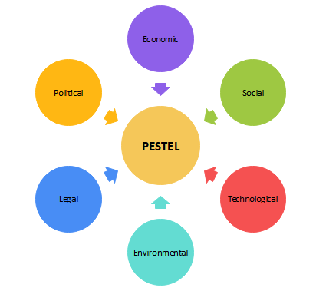
Analytical Framework: PESTEL
PESTEL framework overview
External forces analysis.
Analysis of the sustainability of the entire system (Karadzhov and Patarchanova 2025).
Notes:
Analytical Framework: PESTEL
In the PESTEL framework, the external factors that have an impact on the management of hospitality food waste were analysed. It researches political, economic, social, technological, environmental, and legal environments to provide a systematic and overall approach towards defining mechanisms in which sustainability initiatives are being affected within the industry (Karadzhov and Patarchanova 2025).

Slide 10
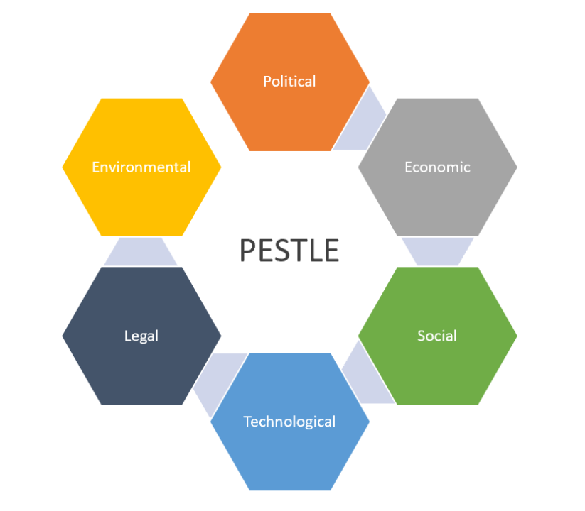
PESTEL Analysis: Key Impacts
Political: departments on sustainability.
Economic: investment vs. cost savings.
Social: sustainability needs of the guests.
Technological: monitoring of waste.
Environmental: decrease in carbon footprint.
Legal: the food safety and food donation laws (Andersen, 2025).
Notes:
PESTEL Analysis: Key Impacts
The sustainability policies influenced policies of politically motivated hotels to adopt policies of food waste reduction, which, however, have not been fully adopted within the sector. The lowering of the waste resulted in cost savings on an economic note, yet an initial investment was a burden. Socially, the process of raising awareness of the guests exerted pressure on the hotels to conduct their business in a sustainable way. Technological advances came with a reduction of waste issues through improved waste tracking, improved monitoring, and prediction. The environmental impact of certain food waste can be reduced as well. The legal impact on surplus food management was the food safety laws and food donation laws (Andersen, 2025).

Slide 11

Industry Examples
Big hotel sustainability programs.
Reduction in food waste, which is measurable.
The marriage of technology and training of employees (Prakash et al., 2023).
Notes:
Industry Examples
Examples of industry cases were provided to show that the strategies of food waste reduction could be implemented in a larger hotel. Such organisations have already demonstrated that they can connect digital tracking systems to their staff training policies and report massive staff waste loss effects, greater efficacy of their operations, and their compliance with the sustainability goals (Prakash et al., 2023).

Slide 12
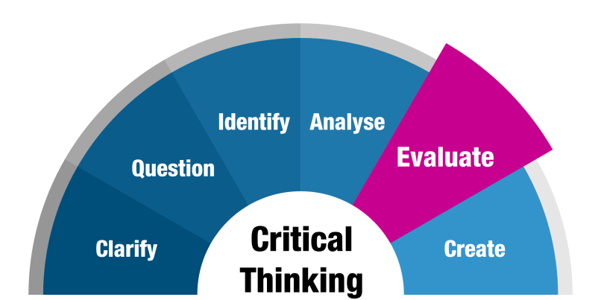
Critical Evaluation
Economical: implementation, use of technology, and employee engagement.
Problems: costly, change-resistant.
The differences and distinctions between the small and the big hotels (Bah et al., 2024).
Notes:
Critical Evaluation
It was revealed in this analysis that the food waste reduction measures helped most efficiently when they were complemented with the application of technology and the active participation of the staff. However, the costs involved in implementing were high, and resistance to change of operation was another factor that could not allow success to be achieved, particularly in small hotels. Larger hotel brands were more equipped to meet their costs and implement sustainable initiatives on a permanent basis (Bah et al., 2024).

Slide 13

Conclusion
The issue of food waste is a significant sustainability issue, and it needs to be adequately dealt with. Reduction of waste has become a key agenda among hospital practitioners as they strive to achieve increased efficiencies and add value to their long-term environment and operational goals.
Notes:
Conclusion
In conclusion, food waste has been cited as a stringent sustainability problem within the hospitality industry. The findings served to point out that effective and well-coordinated food waste management activities could go a long way towards curbing environmental degradation, managing costs, and pleasing stakeholders.

Slide 14

Recommendations for the Industry
Waste management systems that are based on artificial intelligence.
Better training programmes for employees.
Supplier collaboration
Policy incentives
Programs of guest involvement (Sinthiya et al., 2022).
Notes:
Recommendations for the Industry
Based on the findings of the research, AI and online tracking tools must be adopted in the operations of hospitality organisations in order to optimise and predict waste better. This must come as part of the daily routine, along with the increased education of the personnel, to aid the behavioural change. The coordination with the suppliers might be improved so as to reduce the cases of overordering, and it might be possible to provide easier access to the small hotels, with the aid of the policy encouragement (Sinthiya et al., 2022).

Slide 15

Implications for Sustainability
Assistance in realising sustainability.
Long-term congruent advantages.
Competitive advantage
Prior to our expectations about the sustainability of guests (Bhutto, 2024).
Notes:
Implications for Sustainability
Active food waste management, in its turn, directly influenced the sustainability objectives, dropping the environmental impact and increasing the resource efficiency. These practices gave the hotels a competitive edge over the long run, and the hotels' operations correlated with the increased expectations held by guests of the hotels, which include environmentally responsible and ethical hospitality services (Bhutto, 2024).

Slide 16
References
Abdelmawgoud, M (2023) ‘The effect of food operations sustainability on food operations efficiency: The mediation role of food waste management in five-star hotels in Greater Cairo’. Journal of the Faculty of Tourism and Hotels-University of Sadat City, 7(2/3). Online available at: https://www.researchgate.net/profile/Mohamed-Abdelmawgoud/publication/379364500_The_Effect_of_Food_Operations_Sustainability_on_Food_Operations_Efficiency_The_Mediation_Role_of_Food_Waste_Management_in_Five-Star_Hotels_in_Greater_Cairo/links/66058bc4390c214cfd234ee7/The-Effect-of-Food-Operations-Sustainability-on-Food-Operations-Efficiency-The-Mediation-Role-of-Food-Waste-Management-in-Five-Star-Hotels-in-Greater-Cairo.pdf Last accessed on: 14th Jan 26
Andersen, P.D (2025) ‘The PESTEL framework and its variants for analysing the strategic environment: Evolution, limitations and adoption in energy policy research’. Limitations and Adoption in Energy Policy Research. Online available at: https://papers.ssrn.com/sol3/Delivery.cfm?abstractid=5266562 Last accessed on: 14th Jan 26
Bah, M.O.P., Sun, Z., Hange, U. and Edjoukou, A.J.R (2024) ‘Effectiveness of organizational change through employee involvement: Evidence from telecommunications and refinery companies’. Sustainability, 16(6), p.2524. Online available at: https://www.mdpi.com/2071-1050/16/6/2524 Last accessed on; 14th Jan 26
Bhutto, S.M.S.Z.A (2024) ‘Sustainability in Business Management: Strategies for Long-Term Success’. Journal for Business Research Review, 2(1), pp.39-50. Online available at: https://journalbrr.com/index.php/Journal/article/download/22/22 Last accessed on: 14th Jan 26
Dubey, U.K.B. and Kothari, D.P (2022) ‘Research methodology: Techniques and trends’. Chapman and Hall/CRC. Online available at: https://amberton.edu/wp-content/uploads/2025/07/RGS6035_E2_Fall2025.pdf Last accessed on: 14th Jan 26
Karadzhov, V. and Patarchanova, E (2025) ‘How to create the best PESTEL analysis’. International Journal of Digital Research, 1(3), pp.8-20. Online available at: https://ijdr.net/wp-content/uploads/2025/11/Vol-1-Issue-3-Whole-Issue.pdf#page=8 Last accessed on: 14th Jan 26
Kasavan, S., Siron, R., Yusoff, S. and Fakri, M.F.R (2022) ‘Drivers of food waste generation and best practice towards sustainable food waste management in the hotel sector: A systematic review’. Environmental science and pollution research, 29(32), pp.48152-48167. Online available at: https://idp.springer.com/authorize/casa?redirect_uri=https://link.springer.com/article/10.1007/s11356-022-19984-4&casa_token=HKTXSWxh4iYAAAAA:-VS8KLDAOCWChReesksb1t9rFegzuvhFApMyyk-2XJl5VW5qxzRejkpIgWG37m0Zoyled6hm9TAM5g Last accessed on: 14th Jan 26
Lee, H.H. and Huang, P.Y (2023) ‘Food waste and environmental sustainability of the hotel industry in Taiwan’. Sustainability, 15(21), p.15459. Online available at: https://www.mdpi.com/2071-1050/15/21/15459 Last accessed on: 14th Jan 26
Monforte, C.M.A.T (2025) ‘Food Waste Reduction Strategies for Buffet-Style Service’. Online available at: https://www.researchgate.net/profile/Michael-Potroz-2/publication/392122971_Food_Waste_Reduction_Strategies_for_Buffet-Style_Service/links/68357e116b5a287c304648e0/Food-Waste-Reduction-Strategies-for-Buffet-Style-Service.pdf Last accessed on: 14th Jan 26
Nogueira, E., Gomes, S. and Lopes, J.M (2023) ‘Triple bottom line, sustainability, and economic development: What binds them together? A bibliometric approach’. Sustainability, 15(8), p.6706. Online available at: https://www.mdpi.com/2071-1050/15/8/6706 Last accessed on: 14th Jan 26
Prakash, S., Sharma, V.P., Singh, R., Vijayvargy, L. and Nilaish (2023) ‘Adopting green and sustainable practices in the hotel industry operations-an analysis of critical performance indicators for improved environmental quality’. Management of Environmental Quality: An International Journal, 34(4), pp.1057-1076. Online available at: https://www.bmu.edu.in/wp-content/uploads/2024/11/Adopting-green-and-sustainable-practices-in-hotel-industry-MEQ.pdf Last accessed on: 14th Jan 26
Sinthiya, N.J., Chowdhury, T.A. and Haque, A.B (2022) ‘Artificial intelligence based Smart Waste Management—a systematic review’. Computational intelligence techniques for green smart cities, pp.67-92. Online available at: https://lutpub.lut.fi/bitstream/handle/10024/164859/sinthiya_et_al_artificial_intelligence_am.pdf?sequence=1 Last accessed on: 14th Jan 26
Tiwari, T., Garg, T., Singh, G., Mishra, S. and Guleria, K (2024) ‘Optimizing Food Utilization: A Smart Inventory Management and AI-Predictive Analytics in Reducing Food Waste’. International Journal of Science and Social Science Research, 2(3), pp.165-170. Online available at: https://www.researchgate.net/profile/Tushar-Tiwari-4/publication/387505590_Optimizing_Food_Utilization_A_Smart_Inventory_Management_and_AI-Predictive_Analytics_in_Reducing_Food_Waste/links/67718da8e74ca64e1f37495d/Optimizing-Food-Utilization-A-Smart-Inventory-Management-and-AI-Predictive-Analytics-in-Reducing-Food-Waste.pdf Last accessed on: 14th Jan 26

