Slide 1





Paulette Canegan
ID 2123588
Digital Skills and Research Methods
BMSW4003

Slide 2

Global financial institution
HSBC operates 4,000 offices, across 70 countries, employs 235,000 people and serves 37 million customers. Operating
Over one hundred years

Slide 3
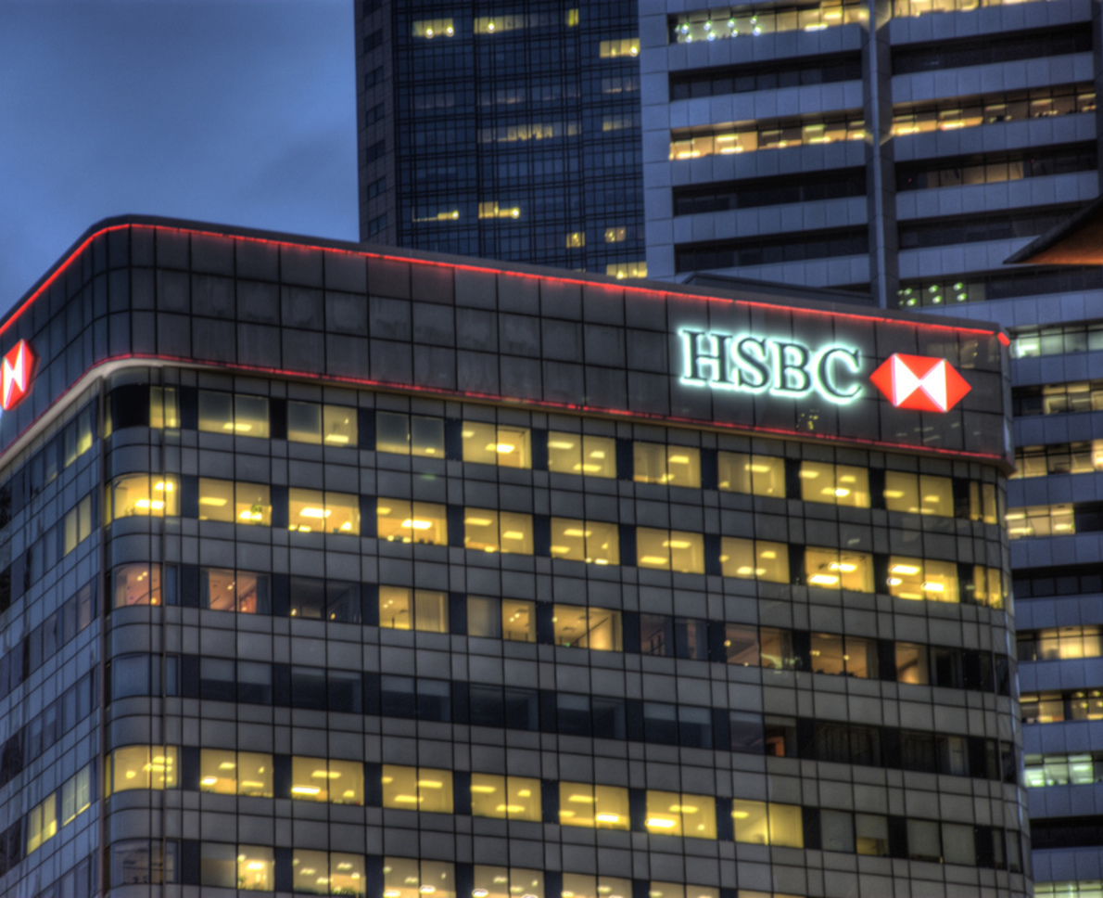
The Challenges HSBC face before modern technology
2
paper-based processes
Appointment and waiting time
Checking account balance
Mortgage loan approval
Posting of document
Answering phone calls to multiple agents
This Photo by Unknown author is licensed under CC BY-ND.

Slide 4
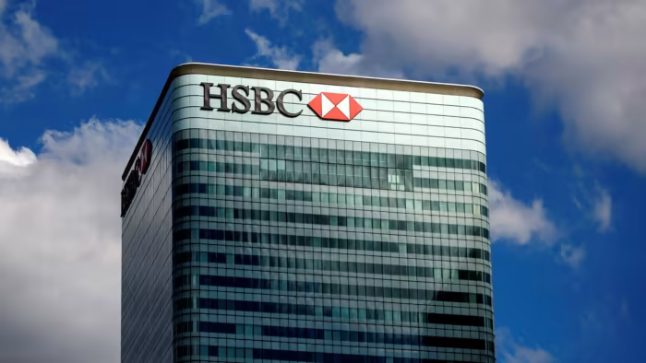
Reduction in Friction
3
HSBC found itself in a situation diginomica argued friction in the enterprise - whether consumer faced it or internally - puts the organization at risk of losing out to competition that are more digitally enabled
Craig Johnson, Global Head of Multi-Channel and Staff Tables at HSBC moved forward and facilitate the reduction in friction using digital by signing Adobe in 2015

Slide 5


HSBC reduces friction and boosts revenue by going paperless with Adobe
4
customers got the opportunity to signed documentation online, instead going into branch or via posting. HEBC said By using Adobe Sign, they were able to digitise the paper process and deliver documentation to their customer securely

Slide 6
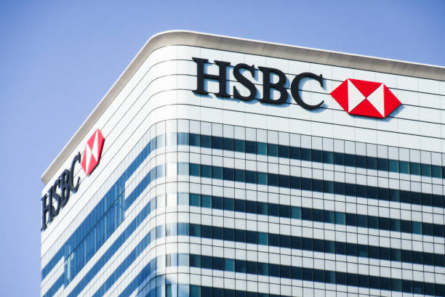
5
struggle with legacy.
According to the date report in 2019 The
organization still relies on paper with someone in the back-end inputting data thousands of HSBC employees in the back-end inputting data

Slide 7


Reference
Sourced Preez Du Derek (2019)
https://diginomica.com>hsb-friction-and-boosts
This Photo by Unknown author is licensed under CC BY.

