Slide 1



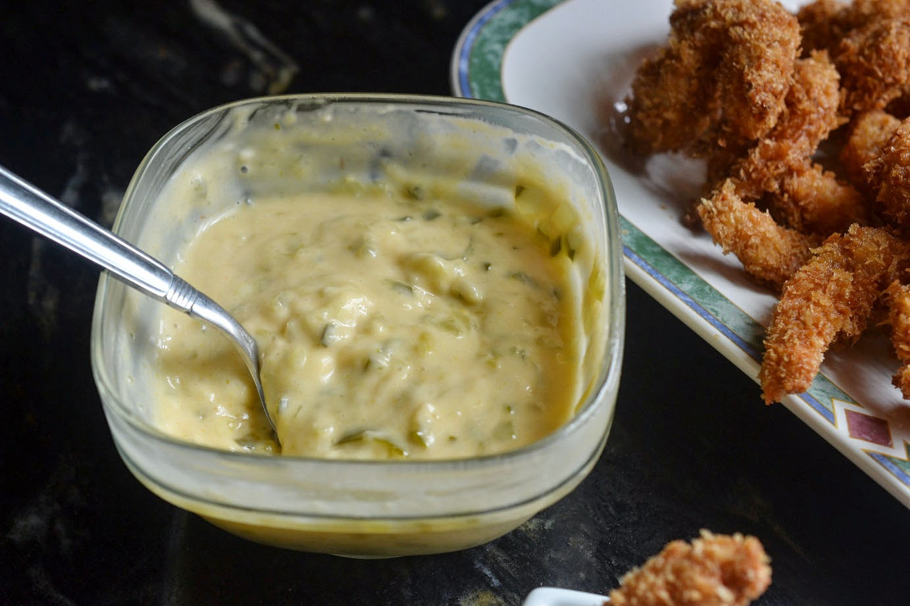
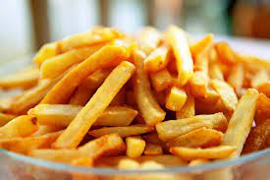

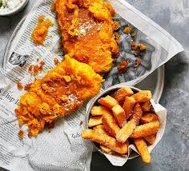
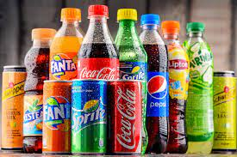


HOTEL TRINITY
WEEKDAY MENU
STARTER
Grilled bread topped with diced tomatoes £2.32
Fried squid rings with lemon and tartar sauce £4.32
Cooked prawns served in a bowl with lettuce £8.4
Brie cheese baked served with crackers £2.1
PLATTER
Smoked salmon, served with lemon wedges £3.2
Hard-boiled egg wrapped in sausage meat £5.1
Cherry tomatoes served with soy sauce £1.2
BEVERAGES
SODA
Coca cola |£0.9
Fanta |£0.9
Sprite |£0.9
Krest |£0.9
WINE
White Wines |£2.9
Rosé Wines |£2.7
Sparkling Wines |£2.9
WEEKEND MENU
STARTER
Veal Bolognaise Raviolo served with soy sauce £4.2
Hand Cut Fusilli Pasta served with sauces £1.9
Beef Tartare served with chips £3.2
PLATTER
Warm Smoked Salmon served with syrup £4.1
Salted Caramel served with red onion, and capers £4.3
Yellowfin Tuna served with french fries £2.4
DEPOSIT NEEDED FOR THE PREORDER.
OFFER ON WEEKEND
- 30% DISCOUNT. FREE 500ML SODA
MUSIC ENTERTAINMENT IS ALWAYS AVAILABLE FOR OUR CUSTOMERS
NOTE:
IF YOU DO HAVE AN ALLERGIC REACTION TO A PARTICULAR DISH, PLEASE ASK A MEMBER OF THE STAFF TO VERIFY THAT YOUR ORDER IS FREE OF ALLERGENS.
Notes:
Weekday menu
Starters
Grilled bread topped with diced tomatoes £2.32
fried squid rings with a side of lemon and tartar sauce £4.32
Cooked prawns served in a bowl with lettuce £8.4
brie cheese baked served with crackers £2.1
Platters
smoked salmon, served with lemon wedges £3.2
hard-boiled egg wrapped in sausage meat £5.1
cherry tomatoes served with soy sauce £1.2
Weekend menu
starter
Veal Bolognaise Raviolo served with soy sauce £4.2
Hand Cut Fusilli Pasta served with sauces £1.9
Beef Tartare served with chips £3.2
Platter
Warm Smoked Salmon served with syrup £4.1
Salted Caramel served with red onion, and capers £4.3
Yellowfin Tuna served with french fries £2.4
Slide 2
BEVERAGES
SODAS
Coca cola |£0.9
Fanta |£0.9
Sprite |£0.9
Krest |£0.9
WINE
White Wines |£2.9
Rosé Wines |£2.7
Sparkling Wines |£2.9
DEPOSIT NEEDED FOR THE PREORDER.
OFFER ON WEEKEND
- 30% discount. Free 500ml soda
Music entertainment is always available for our customers
NOTE:
If you do have an allergic reaction to a particular dish, please ask a member of the staff to verify that your order is free of allergens.

Slide 2
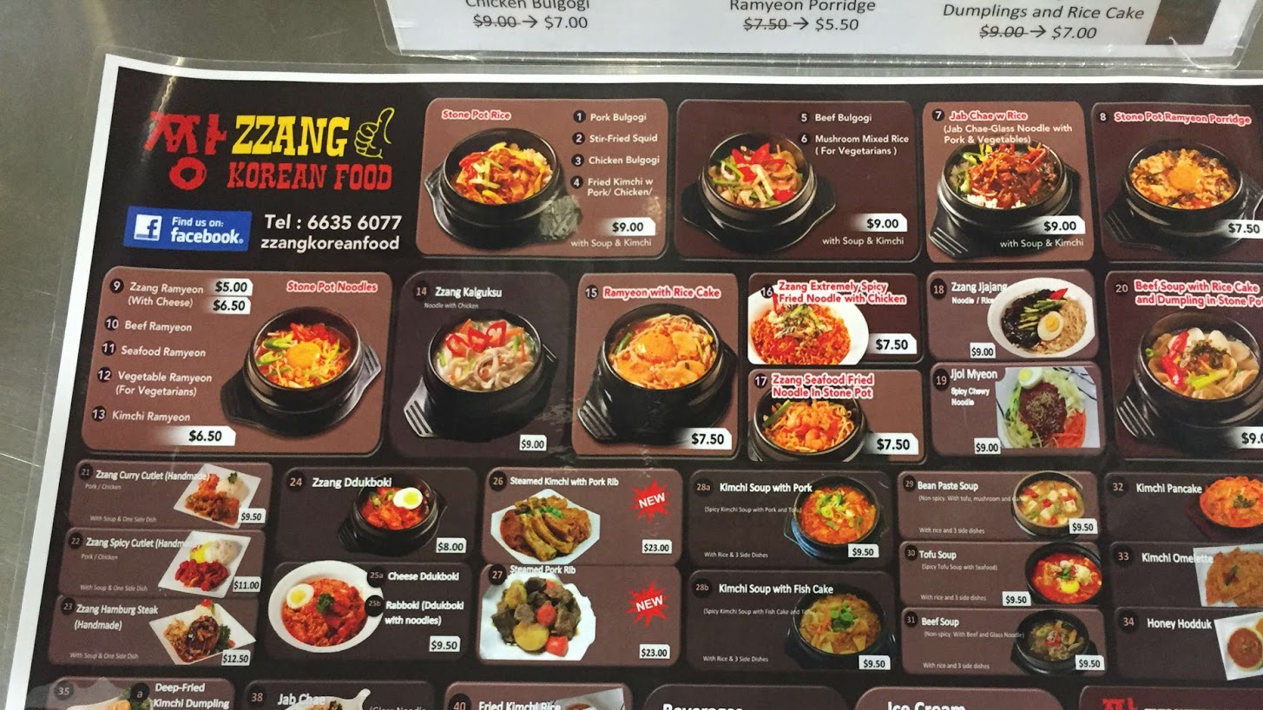
REFERENCES
Cousins, J. (2020) Food and beverage service. 9th ed. London: Hodder Education Group.**
Davis, B et al. (2018) Food and Beverage Management. 6 edn London: Routledge.**
Johnston, R. (2012) Service operations management : improving service delivery. 4th ed. Harlow, England: Pearson.*
Boussard, S (2021) Food and Beverage Management in the Luxury Hotel Industry. New York: Business Expert Press**
Foskett, D. et al. (2021) The Theory of Hospitality and Catering. 14th Edition. London: Hodder Education Group.*
Walker, J (2017) Introduction to Hospitality. Harlow: Pearson Education Limited.*
Wood, R. (2013) Key Concepts in Hospitality Management. London: Sage*
Notes:
References
Cousins, J. (2020) Food and beverage service. 9th ed. London: Hodder Education Group.**
Davis, B et al. (2018) Food and Beverage Management. 6 edn London: Routledge.**
Johnston, R. (2012) Service operations management : improving service delivery. 4th ed. Harlow, England: Pearson.*
Boussard, S (2021) Food and Beverage Management in the Luxury Hotel Industry. New York: Business Expert Press**
Foskett, D. et al. (2021) The Theory of Hospitality and Catering. 14th Edition. London: Hodder Education Group.*
Walker, J (2017) Introduction to Hospitality. Harlow: Pearson Education Limited.*
Wood, R. (2013) Key Concepts in Hospitality Management. London: Sage*

