Slide 1
Student Name: Dalia Juliana Plesca
Student ID: g60906
Lecturer’s Name: Annamarie Dufficy Anita Nan
Module Code: LCLM 4004
Module Name: Problem Solving and Decision-Making
Component 1: Basil’s Bakery

Slide 2
Good morning/afternoon,
My name is Dalia and in my presentation I will show you an overview of Basils Bakery and the nature and scope of the problems they currently have. I will provide a critique and application of the PESTLE framework and of the cause and effect model. Lastly I will show you a summary of the key findings.

Slide 3
Basils Bakery
Basil Bakery is an independent bakery which sells bread, cakes and pastries.
They are located in a retail park in Coventry
Opened in 2015
In 2020 due to COVID, the sales decreased

Slide 4
Nature and scope of the problem
The main issues that are affecting Basil’s Bakery
External problems
Customers have decreased as less people visit the retail park
Operating and ingredients costs have increased
Hybrid working has decreased customer visits
Internal problems
Options to order are limited
Long waiting times
The business has limited time to manage orders while baking.
The impact this has on the Basil’s Bakery is that they have less sales opportunities and they are uncertain of the future of the business.

Slide 5
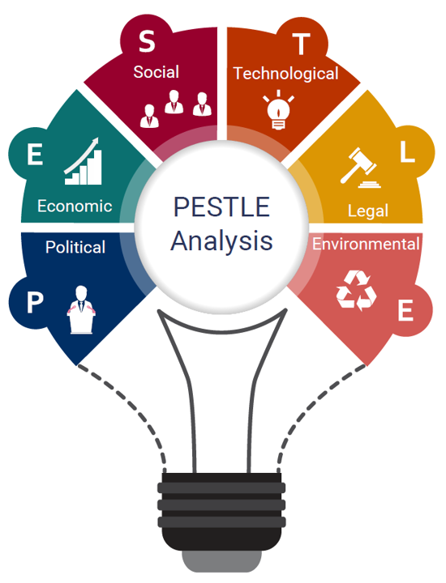
Critique of the PESTEL framework
What is pestle
A PESTLE analysis studies the key external factors (Political, Economic, Sociological, Technological, Legal and Environmental) that influence an organisation. https://www.cipd.org/uk/knowledge/factsheets/pestle-analysis-factsheet/
Purpose
The business is able to understand its environment
It helps identify external opportunities and threats
Benefits
Its structure is simple and organised
It covers 6 external factors
The business can identify risks before making a decision
Limitations
It isn’t a detailed analysis
Doesn’t show which factor is most essential
The results depend on the quality of available evidence
Source: Sammut-Bonnici and Galea (2015); Johnson we al. (2017)

Slide 6
Factor | Sub factor 1 | Sub factor 2
Political | Business rates | Changes to government support
Economical | Rising costs causing higher rent and increase of ingredients cost | Profit is reduced when expenses are increased due to unpredicted price changes
Social | Customer behaviour changing | Fewer people visit retail parks due to hybrid working which reduces sales
Technological | Ordering technology | The business struggles to manage phone orders
Legal | Food safety requirements | The bakery must follow food safety and allergen information requirements
Environmental | Crop failure | Poor growing conditions causes unpredictable ingredient supplies

Slide 7
Critique of the cause and effect model
What is the cause and effect model?
It is an visual tool that is used to identify and organise possible causes of a problem. Its purpose is that it finds out the root causes, groups causes into different categories and supports problems solving.
Benefits
It is simple so easy to visually understand
Organises complex problems
Limitations
It has no evidence that a cause is responsible
It can rely on assumptions or incomplete information
It doesn’t tell us which cause is most important
Sources: American society for quality (n.d.); institute for health care improvement (n.d).

Slide 8
Application of the cause and effect model
Root problem- sales decrease approximately 25% below 2019 levels.
Methods
There is no delivery service
Waiting times are long
Phone calls are missed
Machines
There is no ordering system online described
People
Extra orders are difficult to manage
The baker must present at all times
Less time to answer calls
Materials
Supplies are affected due to crop failure
Ingredients can change
Measurements
There is no data on missed orders or waiting times
No detailed sales breakeven provided
Environmental
Working patterns have changed
Covid-19 has a huge effect
Decline of retail park activity
Sources: Authors own distance based on Basil’s Bakery case study and American Society for Quality (n.d.)

Slide 9
Key findings
It states that sales remain around 25% below the 2019 level
Reduced footfall, hybrid working and rising costs are all external factors
Missed orders, long waiting times and limited ordering options are internal operational limitations
PESTLE and the cause of effect model helps the business identify possible causes however further evidence is required to confirm their impact.

Slide 10
References
https://asq.org/quality-resources/fishbone
https://www.gov.uk/government/publications/food-safety-for-food-delivery/food-safety-for-food-delivery
https://www.gov.uk/business-rates-relief
https://www.ihi.org/library/tools/cause-and-effect-diagram
https://www.ons.gov.uk/employmentandlabourmarket/peopleinwork/employmentandemployeetypes/articles/whohasaccesstohybridworkingreatbritain/2025-06-11

Slide 11


