Slide 1
Feminism
Samantha Derl-Davis
SJSI4017

Slide 2
Definition of Feminism
.
“Feminism is the belief that women should have equality .
The same power opportunities and rights of men.”
Collins Dictionary

Slide 3
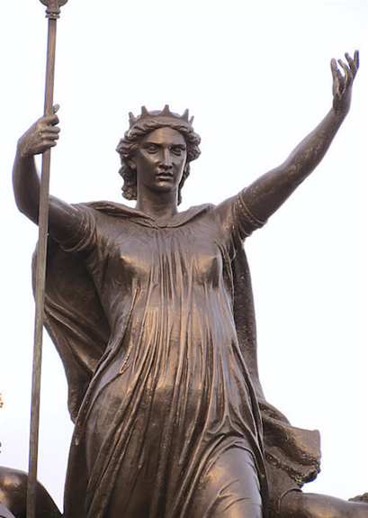
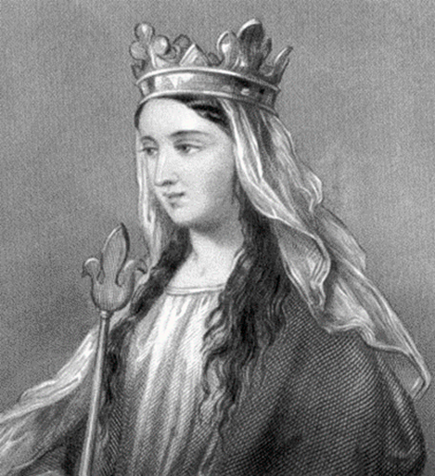
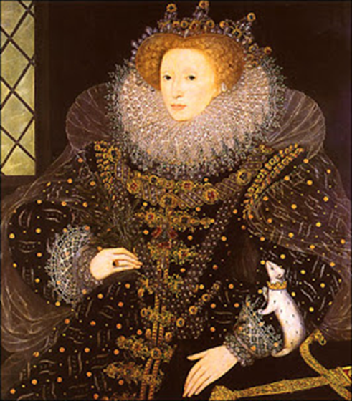
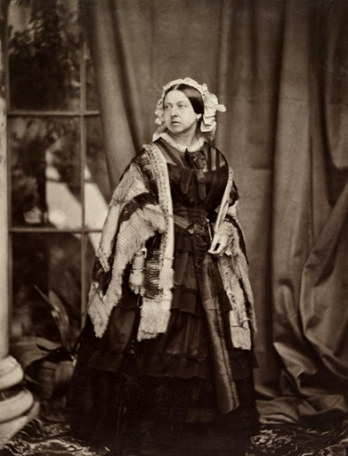
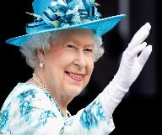
Introduction
Image 1
Image 2
Image 3
Image 5
Image 4
Queen Boudicca
Queen Matilda
Queen Elizabeth I
Queen Victoria
Queen
Elizabeth II

Slide 4
Celtic Britain
Image 1
Equal rights
Equal opportunities
Equality within marriage
Roman oppression led
to the removal of
women’s rights

Slide 5
Medieval Britain
Image 2
Fewer opportunities
Influence of the church (Adam and Eve) led to subjugation of women

Slide 6
Elizabethan Britain
Image 3
At Tilbury in 1588 Queen Elizabeth said
“I have the body of a feeble women, but the heart and stomach of a King, and a King of England too”.

Slide 7
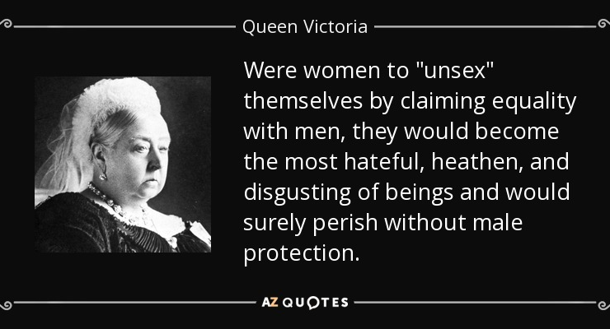
Victorian Britain

Slide 8
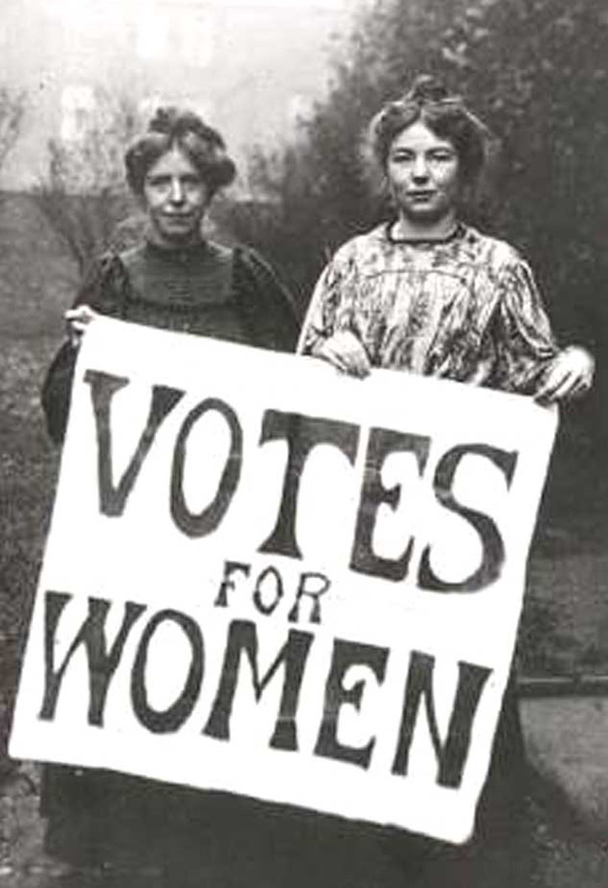
The Suffragette Movement
1897 the foundation of The National Union of Women’s Suffrage
Suffrage means right to vote
1903 the foundation of Women’s Social and Political Union
1913 The Cat and Mouse Act
The Suffragettes first martyr

Slide 9
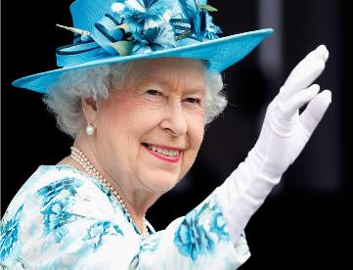
Modern Day
Image 5
Women returned to the front line
Opportunities
The 60s

Slide 10
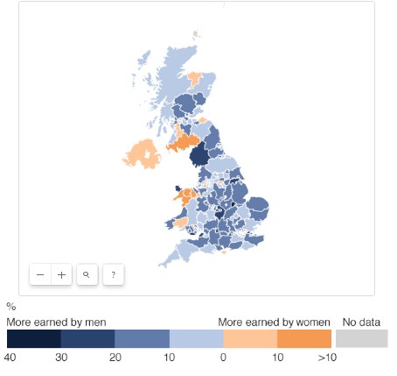

Pay Inequality
Carmarthenshire
Warwickshire
Image 6

Slide 11
Timeline
Women's Suffrage founded 1897
Representation of the People Act (partial vote) 1918
The Commonwealth Charter 2013
Equal Pay Act 1970
The Equality Act 2010
Married Women’s Act (own property)
1870
Votes for Women petition 1902
Equality of Vote 1928
The Discrimination Act 1975

Slide 12
Conclusion
The past
The present

Slide 13
Definition of Feminism
“Feminism is the belief that women should have equality .
The same power opportunities and rights of men.”
Collins Dictionary

Slide 14
Referenced images
Image 1 of Boudicca available at: http://www.behindthename.com/name/boudicca (accessed 01 May 2018)
Image 2 of Matilda available at :http://arrayedingold.blogspot.co.uk/2011/08/wife-of-conqueror-matilda-of-flanders.html (accessed on 01 May 2018)
Image 3 available at http://arrayedingold.blogspot.co.uk/2011/08/wife-of-conqueror-matilda-of-flanders.html (accessed on 01 May 2018)
Image 4 of Victoria available at: https://commons.wikimedia.org/wiki/File:Queen_Victoria_by_JJE_Mayall,_1860.png(Accessed:01 May 2018)
Image 5 of Elizabeth II available at: http://fortune.com/2017/04/21/queen-elizabeth-ii-birthday/ Barnett, Barnett,E (2018)https://www.telegraph.co.uk/women/womens-life/11848292/Queen-is-my-feminist-icon-and-she-should-be-yours-too.html (Accessed:01 May 2018)
Image 6 available at: http://www.bbc.co.uk/news/uk-england-41805053(Accessed:01 May 2018)

Slide 15
Reference list
BBC (2014)available at: http://www.bbc.co.uk/schools/gcsebitesize/rs/prejudice/christianityrev3.shtml (Accessed:01 May 2018)
Boudicca/Celtic Britain available at:
Bovey.A (2015) Women in medieval Society, The British Library available at: https://www.bl.uk/the-middle-ages/articles/women-in-medieval-society (accessed:01 May 2018)
Cochrane,K (2013) 1963: the beginning of the feminist movement, he Guardian available at: https://www.theguardian.com/lifeandstyle/2013/may/07/1963-beginning-feminist-movement (Accessed 07 may 2018)
Elizabeth quote http://www.elizabethi.org/contents/quotes(Accessed:01 May 2018)
Elizabethan Women(1998-2018) Elizabethan Women available at: http://www.phillyshakespeare.org/wp-content/uploads/2014/11/elizabethan-women.pdf (Accessed:15 May 2018)
Elizabethan Women(1998-2018) women in Tudor history available at: https://www.elizabethi.org/contents/women/(Accessed:01 May 2018)
Feminism definition available at: https://www.collinsdictionary.com/dictionary/english/feminism (accessed 05 May 2018)
Gov (2016) available at: https://www.gov.uk/government/news/ban-on-women-in-ground-close-combat-roles-lifted (Accessed:01 May 2018)
Historylearningsite(2018) 1918 representation Act available at: www.historylearningsite.co.uk/the-role-of-british-women-in-the-twentieth-century/the-1918-representation-of-the-people-act/ (Accessed:01 May 2018)
Hughes,K (2014) Gender roles in the 19th century, British Library available at: https://www.bl.uk/romantics-and-victorians/articles/gender-roles-in-the-19th-century (Accessed:01 May 2018)
Married Women’s Act (1870) available at: https://www.parliament.uk/about/living-heritage/transformingsociety/private-lives/relationships/overview/propertychildren/ (Accessed:01 May 2018)
Parliament Uk (no date) available at: https://www.parliament.uk/about/living-heritage/transformingsociety/electionsvoting/womenvote/case-study-the-right-to-vote/the-right-to-vote/birmingham-and-the-equal-franchise/1928-equal-franchise-act/ (Accessed:01 May 2018)
Queen Victoria's Quote available at: https://www.azquotes.com/author/15079-Queen_Victoria (Accessed:01 May 2018)
Savage,W (2015)East Anglian Daily Times,Portland House, Ipswitch. Available at: http://www.eadt.co.uk/what-s-on/was-queen-elizabeth-i-the-first-feminist-1-3911236 (Accessed:01 May 2018)

Slide 16
Sex discrimination Act (1975) available at: https://www.legislation.gov.uk/ukpga/1975/65 (Accessed:01 May 2018)
Swirk (no date) available a: http://www.skwirk.com/p-c_s-14_u-169_t-463_c-1640/nsw/history/-ancient-societies-britain/ancient-britain-part-ii/a-person-queen-boudicca(accessed 01 May 2018)
Texas coritani, the lives of ancient celtic women available at: http://www.texascoritani.com/articles/celticwomen/ (accessed 15. May 2018)
The commonwealth Charter (2013) https://assets.publishing.service.gov.uk/government/uploads/system/uploads/attachment_data/file/136337/Cm_8572.pdf (Accessed:01 May 2018)
The Goverments Equalities office (2015) available at: https://www.gov.uk/guidance/equality-act-2010-guidance(Accessed:01 May 2018)
Trueman, C,N (2015)"The 1918 Representation of the People Act"
The History Learning Site,2018, available at: www.historylearningsite.co.uk (Accessed:07May 2018)
Valmcbeath (2017) available at: https://valmcbeath.com/victorian-era-womens-rights/#.WvBOSExFxYd (accessed:01 May 2018)
Votes for women petition MMU (no date) available: www.mmu.ac.uk/equality-and-diversity/doc/gender-equality-timeline.pdf accessed:01 May 2018)
Wainwright, D (2017) available at http://www.bbc.co.uk/news/uk-england-41805053 (Accessed:01 May 2018)

