Slide 1
Student name: Sandra Gorolova
Student ID: 2311229
Module name: Building a Sustainable Marketing Relationship BMSW5007
Date: 04.12.24
Presented to Tesco Management Team

Slide 2
"Tesco’s Use of Digital and Social Media in Customer Relationship Management"
Presented to Tesco Management Team

Slide 3
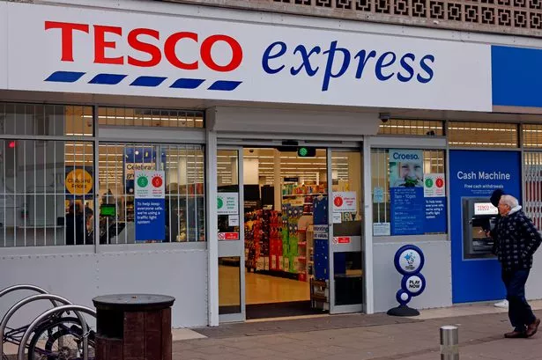

Introduction to Tesco and CRM
Tesco, a leading multinational retailer based in the UK, serves millions of customers through its extensive range of products, from groceries to financial services (Smith, 2023). Guided by its mission to “serve customers a little better every day,” Tesco focuses on convenience, quality, and affordability.
Customer Relationship Management (CRM): Relationship marketing focuses on establishing reliable, long-term connections with customers in order to increase their happiness and loyalty (Singh et al., 2023).
Importance of CRM: Customer relationship management that works helps Tesco stand out from the competition, increases sales, and keeps customers coming back for more (Kumar, 2021).

Slide 4
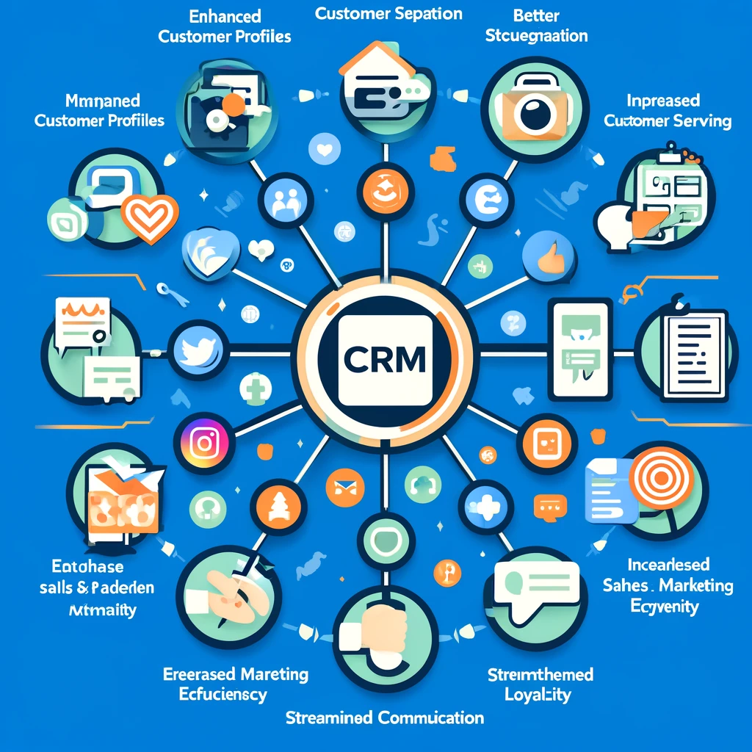
Defining Social Media and Digital Media in CRM
Digital Media in CRM
In Customer Relationship Management (CRM), digital media refers to online channels like websites, emails, and mobile apps that facilitate direct and personalised interactions with customers (Magatef et al., 2023). These platforms allow businesses to understand customer behaviors and preferences effectively.
Social Media in CRM
In CRM, social media serves as a powerful tool for engaging directly with customers, addressing their needs, and fostering brand loyalty. By leveraging platforms like Facebook, Twitter, and Instagram, Tesco connects with its audience, shares updates, and responds to inquiries in real time (Mustak et al., 2024).

Slide 5
Tesco’s Digital Engagement Strategy
1
2
1
1
Data Collection Tools:
Behavioural Insights:
By analyzing this data, Tesco identifies customer shopping patterns, popular products, and seasonal trends. This allows the company to tailor offers and stock inventory efficiently, as well as optimize customer satisfaction through relevant promotions (Vaka, 2024).
Tesco leverages its Clubcard program, online purchase data, and website interactions to gather detailed insights into customer behaviours, preferences, and shopping frequencies. This data collection enables precise targeting and personalized marketing.

Slide 6

Social Media Strategy
Customer Engagement:
Tesco uses social media to foster two-way communication with customers, address inquiries, handle feedback, and build loyalty. By maintaining a responsive presence, Tesco enhances its customer relationships and trust (Alnawaset al., 2023).
Diverse Content:
Tesco’s social media content includes promotions, exclusive discounts, and customer service support, ensuring customers receive timely assistance and incentives. Additionally, sustainability updates are shared to communicate Tesco’s environmental initiatives, resonating with eco-conscious consumers and reinforcing brand values (Gajdzik, et al., 2024).

Slide 7
Data Analytics in CRM
Predictive Analytics: Tesco employs predictive analytics to anticipate customer needs and preferences, analyzing historical data to forecast buying patterns and optimize inventory. This proactive approach ensures that popular items are well-stocked and reduces wastage.
Machine Learning for Trend Analysis: Machine learning models analyze vast customer datasets to uncover trends, such as seasonal demands or emerging product interests, allowing Tesco to respond rapidly to market shifts (Sadrnia, 2023).
Personalized Recommendations: Through data-driven insights, Tesco tailors promotions and product recommendations, offering personalized discounts and targeted suggestions that enhance customer satisfaction and boost loyalty (Zeba and Shaheen, 2021).

Slide 8
Impact of Digital and Social Media on Customer Relationships
Enhanced Loyalty and Satisfaction:
Tesco’s digital and social media strategies foster customer loyalty by providing personalised experiences and relevant promotions, which increase customer satisfaction and repeat engagement (Farooq, 2024).
Adaptation to Market Needs:
By actively monitoring social and digital interactions, Tesco quickly adapts to shifting customer demands and market changes, ensuring its offerings remain competitive and customer-centric.

Slide 9
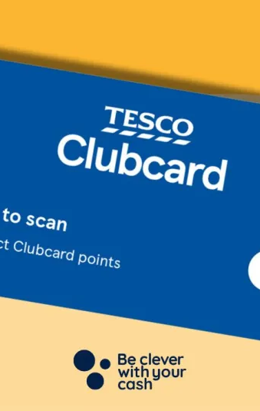
Case Study: Tesco Clubcard
Core CRM Tool: The Tesco Clubcard is central to Tesco's CRM efforts, collecting data on customer purchases to drive loyalty and create a more personalized shopping experience (Yawson
and Yamoah, 2022).
Data-Driven Personalization: By tracking customer preferences and purchase history, the Clubcard allows Tesco to deliver targeted offers, relevant discounts, and tailored product recommendations, enhancing customer satisfaction and loyalty (Koerniawan, 2022).
Proven Success: The Clubcard program has significantly boosted Tesco’s ability to analyse buying behaviours, helping the company refine marketing strategies and increase customer retention through valuable, data-informed insights.

Slide 10
Measuring Success in Digital and Social Media Efforts
Revenue Growth:
By evaluating sales data linked to digital campaigns, Tesco tracks revenue generated from online and targeted promotions, quantifying the financial success of its digital strategy (Erdmannand Ponzoa, 2021).
Engagement Rate:
Tesco measures the effectiveness of its social media interactions through engagement rates, tracking likes, comments, and shares to gauge customer interest and response to content
(Li et al., 2023).
Your Content Here
You can simply impress your audience and add a unique zing and appeal to your Presentations.
Easy to change colors, photos and Text.
Successful Campaigns:
Notable campaigns, like seasonal promotions and sustainability initiatives, have seen high engagement and positive customer feedback, demonstrating Tesco’s effective use of digital channels to reinforce brand loyalty and drive sales.
Customer Retention:
Retention rates are closely monitored to assess the impact of personalized offers and loyalty initiatives, with Clubcard data helping to identify long-term engagement trends.

Slide 11
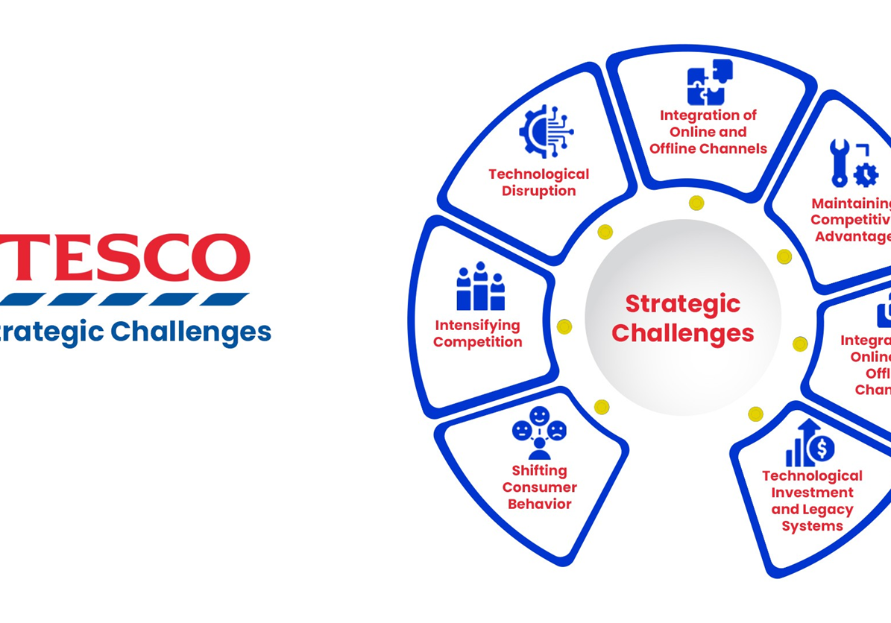
Challenges and Ethical Considerations
Ethical Data Usage:
While personalizing offers enhances customer experience, Tesco must carefully balance this with ethical data practices, ensuring transparency and respecting customer choices on data collection and usage (Krafft et al., 2021).
Data Privacy and Security:
Tesco faces stringent requirements under GDPR to protect customer data, implementing strong security measures to ensure data privacy and maintain customer trust while managing vast amounts of personal information.

Slide 12
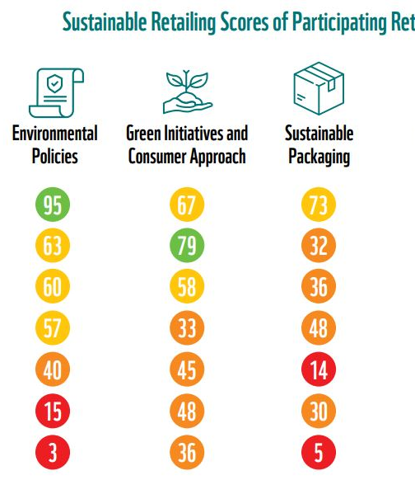

Tesco’s Sustainability and Ethical Commitments
Alignment with Customer Values:
Through implementing things like donating food, using less plastic, and trying for net-zero emissions, Tesco actively aligns its operations with the values of its customers, making it easier for people who care about social and environmental issues to do business with them (Chkanikova and Sroufe, 2021).
Strengthening Customer
Relationships:
People who care about the environment appreciate Tesco's dedication to ethical sourcing, reducing waste, and lowering carbon emissions. This builds trust and confidence among customers, who expect businesses to act responsibly. These actions help Tesco's brand image (Samdani, 2020).

Slide 13
Conclusion and Recommendations
Summary and Impact: The way Tesco interacts with customers through digital and social media as part of its CRM strategy has made them more loyal and improved the company's image by tailoring interactions to each customer's needs. In a competitive market, this strategy has made Tesco a brand that focuses on the customer.
Recommendations:
Tesco's customers would believe and be more interested in the company if they knew more about how their data was being used and if they had more interactive digital experiences.
Setting up regular feedback loops and increasing personalized offerings would help Tesco stay in touch with customers' wants and build stronger, more dynamic relationships with them.

Slide 14
References
Alnawas, I., Al Khateeb, A. and El Hedhli, K., 2023. The effects of app-related factors on app stickiness: The role of cognitive and emotional app relationship quality. Journal of Retailing and Consumer Services, 75, p.103412. https://doi.org/10.1016/j.jretconser.2023.103412
Chkanikova, O. and Sroufe, R., 2021. Third-party sustainability certifications in food retailing: Certification design from a sustainable supply chain management perspective. Journal of Cleaner Production, 282, p.124344. https://doi.org/10.1016/j.jclepro.2020.124344
Erdmann, A. and Ponzoa, J.M., 2021. Digital inbound marketing: Measuring the economic performance of grocery e-commerce in Europe and the USA. Technological forecasting and social change, 162, p.120373. https://doi.org/10.1016/j.techfore.2020.120373
Farooq, H., 2024. Customer Loyalty Programs: Maximizing Engagement and Profitability. Liberal Journal of Management & Social Science, 1(4), pp.56-73.
Gajdzik, B., Bartuś, K., Jaciow, M., Wolniak, R., Wolny, R. and Grebski, W.W., 2024. Evolution of Polish E-Consumers’ Environmental Awareness and Purchasing Behavior over Ten Years. Sustainability, 16(11), p.4686. https://doi.org/10.3390/su16114686
Koerniawan, N., 2022. The Use of Customised Market Intelligence by Small Food and Drink Producers: The Role of Strategic Orientations and Commitment (Doctoral dissertation, University of East Anglia). https://ueaeprints.uea.ac.uk/id/eprint/97288

Slide 15
Continued…..
Krafft, M., Kumar, V., Harmeling, C., Singh, S., Zhu, T., Chen, J., Duncan, T., Fortin, W. and Rosa, E., 2021. Insight is power: Understanding the terms of the consumer-firm data exchange. Journal of Retailing, 97(1), pp.133-149. https://doi.org/10.1016/j.jretai.2020.11.001
Kumar, A., 2021. Relationship marketing implementation and customer relationship management. In Proceedings of International Conference on Embracing Change & Transformation-Breakthrough Innovation and Creativity (pp. 968-982).
Li, X., Xu, M., Zeng, W., Tse, Y.K. and Chan, H.K., 2023. Exploring customer concerns on service quality under the COVID-19 crisis: A social media analytics study from the retail industry. Journal of Retailing and Consumer Services, 70, p.103157. https://doi.org/10.1016/j.jretconser.2022.103157
Magatef, S., Al-Okaily, M., Ashour, L. and Abuhussein, T., 2023. The impact of electronic customer relationship management strategies on customer loyalty: A mediated model. Journal of Open Innovation: Technology, Market, and Complexity, 9(4), p.100149. https://doi.org/10.1016/j.joitmc.2023.100149
Mustak, M., Hallikainen, H., Laukkanen, T., Plé, L., Hollebeek, L.D. and Aleem, M., 2024. Using machine learning to develop customer insights from user-generated content. Journal of Retailing and Consumer Services, 81, p.104034. https://doi.org/10.1016/j.jretconser.2024.104034
Sadrnia, L., 2023. The Future of Marketing: How Predictive Modeling Optimizes Campaign Strategies. iBusiness, 15(4), pp.249-262. https://doi.org/10.4236/ib.2023.154018

Slide 16
Continued…..
Samdani, T., 2020. Impact of Tesco's Private Label brands on buying behaviour of Millennials in terms of brand preference in Irish market (Doctoral dissertation, Dublin, National College of Ireland).
Singh, V., Sharma, M.P., Jayapriya, K., Kumar, B.K., Chander, M.A.R.N. and Kumar, B.R., 2023. Service quality, customer satisfaction and customer loyalty: A comprehensive literature review. Journal of Survey in Fisheries Sciences, 10(4S), pp.3457-3464.
Smith, D., 2023. Logistics in Tesco: past, present and future. In Logistics And Retail Management insights Into Current Practice And Trends From Leading Experts (pp. 154-183). CRC Press.
Vaka, D.K., 2024. Integrating inventory management and distribution: a holistic supply chain strategy. the International Journal of Managing Value and Supply Chains, 15(2), pp.13-23. https://doi.org/10.5121/ijmvsc.2024.15202
Yawson, D.E. and Yamoah, F.A., 2022. The TESCO Club Card Loyalty Programme: The Gold Standard. In Contemporary Retail Marketing in Emerging Economies: The Case of Ghana’s Supermarket Chains (pp. 77-87). Cham: Springer International Publishing. https://doi.org/10.1007/978-3-031-11661-2_3.
Zeba, F. and Shaheen, M., 2021. Consumer Insights through Retail Analytics. In Artificial Intelligence and Machine Learning in Business Management (pp. 15-27). CRC Press.

Slide 17
Thank you

