Slide 1
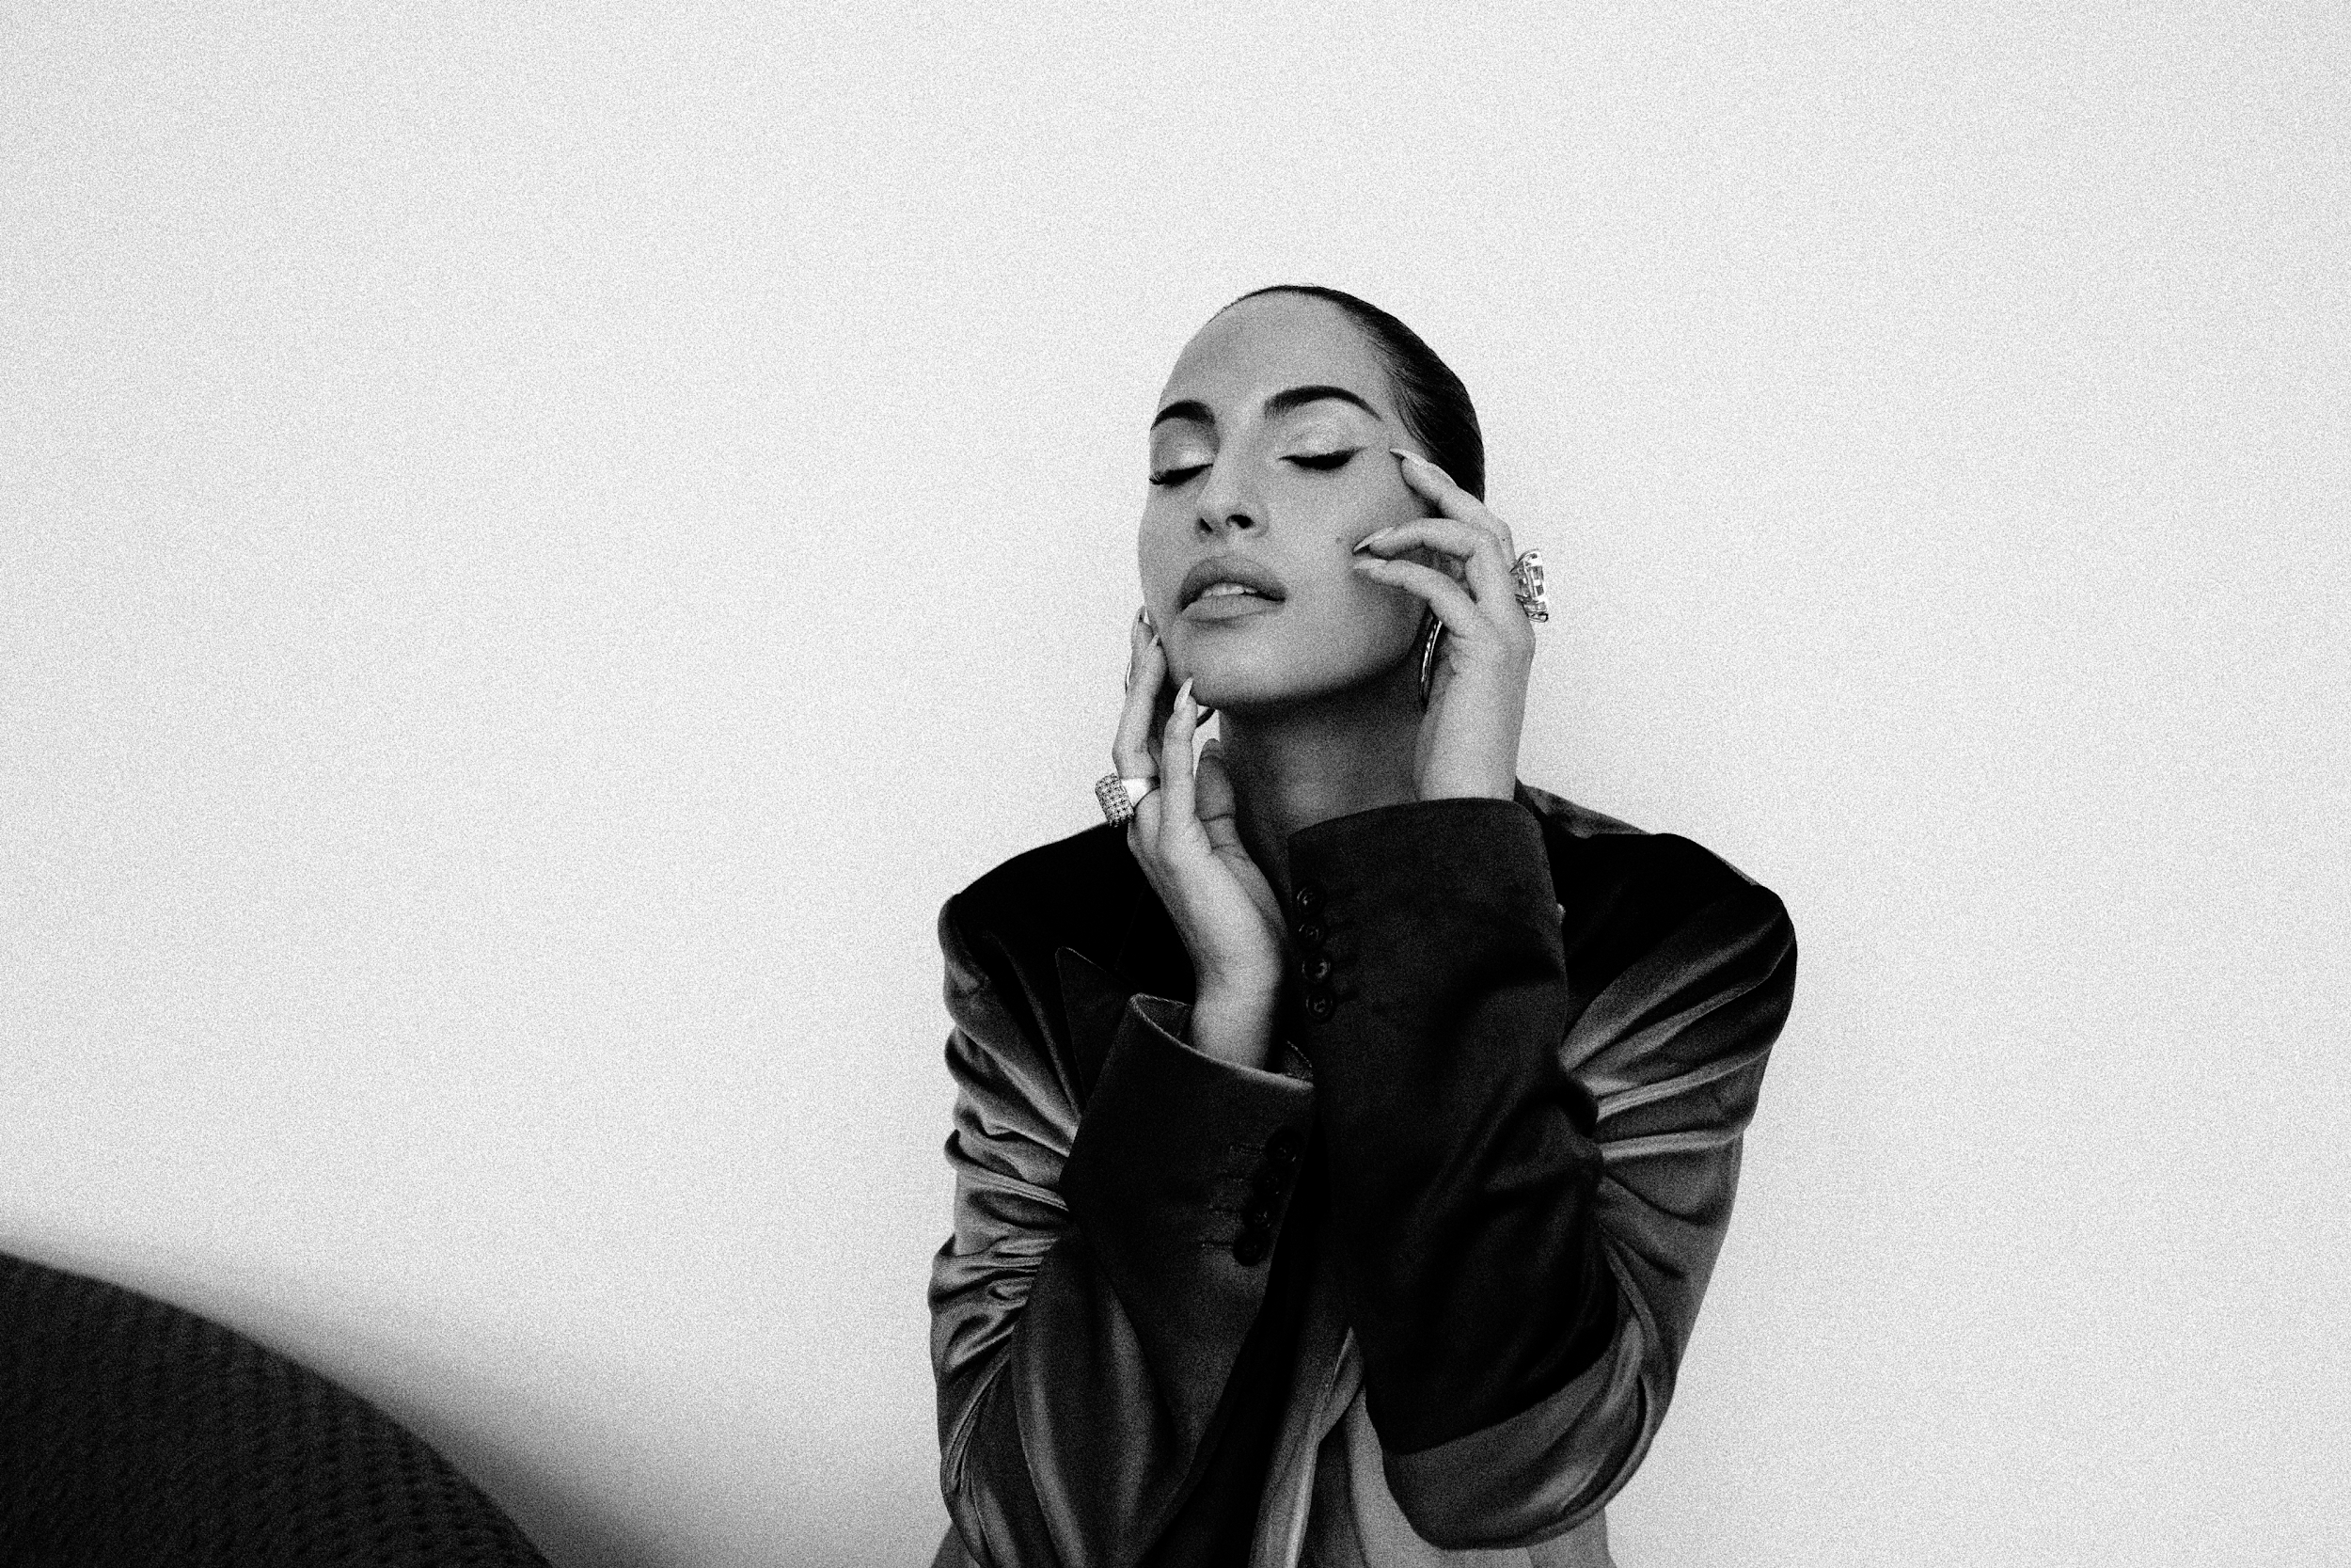
Session 6
Harnessing promotion to amplify the marketing message

Slide 2
LEARNING OUTCOME
Contrast and discuss traditional and contemporary promotions processes and their uses across a range of different channels

Slide 3
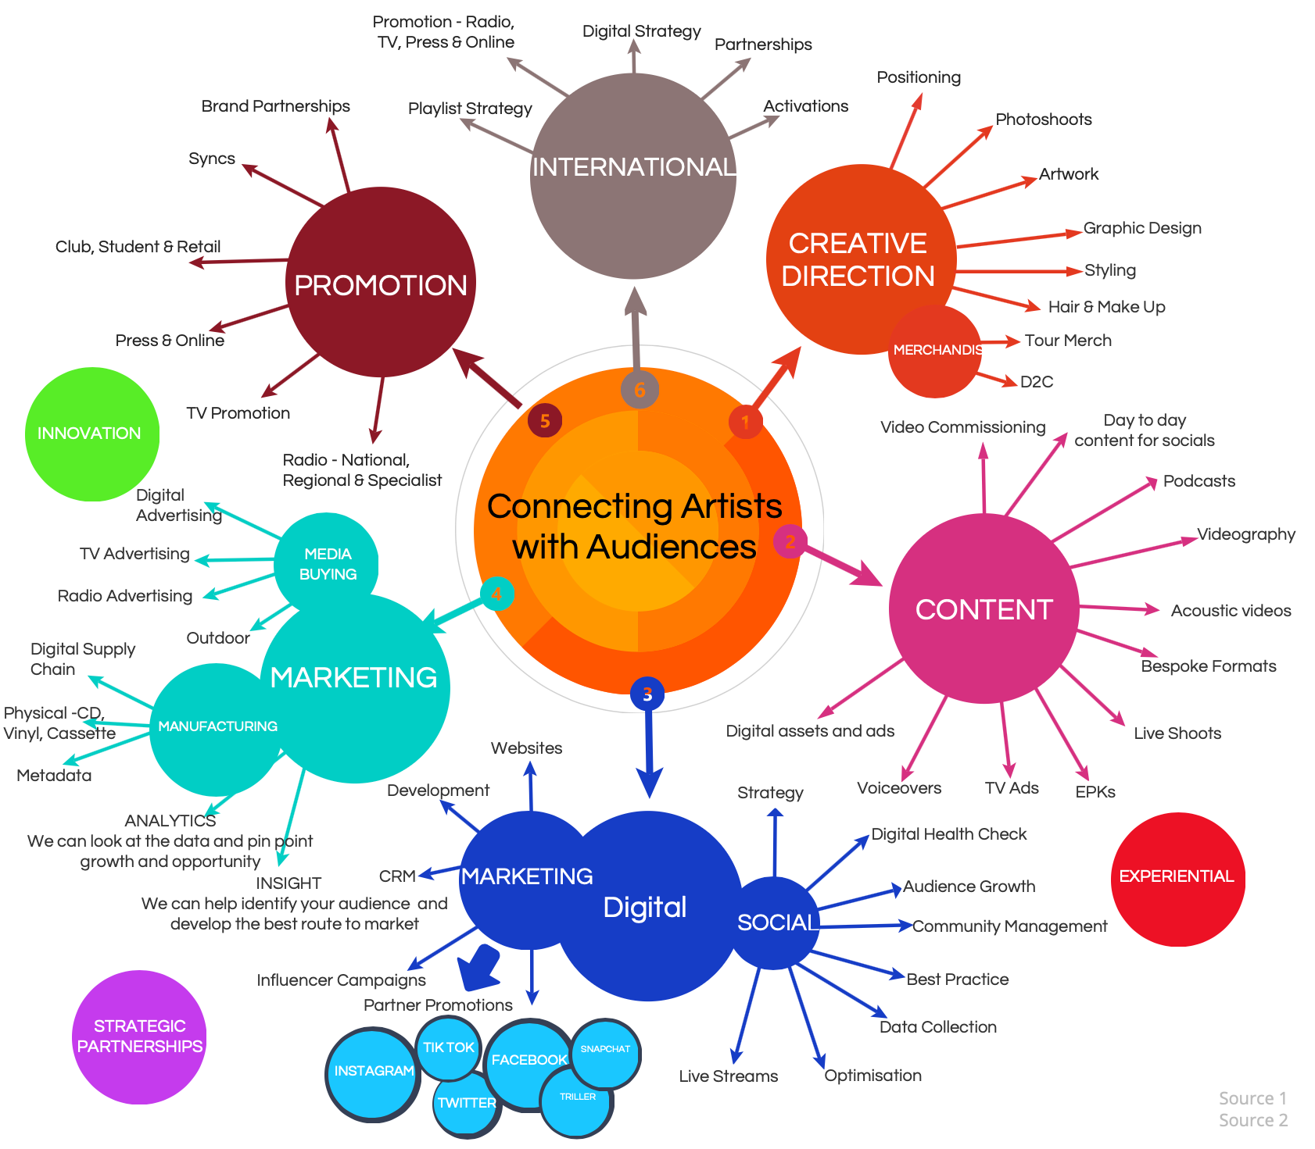

Slide 4

TOPICS
Topics
Framework
Press & Online
Brand Partnership
Sync
Radio

Slide 5
FRAMEWORK

Slide 6
FRAMEWORK
Background
How efficiently you can reach your potential customers with less / Reasonable budgets
Initiatives
Targeting
What kind of people are likely to listen to your sounds?
Occasions
What kind of media are likely to reach your target audience?
Build a useful
and accessible network

Slide 7
FRAMEWORK
Approach
Efficiency with budgets
Reaching potential customers
Increasing awareness in target audiences

Slide 8
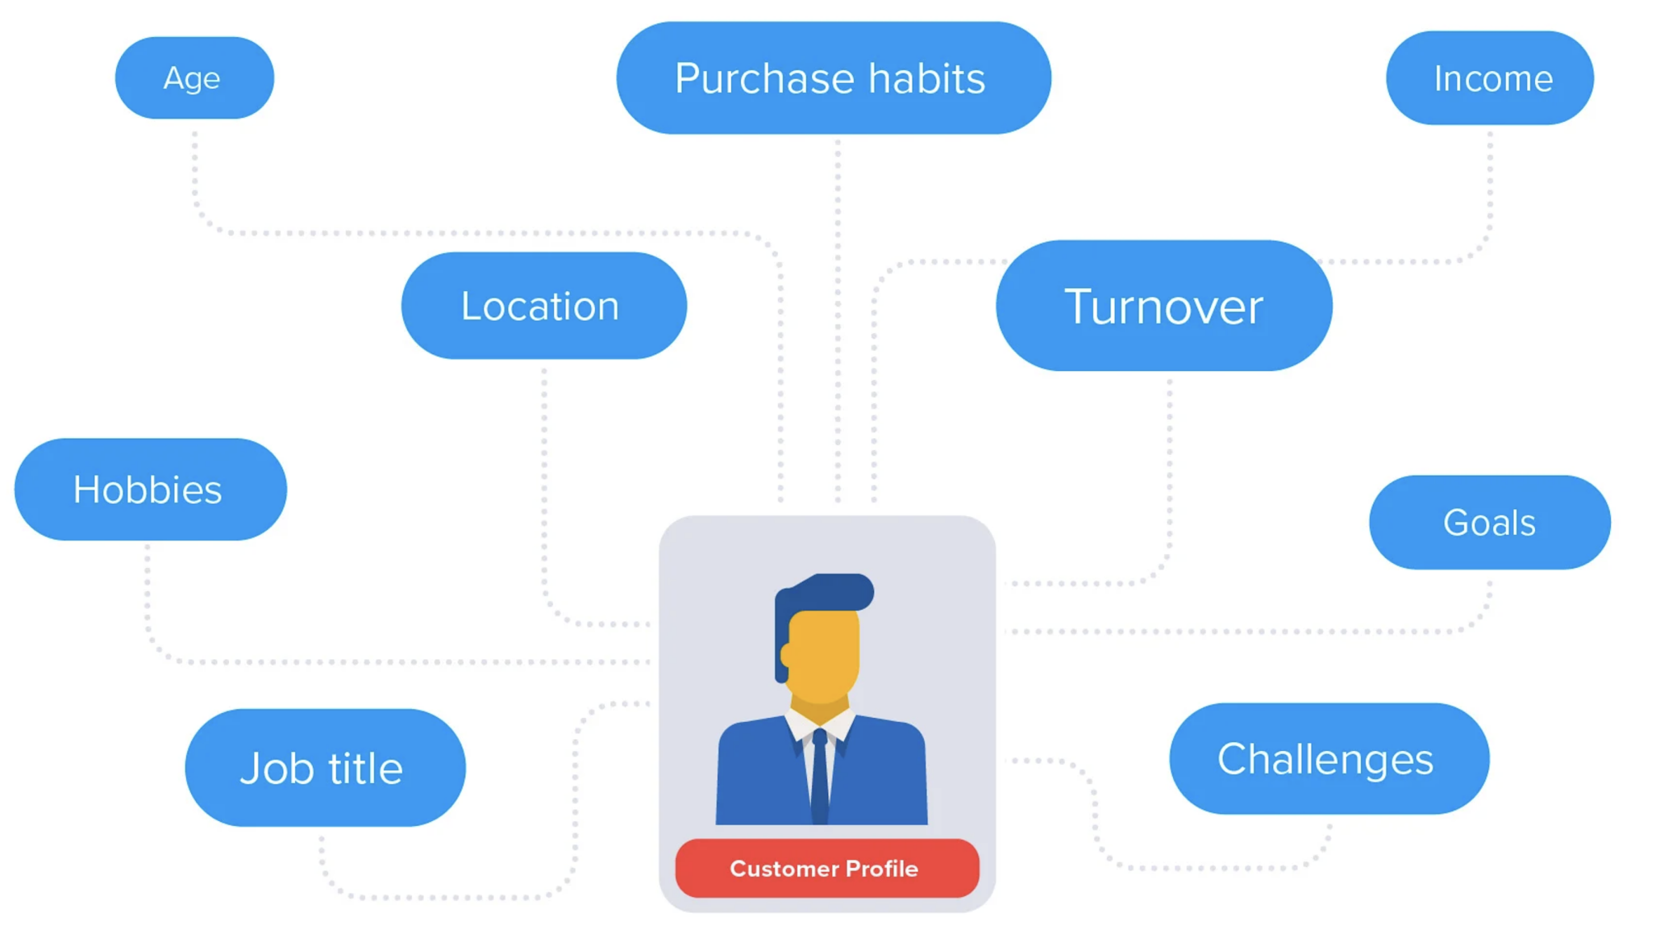
FRAMEWORK

Slide 9
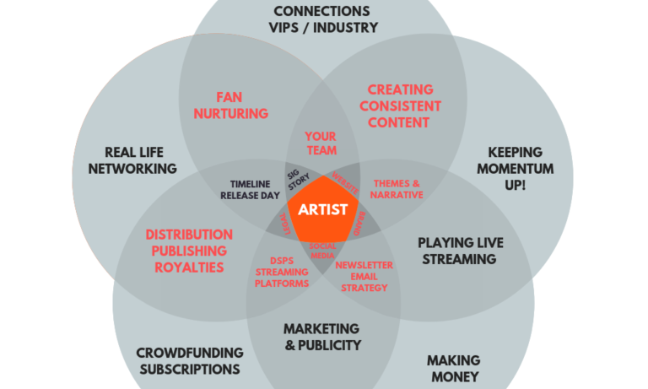
FRAMEWORK

Slide 10
PRESS & ONLINE

Slide 11
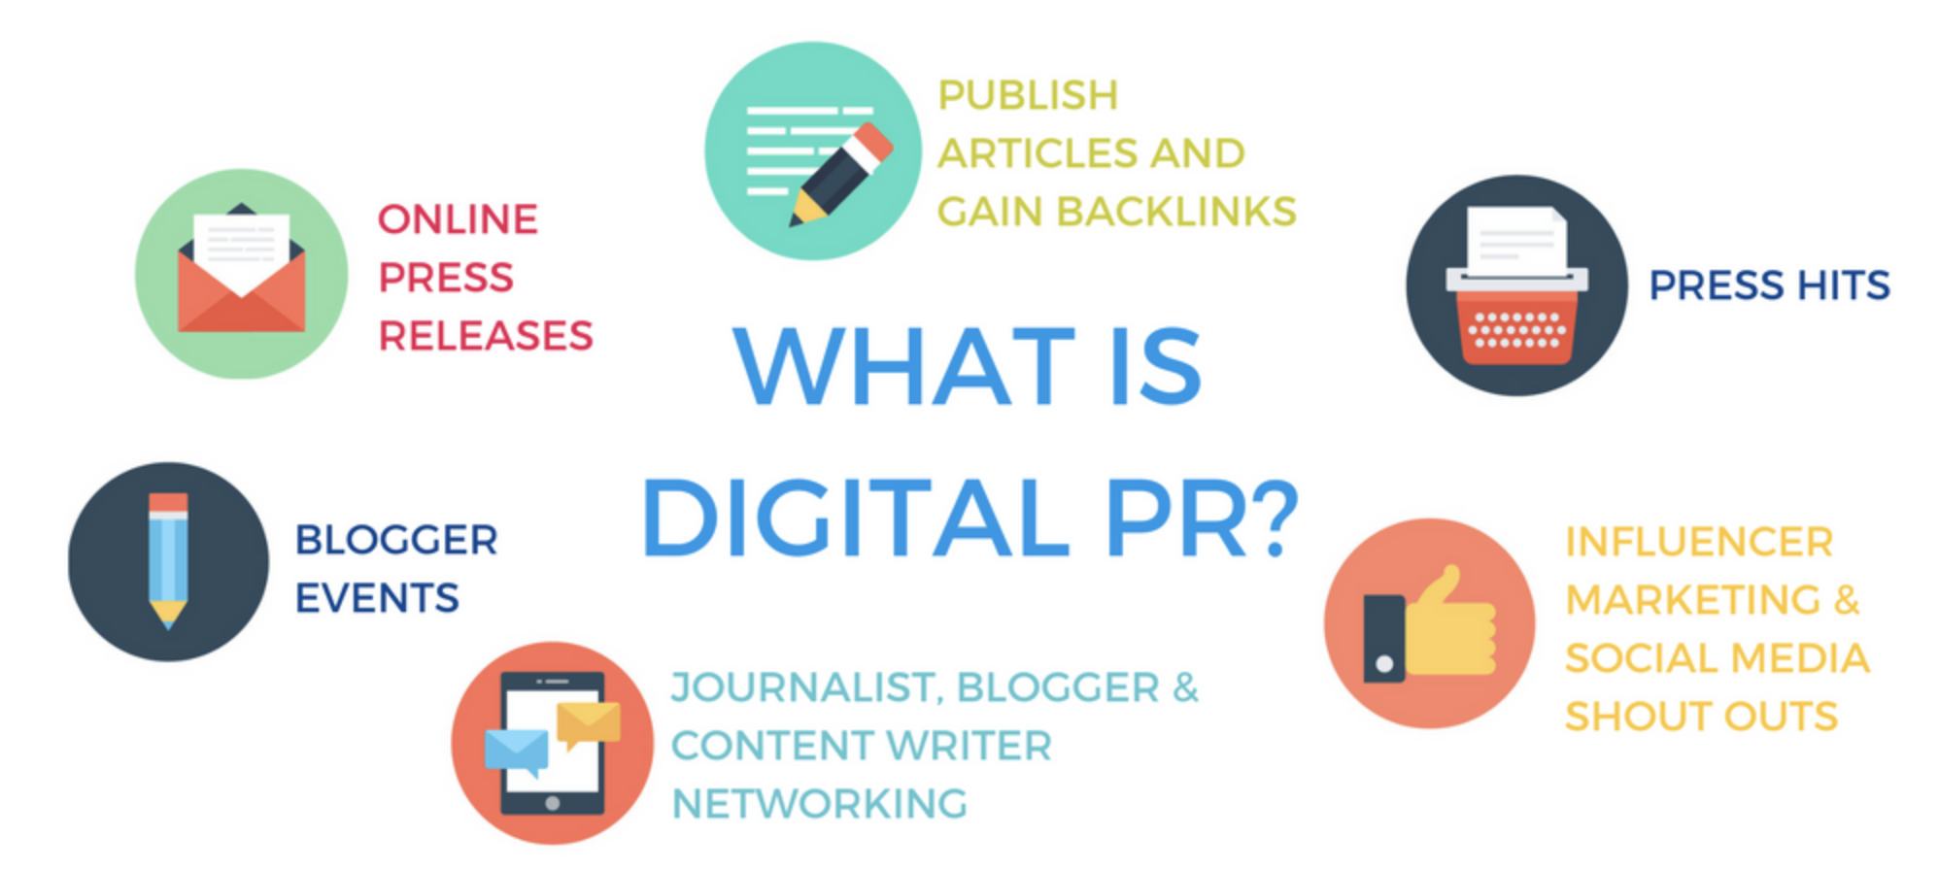
PRESS & ONLINE

Slide 12
BRAND PARTNERSHIP

Slide 13
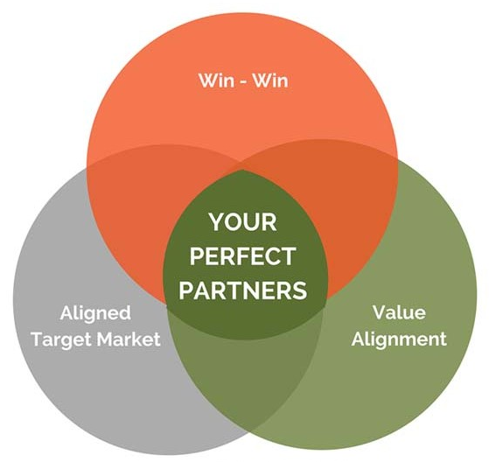
BRAND PARTNERSHIP

Slide 14
SYNC

Slide 15
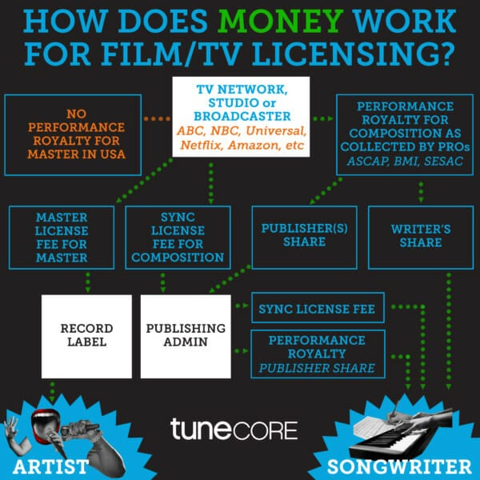
SYNC

Slide 16
RADIO

Slide 17
DISCUSSION TOPIC
Discussion Topic
Contrast and discuss traditional and contemporary promotions processes

Slide 18
Q&A
Q&A
KAYODE THOMAS
FOUNDER, TRIBE
DIGITAL CONTENT PRODUCER, AWAL

