Slide 1

ECES6021/C
Llesiant mewn Addysg
Well-being in Education
Sesiwn 1 / Session 1
Cyflwyniad
Introduction

Slide 2

Eisteddwch nol a gorffwyswch
Sit back and relax
Notes:
Countdown to 5
Who: small or large groups
When: at the beginning of a session
This simple sensory countdown activity is a great way to regain focus, and put your mind in an aware and receptive state. Delegates can write down answers if they choose, or simply relax and count through the following:
5 things you can see
4 things you can touch
3 things you can hear
2 things you can smell
1 thing you can taste

Slide 3

Nod y Modwl / Module Aim
Datblygu dealltwriaeth feirniadol o rôl ac effaith llesiant mewn addysg a dadansoddi’n feirniadol yr arferion a’r dulliau sy’n cefnogi hyn.
To develop a critical understanding of the role and impact of well-being in education and critically analyse the practices and approaches which support this.

Slide 4

Deilliannau Dysgu / Learning Outcomes
Archwilio’n feirniadol effaith deddfwriaeth a pholisi ar yr agenda llesiant yn y Deyrnas Unedig o ran addysg.
Critically examine the impact of legislation and policy on the well-being agenda in the UK in relation to education.

Slide 5

Deilliannau Dysgu / Learning Outcomes
Adfyfyrio’n feirniadol ar rôl ac effaith hunanofal i staff, plant a phobl ifanc wrth gyflawni nodau llesiant ehangach.
Critically reflect on the role and impact of self-care for staff, children and young people in achieving wider well-being goals.

Slide 6
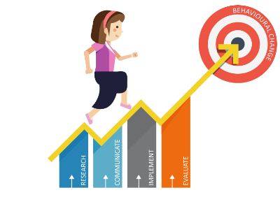
Deilliannau Dysgu / Learning Outcomes
Dadansoddi’n feirniadol ffyrdd o hyrwyddo llesiant cynaliadwy a gwerthuso deilliannau mewn amgylchedd sy’n seiliedig ar addysg
Critically analyse ways of promoting sustainable well-being and evaluating outcomes in an education-based environment.

Slide 7

Llawlyfr y Modwl Module Handbook
Lawrlwythwch y llawlyfr o Moodle
Please download the handbook from Moodle

Slide 8

Asesiad / Assessment
Elfen Asesu 1 – 100%
Portffolio – (cyfwerth â 4000 gair)
Gwerthuswch yn feirniadol rôl ac effaith hyd at 4 arfer gwahanol sy'n hyrwyddo llesiant disgyblion a/neu staff mewn ysgolion cynradd.
Cefnogwch eich dadleuon ag ystod amrywiol o ddeddfwriaeth, theori, polisi ac arfer perthnasol.
Cyflwynwch erbyn 23:59 ar 23/02
Dyddiad postio adborth: 23/03 am 15:00
Assessment Component 1 – 100%
Portfolio – (4000 words equivalent)
Critically evaluate the role and impact of up to 4 different practices which promote the well-being of pupils and/or staff within primary schools.
Support your arguments with a diverse range of relevant legislation, theory, policy and practice.
Submit by 23:59 on 23/02
Post date: 23/03 @ 15:00

Slide 9
Asesiad / Assessment
Ystyriwch drefn berthnasol ar gyfer eich portffolio. Gallwch ddefnyddio adrannau, is-benawdau, tablau, diagramau, pwyntiau bwled ac ati pan fo’n briodol ond nid yn rhy aml.
Strwythur a awgrymir
1. Tudalen clawr blaen
1. Tabl cynnwys
3. Cyflwyniad a throsolwg
Cyflwynwch y pwnc (gosod y cyd-destun). Trafodwch beth a gaiff ei gynnwys yn eich portffolio. Beth yw prif nod eich portffolio? Dylech gynnwys unrhyw wybodaeth gefndir berthnasol ynghylch y gweithgareddau y byddwch chi’n eu cynnwys.
Consider a relevant presentation for your portfolio. You can use sections, sub-headings, tables, diagrams, bullet points etc where suitable but not too often.
Suggested structure
Front cover page
Table of contents
Introduction and overview
Introduce the topic (set the scene). Discuss what will be included in your portfolio. What is the main aim of your portfolio? Include any relevant background information relating to the activities that you will include.

Slide 10
Asesiad / Assessment
4. Dadansoddiad o derminoleg e.e. llesiant, iechyd meddwl, hunanofal ....
Ystyriwch ddiffiniadau gwahanol gan ddefnyddio ystod o destunau ysgolheigaidd a dogfennau polisi perthnasol i ategu eich dadl.
5. Dadansoddiad beirniadol o hyd at 4 arfer gwahanol sy'n hyrwyddo llesiant disgyblion a staff mewn amrywiaeth o ysgolion cynradd sydd â chysylltiadau clir â deddfwriaeth, theori, polisi ac arfer perthnasol.
6. Casgliadau
7. Rhestr Gyfeiriadau
8. Gellir ychwanegu atodiadau ar ddiwedd y portffolio os oes angen.
An analysis of terminology e.g. well-being, mental health, self-care ….
Consider different definitions using a range of relevant scholarly texts and policy documents to support your argument.
A critical analysis of up to 4 different practices that promote the well-being of pupils and staff in a variety of primary schools with clear links to relevant legislation, theory, policy and practice.
Conclusion
Reference List
Appendices can be added at the end of the portfolio if needed.

Slide 11

LLESIANT? / WELL-BEING?
Mewn pâr, neu grwpiau bach, ystyriwch beth mae llesiant yn ei olygu i chi?
Sut byddech chi’n diffinio ‘llesiant’?
In pairs or small groups, consider what well-being means to you?
How would you define ‘well-being’?

Slide 12

Diffiniadau/Definitions
There is a diversity of measures and definitions of well-being, a diversity of steps the law has taken to protect children’s wellbeing, and a diversity of ways the law can affect children’s wellbeing for better or worse. The term “well-being” is rather elusive; it is also quite inclusive. It generally refers to the state of one’s mental or physical health. Well-being threats can range from minor inconveniences to devastating losses or injuries.
(Miller, 2014)

Slide 13

Diffiniadau/Definitions
Psychology has traditionally focussed on illness and dysfunctional behaviour…Positive psychology focuses more on what is going well in a person’s life and what makes life worth living in contrast to directing attention to illness and deficits.
(Lovett & Lovett, 2016)

Slide 14

Diffiniadau/Definitions
Well-being encompasses the environmental factors that affect us, and the experiences we have throughout our lives. These can fall into traditional policy areas of economy, health, education and so on. But well-being also crucially recognises the aspects of our lives that we determine ourselves: through our own capabilities as individuals; how we feel about ourselves; the quality of the relationships that we have with other people; and our sense of purpose.
(What Works Centre for Wellbeing, 2021)

Slide 15

Yr heriau / The challenges
Natur oddrychol y pwnc
Natur gyd-destunol dehongli
Dim diffiniad y cytunwyd arno'n unfrydol
Dim dull y cytunwyd arno'n unfrydol o ran ymchwil
Subjective nature of topic
Contextual nature of interpretation
No unanimously agreed definition
No unanimously agreed approach to research
Notes:
Contextual nature eg £10 makes a much bigger difference to someone on minimum wage compared to someone already earning £35k a year.
And having one more friend to rely on makes a bigger difference to those with no one than someone with many friends in their close network.

Slide 16

PWYSIG / IMPORTANT
A GALL EIN LLESIANT NEWID DROS AMSER E.E. COLLI INCWM, PROFEDIGAETH....NEU GALLWN ADDASU I BETHAU E.E. DIWEDD PERTHYNAS OND NID ERAILL E.E. DIWEITHDRA HIRDYMOR
A HEFYD Y STWFF BACH!
AND OUR WELL-BEING CAN CHANGE OVER TIME EG LOSS OF INCOME, BEREAVEMENT….OR WE CAN ADAPT TO THINGS EG RELATIONSHIP BREAKDOWN BUT NOT OTHERS EG LONG TERM UNEMPLOYMENT
AND ALSO THE SMALL STUFF!
Notes:
Contextual nature eg £10 makes a much bigger difference to someone on minimum wage compared to someone already earning £35k a year.
And having one more friend to rely on makes a bigger difference to those with no one than someone with many friends in their close network.

Slide 17
Termau Allweddol/
Key Terms
Hedonig/Hedonic
Ewdemonig/Eudaimonic
Notes:
Research definitions and find 1 argument for and against each perspective.

Slide 18
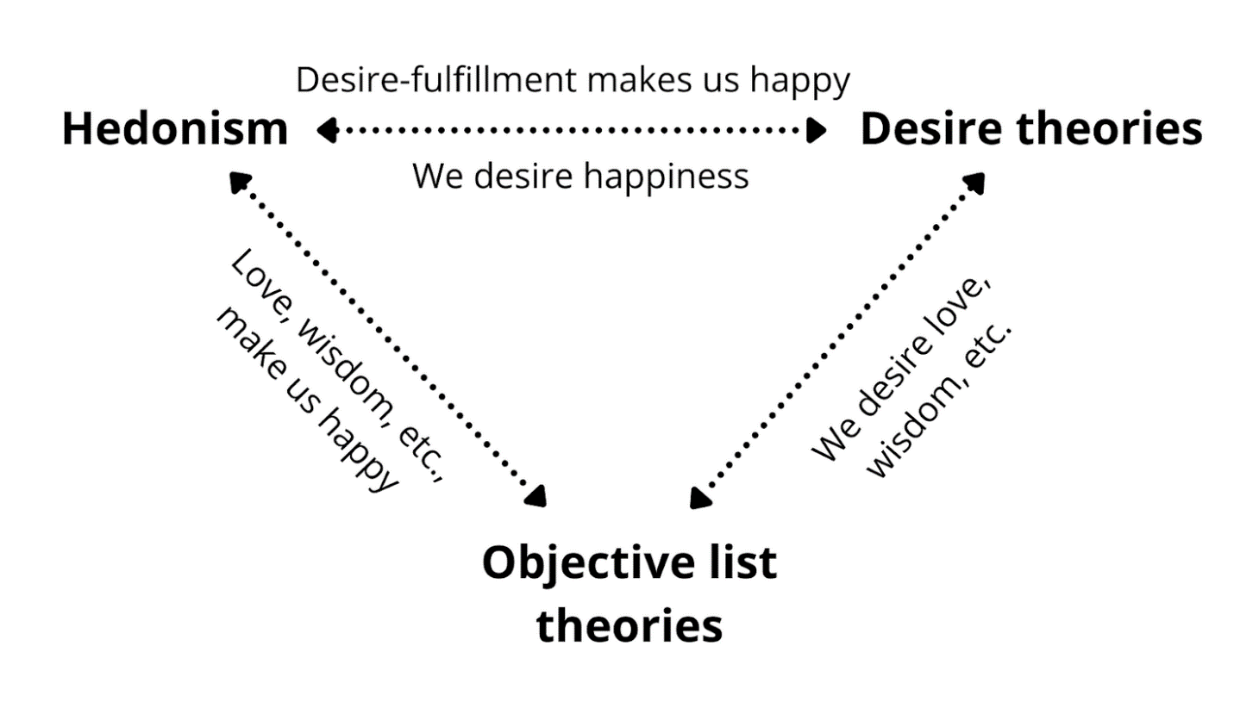
Damcaniaethau
Monig
yn erbyn
Plwralaidd
Notes:
https://utilitarianism.net/theories-of-wellbeing/#:~:text=What%20things%20are%20in%20themselves,theories%2C%20and%20objective%20list%20theories.

Slide 19
Theories
Monist
Vs
Pluralist
Notes:
https://utilitarianism.net/theories-of-wellbeing/#:~:text=What%20things%20are%20in%20themselves,theories%2C%20and%20objective%20list%20theories.

Slide 20

Modelau / Models

Slide 21
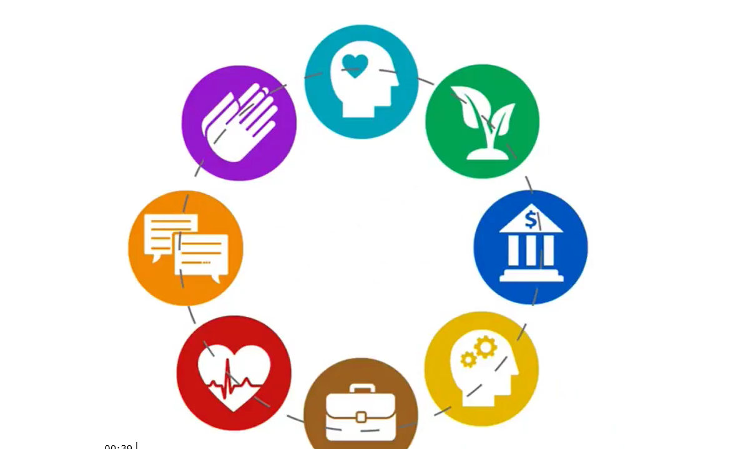
8 dimensiwn llesiant /
8 dimensions of wellbeing
Emosiynol / Emotional
Amgylcheddol / Environmental
Ariannol / Financial
Deallusol / Intellectual
Galwedigaethol / Occupational
Corfforol / Physical
Cymdeithasol / Social
Ysbrydol / Spiritual
(Stoewen, 2017)

Slide 22
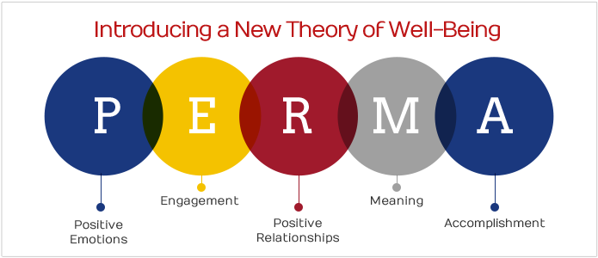
Damcaniaeth Llesiant Seligman /
Seligman’s Theory of Wellbeing (2011)
Emosiwn cadarnhaol
Ymgysylltiad
Perthnasoedd
Ystyr
Cyflawniad
PERMA
Positive emotion
Engagement
Relationships
Meaning
Accomplishment

Slide 23
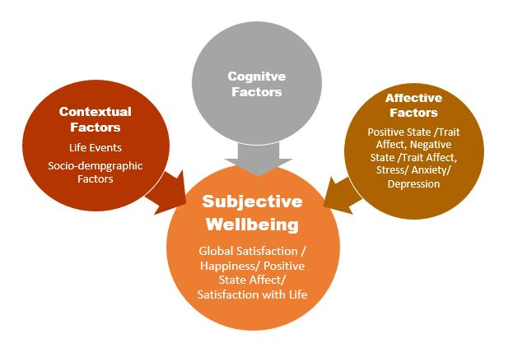
MODEL teiran O lesiant goddrychol
Diener a Ryan (2009)
Notes:
https://usq.pressbooks.pub/wellbeingineducationalcontexts/chapter/theoretical-conceptualisations-of-wellbeing/

Slide 24
TRIPARTITE MODEL OF SUBJECTIVE WELLBEING
Diener and Ryan (2009)
Notes:
https://usq.pressbooks.pub/wellbeingineducationalcontexts/chapter/theoretical-conceptualisations-of-wellbeing/

Slide 25
Llesiant Cyfannol
McCallum &
Price
Holistic Wellbeing
Perthnasoedd cadarnhaol
Cryfderau cadarnhaol
Cyfathrebu cadarnhaol
Ymddygiad cadarnhaol
Emosiwn cadarnhaol
Arweinyddiaeth gadarnhaol
Positive relationships
Positive strengths
Positive communication
Positive behaviour
Positive emotion
Positive leadership
(McCallum & Price, 2016, p. 144).
Notes:
Positive relationships – building and sustaining healthy relationships.
Positive strengths – developing and nurturing individual and group strengths.
Positive communication – establishing effective and safe communication strategies.
Positive behaviour – behaving in a way that welcomes a sense of belonging and connections to others and positive, peaceful and caring action.
Positive emotion – nurturing emotional health.
Positive leadership – scaffolding wellbeing through growing leaders with a democratic leadership style.
(McCallum & Price, 2016, p. 144).

Slide 26

Arall? Other?

Slide 27
A oes modd mesur llesiant?
Can well-being be measured?
Ystyriwch a yw lles yn rhywbeth y mae modd ei fesur?
Os felly, sut?
Consider whether well-being is something that can be measured?
If so, how?

Slide 28


PROSIECT SYG YNGHYLCH MESUR LLESIANT ONS PROJECT ON MEASURING WELL-BEING
Lansiwyd yn 2011
Y pedwar cwestiwn oedd:
  yn gyffredinol, pa mor fodlon ydych chi ar eich bywyd y dyddiau hyn?
  yn gyffredinol, pa mor hapus oeddech chi'n teimlo ddoe?
  yn gyffredinol, pa mor bryderus oeddech chi'n teimlo ddoe?
  yn gyffredinol, i ba raddau ydych chi'n teimlo bod y pethau rydych chi'n eu gwneud yn eich bywyd yn werth chweil?
(SYG, 2012)
Launched in 2011
Asked four key questions
  Overall, how satisfied are you with your life nowadays?
  Overall, how happy did you feel yesterday?
  Overall, how anxious did you feel yesterday
  Overall, to what extent do you feel the things you do in your life are worthwhile?
  (ONS, 2012)
Notes:
Measuring subjective well-being Four questions asking respondents to assess their own well-being (subjective well-being questions) were included on ONS’s largest household survey, the Integrated Household Survey (IHS) from April this year. This initiative was taken quickly because subjective well-being is not currently measured in large-scale UK-wide datasets, and there was recognition that the life satisfaction and happiness of individuals is an important component of national well-being. The four questions are: • overall, how satisfied are you with your life nowadays? • overall, how happy did you feel yesterday? • overall, how anxious did you feel yesterday? • overall, to what extent do you feel the things you do in your life are worthwhile?
Each is measured on a scale from 0 to 10. These questions will be asked of around 200,000 adults (aged 16 and over) each year. The first annual datasets for these questions will be published in July 2012; some information will be published on an interim basis before that. Statistics from these questions will be classed as ‘experimental’ to allow for further refinement and development.
ONS is also undertaking further testing and development of subjective well-being questions, including further questions on the ONS monthly Opinions Survey and will publish the first set of results in November 2011. This work will investigate aspects of well-being that were identified as strong themes in the national debate, such as a sense of purpose and fulfilment, relationships with family and friends, leisure time, job satisfaction, and a sense of community.

Slide 29
Y sefyllfa heddiw
The picture today
Darllenwch y dogfennau
  Personal Wellbeing in the UK April 2022 to March 2023
  Review of the UK Measures of National Wellbeing, October 2022 to March 2023
Ystyriwch
  Beth yw’r pwyntiau allweddol?
  A oes unrhyw ystadegau sy'n sefyll allan neu'n ymddangos yn arwyddocaol?
Read the documents
  Personal Wellbeing in the UK April 2022 to March 2023
  Review of the UK Measures of National Wellbeing, October 2022 to March 2023
Consider
  What are the key points?
  Are there any statistics that stand out or seem significant?

Slide 30
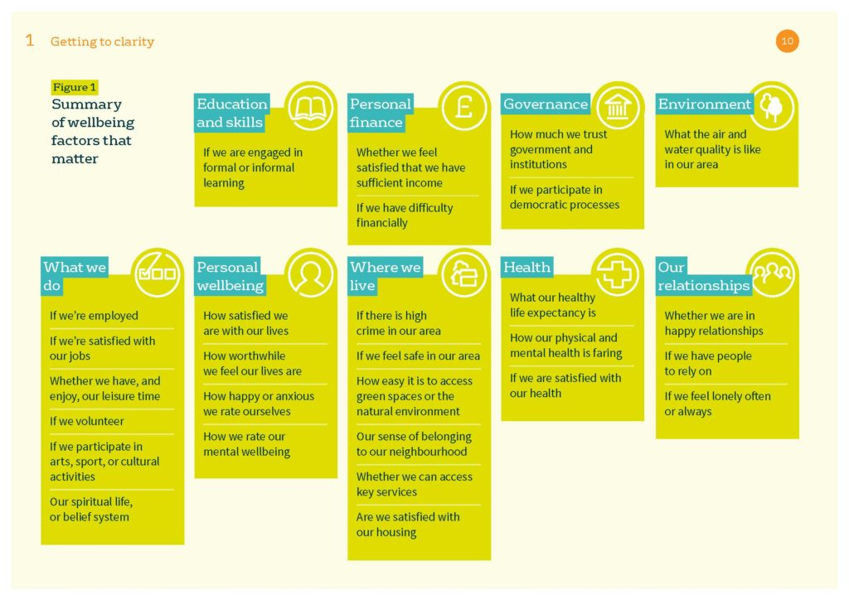
Beth sy'n bwysig ar gyfer llesiant?
What matters for well-being?
AROLWG SYG – Dynodwyd drwy drafodaeth genedlaethol
ONS SURVEY – identified through national debate
Notes:
Wellbeing, put simply, is about ‘how we are doing’ as individuals, communities and as a nation and how sustainable this is for the future.
We define wellbeing as having 10 broad dimensions which have been shown to matter most to people in the UK as identified through a national debate. The dimensions are: the natural environment, personal well-being, our relationships, health, what we do, where we live, personal finance, the economy, education and skills and governance.
Personal wellbeing is a particularly important dimension which we define as how satisfied we are with our lives, our sense that what we do in life is worthwhile, our day to day emotional experiences (happiness and anxiety) and our wider mental wellbeing.

Slide 31





5 Ffordd at Lesiant / 5 Ways to Wellbeing.
Mind (2023)
Notes:
https://www.mind.org.uk/workplace/mental-health-at-work/five-ways-to-wellbeing/
Discuss and consider how could these apply in an educational context for both staff and pupils/students.

Slide 32

Taith gerdded llesiant / Well-being walk
Mae'r ymarfer Saffari yma yn ffordd dda i helpu plant i ddysgu am ymwybyddiaeth ofalgar. Mae'r gweithgaredd yn troi taith gerdded pob dydd yn antur newydd gyffrous.
Dywedwch wrth eich plant y byddwch yn mynd ar saffari: y nod yw sylwi ar gynifer o adar, trychfilod, pryfed ac unrhyw anifeiliaid eraill â phosibl. Mae unrhyw beth sy'n cerdded, cropian, nofio neu hedfan o ddiddordeb, a bydd angen iddyn nhw ddefnyddio eu holl synhwyrau i'w darganfod, yn enwedig y rhai bach. (Karen Young, 2017).
Mae’r ymarfer yma yn ennyn yr un ymateb mewn plant ag y mae mynd am dro meddwlgarwch yn ei ysgogi mewn oedolion, sef cyflwr o ymwybyddiaeth a sylfaen yn y presennol.
The Safari exercise is a great way to help kids learn mindfulness. This activity turns an average, everyday walk into an exciting new adventure.
Tell your kids that you will be going on a safari: their goal is to notice as many birds, bugs, creepy-crawlies, and any other animals as they can. Anything that walks, crawls, swims, or flies is of interest, and they’ll need to focus all of their senses to find them, especially the little ones (Karen Young, 2017).
This exercise provokes the same response in children that a mindful walk elicits in adults: a state of awareness and grounding in the present.
Notes:
Advise to meet at Sail bridge / Allotments straight after lunch break.

Slide 33
Rhestr Gyfeiriadau/Reference List
https://whatworkswellbeing.org/about-wellbeing/what-is-wellbeing/
file:///C:/Users/helen.a.griffiths/AppData/Local/Packages/Microsoft.MicrosoftEdge_8wekyb3d8bbwe/TempState/Downloads/nsreporten_tcm77-230272%20(1).pdf
Psychology, Law, and the Wellbeing of Children
Monica K. Miller, Jared Chamberlain, and Twila Wingrove
Print publication date: 2014
Print ISBN-13: 9780199934218
Published to Oxford Scholarship Online: April 2014
DOI: 10.1093/acprof:oso/9780199934218.001.0001
Bradshaw, J. (ed). (2016) The well-being of children in the UK (4th edition) . Bristol University Press
Notes:
Needs updating!

