Slide 1
Academic writing skills

Slide 2
Paraphrasing & Summarising

Slide 3
Part one - paraphrasing

Slide 4
What is paraphrasing?
When writing academic assignments, you will need to strengthen your arguments by referring to (and evaluating) the ideas of other writers and scholars in the field.
It is best to put their ideas in your own words to show you have understood them.
Doing this effectively and respectfully is an important part of good academic practice.

Slide 5
Introduction
Reading at university usually leads to writing: for example, an essay, notes for a seminar, or ideas for a presentation.
This is really a process of turning reading into ‘your own words’.
The two main ways of doing this are paraphrasing and summarising.

Slide 6
Turning reading into writing
1.Inputs – reading material
2.Transformation process – reading, thinking, writing
3.Outputs – notes, summary, assignment

Slide 7
Don’t over-quote!
You can use some quotations in assignments, but it is generally better to paraphrase or summarise the ideas from other writers’ work.

Slide 8
Quotations
A quotation: is the exact words taken from the source.
Use quotation marks for a short quotation‘…’
Example: Smith (2010, p.221) states that ‘the Council spends £3.3 million each year on biofuel heating rather than £7 million it would spend if it still relied on oil and gas’.
Indent the text and use italics for longer quotations. Example:
It has been suggested that there are five key rules for hygiene maintenance within hospitality environments:
1 Wear a full, clean uniform and ensure that protective clothing is worn when necessary
2 Keep your hair covered when preparing food. Keep a beard or facial hair neat and trimmed
3 Do not wear jewellery or watches when handling food (although a plain wedding band can be an exception)
4 Keep your fingernails short and clean, with no visible signs of nail polish
5 Regularly wash your hands using the correct procedure (Holloway et al, 2017, p. 7).
These steps will ensure health and safety in food preparation areas.

Slide 9
Paraphrasing and summarising
Paraphrase: your understanding of the source in your own words (no page number needed in Harvard Referencing). It is usually about the same length as the original.
Example: Smith (2010) highlights that £3.7 million is saved on heating by the Council from changing to biofuel sustainable energy.
Summary: this is the overall understanding of the key idea, from a page, a couple of pages or a chapter and is shorter than the original.
Example: Smith (2010) suggests that the Council could save millions of pounds on heating from changing to sustainable energy.

Slide 10
Key steps to effective paraphrasing
1.Highlight important words / key terms (words that cannot be changed)
2.Find synonyms / alternative words for high frequency words
3.Change grammar: active to passive, nouns to verbs, adjectives to adverbs, word order
4.Check meaning

Slide 11
Example
Original Sentence: ‘Memory is the capacity for storing and retrieving information’ (Smith, 2017, p.21).
1. Choose key words that can not be changed
Memory has the capacity for storing and retrieving information (Smith, 2017, p.21)

Slide 12
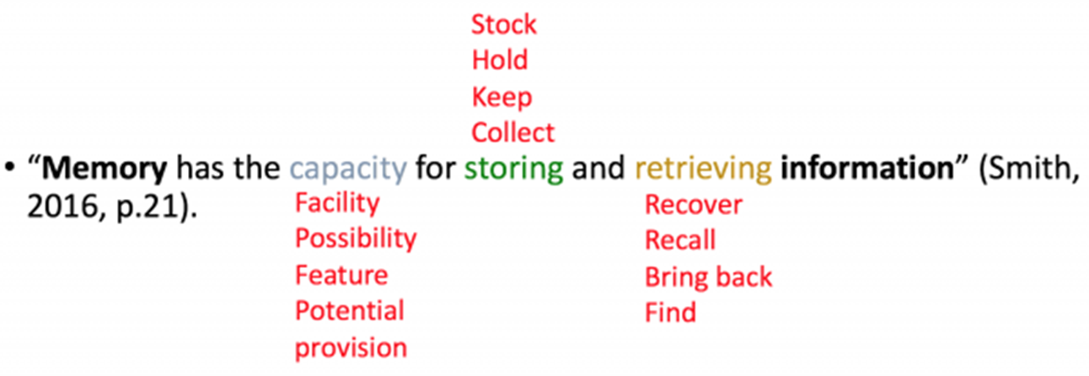
Example continued…..
2. Find Synonyms for the other words
Memory is the capacity for storing and retrieving information.
Use Word synonyms or thesaurus or do a Google search for synonyms:

Slide 13
Example continued….
3. Choose the words that are similar in meaning or change the form (storing to storage)
Memory is the facility for storage and recovering data.
[paraphrased sentence is acceptable]

Slide 14
Example continued…
4. Change the grammar, word forms and structure
Data recovery and storage are facilitated in the memory.
[paraphrased sentence is good]

Slide 15
Synonyms - practice
Which of the words below is a synonym for
…..The impact
force
effect
shock

Slide 16
Which of the words below is a synonym of …. on the economies and hence the political stability
balance
tendency
strength

Slide 17
Which of the words below is a synonym of …. heavily affected countries is a major cause for international concern
business
interest
worry

Slide 18
Which of the words below is a synonym of …. Their influence can be seen
watched
looked at
observed

Slide 19
Which is the best paraphrase?
Past epidemics and the long-term impact of diseases have been among the most potent forces shaping the current global distribution of population and cultures.
a) As a consequence of global distribution, people live in different parts of the world.
b) Because disease has affected many people in the world, their numbers are fewer.
c) The effects of disease around the globe have resulted in changes to where people live.

Slide 20
Past epidemics and the long-term impact of diseases have been among the most potent forces shaping the current global distribution of population and cultures.
Best paraphrase is (c): The effects of disease around the globe have resulted in changes to where people live.
This is because the original sentence says that disease has been one of the most potent forces shaping …distribution of population. This makes a cause–effect connection between disease and where people live.

Slide 21
Any questions on paraphrasing?

Slide 22
Part two - summarising
In academic writing you often have to summarise part of a book or journal article.
It is one of three ways of using another writer's work in your own words (the other two being quotation and paraphrase, as we have already seen). To summarise, you need to paraphrase.
Your summary may be just one or two sentences, to explain the main idea of the article or compare it with another text, or it might be much longer, up to 50% of the original.

Slide 23
Steps to summarising
You cannot just read a text and produce a summary. You will likely miss many of the main points, and include unnecessary detail. You may also fail to paraphrase appropriately, leading to a charge of plagiarism.
In order to write an effective summary, you need to follow certain steps.

Slide 24
5 steps to summarising
1) Skim the text, paying special attention to any headings or subheadings.
2) Read the text again more carefully, underlining/highlighting important information. Check any unknown words needed to understand the main points.
3) Make notes of the main points and supporting points (not supporting examples or details). Remember to use your own words so that you can paraphrase and avoid plagiarism.
4) Write the summary using your notes. Make sure you do not add anything which does not appear in the original (e.g. your own comments).
5) Check the summary to make sure you have covered all the main points. Make sure you have included a reference to the source.

Slide 25
Language to use
Although most of the language in the summary will depend on the content, there are some formulaic phrases which can be used in a summary to help to make it clearer.
These can be divided into three types:
1) the frame, which begins the summary;
2) reminder phrases, which are used throughout the summary;
3) and transition signals, which are used in certain parts of the summary.

Slide 26
The frame
The frame is the main idea of the article. This is usually included in the first sentence, with a reference to the author (through a citation) and the main idea or argument of the text.
You will also need to use a reporting verb.
Some examples of frames are shown below, for an article titled "The Global Warming Crisis" by F. Brown, published in 2014. These use the Harvard style of referencing.
  According to Brown (2014), ...
  Brown's (2014) article on global warming discusses...
  Brown (2014), in his article "The Global Warming Crisis", argues that...

Slide 27
Reminder phrases
It is useful to remind the reader, especially in a longer summary, that you are summarising another text.
This is done by using reminder phrases such as the ones shown below.
Using these also helps to avoid plagiarism, as these phrases include a citation, therefore making clear that the ideas are not your own (a mistake many students make is to just include a reference at the beginning, but if the summary is long, this is not enough).
The author goes on to say that...
The article further states that...
The author further states that...
Brown (2019) also states/ maintains/ argues/ believes that...
Brown (2019) concludes that...

Slide 28
Transition signals
Pay attention to the organisation of the original text, and use appropriate transition signals when organising the ideas in your summary.
For example, you may need:
comparison and contrast signals (e.g. on the other hand…; in contrast…; as opposed to…),
cause and effect signals (e.g. as a result…; therefore….; may be due to…)
classification signals (e.g. similarly….; likewise….; in the same way…) etc.

Slide 29
Finally
Don’t forget to check that your summary makes sense and captures the key points from your reading.

Slide 30
Any questions on summarising?
!

