Slide 2
BMHP6020_BIRM – Independent Project
Dissertation Research Methods
Searching for Information and Gathering Literature
Literature Tracking and Analysis Workbook

Slide 3
BMHP6020 Overview
Module Aim
To develop the ability of students to engage critically and innovatively with theory and/or practice relevant to their studied subject areas problem-solving produce a discipline specific in-depth project.
Module Learning Outcomes
Demonstrate intellectual skills in the identification of an appropriate topic, problem or challenge for investigation pertinent to their field of study and formulate a suitable plan for further research utilising relevant investigative methods in order to produce a response.
Evidence in-depth knowledge and critical understanding of principles necessary to underpin their education within their chosen field of study and problem-solving techniques applicable to this.
Evidence independence of thought and critical evaluation in the production of an independent piece of work, demonstrating transferable skills through exercising initiative and personal responsibility in planning own learning and self-management.
Organise their knowledge and learning through use of a range of media and present their work appropriately in a manner that can be understood by specialist and non-specialist audiences.

Slide 4
Session Aim & Learning Outcomes
Aim of the Session:
To support you to check, complete and improve Stage 1 of your Literature Tracking and Analysis Workbook by evaluating your sources using the CRAAP Test.
This work forms part of the research method you will later explain in your Academic Methods Poster and Chapter 3.
Learning Outcomes:
Check whether your sources are relevant to your research aim and objectives.
Apply the CRAAP Test to evaluate the quality and suitability of your sources.
Explain why a source is strong, weak or unsuitable.
Complete or substantially complete Stage 1 of your Literature Tracking and Analysis Workbook.
Begin identifying the five strongest and most relevant sources to take forward.

Slide 5
This Session We Will Focus On…
Reviewing Your Break Work
Checking Your 10 Sources
Applying and Improving the CRAAP Test
Completing Stage 1 of Your Workbook
Recording Your Method for the Academic Methods Poster and Chapter 3

Slide 6
Recap – What We Covered in Term 2
📝 Dissertation Proposal
🧩 Chapter 1: Introduction
🏛 Chapter 2: Background Information & Analysis
You planned and submitted your dissertation proposal
This included your working title, aim, rationale, and research objectives
The proposal set the foundation for your full dissertation project
📨 Feedback on Chapters 1 & 2
Defined your research question and overall aim
Explained the rationale (why this topic matters)
Set clear research objectives aligned to your aim
Provided context and key concepts relevant to your topic
Explored UK and international perspectives
Introduced relevant theory and contributors
Identified gaps in the literature
Linked back to your research question
You have now received written feedback on your Chapter 1 and Chapter 2 drafts
This feedback should be used to strengthen your work before final submission
Make sure to respond to feedback by editing, clarifying, or expanding where needed

Slide 7

Literature Analysis Workbook
Stage 1 – CRAAP Test Evaluation

Slide 8
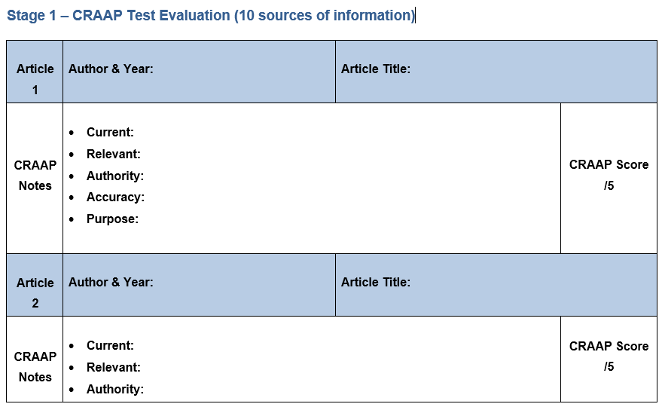
Your Literature Work During the Break
During the break, you were asked to begin Stage 1 of the Literature Tracking and Analysis Workbook. The purpose was not simply to collect any 10 sources. You needed to:
Find sources that directly relate to your research aim and objectives
Consider whether each source is credible, relevant and useful
Explain your CRAAP decisions rather than only giving a score
Keep a clear and organised record of your literature search
Save the full source and Harvard reference so that you can find it again
The Literature Tracking and Analysis Workbook can be found on the BMHP6020 Moodle Page in ‘Templates and Guidance’.
Stage 1 provides evidence of how you evaluated and selected your literature. This forms part of the research method you will later explain in your Academic Methods Poster and Chapter 3.
During this session, you will check, complete and improve this work. If Stage 1 is unfinished, you will have supported time to continue it.
Notes:
🧱 What You Did At Level 5 🧱
At Level 5, during your ‘Introduction to Research’ module, you laid the groundwork for conducting academic research. You practised searching for literature, identifying key terms, deciding what sources were useful, and organising your findings in a basic results table. You also began to group those findings into early themes.
Now, in Level 6, you’re not starting again, you’re building on that foundation!
💡 What You Learned at Level 5:
Searching for literature using keywords
Using basic inclusion and exclusion criteria to choose useful sources
Creating a simple results table with authors, aims, methods, and key findings
Starting to identify patterns or recurring ideas (early theme development)
Citing and referencing correctly using Harvard style
Learning to judge whether a source was trustworthy or not

Slide 9
Starting Point – Where are you now?
Open your Literature Tracking and Analysis Workbook. Which statement best describes your current position?
I have not yet found 10 suitable sources.
I have 10 sources, but some CRAAP evaluations are incomplete.
I have completed CRAAP for all 10 sources, but some of my explanations need improving.
I have completed Stage 1 and I am ready to identify my five strongest sources.
Notes:
🧱 What You Did At Level 5 🧱
At Level 5, during your ‘Introduction to Research’ module, you laid the groundwork for conducting academic research. You practised searching for literature, identifying key terms, deciding what sources were useful, and organising your findings in a basic results table. You also began to group those findings into early themes.
Now, in Level 6, you’re not starting again, you’re building on that foundation!
💡 What You Learned at Level 5:
Searching for literature using keywords
Using basic inclusion and exclusion criteria to choose useful sources
Creating a simple results table with authors, aims, methods, and key findings
Starting to identify patterns or recurring ideas (early theme development)
Citing and referencing correctly using Harvard style
Learning to judge whether a source was trustworthy or not

Slide 10
You are carrying out your Research Method
Your research method is not something that you write about only at the end. It includes the decisions you make throughout the research process:
Search for sources
Evaluate their quality
Select the strongest evidence
Analyse the evidence
Develop themes
Explain the process
The record you create in your workbook will help you demonstrate that your literature was selected through a clear and structured process rather than personal choice. You will explain this process later in: Element 2: Academic Methods Poster and Chapter 3 of your dissertation.
This sessions stage: Evaluate the quality and suitability of your sources.
Notes:
🧱 What You Did At Level 5 🧱
At Level 5, during your ‘Introduction to Research’ module, you laid the groundwork for conducting academic research. You practised searching for literature, identifying key terms, deciding what sources were useful, and organising your findings in a basic results table. You also began to group those findings into early themes.
Now, in Level 6, you’re not starting again, you’re building on that foundation!
💡 What You Learned at Level 5:
Searching for literature using keywords
Using basic inclusion and exclusion criteria to choose useful sources
Creating a simple results table with authors, aims, methods, and key findings
Starting to identify patterns or recurring ideas (early theme development)
Citing and referencing correctly using Harvard style
Learning to judge whether a source was trustworthy or not

Slide 11
Stage 1: What Are You Recording? 🔍
WHO wrote the source?
The author or organisation
1
WHAT is the source called?
The full title of the source
3
WHAT did you find?
Write a clear explanation for: Currency, Relevance, Authority, Accuracy and Purpose
4
HOW strong is the source?
Use your CRAAP findings to give an overall score out of five.
5
WHEN was the source published?
The year of publication
2
Complete this process 10 times, once for each of your 10 sources.
Stage 1 creates a clear record of how you checked the quality and suitability of your literature.
Do not write only “yes”, “no”, “good” or “relevant”. Explain the reason for your decision.
For this session, focus only on CRAAP. Detailed analysis and theme development will come in Session 2.

Slide 12
📖 Is the Source Suitable for Your Project?
Before completing CRAAP, check whether the source is suitable for your particular project.
Does it directly relate to my research aim or objectives?
Does it focus on the correct topic?
Does it include the population or group I am studying?
Is the country, setting or context suitable?
Does it meet my inclusion criteria?
Can I access enough of the source to understand and evaluate it?
Does it contain evidence that I could use in my dissertation?
Make a Decision
KEEP ✔️
It clearly matches your project and provides useful evidence.
RECONSIDER ❓
It partly matches, but you need to check it more carefully.
REPLACE ❌
It does not match your topic, population or context, or you cannot access enough information.
When reviewing a source ask yourself
A source may be credible but still unsuitable for your project if it does not help you answer your research question.
A good-quality source is not automatically a relevant source.
Lets do an activity on the next slide

Slide 13
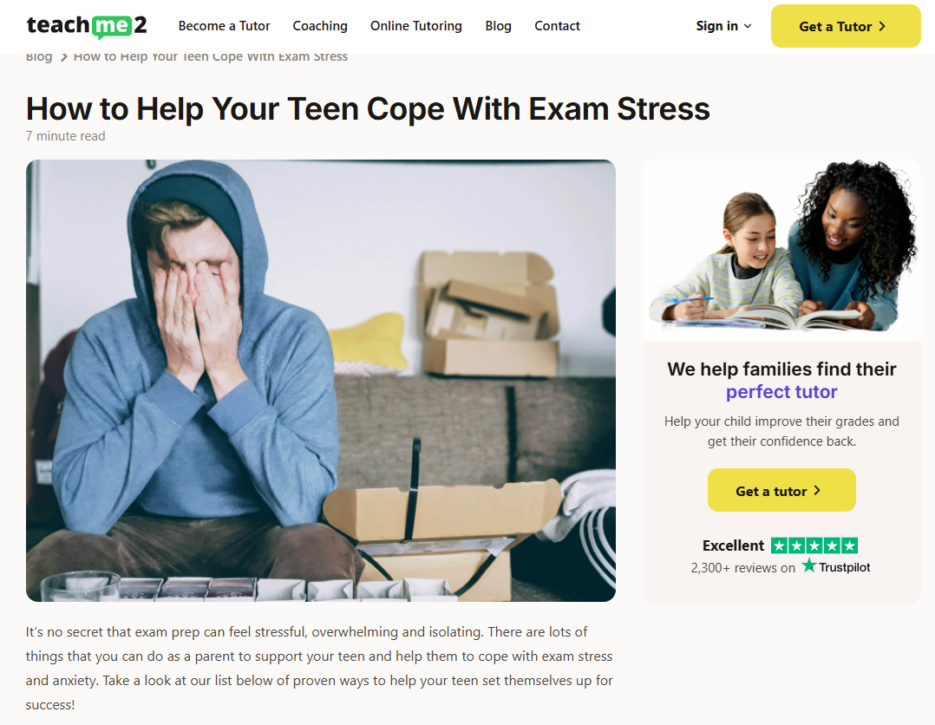
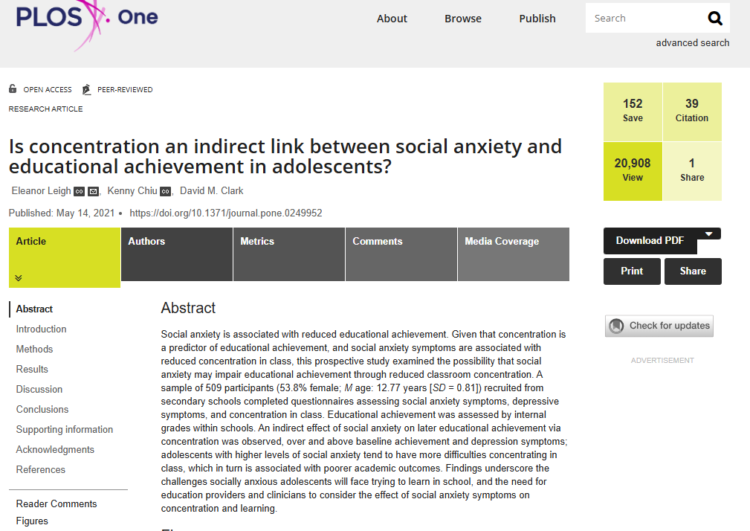
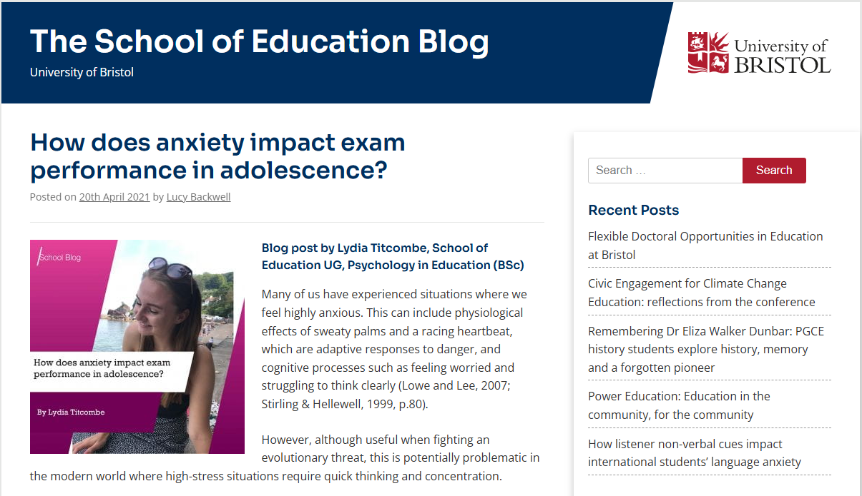
❓ Group Activity Part 1: Which Source Would You Use?
Research title: How does anxiety affect academic achievement in teenagers in the UK?
Is concentration an indirect link between social anxiety and educational achievement in adolescents?
How does anxiety impact exam performance in adolescence?
How to Help Your Teen Cope With Exam Stress
Look at all three sources and for each source, decide:
What type of source is it?
Does it relate to the research title?
Who wrote or published it?
4. Does it provide research evidence?
5. Why was the information published?
6. Would you keep ✔️, reconsider ❓ or replace ❌ it?

Slide 14
❓ Group Activity Part 2: Which Source Would You Use?
Research title: How does anxiety affect academic achievement in teenagers in the UK?
Source A: Is concentration an indirect link between social anxiety and educational achievement in adolescents?
Source B: How does anxiety impact exam performance in adolescence?
Source C: How to Help Your Teen Cope With Exam Stress
It provides general advice rather than research evidence.
There is no clearly identified research method or sample.
Its claims are not supported by a formal reference list.
The website is also promoting tutoring services.
It is not strong enough to be one of your main academic sources.
It is a peer-reviewed research article.
The researchers and their universities are identified.
It explains the sample, method and findings.
It is closely related to anxiety and educational achievement.
It provides original evidence for the dissertation.
It is on a trustworthy university website.
It has a named writer and publication date.
It is relevant and refers to research.
However, it is a student-written blog, not a peer-reviewed study.
It may help you understand the topic, but you should follow its references and find the original research
KEEP ✔️
RECONSIDER ❓
REPLACE ❌

Slide 15
What is the CRAAP Test?
The CRAAP Test helps you decide whether a source is trustworthy, relevant and strong enough to use in your dissertation.
C:
Currency
When was the information published or updated?
R: Relevance
Does the information help you answer your research question?
A: Authority
Who created the information, and are they qualified?
A:
Accuracy
Is the information supported by evidence that can be checked?
P:
Purpose
Why was the information published?
One Strength Does Not Make a Source Reliable
A recent source may still contain inaccurate information.
A source written by an expert may not be relevant to your question.
A source with a relevant title may not provide useful evidence.
A source on a university website may not be a peer-reviewed article.
A source can be useful for background reading but not strong enough to be one of your main sources.
Use all five parts of CRAAP together. Make a judgement about the source as a whole

Slide 16
C stands for Currency 📆
Currency means checking how recent the information is.
Ask yourself:
When was the source published?
Has the source been updated?
Does it meet my date-related inclusion criteria?
Has important research, policy or legislation changed since it was published?
Is it recent enough for the purpose for which I want to use it?
Remember: Older does not always mean useless!
An older source may still be useful if it:
introduces an important theory
provides an original definition
is a key or influential piece of research
helps explain how understanding has developed
is a seminal text
However, you should normally use recent evidence when discussing current experiences, statistics, policy or practice.
When Is Recent Evidence Important?
You should normally use recent evidence for:
statistics
policy and legislation
professional guidance
current services and practice
changing health and social issues
Before You Decide
Ask:
Does it meet my inclusion criteria?
Has anything important changed?
Is newer evidence available?
Can I explain why this date is appropriate?
Current enough does not always mean the newest source available. It means the date is appropriate for the information you need.

Slide 17
Currency: Explaining your Decision 📆
Currency means checking how recent the information is.
Literature Tracking Example: Weak Explanation
“This source was published in 2006, so it is old and I cannot use it.”
Literature Tracking Example: Strong Explanation
“This article was published in 2021. It meets the inclusion criterion of sources published within the last ten years and provides reasonably recent evidence about anxiety and educational achievement.”
Why is this weak?
It does not mention the inclusion criteria.
It does not explain why the date matters.
It assumes that every older source is unsuitable.
It does not consider whether the source is seminal.
What If the Date Is Missing?
Check the article and journal webpage.
Search the complete title or DOI.
Do not use the date you accessed the source.
If no date can be found, record:
“No clear publication date was identified.”
Treat this as a warning and reconsider or replace the source, especially if you need current evidence.
Quick Question 💭
Would a source from 2006 automatically be unsuitable?
Answer: An older source may still be useful if it is seminal, introduces an important theory or provides historical context. However, recent evidence should normally be used for statistics, policy and current practice.

Slide 18
📌 R stands for Relevance
Relevance means checking how closely the source connects to your individual research project.
Ask Yourself
Does the source directly relate to my research aim or objectives?
Does the source focus on the correct topic?
Does the source include the population I am studying?
Is the country, setting or context appropriate?
Does the source provide evidence I can use?
Which part of my dissertation will the source support?
How Relevant Is the Source?
Highly Relevant
matches your topic
matches your population and context
directly supports your aim or objectives
provides evidence you can use
Decision: Keep ✔️
Partly Relevant
relates to your topic
has a different population, country or setting
may provide background or comparison
Decision: Use carefully❓
Not Relevant
only mentions your general topic
does not support your aim or objectives
provides no evidence you can use
Decision: Replace ❌
Look for Four Important Matches
Topic
Does it examine the issue you are researching?
Population
Does it include the people or group you are studying?
Context
Does the country, service or setting match your project?
Evidence
Does it provide findings that help answer your question?

Slide 19
📌 Relevance: Explaining your Decision
Relevance means checking how closely the source connects to your individual research project.
Literature Tracking Example: Weak Explanation
“This article is relevant because it is about anxiety.”
Literature Tracking Example: Strong Explanation
“This article examines the relationship between social anxiety and educational achievement in adolescents. The topic and population match my research question, and the findings could support the discussion in Chapter 4.
Why is this weak?
It only identifies the general topic.
It does not mention the research question.
It does not check the population or context.
It does not explain how the evidence will be used.
Common Relevance Mistakes
Be careful not to:
choose a source from its title alone
assume that matching one keyword makes it relevant
ignore differences in age, population, country or setting
confuse useful background information with direct research evidence
keep a source simply because you have already spent time reading it
Read the abstract and check the population, setting and findings before deciding.
Quick Question 💭
A recent, peer-reviewed article explores anxiety among American university students. How relevant would it be to a project about teenagers in the UK? Explain your decision.
Answer: It would be partly relevant. It may provide useful background or comparison, but the age group, country and educational setting do not match the project. It should not be used as the main evidence unless its inclusion can be clearly justified.

Slide 20
A stands for Authority 🖋️
Authority means checking who created the information and whether they have suitable knowledge or expertise.
Ask Yourself
Is the author or organisation clearly identified?
What qualifications or experience do they have?
Are they knowledgeable about this particular subject?
Are their university or workplace details provided?
Who published the information?
Has the source been peer reviewed?
Who Might Have Authority?
Authority may come from:
a researcher with relevant expertise
a recognised university or research organisation
the NHS or a government department
a professional body
a recognised charity working within its specialist area
Remember:
An organisation can be the author.
An NHS or government publication may not name one individual writer. In this case, check whether the organisation has suitable expertise and responsibility for the subject.
Authority Has Two Parts
The creator
Who wrote or produced the information?
Do they have relevant expertise?
Can their qualifications or experience be checked?
The publisher
Where was the information published?
Is the journal or organisation recognised?
Was the information checked before publication?
Authority must relate to the particular topic.
Being qualified in one area does not make someone an expert in every subject.
Notes:
Quick Question answer:
Not automatically. The students should check:
whether the writer has mental health qualifications or experience
whether they have researched this particular subject
where the information was published
whether the information has been peer reviewed
whether the claims are supported by recognised evidence

Slide 21
Authority: Explaining your Decision 🖋️
Authority means checking who created the information and whether they have suitable knowledge or expertise.
Literature Tracking Example: Weak Explanation
“This source is reliable because it is on a university website.”
Literature Tacking Example: Strong Explanation
“The article has named authors with relevant psychology and research expertise. Their university affiliations are provided, and the article was published in the peer-reviewed journal PUBMED. This gives the source strong authority.”
Why is this weak?
It does not identify the writer.
It does not check their qualifications.
It does not identify the type of source.
Not everything on a university website is peer reviewed.
If the Author Is Not Clear
Check the first and last pages.
Look for an author profile.
Check the journal or organisation’s website.
Search the author’s name and workplace.
Look for an “About Us” page.
If you cannot confirm who created the information or their expertise, reconsider the source.
Quick Question 💭
A source about teenage anxiety is written by a qualified teacher. Does being a teacher automatically make the writer an authority on mental health? What else would you need to check?
Not necessarily. A teacher has expertise in education but may not have expertise in mental health. Check their mental health qualifications, research experience, publisher and supporting evidence before deciding.

Slide 22
🎯 A stands for Accuracy
Accuracy means checking whether the information is supported by evidence that can be traced and checked.
Ask Yourself
Are the main claims supported by references?
Can I trace statistics back to their original source?
Is the research method clearly explained?
Are the sample and data described?
Do the findings support the conclusions?
Has the information been peer reviewed?
Are there obvious factual, spelling or referencing errors?
Accuracy Has Four Important Parts
Evidence
Are claims supported by research, data or references?
Method
Does the source explain how the evidence was collected?
Traceability
Can you follow references and statistics back to their original source?
Consistency
Do the data, findings and conclusions agree with each other?
Good Signs That a Source Is Accurate
The claims are supported by evidence
Statistics are linked to their original source
The research method and sample are explained
References can be traced and checked
The researchers acknowledge limitations
The findings support the conclusion
Numbers, graphs and references do not automatically make information accurate. You must check where they came from.

Slide 23
🎯 Accuracy: Explaining your Decision
Accuracy means checking whether the information is supported by evidence that can be traced and checked.
Literature Tracking Example: Weak Explanation
“This source is accurate because it contains statistics and references.”
Literature Tracking Example: Strong Explanation
“The source clearly explains how the participants were selected and how the data was collected. The findings are presented clearly, and the main claims are supported by references that can be checked.”
Why is this weak?
It does not check where the statistics came from.
References can also be weak or unsuitable.
A statistic may be presented without its full context.
It does not examine how the evidence was collected.
Accuracy Warning Signs
Be cautious if a source:
Makes important claims without evidence
Gives statistics without naming the original source
Does not explain the research method or sample
Presents opinions as facts
Reaches conclusions that are not supported by the findings
Ignores limitations or conflicting evidence
Contains errors or contradictory information
Uses references that cannot be traced or checked
Quick Question 💭
Two academic sources give different statistics about teenage anxiety. Does this automatically mean that one source is inaccurate?
What would you check before deciding?
No. Both statistics could be accurate but may measure different things. Check the dates, populations, countries, sample sizes, definitions and research methods before comparing them.
Notes:
Quick Question answer:
No. Different statistics do not automatically mean that one source is inaccurate.
Students should check:
the publication dates
how anxiety was defined and measured
the ages and number of participants
the country or setting
how participants were selected
the research methods used
The sources may both be accurate but may have studied different groups, used different definitions or collected information in different ways.

Slide 24
P stands for Purpose 🚨
Purpose means checking why the information was created and whether this has influenced how it is presented.
Ask Yourself
Why was the information published?
Is it intended to inform, educate, persuade, entertain or sell?
Who is the intended audience?
Does it present evidence or mainly opinion?
Is the language balanced or emotional?
Who funded or sponsored the information?
Are any conflicts of interest declared?
What Is Bias?
Bias means presenting information in a way that favours one viewpoint, belief, organisation or outcome.
Purpose or bias may influence:
Which evidence is left out
The language used
How findings are explained
The conclusions presented
Which evidence is included
Common Purposes of Information
Information may be created to:
Report research findings
Educate or raise awareness
Provide professional guidance
Campaign for change
Express an opinion
Attract attention
Promote a service
Sell a product
Having a particular purpose does not automatically make a source unreliable.
A charity may campaign for change while providing strong evidence. A company may publish accurate information while also promoting a service.
Ask: Is the source trying to inform me, influence me or sell something to me, and how might this affect the information presented?
Notes:
Quick Question answer:
No. Different statistics do not automatically mean that one source is inaccurate.
Students should check:
the publication dates
how anxiety was defined and measured
the ages and number of participants
the country or setting
how participants were selected
the research methods used
The sources may both be accurate but may have studied different groups, used different definitions or collected information in different ways.

Slide 25
Purpose: Explaining your Decision 🚨
Purpose means checking why the information was created and whether this has influenced how it is presented.
Example: Weak Explanation
“This source has a good purpose because it is trying to help people.”
Example: Strong Explanation
“This webpage was published by a company selling anxiety supplements. Its purpose is partly commercial because the company may benefit if readers believe its claims. It would be beneficial to check the evidence independently before using the information.”
Why Is This Weak?
It does not identify the actual purpose.
It does not consider who published it.
It does not check whether anything is being promoted or sold.
It does not examine whether the information is balanced.
It does not consider funding or possible bias.
Purpose Warning Signs
Be cautious if a source:
uses dramatic or emotional language
promises guaranteed results
presents only one side of an issue
tries to frighten or pressure the reader
promotes a product or service
hides who funded the information
makes claims without supporting evidence
Quick Question 💭
A mental health charity publishes a report to raise awareness and campaign for change. Does its campaigning purpose automatically make the report unreliable?
No. The report may still provide reliable evidence.
Check its research method, references, funding and use of language, and compare its claims with other reliable sources.

Slide 26

CRAAP Test Video Recap🎬
Watch the Video: Evaluating Resources with CRAAP
As you watch, check that you can remember:
what each letter means
what you should check
what might weaken a source
why all five areas must be considered
Quick Question 💭
Which CRAAP area do you think requires the most judgement?

Slide 27
Not Every Source Should Score 5/5 📝
The CRAAP score is an overall judgement about the strength of the source for your particular project.
Score | What Does It Mean?
5/5 | Exceptionally strong for your project, with no important concerns.
4/5 | A strong and usable source with a minor limitation.
3/5 | Useful, but has clear limitations and should be used carefully.
2/5 | Several concerns. Unlikely to be one of your strongest sources.
1/5 | Major problems. The source should normally be replaced.
Your Score Should Match Your Notes
If you identify several weaknesses, the source should not receive 5/5.
A peer-reviewed source is not automatically 5/5.
A source may be reliable but only partly relevant.
One serious accuracy problem may outweigh several strengths.
Different sources should normally receive different scores.
You are not trying to prove that every source is good. You are identifying which sources are strongest.

Slide 28
Stage 1 Expectations: What Must You Complete? ✔️
Stage 1 must contain 10 sources. For every source, record:
The author or organisation
1
The publication year
2
The full source title
3
A specific explanation for each part of CRAAP
4
An honest overall score out of five
5
The complete Harvard reference
6
Your CRAAP Notes Should Include Evidence
For example:
The actual publication date
How the source connects to your project
The author’s relevant expertise
The method, sample or supporting evidence
The reason the information was published
Explanations to Avoid
one-word answers
writing only “yes”, “good” or “relevant”
copying the abstract
using the same explanation for every source
awarding 5/5 without clear justification
hiding or ignoring weaknesses

Slide 29
Activity Part 1: Find or Check One of Your Sources ✏️
Choose the route that matches your current position.
Route A
I already have sources
Route B
I need to find a source
Open your Literature Tracking and Analysis Workbook.
Choose one source you have not fully evaluated or are unsure about.
Open the complete source.
Look at your research title, aim and objectives.
Select two or three important keywords.
Search the UWTSD Library or an appropriate academic database.
Find and open one possible source.
Is Your Source Suitable?
Before moving on, everyone should ask:
Does it directly relate to my aim or objectives?
Does it match my topic and population?
Is the country, setting or context suitable?
Does it meet my inclusion criteria?
Can I access enough of the source to evaluate it?
What useful evidence could it contribute?

Slide 30
📝 Activity Part 2: Apply the CRAAP Test
Evaluate your source using all five parts of CRAAP.
Currency
When was the source published?
Is the source recent enough for your project?
Relevance
How does the source relate to your research question, aim or objectives?
Authority
Who wrote or produced the source?
Are they qualified or experienced in this subject?
Accuracy
Is the information supported by research, evidence and references?
Purpose
Why was the source produced?
Is it intended to inform, persuade, advertise or sell?
Record Your Decision
Write one or two clear sentences for each part of CRAAP.
Do not write only “yes”, “no”, “good” or “relevant”.
Give the source an overall score out of five.
Record your evaluation in Stage 1 of your workbook.
Decide whether to
Keep ✔️ Reconsider ❓ or
Replace ❌ the source.

Slide 31
Before the Next Session: Complete Stage 1 🎯
Fully complete Stage 1 of the Literature Tracking and Analysis Workbook. You must have 10 suitable sources.
For Every Source, Record:
The author or organisation
The publication year
The full title
Specific notes for currency, relevance, authority, accuracy and purpose
An honest CRAAP score out of five
The complete harvard reference
Identify Your Strongest Five
Highlight the five sources that provide the strongest combination of:
academic quality
relevance to your research question
trustworthy evidence
usefulness for your dissertation
Do not choose your strongest five from the score alone. Consider what each source contributes to your project.
Need Help? – Help can be accessed below from
the completed workbook example
the UWTSD Library and academic databases
Cite Them Right for Harvard referencing
Study Skills and Library support
All this information can be found on the BMHP6020 Moodle Page in the ‘Links and Resources’ and ‘Templates and Guidance’ Tiles
In our next session, we will analyse your strongest sources and begin developing your themes which is Stage 2 of your Literature Tracking and Analysis Workbook.

