Slide 1
Gender and History Workshop

Slide 2
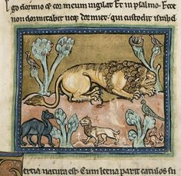
Who drew the lion?
Women’s history, feminism and gender

Slide 3
Workshop
Please prepare for discussion by thinking about the following questions.
What do you understand by the terms ‘feminist history’ and ‘gender history’?
Do you find these helpful approaches to history or do you perceive limitations?

Slide 4
GENDER
An orthodoxy of gender studies is that gender is a SOCIAL and CULTURAL CONSTRUCT
  What does the notion of gender as a ‘social/cultural construct’ mean to you? Can you think of examples or evidence to support this preposition?

Slide 5
GENDER
An orthodoxy of gender studies is that gender is a SOCIAL and CULTURAL CONSTRUCT
  What does the notion of gender as a ‘social/cultural construct’ mean to you?
  How might ‘gender’ differ from ‘sex’ as a categorisation?
  How ‘masculinity’ and ‘femininity’ differ from ‘male’ and ‘female’ as categorisations?
  Interpret the following quotation: ‘One is not born a woman, one becomes one’ Simone de Beauvoir, 1949

Slide 6
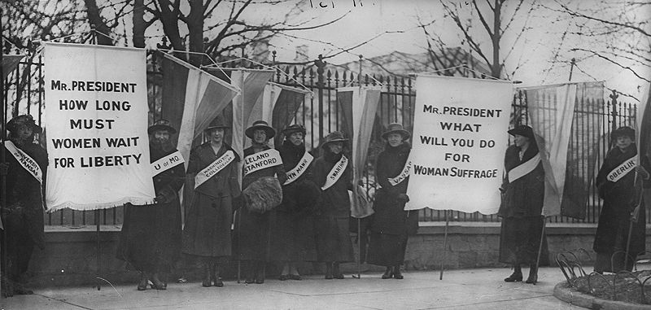
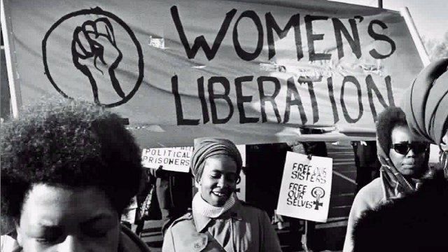
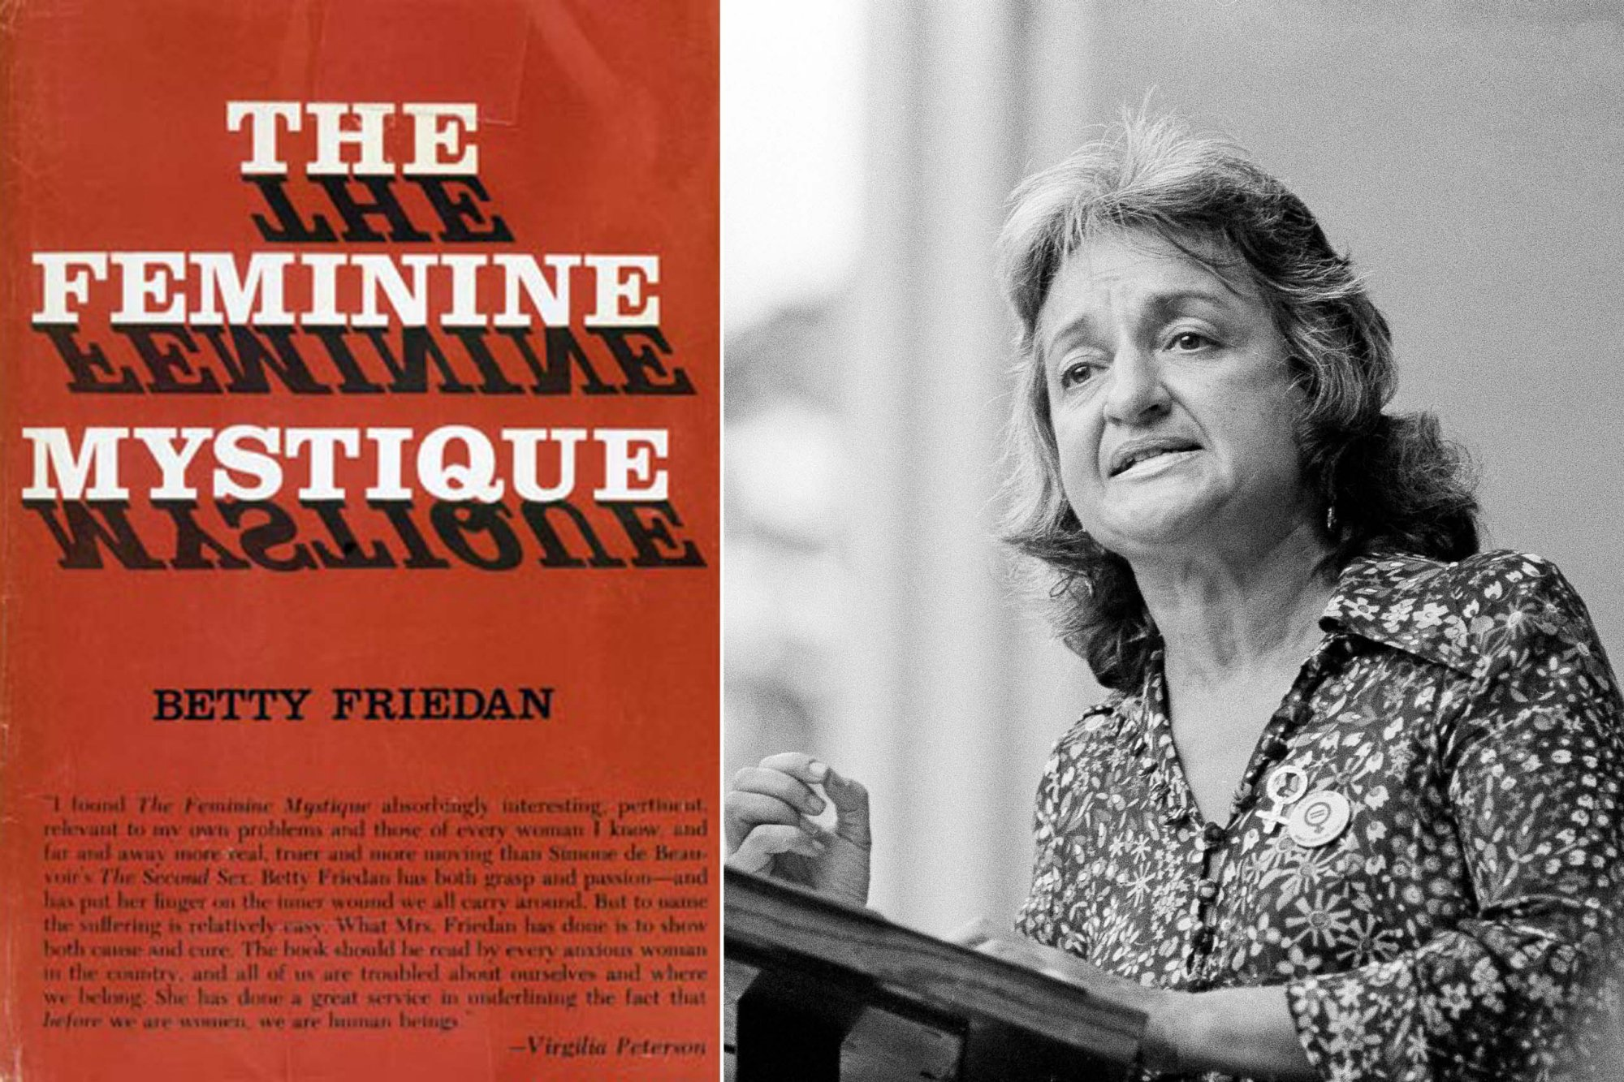
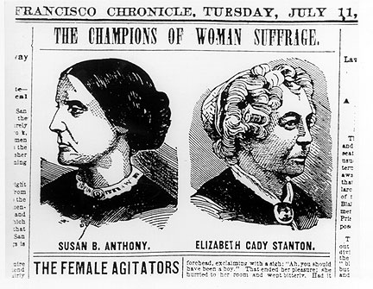
Feminism ‘Waves’
Second-Wave (1960s, 1970s)
First-Wave (c. mid-to-late 19th/early 20th centuries)

Slide 7


Feminism ‘Waves’
Third-Wave (c. 1990s–)
‘Fourth-Wave’ (2010s–)
Emphasis on broader demographics
  Homosexuality
  Developing word
  Less white-, middle-class-oriented
Key phrase: intersectionality
‘Millennials’
Emphasis on and use of technology – especially internet and social media
Broader emphasis on trans issues

Slide 8


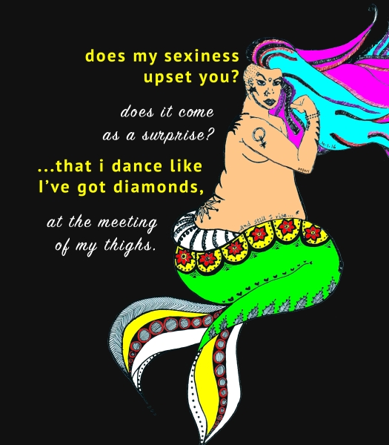
Fourth-Wave Feminism: re-appropriating stereotypes

Slide 9
Workshop
  Take a case study and consider how traditional interpretations may be challenged by adopting a feminist or gender approach.
  Take a subject – childhood, sex, marriage, power, lifestyle etc – and think about how feminist or gender approaches can help our understanding or interpretation.

Slide 10
Workshop
  How might a gender studies and/or feminist approach offer extra insights into the following:
  Norman Identity and Myth
  Enlightenment
  Cultural History of Cities
  1980s Britain and the United States
  Saints in the Middle Ages
  Canterbury Tales

