Slide 1
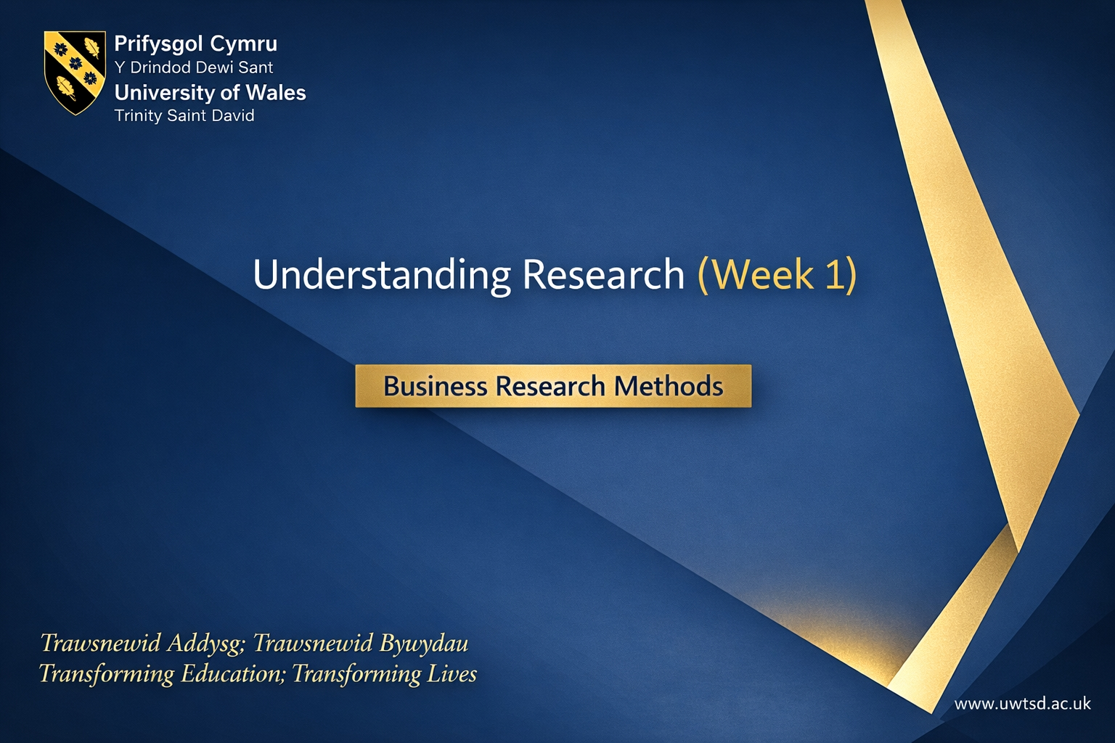
Undestanding Research (Week 1)
Business Research Methods

Slide 2

Contact Details
Lan Zhang (Maggie)
l.zhang@uwtsd.ac.uk

Slide 3

Module Learning Outcomes
Upon the successful completion of this module, the student should be able to:
Critically evaluate the contexts for using research techniques, the philosophical underpinnings, strengths and limitations of research techniques;
Evaluate qualitative and quantitative research principles and approaches;
Apply analysis techniques in order to address a particular research question;
Design and write a research proposal, with particular attention to contemporary methodological approaches, data sources, sampling and research design.

Slide 4
Assignment: Research Proposal
Mode of assessment | Volume | Weighting
Report | 5,000 words | 100%
https://moodle.uwtsd.ac.uk/course/view.php?id=12027#section-1

Slide 5
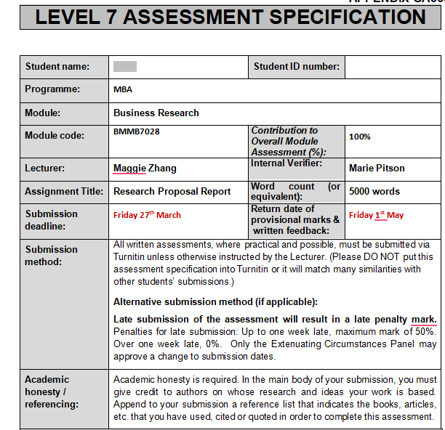

Slide 6
Assignment: Research Proposal (5,000 words)
You are tasked with developing a comprehensive research proposal to investigate a chosen business research area. In your proposal, you should address the key components of a research plan, including:
the background,
research questions,
objectives,
methodology,
data analysis,
significance of the study,
ethical considerations,
limitations,
and a tentative timeline

Slide 7
Week | Theme | Key Proposal Section to Draft
1 | The Foundation | Background, RQs & Objectives (Focus: Moving from a broad topic to a specific 'Gap')
2 | The Context | Significance & Literature Review (Focus: Theoretical vs. Practical value)
3 | Methodology I (Strategy) | Research Philosophy & Approach (Focus: Positivism vs. Interpretivism; Inductive vs. Deductive)
4 | READING WEEK | No Classes. Focus on drafting the Methodology section.
5 | Methodology II (Tactics) | Data Collection Methods (Focus: Interviews, Surveys & Sampling strategies)
6 | The Mechanics | Data Analysis Framework (Focus: How will you analyse the data? e.g., SPSS or Thematic Analysis)
7 | The Feasibility | Ethics, Limitations & Timeline (Focus: Gantt Charts & Ethical Approval Forms)
8 | Final Assembly | Final Proposal Review & Dissertation Preview (Focus: Consistency check & the transition to the full project)

Slide 8
Key Topics of Week 1
What is Level 7 research? (Contribution to knowledge vs. business consultancy)
Brief overview of the Research Proposal
Formulating aim and objectives

Slide 9

What is Research?

Slide 10

Defining Research
“Research is a systematic inquiry to describe, explain, predict, and control the observed phenomenon.”
Babbie (2007)
“Any creative systematic activity undertaken in order to increase the stock of knowledge, including knowledge of man, culture and society, and the use of this knowledge to devise new applications.”
OECD (2001)
“Research is defined as the creation of new knowledge and/or the use of existing knowledge in a new and creative way so as to generate new concepts, methodologies and understandings. This could include synthesis and analysis of previous research to the extent that it leads to new and creative outcomes.”
Song (2021)

Slide 11

What is Research?
Is it a mysterious thing that only special people can do?
Jon Hrubesch

Slide 12



Or is it a Skill that can be developed?

Slide 13
What is Research?
Research is the activity of finding out about a subject in a systematic way.
The subject of the research can be simple or complex – but it needs a clear question to be explored
This module will explore the Skills that are required to do Research
These Skills are important for you to be able to do the Dissertation

Slide 14
Topic 1
What is Level 7 research?

Slide 15
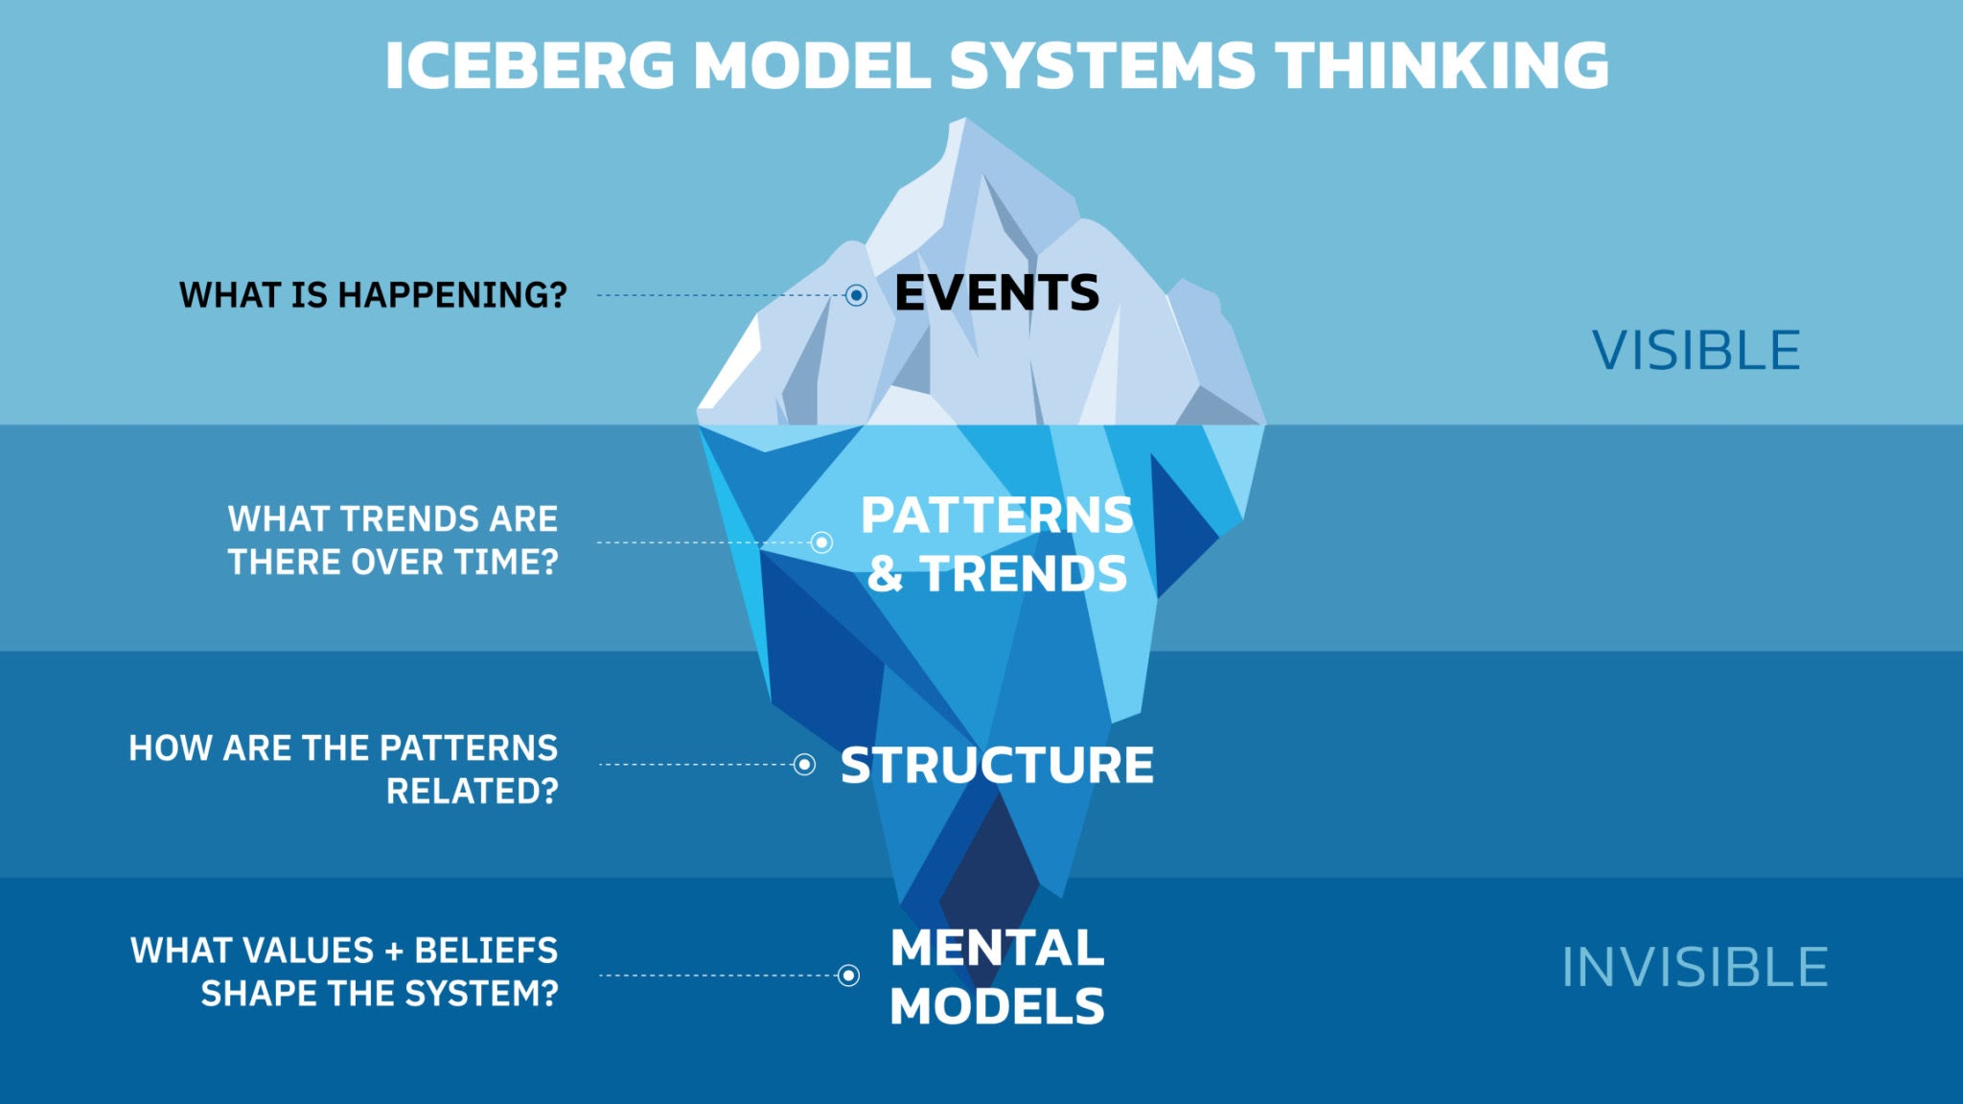
Level 7 Research: Iceberg Model

Slide 16
The Iceberg Model: Moving from Level 6 to Level 7
The 10% Rule: Only 10% of an iceberg is visible above the water. This represents "The What" (Events, Data, Facts).
The 90% Reality: 90% of the mass is underwater, supporting the top. This represents "The Why" (Causes, Context, Theory, Assumptions).
The Problem: Many students spend 2,000 words describing the tip of the iceberg, but never dive underwater.
The Goal: A Master's dissertation must explore the submerged part.

Slide 17
Level 6: The Tip of the Iceberg (Descriptive Writing)
Focus: Describing things as they are.
Key Questions: What happened? When? Where? Who involved?
Characteristics:
Lists facts and figures.
Retells a story or a case study.
Quotes authors without questioning them.
This is necessary to set the scene, but it does not get marks for critical thinking.

Slide 18
Level 7: Beneath the Surface (Critical Analytical Writing)
Focus: Uncovering why things are the way they are.
Key Questions: Why did this happen? Is this outcome inevitable? What theories explain this? What are the limitations of this data?
Characteristics:
Identifies patterns and trends (not just single events).
Challenges assumptions (e.g., "Is pay really the issue, or is it management?").
Link practice to academic theory.
This is where the Distinction marks are.

Slide 19

The Step Up: Level 6 vs. Level 7 Research
Level 6:
Focus: What is happening? How does it work?
Goal: Description and understanding.
Usage of Theory: You select a model (e.g., SWOT) and apply it to a company to describe the situation.
The Voice: "The data shows that sales have dropped by 5%."
Key Action: Reporting facts.
Level 7:
Focus: Why is it happening? So what?
Goal: Critical analysis, synthesis, and evaluation.
Usage of Theory: You critique the model itself. Is SWOT actually useful here? Does it miss the nuance of the digital market?
The Voice: "While sales dropped by 5%, this contradicts Porter’s theory because..."
Key Action: Challenging assumptions; Supporting the theories;

Slide 20
The Step Up: Level 6 vs. Level 7 Research
At undergraduate level, if you told me what Apple's marketing strategy was, you passed. You described the world.
At Master's level, describing isn't enough. I don't just want to know what they did. I want to know why it worked, why it might fail next year, and how it challenges what the theories tell us.
Think of it like an iceberg. Level 6 is the tip (what we can see). Level 7 is everything underneath (the hidden causes, motives, and structural issues).

Slide 21
Quiz
1. Based on the Tip of the Iceberg example provided, which of the following best describes the limitation of the statement: “Employee turnover in the company increased by 15% in 2024. The exit interviews suggest that staff were unhappy with the pay structure.”
A. It is purely descriptive; it reports 'what' happened without asking 'why' or questioning the validity of the claim.
B. It relies too heavily on quantitative data (15%) rather than qualitative interviews.
C. It is factually incorrect because the data was calculated wrong.
D. It is too academic and uses complex theoretical language.

Slide 22
2. Applying this Iceberg Logic to a new scenario: A student writes, “Sales dropped because the price is too high.” Which option rewrites this into a Level 7 Critical Statement?
A. The company should lower the price immediately to stop the decline in sales.
B. It is clear that the pricing strategy is wrong because no one is buying the product.
C. While customers cite 'price' as the barrier, Porter’s Generic Strategies suggest the real failure is the brand’s inability to justify that premium price through differentiation.
D. Sales figures show a sharp decline, and customers have complained about the price being too high.

Slide 23
3. The Hipster Coffee Paradox
Scenario: An independent coffee shop in London has 5-star reviews and a queue out the door every day. Customers love the "ultra-relaxed" vibe and the baristas who spend 10 minutes chatting with every guest. However, the financial data shows the shop is facing bankruptcy due to low daily revenue.
Which of the following statements represents a Distinction-level (Level 7) Critical Analysis of this problem?
A. "The shop is failing because the staff are too slow. Although customers like the service, the baristas need to work faster to serve more customers and increase daily revenue."
B. "To save the business, the owner should immediately raise prices by 20% or install self-service kiosks to reduce labour costs."
C. "The bankruptcy reveals a 'Strategic Misalignment'. The shop’s competitive advantage (high-touch service) is operationally incompatible with its business model (low-margin, volume-dependent). This suggests the 'relaxed vibe' is not a value-add, but a resource drain that the current pricing strategy cannot sustain."

Slide 24
Why A is wrong: It is just describing the symptom. It suggests a 'fix' without understanding the strategic conflict.
Why B is wrong: It is a solution, not an analysis. In a Research Proposal, you must diagnose the root cause before you prescribe the medicine.
Why C is right: It uses concepts like "Competitive Advantage" and "Strategic Misalignment". It identifies the paradox: the thing making them popular is the thing killing them.

Slide 25
Applying the Iceberg to Your Research Proposal
Background Section: Start at the tip (The symptoms/the business problem), then quickly dive down to the structural issues (the academic gap).
Literature Review: Don't just list what authors say (Surface). Group them by themes and debate their arguments (Deep).
Methodology: Don't just say "I will do interviews" (Surface). Explain why interviews are the only way to uncover the deep, subjective reality of the participants (Deep).

Slide 26
Activity: The "Deep Dive" Challenge
Task:
Read the "Surface" problem statement below. It is a factual observation, but it lacks critical depth. Rewrite it into one sentence to make it "Deep" (Analytical/Critical).
The Surface Statement:
"Many companies are forcing employees to return to the office because managers believe that working from home reduces productivity."
This is just reporting what managers think. It accepts their view as fact.
How to make it Deep:
Challenge the assumption (Is productivity actually lower?)
Look for the conflict (Trust vs. Control).
Use words like: contradicts, assumes, perception, lack of evidence, misalignment.
The deep statement: ...

Slide 27
Do you think it is still difficult to make it deeper? How to solve it?
Literature (The existing deep statements)
Findings(Your deep statments)

Slide 28
The "Deep Dive" Process
1. The Surface Statement (The Starting Point)
"Many companies are forcing employees to return to the office because managers believe that working from home reduces productivity."
2. Step 1: Consult the Literature (The Existing "Deep" Answers)
Don't just accept the manager's view. Check the theory.
Theory A (Supports Managers): Knowledge Spillover Theory suggests innovation happens through unplanned face-to-face interactions.
Theory B (Challenges Managers): Deep Work concepts suggest that open-plan offices destroy focus, while home working allows for complex cognitive tasks.

Slide 29
3. Step 2: Your Research Findings (The Evidence)
Your data shows that while creative teams struggled at home (supporting Theory A), data analysts were 20% more productive at home (supporting Theory B).
4. Step 3: The Critical Conclusion (Your Deep Statements)
The blanket 'Return to Office' mandate ignores the distinction between collaborative and cognitive tasks. My findings challenge the managers' belief, suggesting that forcing analysts back to the office is actually driving down productivity by interrupting 'Deep Work'.
Therefore, this study supports the 'Deep Work' concept (Theory B) within the context of data-heavy roles. Conversely, it challenges the universal application of Knowledge Spillover Theory (Theory A), demonstrating that for these specific employees, the cost of open-plan distraction outweighs the benefits of unplanned social interaction.

Slide 30
The Surface Statement:
"Many companies are forcing employees to return to the office because managers believe that working from home reduces productivity."
Final "Deep" Statement (The Level 7 Statement)
"The blanket 'Return to Office' mandate ignores the distinction between collaborative and cognitive tasks. My findings challenge the managers' belief, suggesting that forcing analysts back to the office is actually driving down productivity by interrupting 'Deep Work'.
Therefore, this study supports the 'Deep Work' concept (Theory B) within the context of data-heavy roles. Conversely, it challenges the universal application of Knowledge Spillover Theory (Theory A), demonstrating that for these specific employees, the cost of open-plan distraction outweighs the benefits of unplanned social interaction."

Slide 31

Purpose of Research
To review and synthesise existing knowledge.
To investigate some existing situation or problem.
To provide solutions to a problem.
To explore and analyse more general issues.
To construct or create a new procedures or system.
To explain a new phenomenon.
To generate a new knowledge.
Or combinations of the above.

Slide 32


Are you a Researcher?
How would you select the best flight?
How did you choose your Smartphone?

Slide 33

Research In Business
Business is based on decision-making
How do we know if we are making good decisions?
An important part is the INFORMATION that we are using
This develops our KNOWLEDGE
The Information is based on data from RESEARCH
A common example is Market Research
  Companies need to know what customers may want so gather data

Slide 34

Academic Research
The main aim is the same as Business Research
  To find out more about something
We talk about GOOD and BAD research
We will explore methods in this module that help to produce a GOOD piece of research
GOOD research tells us something of value about a subject area
It can be trusted because it has been correctly produced
There is an Ethical approval
  We will look at this in future sessions

Slide 35
Research Qualities and Skills
Communication Skills
Intellectual skills
Information Technology Skills
Organisational Skills
Motivation
Interdependence
Perseverance

Slide 36
Topic 2
A Brief overview of the Research Proposal

Slide 37
The Definition of a Research Proposal:
A research proposal is a structured document that outlines what you intend to research, why it is worth researching, and how you plan to investigate it. It acts as a 'blueprint' for your study and a contract between the researcher and the supervisor.

Slide 38
A good research proposal will:
Provide some background information on the area that you are interested in;
Explain the rationale behind why you want to focus on a particular aspect of this subject
Identify the overall aim of your research
Specify the individual objectives required to help you achieve your overall research aim;
Outline how you will carry out your research
Provide an estimate of how long you think you will take to complete the various parts of your dissertation; and
List the literature that you have referred to in producing your proposal
Biggam (2020)
Notes:
(a) provide some background information on the area that you are interested in;
(b) explain the rationale behind why you want to focus on a particular aspect of this subject (you need to convince your supervisor that this is an area worthy of study);
(c) identify the overall aim of your research (i.e. what you are trying to achieve);
(d) specify the individual objectives required to help you achieve your overall research aim;
(e) outline how you will carry out your research (your research methods);
(f) provide an estimate of how long you think you will take to complete the various parts of your dissertation; and
(g) list the literature that you have referred to in producing your proposal (i.e. include a short References section)

Slide 39
The Template of Research Proposal
Title
Background
Literature review
Research Question/Aim/Objectives
Methodology/Ethics
Timeline
References
Background
Literature Review
Research Questions & Aim & Objectives
Methodology
Data Analysis Plan
Significance/Expected Outcomes
Timeline
References
5000 words

Slide 40

Why write a proposal ?
Allows the University to determine if your research meets academic standards
Allocation of supervisor
Planning document
Reassurance that any ethical considerations are addressed early on
Notes:
So why do you need to write a proposal?
Allows the University to determine if your research meets academic standards
Allocation of supervisor
Reassurance that any ethical considerations are addressed early on

Slide 41
Dissertation Proposal - The Title
Chose a subject area
Focus on aspect worth researching
Communicate it in writing
General
Specific
Title
Notes:
Main task of your proposal is to clarify whatever it is that you propose to research.
So where do you start?
At the beginning…….
Pick a subject area that you are interested in /grabs your attention/relevant to your work and course – some of you already have
You then need to focus on a particular aspect of that subject area that you think is worth researching – don’t go too wide on your subject area
You need to then communicate your ideas in writing using the template given to you
To achieve research focus :
Think of the subject areas in general terms
Then home in on a particular aspect of that subject
Do some background reading/research to see if it is worth studying – see how much information you can find on the subject? Is there a lot or hardly any? Are there any gaps that your research will close?
Your title should concisely provide the reader with an understanding/overview/the gist of what you are researching in your dissertation
Think in general terms of your topic
Identify the aspect of that topic that you want to concentrate on
Bring them both together to start compiling your Title
GENERAL – SPECIFIC - TITLE

Slide 42
Dissertation Proposal – Background Information
Background reading – support why you want to research your chosen area
Not a comprehensive review of literature on your topic.
Be brief and focused
Basic background information supported by literature/sources to justify your proposal
Use UWTSD Harvard Referencing!
BRIEFLY Explain the general topic area
Introduce the specific area that interests you
Explain why you have chosen to research the topic
Notes:
1.Background reading – support why you want to research your chosen area if asked by your supervisor. What have you found from your initial research? What are the gaps in literature/source material? How much information is there out there ?
This is not a comprehensive review of literature on your topic – that will come in your final document.
You only have about 700 words here so be brief and focused about what you are saying and make sure that you reference your sources using Harvard. This is not a requirement to write about the history of your subject – be focused on what you want to research only. Remember to justify your proposal and the need to research your topic

Slide 43
Dissertation Proposal – Research Aim
General statement which originates from your research area
Describes your intentions and what you hope to achieve
Answer the ‘why’, ‘what’ & ‘how’ of your research question
Step 1 – research area
Step 2 - Add other words to clarify the focus of your research – what you want to achieve
Step 3 – Connect the words to form a sentence
Step 4 – Convert this sentence into a formal research aim

Slide 44
Research proposal – Research Objectives
To address your ‘Research aim’
Consider ‘key words’ – influence depth of study to be carried out
‘Key words’ = Nouns used to indicate the type of study activity linked with the objective
4 maximum
Use them to keep you focused in your research
Key words
Identify
Assess
Evaluate
Explore
Outline
Discuss
Analyse
Notes:
In order to realise or address your overall research aim , you have to list your objectives to show how you will get there
Important to consider the key words - NOUNS that you use as these will influence the depth of study that you propose to carry out.
e.g. Identify, evaluate, explore, formulate. A noun is a word of action
Which of these words will require more work than others?

Slide 45
Research Questions
which social media sites?
How should social networking sites address the harm they cause?
RESULT:
What action should social network sites like facebook and MYSpace take to protect users’ personal information and privacy?
Assumes that harm is proven and or accepted
What type of harm?
To whom?
Age/gender
Notes:
Let’s look at this research question
What do you think?
What would you change and why?
Break it down – social networking - which ones?
Harm – what type of harm?
To whom? – children/adults/gender/age groups/ other groups/ organisations etc etc

Slide 46
Dissertation proposal – Research Methods
Research methods = How you intend to do your research
For proposal need to outline briefly.
Collecting empirical data
Literature review

Slide 47
Research Methods
Literature Review
Main activity in your final document – seek sources to show how well read
Proposal – indicate the types of literature being sourced (books, journals etc) and providing examples of relevant literature
Indicate databases used/to be used
Literature review – based on theory
Empirical Data
Supplements literature review
How you will gather your data – interviews, questionnaires, experiments, observations etc.
Who will be involved and how selected
Primary/secondary data

Slide 48
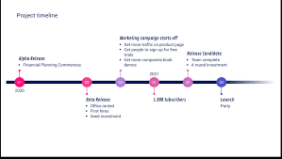
Dissertation proposal - Timeline
Estimate of how long you believe each stage of your research will take
Look at the timeline provided – spread out between March and September.
Idea of time to give to each stage
Key submission dates
Overlaps
Not too detailed – can de-motivate you

Slide 49
Time line example 1
 | March | April | May | June | July | August | September | October
Lesson | Introduction and Literature Review | Research methodology & questionnaire design | Analysis of data | Writing up results & conclusions |  |  | writing up results & conclusions | Dissertation format
Work to be done | Proposal Introduction (2000 words) & ethics form (500 words) | * Feedback on proposal and ethics form | * Literature review (4000 words) | *Methodology & planning (3000 words) |  |  | *Analysis of results (3000 words) | *findings and conclusions (1500 words)

Slide 50
Timeline example 2
Dissertation activity | Duration (weeks) | Month
Clarify Aim/Objectives | 2 | March
Start Introduction | 2 | March
Literature review | 4 | April
Write and Distribute questionnaire/conduct interviews |  | May
Research Methods | 2 | May/June
Data Collection | 4 | July /Aug
Findings | 3 | August/September
Conclusion | 2 | September
Notes:
Dissertation over 4 month period

Slide 51
Dissertation Proposal - Ethics
Ethics is a code of conduct on how we ought to lead our lives
Written in Laws
Unwritten in our philosophical and social beliefs – appear in everyday behaviour
Popular concept that now impacts on many areas of life
Research Ethics:
‘Application of a code of conduct when human participants are the focus of empirical research’ (Biggam, 2015. p.73)
Design of empirical research : Research Ethics!
Ethics form – All to complete
Notes:
What do we mean by ‘Ethics’?
What about ‘Research Ethics’?

Slide 52
Research Integrity and Ethics
Research Ethics
Transparency
Confidentiality
Voluntary
Do no harm
Impartial
Notes:
Transparency – Purpose of your research should be clearly explained to your participants and also how you will conduct your primary research ( e.g. questionnaire, focus group etc) together with the intended use of the data. Always good to provide an information sheet
Confidentiality – you must respect confidentiality and anonymity of your participants. If you aren’t you may be in breach of Data Protection law or putting people at risk.
Voluntary – participants must not be coerced to become part of your research and should be free to withdraw at anytime
Do no harm – Your research should not put any participant in any danger or risk of harm, neither should you.
Impartiality – if you are connected to the research participants in any way ( e,g, fellow students or relatives) or it could be perceived that you may be biased you need to declare your relationship.
NB - What ethical considerations do you think you will have? And how will you overcome them?
-

Slide 53
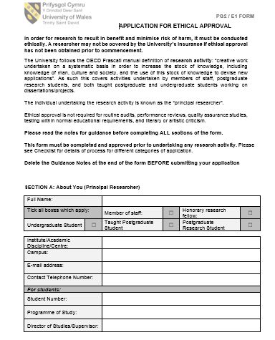
Ethics Form
Must be completed for all dissertations – template on Moodle
(https://moodle.uwtsd.ac.uk/course/section.php?id=174165)
Approval granted asap
Ethics panel – if necessary
Vulnerable adults/children
Consent from your organisation if necessary

Slide 54
TOPIC 2: The Template of Research Proposal
Title
Background
Literature review
Research Question/Aim/Objectives
Methodology/Ethics
Timeline
References
Background
Literature Review
Research Questions & Aim & Objectives
Methodology
Data Analysis Plan
Significance/Expected Outcomes
Timeline
References
5000 words

Slide 55
TOPIC 3
Formulating aim and objectives

Slide 56
The "Golden Thread" of Alignment
A good research/research proposal has a visible thread connecting every part.
The Hierarchy:
The Aim: The final destination (The "What").
The Objectives: The stepping stones to get there (The "How").
The Research Questions: The specific problem you are solving.
The Aim (destination)
The Objectives (how to get there)
The Research Questions(the specific problem)

Slide 57
Dissertation Proposal – Research Aim
General statement which originates from your research area
Describes your intentions and what you hope to achieve
Step 1 – research area
Step 2 - Add other words to clarify the focus of your research – what you want to achieve
Step 3 – Connect the words to form a sentence
Step 4 – Convert this sentence into a formal research aim

Slide 58
Aim vs. Objectives (The Difference)
The Research Aim (The Destination)
A single, broad statement of intent.
It usually starts with: "The aim of this research is to..."
Example: "To investigate the impact of remote working on employee engagement in UK tech start-ups."

Slide 59
2. The Research Objectives (The Steps)
Operational steps to achieve the Aim.
Usually 3-4 distinct points.
The Logic Flow:
Objective 1: Review the literature (Theory).
Objective 2: Collect and analyse primary data (Fieldwork).
Objective 3: Compare findings with literature (Synthesis).
Objective 4: Propose frameworks or recommendations (Contribution).

Slide 60
Example
The Strategic Objectives (The "How"):
To critically evaluate existing literature on remote working models and employee engagement theories (such as Kahn’s Engagement Model) to identify a conceptual framework. (Step 1: The Theoretical Foundation)
To analyse the perceptions of employees within UK tech start-ups regarding communication, autonomy, and work-life balance in a remote setting. (Step 2: The Data Collection / Fieldwork)
To examine the correlation between remote working frequency and reported levels of emotional and cognitive engagement. (Step 3: Findings)
To develop a set of evidence-based recommendations for start-up founders to optimise remote working policies for maximum engagement. (Step 4: The Contribution )

Slide 61
Level 7 Verbs (Bloom's Taxonomy)
Avoid (Level 4-6) | Use (Level 7)
To describe... | To critically analyse...(Data collection)
To look at... | To evaluate... (Literature)
To list... | To synthesise...(Findings)
To find out... | To develop...(Contribution)
The Rule: Do not use "weak" verbs. Level 7 requires critical thinking.

Slide 62
QUIZ
1. In a Research Proposal, what is the fundamental difference between the 'Research Aim' and the 'Research Objectives'?
A. The Aim is the final destination (what you want to achieve), while the Objectives are the steps to get there (how you will achieve it).
B. The Aim is the specific steps taken, while the Objectives are the broad vision.
C. The Aim must include data analysis methods, whereas Objectives do not.
D. The Aim is written for the supervisor, while the Objectives are written for the participants.

Slide 63
2. Which of the following statements represents a Level 7 standard 'Research Aim'?
A. To hand out questionnaires to 50 employees.
B. To investigate the impact of digital transformation on customer loyalty in UK retail banking.
C. To read the literature on leadership styles.
D. To compare the shopping habits of men and women.

Slide 64
3. If your research project is like 'building a house', what role do the 'Research Objectives' play?
A. They represent the people living inside the house.
B. They are the total budget for the construction.
C. They are the final photograph of the finished house.
D. They are the specific bricks and construction steps (e.g., laying the foundation, building walls) required to complete the structure.

Slide 65
4. Which set of verbs is most appropriate for writing Level 7 'Research Objectives'?
A. Hope, Wish, Try, Plan
B. Investigate (used for all points)
C. Review, Analyse, Identify, Recommend
D. Think about, Look at, Read, Write

Slide 66
5. What is the relationship between the Research Objectives and the Research Aim?
A. The Aim is written after the research is finished, while Objectives are written before.
B. The Objectives are more important than the Aim.
C. If you achieve all your Objectives, you should automatically have achieved your Aim.
D. They are unrelated lists of things to do.

Slide 67
Recap of Week 1
What is Level 7 research? - Iceberg Model
Brief overview of the Research Proposal -
Formulating aim and objective- Destinations and Stepping stones

Slide 68

Cwestyniau/Questions?

Slide 69
Many Thanks
Maggie: l.zhang@uwtsd.ac.uk

