Slide 1
Community of practice: a reflective presentation.
Drawing upon appropriate psychological theories covered in this module, critically reflect upon your engagement with and the role of a chosen community of practice in supporting your personal and professional development.
Olivia A. Lovell

Slide 2
Declaration of AI Usage
I confirm that this presentation has been created without the use of AI. No elements of AI have been used during any stage of this assignment. I confirm that I hold version drafts of this presentation, and the notes used.
All images used in this presentation, unless otherwise stated, have been selected from the Microsoft 365 stock image gallery.

Slide 3
Communities of Practice – What are they?
A community of practice describes a group of individuals that continuously come together to work on fulfilling a shared goal (Lave & Wenger, 1991; Koliba & Gajda, 2009; Roberts, 2006; Wenger, 1998).
The term was initially coined by Lave and Wenger in 1991 and was later further developed by Wenger (1998; 2000). It is through such groups that individuals within them can continuously develop and learn from one another (Lave & Wenger, 1991).
Within a community of practice, participants will all be engaged with the group’s goals and practices using shared group social representations (Wenger, 1998; Jawitz, 2007).
A community of practice must have a space where they can come together (Koliba & Gajda, 2009).
When joining a community of practice, new members will undertake ‘legitimate peripheral participation’ (Lave & Wenger, 1991), where new members of the group will be introduced to the goals and practices adopted by the group (Jawitz, 2007).
Notes:
A community of practice describes a group of individuals that continuously come together to work on fulfilling a shared goal (Lave & Wenger, 1991; Koliba & Gajda, 2009; Roberts, 2006; Wenger, 1998). The term was initially coined by Lave and Wenger in 1991 and was later further developed by Wenger (1998; 2000). It is through such groups that individuals within them can continuously develop and learn from one another (Lave & Wenger, 1991). Within a community of practice, participants will all be engaged with the group’s goals and practices using shared representations unique to the group (Wenger, 1998; Jawitz, 2007). A community of practice must also have a designated space, either physically or virtually, where they can come together (Koliba & Gajda, 2009). When joining a community of practice, new members will undertake what Lave and Wenger (1991) describe as ‘legitimate peripheral participation’, where new members of the group will be integrated into the wider community of practice and will be introduced to the goals and practices adopted by the group (Jawitz, 2007).

Slide 4
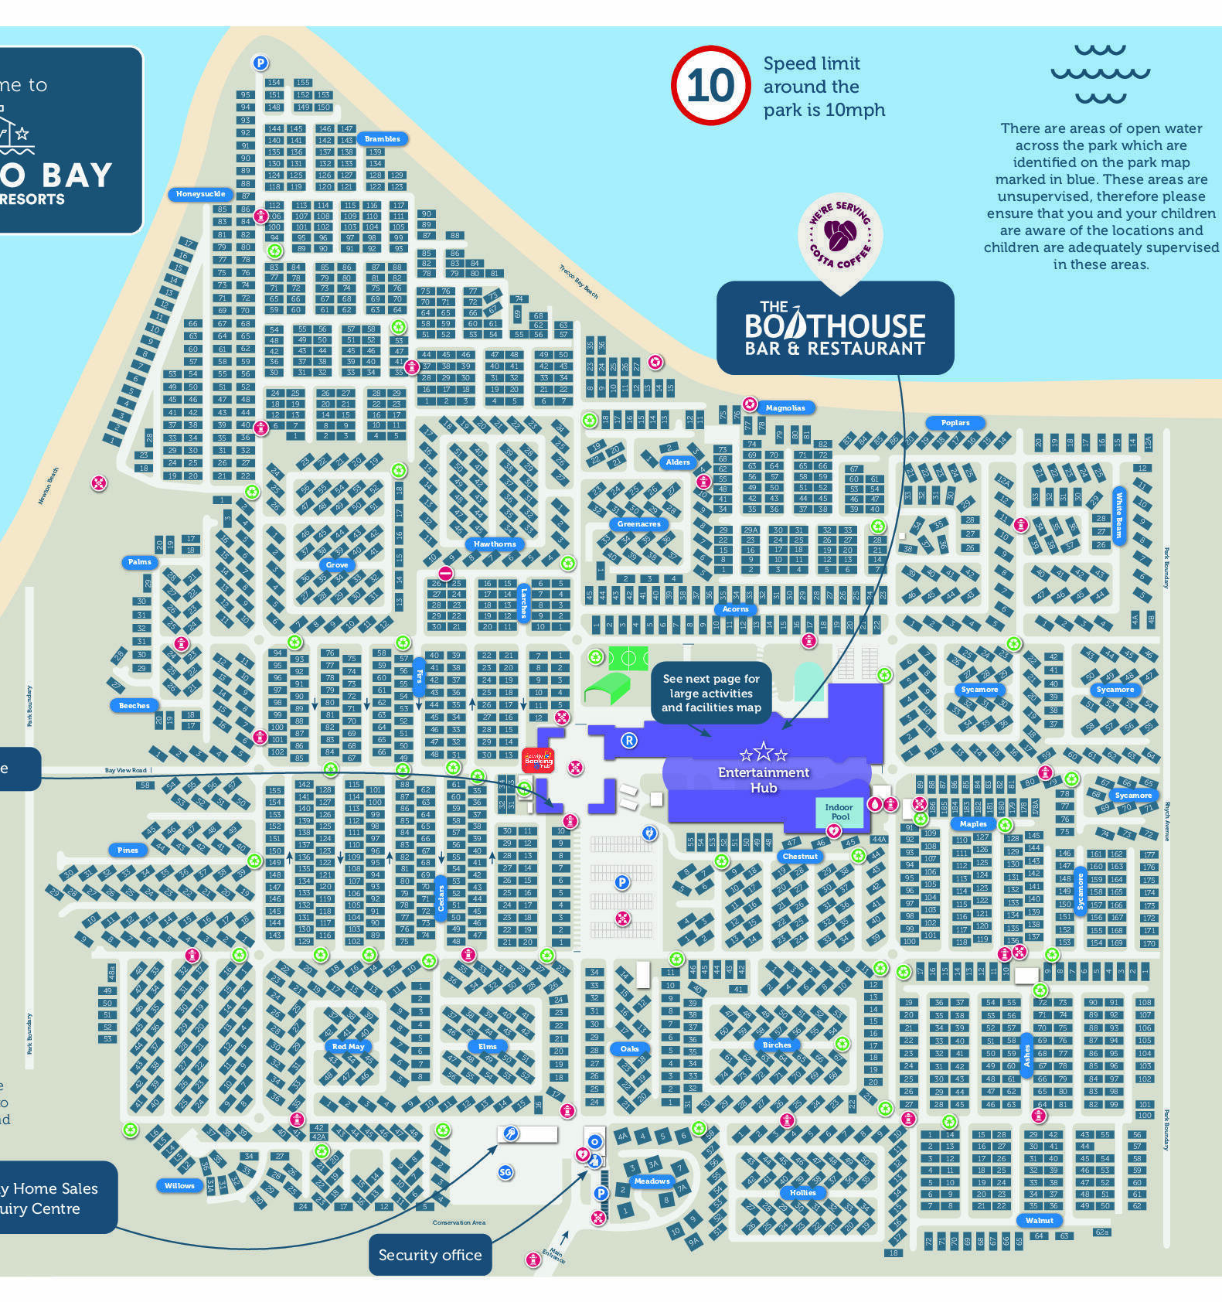


My community of practice – Parkdean Resorts
In the summer of 2024, I became a member of the accommodation cleaning team at Parkdean Resorts in Porthcawl. As a part of the team, I was responsible for ensuring that all work assigned to me was completed on time and to a high standard.
We usually were assigned 4/5 caravans per shift.
I was interested in joining this community for the purpose of experience.
*Images used are Parkdean Resorts' Trecco Bay official map and official logo.
Notes:
For this presentation, I will be discussing my experience as part of a community of practice. In the summer of 2024, I became a member of the accommodation cleaning team at Parkdean Resorts in Porthcawl. As a part of the team, I was responsible for ensuring that all work assigned to me was completed on time and to a high standard. This would usually be 4 or 5 caravans that I would be assigned to clean for the day. I was interested in joining this community of practice to gain some work experience while working on my Empirical Project over the summer.

Slide 5

Induction to the team
I took part in induction training to become acquainted with the park’s general safety procedures.
At this point, I was unaware of the team’s identity.
It would take time for me to integrate into the Parkdean staff’s ‘ingroup’. However, this process would allow me to begin to understand the social identities present amongst my colleagues (Tajfel & Turner, 1979; Greene, 2004).
Notes:
When I became a member of the accommodation cleaning team at Parkdean Resorts, I was first given an induction by the team managers alongside the other new hires at the time. This induction included safety training and demonstrations of what was expected of us as members of the team. At first, it was a little daunting to intake all the expectations of the team, as I was unfamiliar with the team’s identity. As such, I was initially apprehensive to begin interacting with my colleagues. At this point, I remained at the peripheral line of the team, hence the team’s identity was difficult to distinguish. However, as I began to integrate myself into the team, it became more apparent that the people I was working with had their own unique identities that came together to create the community of Parkdean staff. My experiences of identity within this group align with social identity theory (Tajfel & Turner, 1979). Before I became a part of the group, it was difficult for both me and the other members of the team to coordinate socially as part of the same group. This changed over the course of my time working with Parkdean Resorts, as I became a member of the ingroup (Greene, 2004).

Slide 6
Progression with the team
I had intended to maintain legitimate peripheral participation within the team at first (Lave & Wenger, 1991; Fuller et al., 2005).
Even without meaning to, I continued to learn from my colleagues and pick up more efficient ways of completing my work.
During my first two months with the team, I primarily reported to the park’s secondary office. Here, I was able to more comfortably integrate into the team due to the quiet atmosphere in the office (McAdams & McLean, 2013).
A change in park management led to the secondary office closing, thus all cleaners were then assigned to the primary office.
The narrative I had formed of myself as a member of the team had to change due to this (Murray, 2018).
Part of this was having to adapt to new ways of working near the primary office, such as planning where and how I would receive my work equipment.
Notes:
Initially, I had intended to participate peripherally within the team and retain my status as a novice while completing my work. This was primarily due to my lack of confidence when beginning my work with Parkdean Resorts. However, as my confidence grew, and I became better at completing the work assigned to me, I felt I was able to further integrate myself into the team. I was able to do this because I continued to learn from my colleagues throughout my time with the team. Whether I was actively receiving advice from others, or picking up tips passively, interacting with the team gave me the opportunity to learn from the community (Lave & Wenger, 1991; Fuller et al., 2005).
Mid-way through the summer, there were some changes to the organisation and management of the accommodation team in the park. Because of this, all cleaning staff were allocated to the park’s main accommodation office. I had been previously working at the park’s secondary office, which was much smaller, and quieter compared to the main office. Working at the park’s secondary office allowed me to develop my sense of identity within the team at a more comfortable pace since I am introverted (McAdams & McLean, 2013). It was initially difficult for me to then get used to reporting to the park’s main office, as there were many cleaners situated there. This also made collecting equipment more difficult since there was a queue, instead of the quiet office I was used to. This move to the main office caused a change in the narrative I had developed for my work with Parkdean Resorts (Murray, 2018).
Another struggle of this change in office, however, was that the main waiting area was a small open shed, rather than the outdoor open space I had been used to in the secondary office. Due to this, it was often difficult to avoid breathing in secondhand cigarette smoke from the other members of the team. I found this change to be very difficult to deal with at first. Over time, I became more accustomed to the main office, and figured out a strategy to ensure I could gather my equipment in good time. This involved waiting at the far end of the office, where I could also get away from most of the cigarette smoke.

Slide 7




Team relationships
When I first joined the team, I was unfamiliar with the team’s social representations.
The team frequently used dark humour when discussing work with each other. This most notably came in the form of comments and jokes regarding suicide.
These uncomfortable comments made up part of the team’s social representations (Šuľová & Popper, 2023; Wagner et al., 1999).
Over time, I began to understand the meaning behind these comments and came to accept using them while at work. This occurred as I became further integrated into the group (Greene, 2004).
During my time at Parkdean Resorts, there were two members of the team that I ended up building a strong relationship with. These were a close colleague and my supervisor.
It was initially difficult to approach my supervisor as I was less confident. Over time, our relationship began to change (Murray, 2018), which led me to interact more with my supervisor and other members of the team.
Notes:
When I first joined the team, I was unfamiliar with the social representations commonly held by other team members. The most jarring thing to get used to for me was the team’s frequent use of dark humour when discussing work with each other. This most notably came in the form of comments and jokes regarding suicide, and I was initially very uncomfortable hearing this. These uncomfortable comments made up part of the representations that the team had of their work, as such they each understood the meaning derived from this (Šuľová & Popper, 2023; Wagner et al., 1999). Over time, I also began to understand the meaning behind these dark comments and came to accept using them while at work. This mostly occurred as I became further integrated into the group of accommodation cleaning staff, as this gave me more opportunities to make conversation with others in the team (Greene, 2004). Now that I am no longer a member of the team, I have found myself needing to remove these dark jokes from my own vocabulary.
During my time at Parkdean Resorts, there were two members of the team that I ended up building a strong relationship with. The first of these was a friend I had in the team. When I was a new member of the team, he helped me and gave me advice on how to complete tasks more easily. I also formed a strong relationship with my supervisor over the course of the summer. At first, I found it difficult to approach her, as I was less confident and competent in my work. However, over time, our relationship began to change. I remember there was a time when my supervisor asked me to take on some extra tasks, as another member of the team was running behind. During this time, I was able to complete my work quickly and to a high standard. From this point onwards, my relationship with my supervisor noticeably improved and she began to trust me more. It was then that I truly began to feel as if I were a part of her team. This change in my narrative within the team (Murray, 2018) led me to have more interesting interactions with both my supervisor and other members of the team.

Slide 8
Conclusion – leaving the team
Over the course of my time with the Parkdean Resorts accommodation cleaning team, I was able to pick up many new skills.
I have been able to engage with new ideas and representations of identity (Tajfel & Turner, 1979) and develop meaningful relationships with colleagues.
At the beginning of my time with the team, I asked for help more often. Over time, I relied less on my team members, as I began to develop my understanding of the team’s work after peripheral participation (Lave & Wenger, 1991; Fuller et al., 2005).
There were occasions where it was difficult to complete work as part of the team:
  Completing work in less time or with less equipment.
  Difficulty obtaining equipment in good time.
  Increased workload per caravan.
This was a great opportunity to reflect on my relationship with the team and the changes that occurred over the course of my time working with them (Murray, 2018).
Notes:
At the end of the summer, my time as a member of the accommodation cleaning team at Parkdean Resorts ended. Over the course of my time with the team, I was able to pick up many new skills. This experience has improved my time management skills and has allowed me to experience a range of responsibilities relevant to the work I completed.
Throughout my time with this community of practice, I was able to engage with new ideas and representations of identity (Tajfel & Turner, 1979). Working as part of a team also helped me to develop strong relationships with my colleagues. At the beginning of my time with the team, I ended up asking for help from my colleagues when facing challenges with the work. However, as time progressed, I relied less on my team members and even began to provide help to them in return. This was a result of my integration into the team, as I gradually began to move further into my understanding of the team’s work after a period of peripheral participation (Lave & Wenger, 1991; Fuller et al., 2005).
Despite my overall positive experience with the team, there were occasions where it was difficult to complete work as part of the team. As mentioned previously, suddenly becoming part of a much larger group was very overwhelming at first. It was much more difficult to obtain the equipment I needed from the main office storage as there were so many other cleaners all doing the same. At times, this would result in some of us starting our work later than intended, which would stress our time limit to complete tasks. In such cases, or when park accommodation was left in poor condition by customers, the team would come together to help each other. This was especially the case during the last few weeks of my time with the team, as there was an increase in tasks to handle in each caravan. However, this period of work was a great opportunity to reflect on my relationship with certain members of the team and how these changed over the course of my time working with them (Murray, 2018).

Slide 9
Thank you for listening!

Slide 10
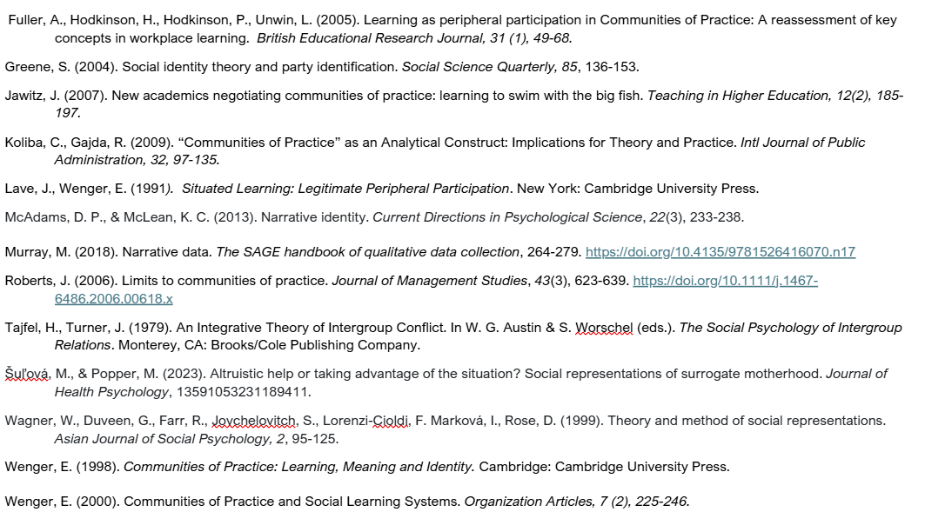
References
Notes:
Copy of References (unfortunately the hanging indent is not functioning here):
Fuller, A., Hodkinson, H., Hodkinson, P., Unwin, L. (2005). Learning as peripheral participation in Communities of Practice: A reassessment of key concepts in workplace learning. British Educational Research Journal, 31 (1), 49-68.
Greene, S. (2004). Social identity theory and party identification. Social Science Quarterly, 85, 136-153.
Jawitz, J. (2007). New academics negotiating communities of practice: learning to swim with the big fish. Teaching in Higher Education, 12(2), 185-197.
Koliba, C., Gajda, R. (2009). “Communities of Practice” as an Analytical Construct: Implications for Theory and Practice. Intl Journal of Public Administration, 32, 97-135.
Lave, J., Wenger, E. (1991). Situated Learning: Legitimate Peripheral Participation. New York: Cambridge University Press.
McAdams, D. P., & McLean, K. C. (2013). Narrative identity. Current Directions in Psychological Science, 22(3), 233-238.
Murray, M. (2018). Narrative data. The SAGE handbook of qualitative data collection, 264-279. https://doi.org/10.4135/9781526416070.n17
Roberts, J. (2006). Limits to communities of practice. Journal of Management Studies, 43(3), 623-639. https://doi.org/10.1111/j.1467-6486.2006.00618.x
Tajfel, H., Turner, J. (1979). An Integrative Theory of Intergroup Conflict. In W. G. Austin & S. Worschel (eds.). The Social Psychology of Intergroup Relations. Monterey, CA: Brooks/Cole Publishing Company.
Šuľová, M., & Popper, M. (2023). Altruistic help or taking advantage of the situation? Social representations of surrogate motherhood. Journal of Health Psychology, 13591053231189411.
Wagner, W., Duveen, G., Farr, R., Jovchelovitch, S., Lorenzi-Cioldi, F. Marková, I., Rose, D. (1999). Theory and method of social representations. Asian Journal of Social Psychology, 2, 95-125.
Wenger, E. (1998). Communities of Practice: Learning, Meaning and Identity. Cambridge: Cambridge University Press.
Wenger, E. (2000). Communities of Practice and Social Learning Systems. Organization Articles, 7 (2), 225-246.

Slide 11
Copy of References:
Fuller, A., Hodkinson, H., Hodkinson, P., Unwin, L. (2005). Learning as peripheral participation in Communities of Practice: A reassessment of key concepts in workplace learning. British Educational Research Journal, 31 (1), 49-68.
Greene, S. (2004). Social identity theory and party identification. Social Science Quarterly, 85, 136-153.
Jawitz, J. (2007). New academics negotiating communities of practice: learning to swim with the big fish. Teaching in Higher Education, 12(2), 185-197.
Koliba, C., Gajda, R. (2009). “Communities of Practice” as an Analytical Construct: Implications for Theory and Practice. Intl Journal of Public Administration, 32, 97-135.
Lave, J., Wenger, E. (1991). Situated Learning: Legitimate Peripheral Participation. New York: Cambridge University Press.
McAdams, D. P., & McLean, K. C. (2013). Narrative identity. Current Directions in Psychological Science, 22(3), 233-238.
Murray, M. (2018). Narrative data. The SAGE handbook of qualitative data collection, 264-279. https://doi.org/10.4135/9781526416070.n17
Roberts, J. (2006). Limits to communities of practice. Journal of Management Studies, 43(3), 623-639. https://doi.org/10.1111/j.1467-6486.2006.00618.x
Tajfel, H., Turner, J. (1979). An Integrative Theory of Intergroup Conflict. In W. G. Austin & S. Worschel (eds.). The Social Psychology of Intergroup Relations. Monterey, CA: Brooks/Cole Publishing Company.
Šuľová, M., & Popper, M. (2023). Altruistic help or taking advantage of the situation? Social representations of surrogate motherhood. Journal of Health Psychology, 13591053231189411.
Wagner, W., Duveen, G., Farr, R., Jovchelovitch, S., Lorenzi-Cioldi, F. Marková, I., Rose, D. (1999). Theory and method of social representations. Asian Journal of Social Psychology, 2, 95-125.
Wenger, E. (1998). Communities of Practice: Learning, Meaning and Identity. Cambridge: Cambridge University Press.
Wenger, E. (2000). Communities of Practice and Social Learning Systems. Organization Articles, 7 (2), 225-246.

