Slide 1
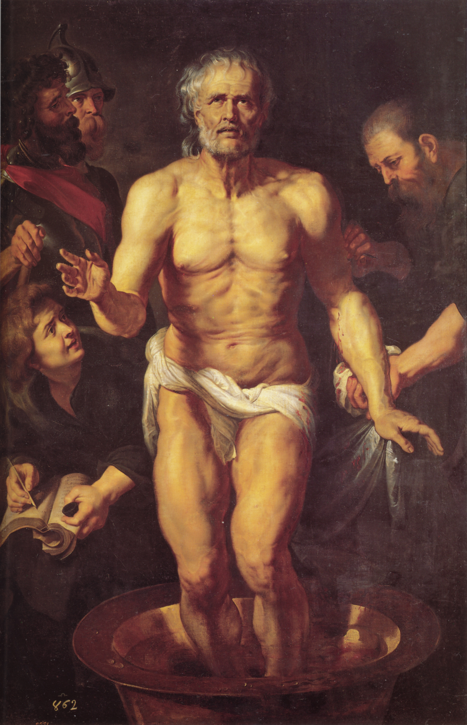
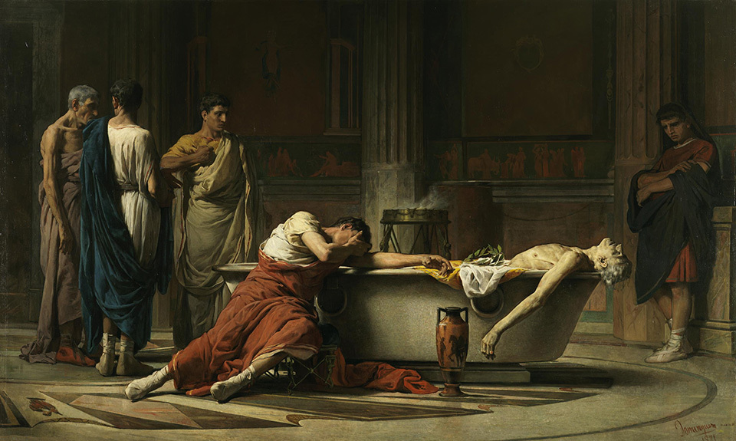
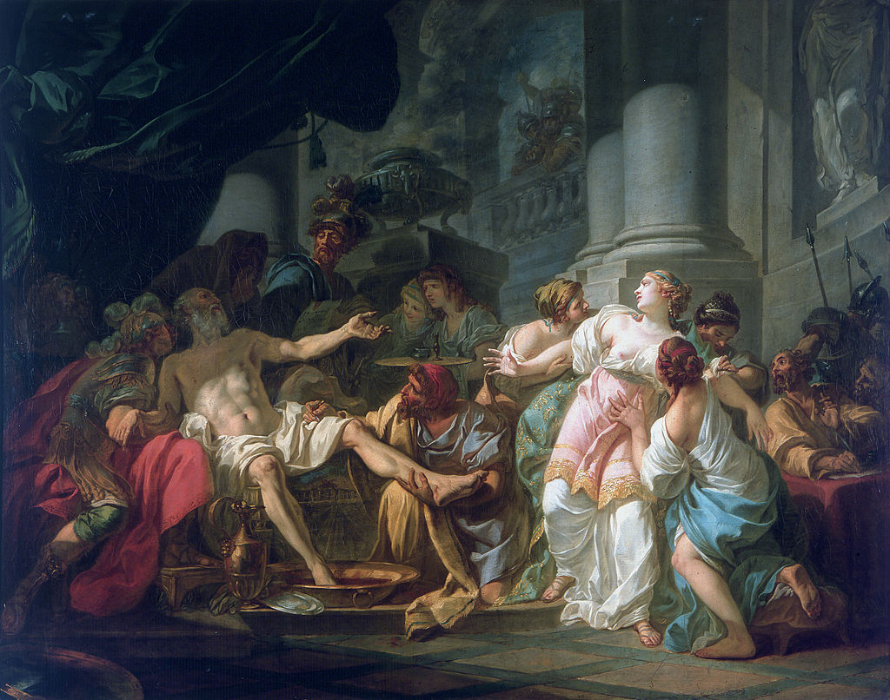
Literature and Culture in the Reign of Nero
CLCS5010
Seneca: A Tragic Figure
Manuel Domínguez Sánchez, 1871
Peter Paul Rubens, 1615
Jacques-Louis David, 1773

Slide 2
Senecan Tragedy
Ghosts a common and important features of many of Seneca’s tragedies (particularly Thyestes, Agamemnon; also visions of ghosts – Medea, Troades, Oedipus).
Cruelty, tyranny and revenge are often the overriding themes of many of the plays.
Dating Seneca’s works and the phases of his literary career – period of exile (AD 41-49); tutelage (AD 49-54); prominence (AD 54-59); decline in influence (AD 59-62); precarious position (AD 62-65).
  Agamemnon, Phaedra, Oedipus – period of exile?
  Hercules Furens pre-Apocolocyntosis? Troades and Medea may also cluster around AD 54.
  Third groups dates to the AD 62 onwards – Thyestes and Phoenissae.
  However some argue for all the tragedies to be dated to the AD 60s.

Slide 3
“The death of Burrus shook the position of Seneca: for not only had the cause of decency lost in power by the removal of one of its two champions, but Nero was inclining to worse counsellors. These brought a variety of charges to the assault on Seneca… the count proceeded, "he arrogated to himself alone; and he was writing verse more frequently, now that Nero had developed an affection for the art. For of the emperor's amusements in general he was an openly captious critic, disparaging his powers when he drove his horses and deriding his notes when he sang! How long was nothing to be counted brilliant in Rome, unless it was believed the invention of Seneca? Beyond a doubt, Nero's boyhood was finished, and the full vigour of youth had arrived: let him discharge his pedagogue — he had a sufficiently distinguished staff of teachers in his own ancestors." Seneca was aware of his maligners: they were revealed from the quarters where there was some little regard for honour, and the Caesar's avoidance of his intimacy was becoming marked…[Seneca goes to Nero to ask to retire]… He [Nero] followed his words with an embrace and kisses — nature had fashioned him and use had trained him to veil his hatred under insidious caresses. Seneca — such is the end of all dialogues with an autocrat — stated his gratitude: but he changed the established routine of his former power, banished the crowds from his antechambers, shunned his attendants, and appeared in the city with a rareness ascribed to his detention at home by adverse health or philosophic studies.- Tac. Ann. 14.52-53, 56.

Slide 4
Failure to become a Sage Man (Sapiens)
Had Seneca been too willing to comprise? Could he have rally stood up to the “tyrant”?
  “[Megara] Who can be forced has not learned how to die.” – Hercules Furens 426.
  “[Thrasea Paetus]… But since even among those who praise him to excess there are many whom he has either already disposed of or will yet destroy, why should one degrade oneself to no purpose and then perish like a slave, when one may pay the debt to nature like a freeman? As for me, men will talk of me hereafter, but of them never, except only to record the fact that they were put to death." – Cassius Dio 61.15.3-4.
Could Seneca contemplate his own ambitions and failures through his tragedies? As well as consider the world of Neronian Rome around him?

Slide 5
Thyestes – A Meditation on Service to Nero?
Thyestes – quite likely written under Nero, probably in the AD 60s.
A reflection on his own ambitions and his failure at educating and advising Nero?
Theme of the play: Thyestes is tricked into coming back from exile by his brother Atreus, and unwittingly eats his own children at a banquet.
  Atreus aggrieved by Thyestes earlier seduction of his wife.
A more abstract reflection on the destructiveness of desire and its inescapability?

Slide 6
ATTENDANT
[204] Does public disapproval deter thee not?
ATREUS
[205] The greatest advantage this of royal power, that their master’s deeds the people are compelled as well to bear as praise.
ATTENDANT
[207] Whom fear compels to praise, them, too, fear makes into foes; but he who seeks the glory of true favour, will wish heart rather than voice to sing his praise.
ATREUS
[211] True praise even to the lowly often comes; false, only to the strong. What men choose not, let them choose.
ATTENDANT
[213] Let a king choose the right; then none will not choose the same.
ATREUS
[214] Where only right to a monarch is allowed, sovereignty is held on sufferance.
ATTENDANT
[215] Where is no shame, no care for right, no honour, virtue, faith, sovereignty is insecure.
ATREUS
[217] Honour, virtue, faith are the goods of common men; let kings go where they please.
ATTENDANT
[219] O count it wrong to harm even a wicked brother.

Slide 7
ATTENDANT
[246] Slain by the sword, let him spew forth his hateful soul.
ATREUS
[247] Thou speakest of punishment’s completion; I punishment itself desire. Let the mild tyrant slay; in my dominion death is a boon to pray for.
ATTENDANT
[249] Does piety move thee not?
ATREUS
[250] Be gone, O Piety, if ever in our house thou hadst a place. Let the dread band of Furies come, the fiend Discord, and Megaera, brandishing her torches twain; not great enough the frenzy with which my bosom burns; with some greater horror would I be filled.
ATTENDANT
[254] What strange design does thy mad soul intend?
ATREUS
[255] Naught that the measure of accustomed rage can hold; no crime will I leave undone, and no crime is enough.
ATTENDANT
[257] The sword?
ATREUS
[257] ‘Tis not enough.
ATTENDANT
[257] Fire, then?
ATREUS
[257] Still not enough.
ATTENDANT
[258] What weapon, pray, will thy great anguish use?
ATREUS
[259] Thyestes’ self.

Slide 8
Can we teach goodness to those in power?
ATTENDANT
[310] Toward their father they will act as toward their uncle thou instructest them; often upon the teacher have his bad teachings turned.
ATREUS
[312] Though none should teach them the ways of treachery and crime, the throne will teach them. Lest they become evil, fearest thou? They were born evil. What thou callest savage, cruel, thinkest is done ruthlessly, with no regard for heaven’s law, perchance even there is being done.
Compare with the hopes of Seneca’s De Clementia:
  “I have undertaken, Nero Caesar, to write on the subject of mercy, in order to serve in a way the purpose of a mirror… [Seneca imagining Nero speaking to himself] With all things thus at my disposal, I have been moved neither by anger nor youthful impulse to unjust punishment…” (1.1)

Slide 9
Should Seneca have come back from exile?
THYESTES
[446] False, believe me, are the titles that give greatness charm; idle our fears of hardship. While I stood high in power, never did I cease to dread, yea, to fear the very sword upon my thigh. Oh, how good it is to stand in no man’s road, care-free to eat one’s bread, on the ground reclining! Crime enters not lowly homes, and in safety is food taken at a slender board; poison is drunk from cups of gold. I speak that I do know: evil fortune is to be preferred to good. The lowly citizen fears no house of mine set high and threatening on a mountain top; my towering roofs flash not with gleaming ivory, no guard watches o’er my slumbers; with no fleet of boats I fish, with no piled break-water do I drive back the sea; I gorge not my vile belly at the world’s expense; for me no fields are harvested beyond the Getae and the Parthians; no incense burns for me, nor are my shrines adorned in neglect of Jove; no planted grove waves on my battlements, nor does many a pool heated by art steam for me; my days are not given to sleep nor are my nights linked with wakeful revelry: but I am not feared, safe without weapons is my house and to my small estate great peace is granted. ‘Tis a boundless kingdom, – the power without kingdoms to content.

Slide 10
Reception of Seneca

Slide 11
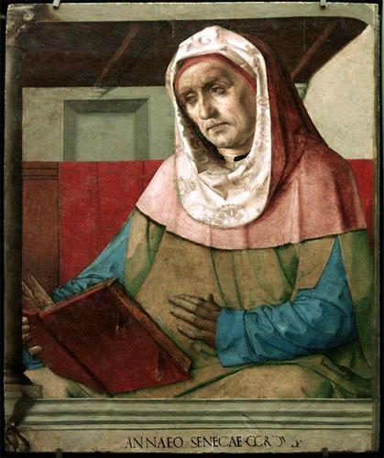
Legacy of Seneca
Seneca was a controversial figure after the downfall of the Julio-Claudian dynasty.
  Could he be blamed for what went wrong?
  Or he be praised for having ameliorating the worst excesses?
Negative tradition recorded by Cassius Dio.
Likely the favourable tradition deriving from Fabius Rusticus.
Positive response to Seneca in the Octavia.
Pedro Berruguete, 1447

Slide 12
Seneca’s Works in Antiquity
Unclear whether Seneca’s tragedies were performed in Antiquity, although they were read and copied.
Some influence on Flavian era poets (e.g. Valerius Flaccus Argonautica; Statius Thebiad); Senecan choruses also influential (e.g. Caesius Bassus).
By late 1st century AD his works come under criticism, particularly for their style:
  “On the day of the obsequies, the prince opened his panegyric of Claudius… hough the speech, as the composition of Seneca, exhibited the degree of polish to be expected from that famous man, whose pleasing talent was so well suited to a contemporary audience…” – Tac. Ann. 13.3.
  Quintilian attacks Seneca’s rhetorical style for being corrupt and a bad influence on the youth.
Christian appreciation of Senecan moral themes:
  “He [Seneca] might have been a true worshipper of God, if any one had pointed out to him God; and he might assuredly have despised Zeno, and his teacher Sotion, if he had obtained a true guide of wisdom.” – Lactantius Divine Institutes 6.24.

Slide 13
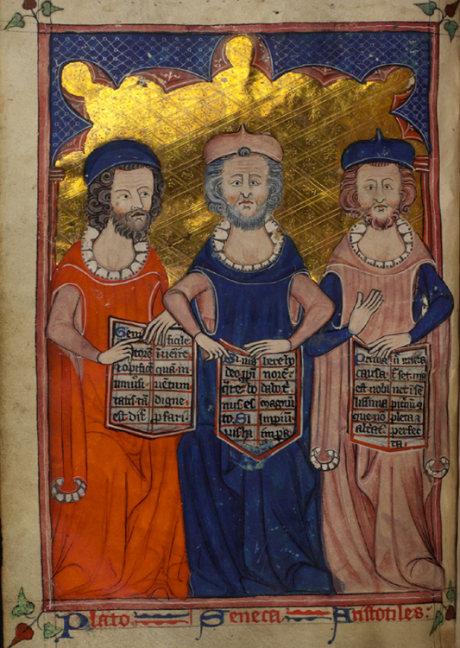
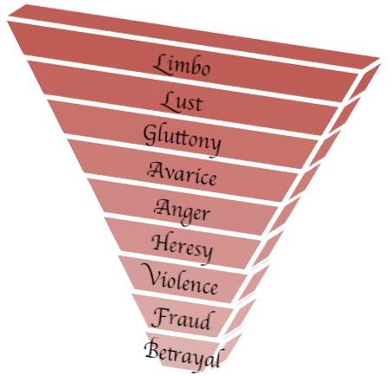
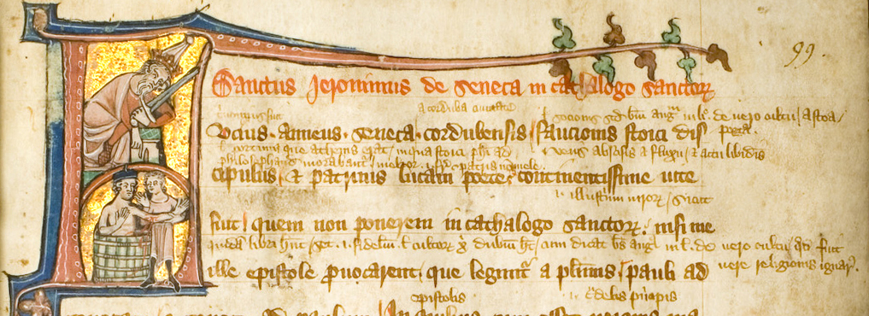
Medieval-Renaissance Reception
Apocryphal tradition of a series of letters of correspondence between Seneca and Paul the Apostle (probably created in the 4th century AD).
Appreciation for Senecan moral aphorisms.
Dante presents “Seneca the Moralist” as part of the Philosophic circle surround Aristotle in Limbo (the first circle of Hell).
Plutarch-esque biography of life of Seneca and Socrates (Gianozzo Manetti, 1396-1459).
Legend that Seneca was really a Christian – probably invented by Albertino Mussato, 1261-1329).
Seneca popular with Humanists and Reformists.

Slide 14
7. ANNAEUS SENECA TO PAUL AND THEOPHILUS, greeting
I profess myself well content with the reading of your letters which you sent to the Galatians, Corinthians, and Achaeans; and may we so live together as you show yourself to be inspired with the divine frenzy (horror). For it is the holy spirit which is in you and high above you which expresses these exalted and adorable thoughts. I would therefore have you careful of other points, that the polish of the style may not be wanting to the majesty of the thought. And, brother, not to conceal anything from you, and have it on my conscience, I confess to you that the Augustus was moved by your views. When I read to him the beginning of the power (virtue) that is in you (perhaps he meant your exordium about virtue) his words were these: that he could wonder that a man not regularly educated could think thus. I replied that the gods often speak by the mouths of the simple (innocent), not of those who try deceitfully to show what they can do by their learning. And when I cited him the example of Vatienus the rustic, to whom two men appeared in the territory of Reate, who afterwards were recognized as Castor and Pollux, he appeared fully convinced. Farewell.
8. PAUL TO SENECA, greeting
Though I am aware that Caesar, even if he sometimes lapses, is a lover of our wonders, you will suffer yourself to be, not wounded but admonished. For I think that you took a very serious step in bringing to his notice a matter alien to his religion and training. For since he is a worshipper of the gods of the nations, I do not see why you thought you would wish him to know this matter, unless I am to think that you did it out of excessive attachment to me. I beg you not to do so in future; For you must be careful not to offend the empress in your love for me: yet her anger will not hurt us if it lasts, nor do good if it does not. As a queen, she will not be angry: as a woman, she will be offended. Farewell.

Slide 15
Seneca in Medieval and Renaissance Political Discourse
Part of the de Clementia used almost verbatim in Emperor Frederick II’s prologue to this law codes for Sicily (1231).
  ‘Have I, of all mortals found favour and been chosen to act on earth in place of the gods? I am the arbiter of life and death over Peoples.’
Seneca’s theory of tyranny (among others from Classical Antiquity) important in Renaissance political thought.
  Cruelty as a political vice – merciless pursuit of retribution.
De Clementia useful for those consolidating monarchical power in the former Republican city-states of northern Italy (e.g. Verona, Mantua, Ferrara).
  At this time certain Senecan tragedies dealing with tyranny also start to circulate more widely.

Slide 16
Senecan Drama in the Renaissance
Seneca’s tragic works start to become known in western Europe again in the 13th century (after several centuries of obscurity).
  Outside the Letters to Lucilius Seneca’s extended prose and verse works were relatively unknown.
Reports of public performances of Seneca plays in England and in Italy during the late 15th century – Secularisation of drama during the 16th century.
Seneca’s tragedies held in high esteem in the Elizabethan period (1558-1603).
  Translations of various works by Jasper Heywood – Troades (1559), Thyestes (1560), Hercules Furens (1561); translation of the Oedipus by Alexander Neville, 1563; and of the Agamemnon and Medea by John Studley in 1566.
Seneca a strong influence on European revenge tragedy.
  Thyestes – Shakespeare Titus Andronicus; Matthew Gwinne Nero: A New Tragedy (1603).

Slide 17
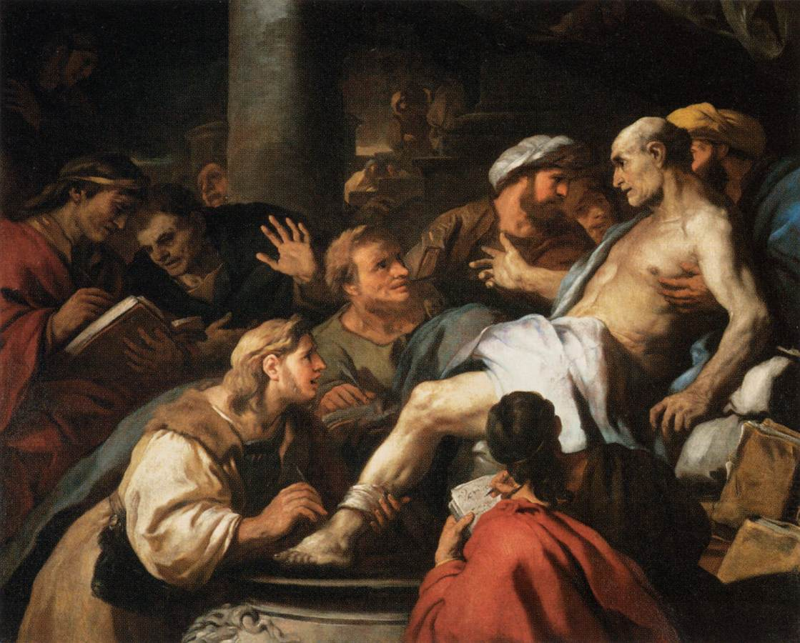
The Baroque Seneca (17th Century)
In Italy an emphasis shifts from dialogues and monologues, to choruses – music increasingly playing a role on stage.
  Influence on the development of libretti and opera.
Germany – contrasts of Stoic imperturbability, and tyrannical cruelty.
Seneca influential on developments of self-hood, early “self-fashioning” and autonomy.
The Death of Seneca by Luca Giordano, 1684-1685

Slide 18
Decline and Revival
Decline
Revival
By late-17th to early-18th century, Greek drama more influential (Style of Seneca’s plays seen as too bombastic); in 19th century interests in Seneca tragedy largely philological.
Criticism of Seneca, especially in Germany of his philosophy and morality – emotionally cold, obsessed with self-salvation.
Rhetorical language of many of Seneca’s plays had lead some to assume they were not meant to be performed.
Post-WW2 – Seneca and the problems of collaboration.
Last several decades have seen a revival and re-appreciation for Senecan works.
Interest in Seneca’s pragmatic philosophy and daily self-examination (Foucault The Care of the Self)
Greater willingness to consider Seneca’s rhetoric in its contemporary context.

Slide 19
Bibliography (1)
Braund, S. 2013. ‘Haunted by Horror: The Ghost of Seneca in Renaissance Drama’, in A Companion to the Neronian Age, Buckley, E. and Dinter, M. T. (eds.), Oxford: Wiley-Blackwell: 425-443.
Laarmann, M. 2014. ‘Seneca the Phiilosopher’, in Brill's companion to Seneca philosopher and dramatist, Damschen, G., and Heil, A. (eds.), Leiden: Brill: 53-71.
Marshall, C. W. 2014. ‘The Works of Seneca the Younger and their Dates’, in Brill's companion to Seneca philosopher and dramatist, Damschen, G., and Heil, A. (eds.), Leiden: Brill: 33-44.

Slide 20
Bibliography (2)
Schubert, W. 2014. ‘Seneca the Dramatist’, in Brill's companion to Seneca philosopher and dramatist, Damschen, G., and Heil, A. (eds.), Leiden: Brill: 73-93.
Stacey, P. 2017. ‘The Image of Nero in Renaissance Political Thought’, in The Cambridge Companion to the Age of Nero, Bartsch, S., Freudenburg, K. and Littlewood, C. (eds.), Cambridge: Cambridge University Press: 290-304.
Wilson, E. 2014. Seneca: A Life. Penguin.
Wilson, M. 2008. ‘Rhetoric and Seneca the Younger’, in A Companion to Roman Rhetoric, Hall, J. and Dominik, W. (eds.), Williston: Wiley-Blackwell: 425-438.

