Slide 1
STUDENT ID – 2434584
STUDENT NAME – PARTH KAMLESHKUMAR SUTHAR
COURSE – MSC DATA AND AI
MODULE TITLE – RESEARCH METHODS AND PROFESSIONAL DEVELOPMENT
MODULE CODE – ACFA7004
LECTURER NAME – VIJEYANANTHAN THAYANANTHAN

Slide 2
Explainable Artificial Intelligence for Financial Fraud Detection in Digital Banking
A Qualitative Study of Challenges, Frameworks, and Applications in Digital Banking

Slide 3
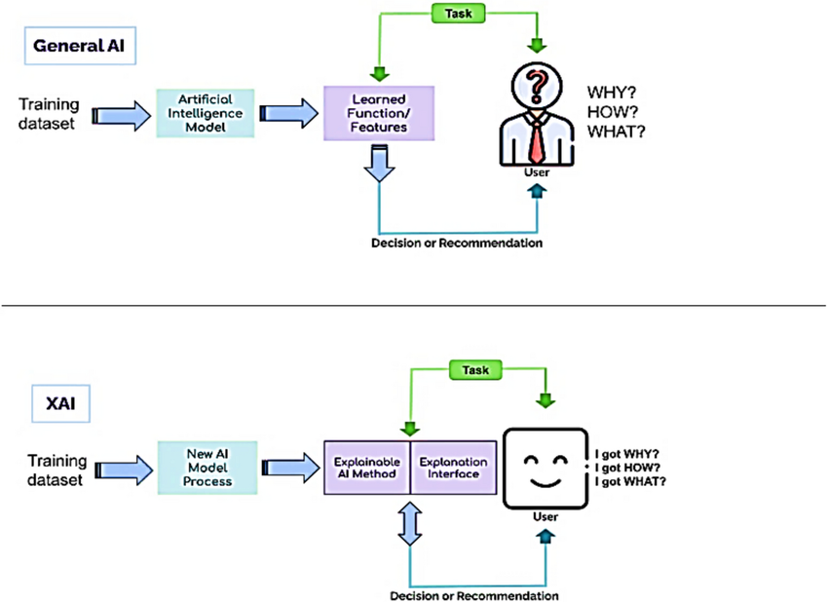
Introduction
As more people use digital banking, the chances of financial fraud have also gone up [2].
AI is good at spotting fraud, but its decisions are often hard to understand because it works like a “black box” [10].
Explainable AI (XAI) helps make these AI decisions clearer and easier to trust [10].
This research looks at how XAI can improve fraud detection in online banking systems [2].
Notes:
Digital banking has led to the convenience of transacting business but with higher chances of fraud as well. Although AI is useful in recognizing a suspicious activity, it is not trusted because of its black-box feature. Explainable AI (XAI) makes these systems clear and transparent to enable banks to make improved, understandable, and trusting decisions on fraud detection.

Slide 4
Research Objectives
To examine current applications of AI in financial fraud detection and identify limitations in transparency.
To analyze key explainability frameworks (e.g., SHAP, LIME, neural-symbolic models) used in fraud detection.
To explore how XAI models can address ethical, legal, and technical challenges in digital banking.
To synthesize secondary qualitative data on best practices for implementing XAI in real-time fraud detection systems.
To identify future research directions and technological innovations that may enhance explainability and trust in AI-driven financial security tools.
Notes:
The purpose of this study is to gain insight into how XAI can enhance transparency and trustability in fraud detection in the banking sector. It analyzes the existing limitations of AI, ethical and technological issues, and several tools of explainability such as SHAP and LIME. The idea is to propose superior structures and harmonize AI application with regulatory and ethical requirements.

Slide 5
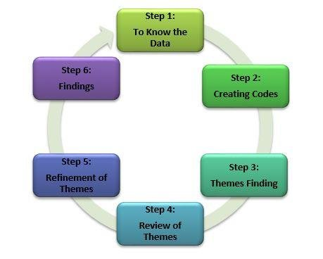
Research Design & Methodology
This study adopts a secondary qualitative research methodology to explore XAI in financial fraud detection [1].
Thematic analysis using Braun & Clarke’s (2006) approach structures the analysis process [6].
Literature from 2019–2025 is sourced from journals, industry reports, and regulatory documents [1].
Microsoft Excel is used for coding; Google Drive supports cloud collaboration [6].
Notes:
The proposed study employs a secondary qualitative approach to explore the current body of literature about XAI in fraud detection. Thematic analysis assists in the recognition of patterns and illuminations. The peer-reviewed papers and industry reports published between 2019 and 2025 are used as a source. Themes are easily coded with the help of Excel, whereas Google drive provides efficiency and collaboration.

Slide 6
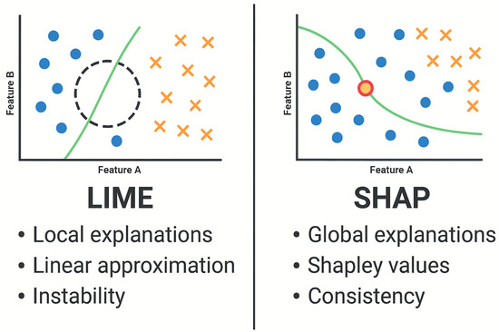
Literature Review Themes
AI techniques like decision trees and neural networks are widely used in fraud detection [1], [3].
The black box problem highlights AI’s lack of transparency and interpretability [4].
Post-hoc frameworks like SHAP and LIME face limitations under adversarial conditions [5], [6].
Ethical and regulatory concerns require fairness and accountability in AI models [7], [8].
Notes:
The literature review concentrates on five topics regarding AI and XAI in financial fraud detection. It discusses the usage of AI models of fraud patterns, such as decision tree and neural networks, the interpretability problem of black-box systems, and the shortcoming of post-hoc models, including SHAP and LIME. Ethical and regulatory categories also arise, that is, focusing on fairness, accountability, and responsible use of explainable models in the financial sector.

Slide 7
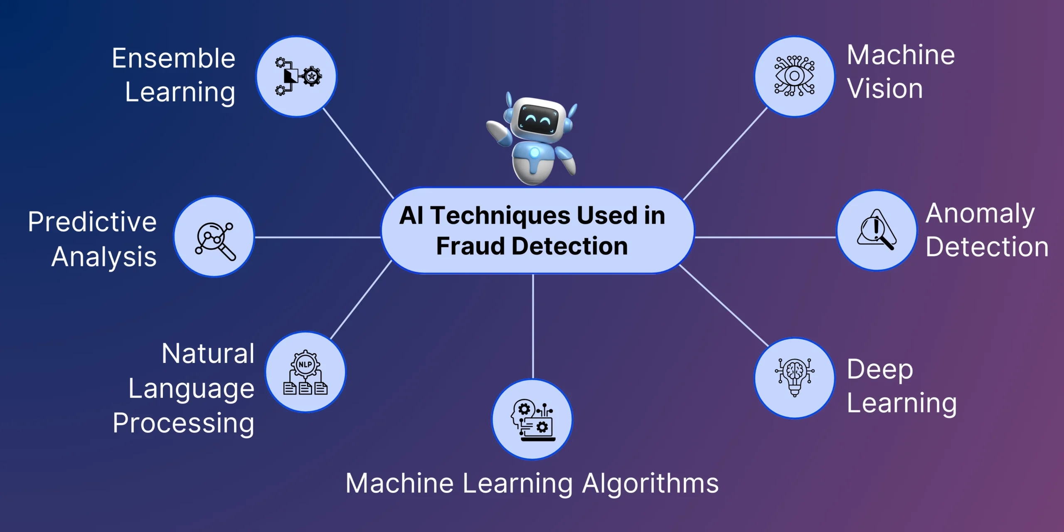
ThEme 1: AI Techniques in Fraud Detection
Machine learning models such as XGBoost and Random Forest dominate structured fraud detection pipelines [1].
Deep learning models, particularly CNNs, offer high accuracy in complex pattern recognition [4].
These models suffer from poor interpretability, limiting trust in automated decisions [9].
Balancing prediction accuracy and model transparency remains a critical trade-off [1], [4], [9].
Notes:
This slide describes the basic AI methods of fraud detection. XGBoost and Random Forest machine learning models are common because of their formatted results and performance. Models such as CNNs are very efficient in dealing with complicated patterns of fraud but are not interpretable. This black box nature may become a barrier to decision trust. The major dilemma is to find the right balance between the high detection and transparency in automated decisions.

Slide 8
Theme 2: The Black Box Problem
Deep learning models like neural networks lack inherent interpretability [5].
It is difficult to explain model outputs to users and regulatory bodies [6].
Lack of transparency affects auditability and trust in financial systems [5].
This opacity poses risks to compliance with AI governance standards [6].
Notes:
This slide has pointed out the severe problem that is called the black box problem in AI. Even though deep learning models are accurate, it is not a matter of how to make decisions, which is problematic in a controlled setting such as banking. Auditors and other financial practitioners are few in position and understanding to verify, and interpret fraud warnings, which discourages trust of operation. This transparency failure complicates the ability to observe regulatory requirements. With the increasing integration of AI within the finance industry, it is critical to consider this challenge to build systems that are both robust and responsible and audit in practical contexts.

Slide 9
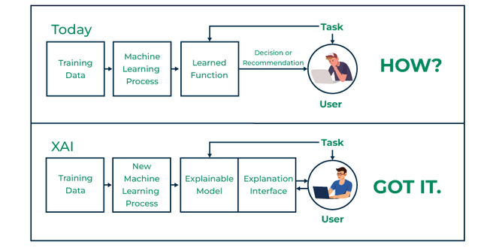
Theme 3: XAI Frameworks and Limitations
Post-hoc XAI methods like SHAP and LIME are widely used for model interpretability [3].
These techniques can be vulnerable to adversarial manipulation and may misrepresent decision logic [3].
Counterfactual explanations offer personalized insights but face consistency issues [10].
A shift toward neuro-symbolic AI enhances semantic transparency and reasoning [7].
Notes:
This slide is concerned with important XAI frameworks and weaknesses. Although post-hoc tools like SHAP and LIME are trendy towards explaining complex models, research has indicated that the tools are subject to manipulation to give misleading explanations, which are a danger to trust and reliability. These flaws have led to neuro-symbolic AI being investigated by researchers as a means to combine the pattern recognition aspect of neural networks and logical reasoning found in symbolic systems. This combination strategy will provide more faithful and readable by human’s explanations, to enhance the accuracy and accountability in financial fraud detection systems.

Slide 10
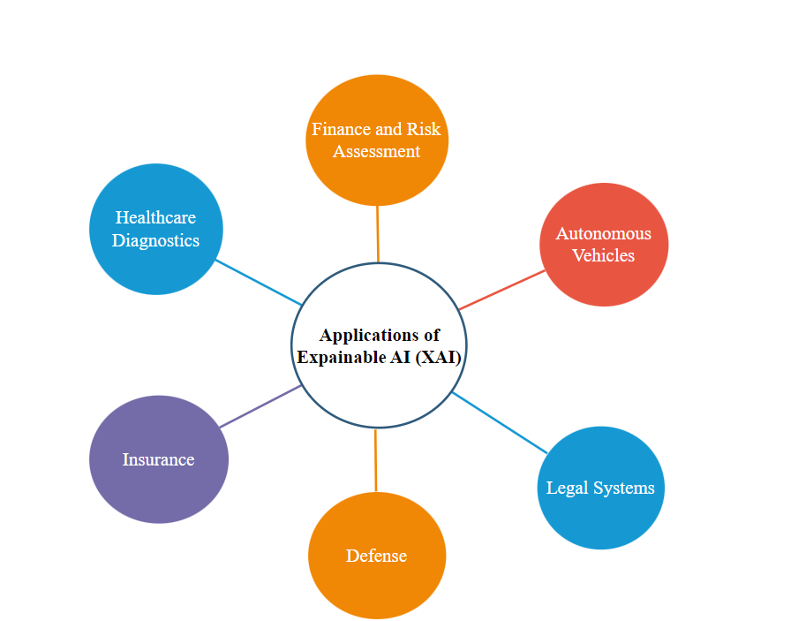
Theme 4: Applications of XAI in Finance
Real-time XAI systems assist banking staff in understanding AI-generated fraud alerts [2].
Federated learning with XAI enables secure collaboration while preserving data privacy [4].
Explainability supports transparency in anti-money laundering investigations [6].
XAI enhances compliance with regulatory expectations for auditability and accountability [9].
Notes:
This slide discusses the use of XAI in the real-time detection of fraud on the financial sector. It assists the staff to perceive the alerts and make decisions faster and more precise. Federated learning introduces privacy without compromising transparency. XAI is also useful in enhancing anti-money laundering efforts, and enhancing institutions to comply with regulatory demands of explainability, auditability and accountability in digital banking.

Slide 11
Theme 5: Ethics, Regulation, and Fairness
Algorithmic bias and GDPR violations challenge AI integrity in finance [6].
XAI ensures auditability, fairness, and redress mechanisms in digital banking [7].
Opacity in AI decision-making risks legal and reputational damage [8].
Human-centered design with XAI promotes responsible AI implementation.
Notes:
This slide discusses the use of XAI in the real-time detection of fraud on the financial sector. It assists the staff to perceive the alerts and make decisions faster and more precise. Federated learning introduces privacy without compromising transparency. XAI is also useful in enhancing anti-money laundering efforts, and enhancing institutions to comply with regulatory demands of explainability, auditability and accountability in digital banking.

Slide 12
Expected Outcomes
Anticipated: XAI improves model transparency, trust, and regulatory compliance [6].
Implications: Findings may guide policy, support ethical AI design, and advance technical frameworks [8].
Limitations: Reliance on secondary data may omit real-time dynamics.
Challenge: Fast-paced AI evolution could outdate current frameworks.
Notes:
In this research, it is expected that XAI will increase transparency, user trust, and compliance with regulations in fraud detection. The results can have an effect on policy and AI ethical design in the future. The secondary source of data may miss current problems, and the AI map can evolve quite rapidly, which will limit the validity of the existing systems in the long term.

Slide 13
Reference List
Alnaser, F.M., Rahi, S., Alghizzawi, M. and Ngah, A.H., 2023. Does artificial intelligence (AI) boost digital banking user satisfaction? Integration of expectation confirmation model and antecedents of artificial intelligence enabled digital banking. Heliyon, 9(8). https://www.cell.com/heliyon/pdf/S2405-8440(23)06138-8.pdf
Aziz, L.A.R. and Andriansyah, Y., 2023. The role artificial intelligence in modern banking: an exploration of AI-driven approaches for enhanced fraud prevention, risk management, and regulatory compliance. Reviews of Contemporary Business Analytics, 6(1), pp.110-132. https://www.researchgate.net/profile/Yuli-Andriansyah/publication/373489510_The_Role_Artificial_Intelligence_in_Modern_Banking_An_Exploration_of_AI-Driven_Approaches_for_Enhanced_Fraud_Prevention_Risk_Management_and_Regulatory_Compliance/links/64eecb546d6b3c6a2bac49ac/The-Role-Artificial-Intelligence-in-Modern-Banking-An-Exploration-of-AI-Driven-Approaches-for-Enhanced-Fraud-Prevention-Risk-Management-and-Regulatory-Compliance.pdf
Slack, D., Hilgard, S., Jia, E., Singh, S. and Lakkaraju, H., 2020, February. Fooling lime and shap: Adversarial attacks on post hoc explanation methods. In Proceedings of the AAAI/ACM Conference on AI, Ethics, and Society (pp. 180-186). https://dl.acm.org/doi/pdf/10.1145/3375627.3375830
Mohammed, A., 2025. Fraud Detection in Banking Data by Machine Learning Techniques. https://www.researchgate.net/profile/Amer-Mohammed-17/publication/390411352_Fraud_Detection_in_Banking_Data_by_Machine_Learning_Techniques/links/67ecd89e03b8d7280e1bde9e/Fraud-Detection-in-Banking-Data-by-Machine-Learning-Techniques.pdf
Hussain, J., 2019. Deep learning black box problem. https://www.diva-portal.org/smash/get/diva2:1353609/FULLTEXT01.pdf
Patil, D., 2024. Artificial Intelligence In Financial Risk Assessment And Fraud Detection: Opportunities And Ethical Concerns. Available at SSRN 5057434. https://papers.ssrn.com/sol3/Delivery.cfm?abstractid=5057434
Singh, S. and Yadav, D., Explainable AI: Bridging Performance, Transparency, and Accountability in High-Stakes Systems. Next-Gen Machine Learning: Algorithms for Adaptive Intelligence, p.84. https://www.researchgate.net/profile/Arihant-Pattnaik/publication/395467777_Neuro-Symbolic_AI_Bridging_Reasoning_and_Learning/links/68c662a59534473a6d4aa74e/Neuro-Symbolic-AI-Bridging-Reasoning-and-Learning.pdf#page=93
Patel, K., 2024. Ethical reflections on data-centric AI: balancing benefits and risks. Available at SSRN 4993089. https://papers.ssrn.com/sol3/Delivery.cfm?abstractid=4993089
Hentzen, J.K., Hoffmann, A., Dolan, R. and Pala, E., 2022. Artificial intelligence in customer-facing financial services: a systematic literature review and agenda for future research. International journal of bank marketing, 40(6), pp.1299-1336. https://arvidhoffmann.nl/Hentzen%20et%20al.%202021%20IJBM.pdf
Das, A. and Rad, P., 2020. Opportunities and challenges in explainable artificial intelligence (xai): A survey. arXiv preprint arXiv:2006.11371. https://arxiv.org/pdf/2006.11371

Slide 14
Thank you

