Slide 1

MANAGEMENT OF SUSTAINABLE CONSTRUCTION
LIFE CYCLE COST ANALYSIS
Juan A Ferriz-Papi

Slide 2

LIFE CYCLE COST
LIFE CYCLE COST
Method for assessing the total cost of facility ownership
Consideration of costs of acquiring, owning and disposing of a building or building system
Different alternatives to fulfil the same performance
Assessment of initial costs, operating, maintenance and end of life costs
Comparison of costs at different stages of the life cycle
Choose the most cost-effective option

Slide 3
LIFE CYCLE COST
LIFE CYCLE COST
Other techniques for economic evaluation:
Net savings (or net benefits)
Savings-to-investment ratio
Internal Rate of Return
Payback period

Slide 4
LIFE CYCLE COST
LIFE CYCLE COST
COSTS
Very different costs associated. Classification in categories:
Initial costs
Energy and water
Operation, maintenance and repair
Replacement costs
Residual value
Other costs

Slide 5
LIFE CYCLE COST
LIFE CYCLE COST
COSTS
Initial Costs
Land acquisition
Construction
Installation
Purchase/procurement
Energy and Water
Energy usage (occupancy, building use, external consumptions, etc.)
Energy price and projections
Water costs (water supply and water discharge)

Slide 6
LIFE CYCLE COST
LIFE CYCLE COST
COSTS
Operation, maintenance and repair
Historical data
Specifications from supplier
Statistical analysis
Waste management
Replacement costs and residual value
Other costs
Finance charges and taxes
Non-monetary benefits or costs (aesthetics, historic preservation, Security, safety, etc.)

Slide 7
LIFE CYCLE COST
LIFE CYCLE COST
EXAMPLE
Compare the Life Cycle cost of a 58 W Fluorescent Tube to 20 W LED Tube running 24/7 over 3 years (26,280 hours).

Slide 8
LIFE CYCLE COST
LIFE CYCLE COST
EXAMPLE
58 W Fluorescent Tube running 24/7 over 3 years
Initial Cost
58W Fluorescent Tube - £1.36
Operation Cost
Energy consumed – 58W x 24h x 365 days x 3 years = 1,524 kWh
£0.12375 x 1,524 kWh = £188.60
Maintenance Cost
Replacement every 25,000 hours
Working 24h x 365days x 3 years = 26,280 hours
Total = 1 replacement - £1.36
Total LCC = £1.36 + £188.60 + £1.36 = £191.32

Slide 9
LIFE CYCLE COST
LIFE CYCLE COST
EXAMPLE
20 W LED Tube running 24/7 over 3 years
Initial Cost
20W LED Tube - £9.52
Operation Cost
Energy consumed – 20W x 24h x 365 days x 3 years = 525.6 kWh
£0.12375 x 525.6 kWh = £65.04
Maintenance Cost
Replacement every 50,000 hours
Working 24h x 365days x 3 years = 26,280 hours
Total = 0 replacements
Total LCC = £9.52 + £65.04 = £74.56
61% CHEAPER

Slide 10
LIFE CYCLE COST
LIFE CYCLE COST
QUESTIONS
Can you calculate the LCC of a heating system boiler for one building?
What costs should be considered?
Do you think the money we invest today has the same value 10 years later?
What risks/uncertainties can be identified in this procedure?

Slide 11

LIFE CYCLE COST
LIFE CYCLE COST
PRESENT-VALUE ANALYSIS
Compare cash-flows incurred at different times during the life cycle.
Convert them to present values
Discount rate - Interest rate used– reflects the investor’s opportunity cost of money over time
$$F=P×{\left(1+i\right)}^{n}$$
F: Future value
P: Present value
i: discount rate (per year)
n: number of years

Slide 12
LIFE CYCLE COST
LIFE CYCLE COST
UNCERTAINTY ASSESSMENT IN LIFE-CYCLE COST ANALYSIS
SENSITIVITY ANALYSIS
Identification of critical parameters that can take the greatest impact
Testing different scenarios to answer “what if” questions
Simply change the value of each input up and down, holding all others constant, and recalculate the economic measure to be tested.

Slide 13
LIFE CYCLE COST
LIFE CYCLE COST
UNCERTAINTY ASSESSMENT IN LIFE-CYCLE COST ANALYSIS
BREAK-EVEN ANALYSIS
maximum cost of an input that will allow the project to still break even, or conversely, what minimum benefit a project can produce and still cover the cost of the investment.

Slide 14
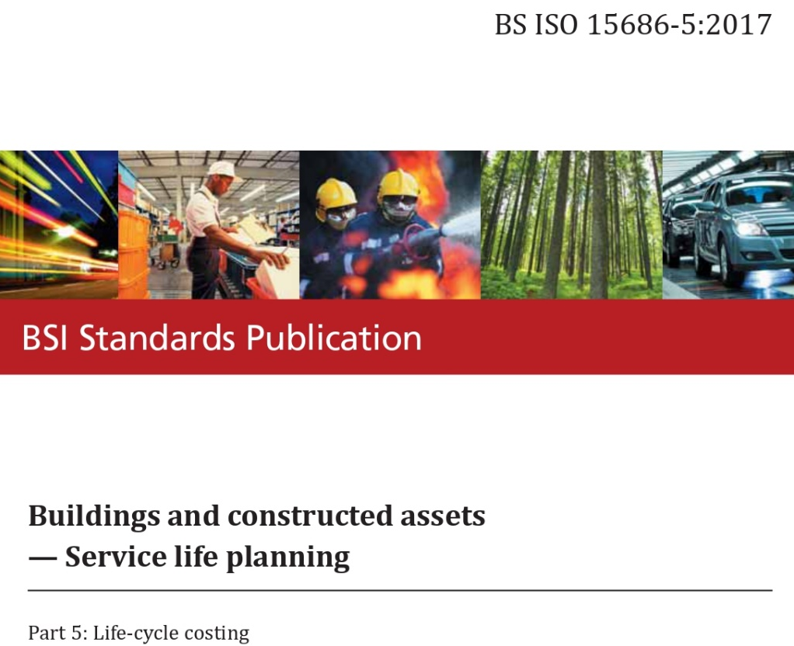
LIFE CYCLE COST

Slide 15
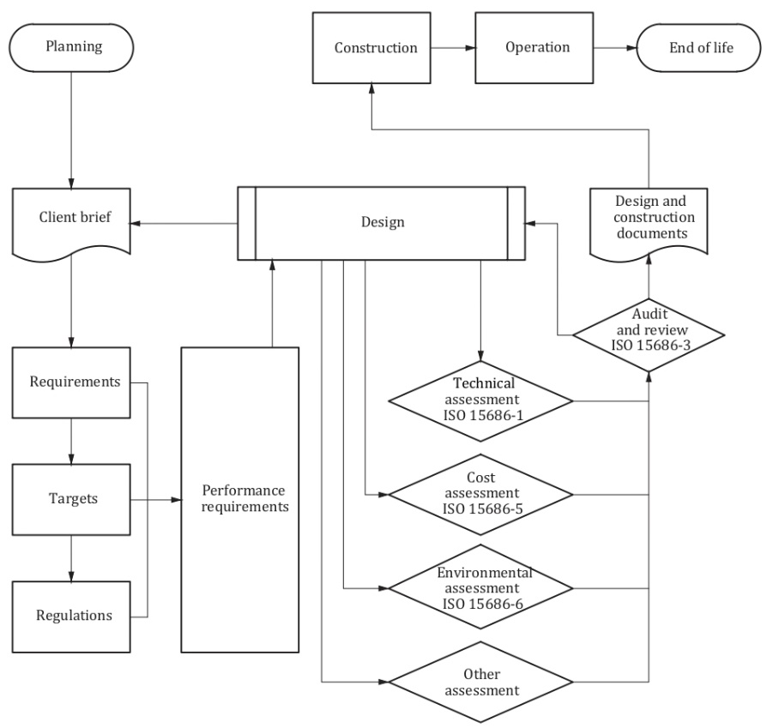
LIFE CYCLE COST
BS ISO 15686-5:2017
Performance Requirements

Slide 16
LIFE CYCLE COST
LIFE CYCLE COST
DEFINITIONS (BS ISO 15686-5:2017)
Whole-life cost
All significant and relevant initial and future costs and benefits of an asset, throughout its life cycle, while fulfilling the performance requirements.
Life Cycle Cost
Cost of an asset or its parts throughout its life cyle, while fulfilling the performance requirements.
Operation cost
Costs incurred in running and managing the facility or built environment, including administration support services.
Maintenance cost
Total of necessarily incurred labour, material and other related costs incurred to retain a building or its parts in a state in which it can perform its required functions.

Slide 17
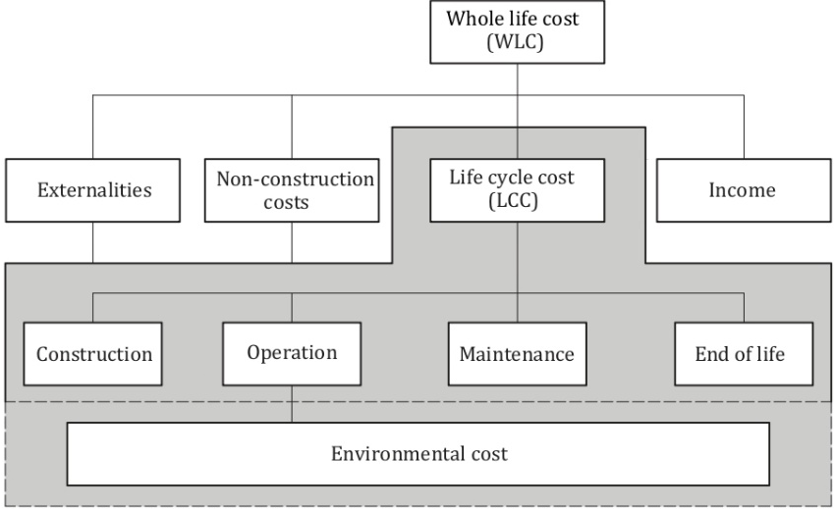
LIFE CYCLE COST
BS ISO 15686-5:2017
WLC and LCC elements

Slide 18
LIFE CYCLE COST
BS ISO 15686-5:2017
Typical decisions informed by Life Cycle Cost Analysis (LCCA)
Evaluation of different investment scenarios
Choices between alternative designs
Choices among alternative components
Comparison and/or benchmarking analysis of previous decisions
Estimation of future costs for budgetary purposes or investment approval

Slide 19
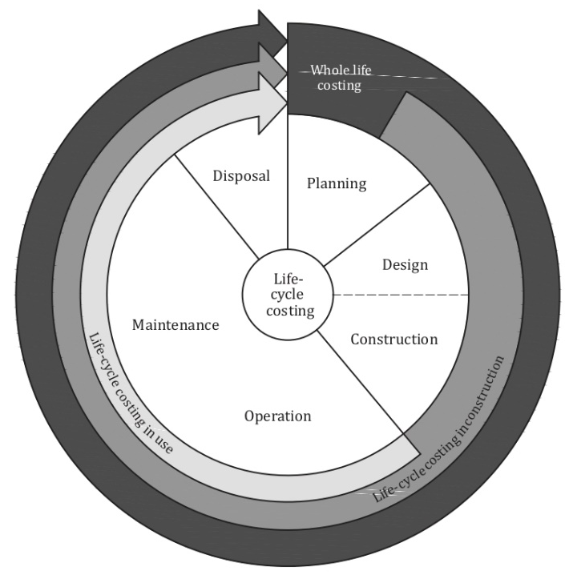
LIFE CYCLE COST
BS ISO 15686-5:2017
Analysis at different stages of the life cycle

Slide 20
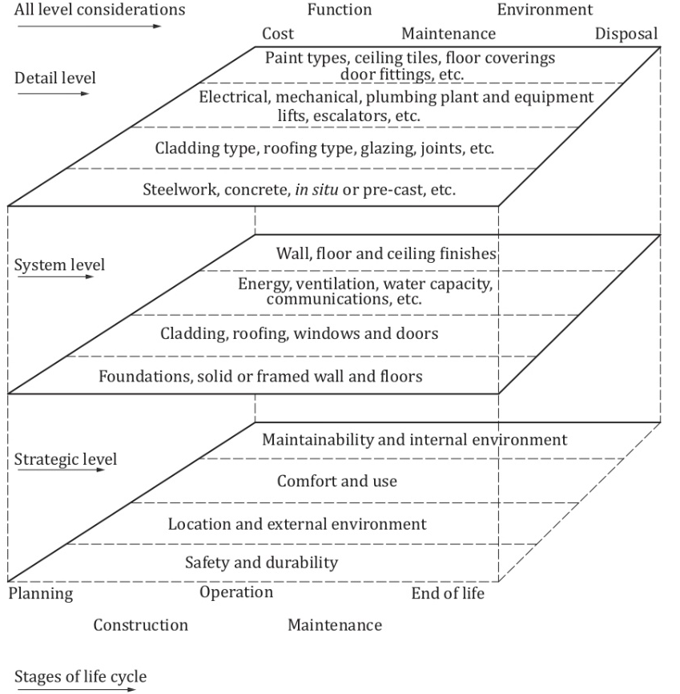
LIFE CYCLE COST
BS ISO 15686-5:2017
Different levels of analysis at different stages of the life cycle

Slide 21
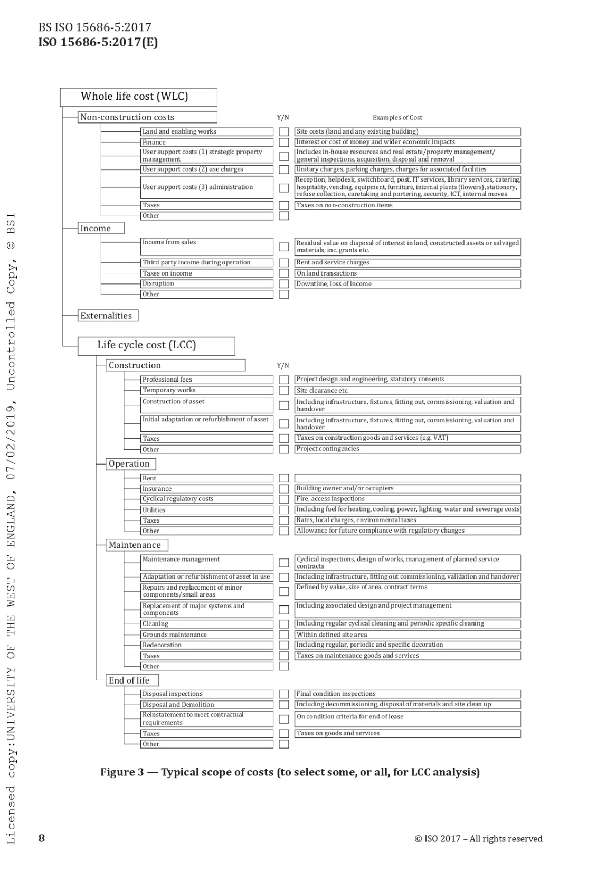
LIFE CYCLE COST
BS ISO 15686-5:2017
Classification of costs
Typical scope of costs

Slide 22
LIFE CYCLE COST
BS ISO 15686-5:2017

Slide 23
LIFE CYCLE COST
BS ISO 15686-5:2017

Slide 24
LIFE CYCLE COST
BS ISO 15686-5:2017

