Slide 1
Reflections on Privatisation of the Water Industry in Wales
Huw Thomas
huw.thomas@tsd.ac.uk

Slide 2
1989: a key date
Before then:
  Water Boards / Water Authorities
  Formed from amalgamation of municipal and many small, local services
  Water mains system from Victorian times (>25% leakage)
  Many areas with only basic sewage treatment
After:
  PLCs and ‘holding’ companies
  Stakeholders - Shareholders
Notes:
In Welsh, still some people who refer to y Bwrdd Dwr (water board)
Mention treatment works near Knab Rock/Verdi’s – maceration only

Slide 3

Some marketing issues
Public awareness:
from uninformed ignorance
to informed concern
Monopoly position – no consumer choice
Image & perceptions
Notes:
Previously – turn on the tap = fresh clean drinking water. Flush the toilet = away the waste goes!
John Elfed Jones: “If people had a choice, we would want them to choose us”!
Started talk of developing the ‘brand’ – linked to share price and stakeholder confidence
From old plumber in overalls to modern & efficient
Newsletters and mail-outs, but most people thought “well they would say that wouldn’t they” – communications process and recipients interpreting the message to conform to their beliefs

Slide 4

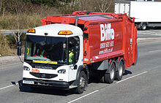
Strategic Issues
Short term - cash rich
3-8 year programme of multi-£m engineering investments
Growth through aquisition:
Acer & Wallace Evans
Swalec
Severn Trent - Biffa
Notes:
Finally have the money for engineering investment, but new engineering projects take considerable time eg Swansea Bay WWTW 8 years and £85m cost
Wallace Evans – Penart based consulting engineers – projects worldwide eg airport runways and other major engineering projects in water and sewerage infrastructure
Seevrn Trent - Biffa waste disposal

Slide 5

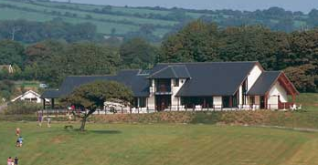
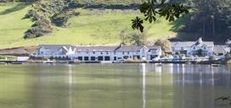
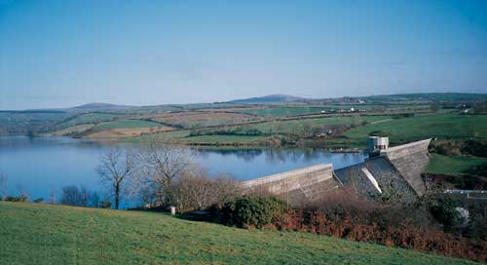
Other opportunities ....
Hyder
Hamdden: reservoirs, fishing, hotels!
Notes:
Hyder – using expertise of Acer consulting and Wallace Evans to get involved in projects outside Wales
Hamdden – quality country house hotels. Eventually owned 5.
Fishing at reservoirs. Ty’n y Cornel – 222 acre lake with wild brown trout fishing.
Visitor centres at reservoirs – Llys y Fran 1m visitors a year Llandegfedd (SE) Llyn Brenig N Wales
Also note the names – Hyder = confidence. Hamdden = leisure

Slide 6
Criticisms
Directors’ salaries – same people there when it was a Water Authority
Real & perceived delays in engineering works and improvements
Blue flag beaches – Britain the ‘dirty man’ of Europe. Campaigns eg Surfers Against Sewage
Notes:
Directors salaries tripled in 2 years, some from 48k to 150k plus share options
Major projects not going to happen overnight, but still burst mains, poor sewage treatment, high leakage rates – and increased public awareness. Surfers Against Sewage

Slide 7
Change perceptions?
Privatisation was a Government decision, but for some time this was not accepted as an ‘excuse’ by the media. Eventually changed.
Can you have choice with a monopoly?
Media campaign – newspaper ads ok, not TV
Notes:
Govt decision, but this was not always accepted as a good defense for water companies to hide behind – get on with the improvements etc. Eventually many journalists tired of the water companies saying ‘don’t blame us for acting as a private company .. that’s what we are now!’
John Elfed Jones – if people had a choice, we would want them to choose us
adverts – campaign to get public support. TV too high profile (and expensive) –may be seen as ‘wasting’ bill payers money.

Slide 8
PR activities
‘Events’ at completion of engineering projects
Community projects, sponsorship, schools, agric.shows & Eisteddfodau
Internal Comms – newsletter, quarterly staff video
Newsletters and mailouts
Re-active press: burst mains, boiling orders
Notes:
Events – press and media, local councillors, community leaders etc.
Sponsorship – Tall Ships Race, but never on the level of Swalec – rugby etc Scott Gibbs
Schools – water cycle, education officer, but small scale
RWAS, 3 counties, Anglesey show, Urdd & Nat Eisteddfod 250k tomos the tap
Mail-outs, estimated over 1m pieces of print annually
But after some re-organisation, HT became basically a press officer for burst mains, boiling orders etc

Slide 9
Bottled water?
For many years after privatisation, may have been seen as a diversion from core activities
Not a priority
Have market conditions changed for this ‘convenience’ product (Tesco & Asda)
Bottled Dŵr Cymru on sale in other parts of UK?
Notes:
Commercial development of bottled water not seen as a prority
Bottled water is a ‘convenience product’
Tesco and Asda August 2012 selling bottled mains water – as ‘still water’ filtered to remove chlorine and ‘impurities’ 17p for 2 litres, no mention on label that its tap water (44p for Tesco own label mineral water)

Slide 10
Conclusions?
Strategic direction
Seemed like a good idea at the time:
Privatisation & water company strategic decision making
Shareholder- stakeholder imbalance? – note current structure of Dŵr Cymru Welsh Water
Notes:
Strategic issues – difficult when a monopoly

Slide 11
Any questions ...
Diolch – Thankyou!
Huw.thomas@tsd.ac.uk
Notes:
Strategic issues

