Slide 1
Psychopathological Classifications & Provisions
BMHP6029_BIRM
Component 1 poster
Aisha Begum
2321254

Slide 2
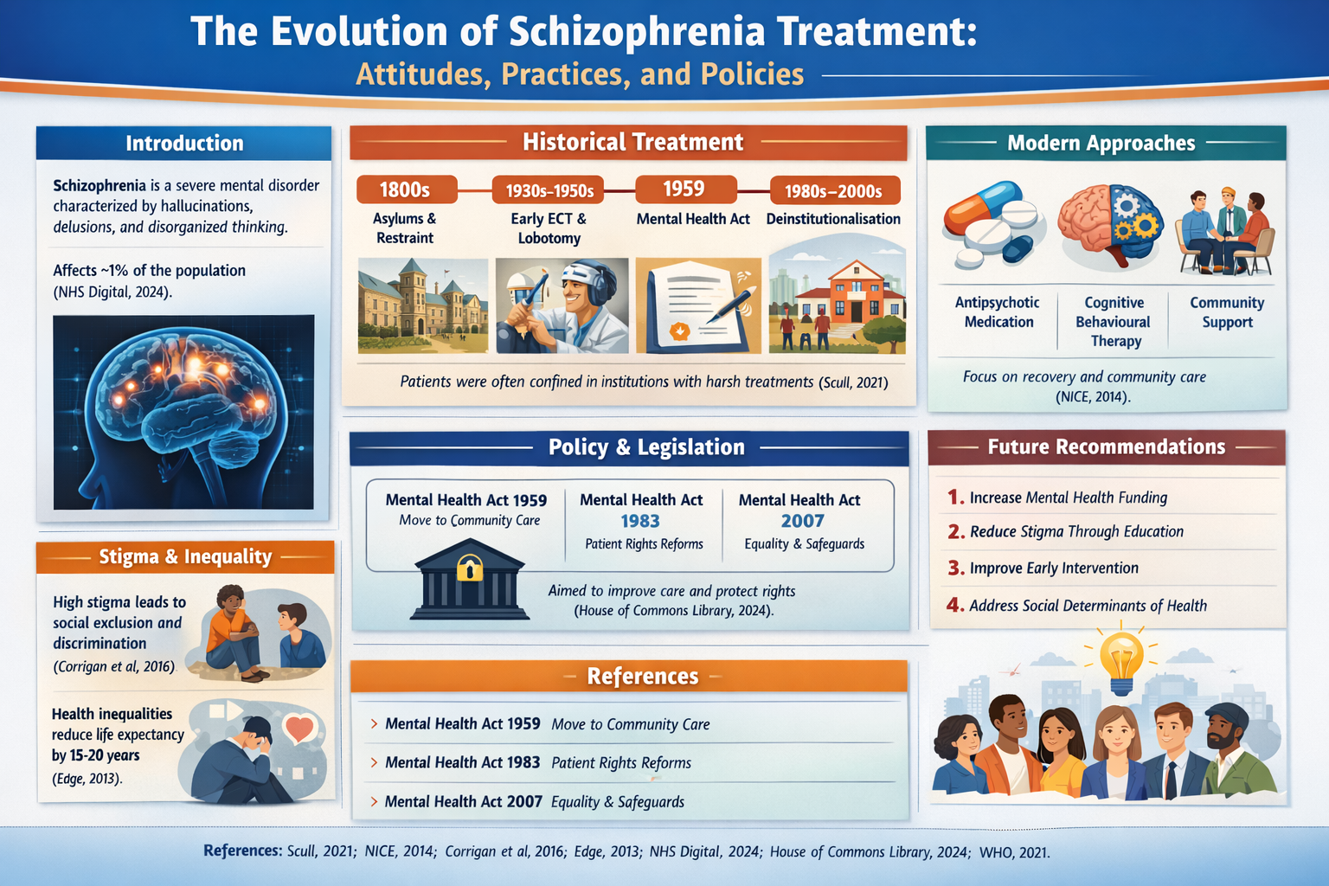
Notes:
Today I will be discussing schizophrenia and critically analysing how attitudes, treatment practices, and policies have evolved over time.
Schizophrenia is a severe and long-term mental health disorder characterised by symptoms such as hallucinations, delusions, disorganised thinking, and social withdrawal. It significantly affects a person’s ability to function in daily life.
It is important to study schizophrenia because it is one of the most serious and stigmatised mental health conditions worldwide. Understanding its historical treatment, social attitudes, and policy developments helps us evaluate how far mental health care has progressed and what improvements are still needed.
HISTORICAL treatments 2 mins
Historically, schizophrenia was poorly understood. In the 18th and 19th centuries, individuals with severe mental illness were often placed in large psychiatric institutions or asylums.
Care focused mainly on containment rather than recovery. Patients were sometimes restrained, isolated, or subjected to treatments that would now be considered unethical.
This reflects the strong stigma that existed at the time. Mental illness was often viewed as dangerous, uncontrollable, or even a moral failing rather than a medical condition.
These historical practices show how limited scientific understanding and negative social attitudes shaped treatment.
CHANGING ATTITUDES 2 MINUTES
In the mid-20th century, attitudes began to change due to advances in medical research.
The development of antipsychotic medication in the 1950s was a major turning point. For the first time, symptoms such as hallucinations and delusions could be managed more effectively.
There was also a shift from institutional care towards community-based care. This reflected growing recognition that people with schizophrenia could live meaningful lives outside hospital settings.
Despite these advances, stigma has not completely disappeared. Although medical understanding improved, negative stereotypes and discrimination continue to affect individuals today.
POLICY AND LEGISLATION 2 MINUTES
Mental health policy has played an important role in shaping care.
In the UK, the Mental Health Act introduced legal frameworks to regulate treatment, particularly when individuals may need compulsory care for safety reasons.
The Act aimed to balance patient rights with public safety. Later reforms strengthened safeguards, ensuring greater protection, review processes, and rights for individuals receiving treatment.
These legislative changes reflect a shift towards more ethical, rights-based mental health care, moving away from purely institutional control towards accountability and patient protection.
CONTEMPORARY TREATMENTS 2 MINUTES
Today, schizophrenia is treated using a biopsychosocial approach. This means care considers biological, psychological, and social factors.
Biological treatment usually includes antipsychotic medication.
Psychological support may include therapies such as Cognitive Behavioural Therapy, which helps individuals manage symptoms and develop coping strategies.
Social interventions are also essential, including community mental health teams, supported housing, employment support, and family involvement.
This integrated approach recognises that recovery is not just about reducing symptoms, but about improving quality of life and social functioning.
FUTURE RECOMMENDATIONS 1 MINUTE
Although progress has been made, improvements are still needed.
First, early intervention services should be expanded. Research shows that early treatment leads to better long-term outcomes.
Second, stigma must be reduced through education and public awareness campaigns. Stigma continues to contribute to discrimination and delays in seeking help.
Finally, community mental health services should be strengthened, with better funding and improved access, particularly for disadvantaged and minority groups.
Addressing social inequalities is essential for ensuring fair and effective mental health care.

Slide 3
REFERENCES
American Psychiatric Association (2022) Diagnostic and statistical manual of mental disorders (DSM-5-TR). Arlington, VA: American Psychiatric Publishing.
Bhugra, D., et al. (2010) ‘Schizophrenia: prejudice and public awareness’, International Review of Psychiatry, 22(4), pp. 1–8.
Corrigan, P. and Watson, A.C. (2002) ‘Understanding the impact of stigma on people with mental illness’, World Psychiatry, 1(1), pp. 16–20. Available at: https://www.ncbi.nlm.nih.gov/pmc/articles/PMC1489832/ (Accessed: 6 March 2026).
Department of Health (2007) Mental Health Act 2007: Policy paper. Available at: https://www.gov.uk/government/publications/mental-health-act-2007-policy-paper (Accessed: 6 March 2026).
Healy, D. (2002) The creation of psychopharmacology. Cambridge, MA: Harvard University Press.
Mental Health Act 1983. Available at: https://www.legislation.gov.uk/ukpga/1983/20/contents (Accessed: 6 March 2026).
Mental Health Act 2007. Available at: https://www.legislation.gov.uk/ukpga/2007/12/contents (Accessed: 6 March 2026).
Mueser, K.T. and McGurk, S.R. (2004) ‘Schizophrenia’, The Lancet, 363(9426), pp. 2063–2072. Available at: https://www.sciencedirect.com/science/article/pii/S0140673604163631 (Accessed: 6 March 2026).
National Institute for Health and Care Excellence (NICE) (2014) Psychosis and schizophrenia in adults: prevention and management (CG178). Available at: https://www.nice.org.uk/guidance/cg178 (Accessed: 6 March 2026).
NHS Digital (2024) Adult psychiatric morbidity survey: psychotic disorders. Available at: https://digital.nhs.uk/data-and-information/publications/statistical/adult-psychiatric-morbidity-survey/survey-of-mental-health-and-wellbeing-england-2023-24/psychotic-disorder (Accessed: 6 March 2026).
Pilgrim, D. (2019) Key concepts in mental health. 3rd edn. London: SAGE Publications.
Porter, R. (2002) Madness: A brief history. Oxford: Oxford University Press.
Thornicroft, G. (2006) Shunned: discrimination against people with mental illness. Oxford: Oxford University Press.
van Os, J. and Kapur, S. (2009) ‘Schizophrenia’, The Lancet, 374(9690), pp. 635–645. Available at: https://www.thelancet.com/journals/lancet/article/PIIS0140-6736(09)60995-8/fulltext (Accessed: 6 March 2026).
World Health Organization (WHO) (2022) Schizophrenia fact sheet. Available at: https://www.who.int/news-room/fact-sheets/detail/schizophrenia (Accessed: 6 March 2026)

