Slide 1
BMHP5001
Complementary Therapies
Week 3: Exploring research focusing on complementary therapies

Slide 2
MODULE AIM & LEARNING OUTCOMES
AIM
To develop learners understanding of the role of complementary therapies in health and social care and their effectiveness in maintaining health and wellbeing.
LEARNING OUTCOMES
1. Critically understand the principles behind current use of complementary therapies
2. Critically understand the role of complementary therapies in relation and comparison to orthodox treatments
3. Analyse evidence for the efficacy of complementary therapies in sustaining health and wellbeing
4. Evaluate the systems for regulating the use of complementary therapies.

Slide 3
Lesson Objectives
1. Analyse the use of complementary therapies
2. Analyse treatments available
3. Discuss physical and psychological effects
4. Use research available to discuss the use, benefits of CTs

Slide 4
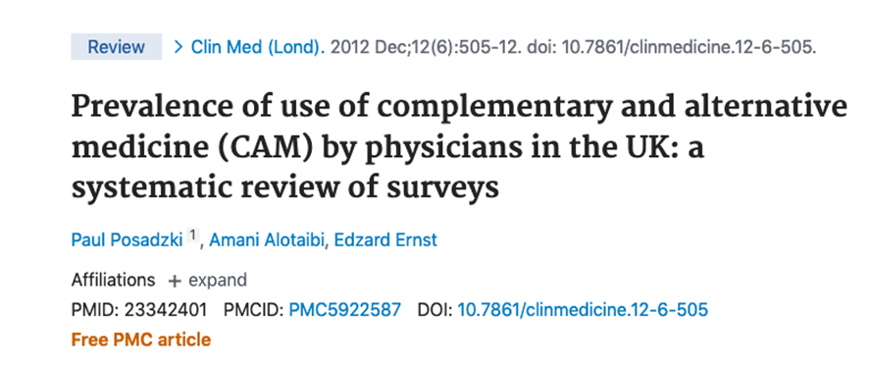

Slide 5
Summary of findings
(Posadzki et al., 2012)
This systematic review aims to estimate the prevalence of use of complementary and alternative medicine (CAM) by physicians in the UK.
14 papers that reported 13 separate surveys were reviewed
The average prevalence of use of CAM across all surveys was 20.6% (range 12.1–32%).
The average referral rate to CAM was 39% (range 24.6–86%), and CAM was recommended by 46% of physicians (range 38–55%).
The average percentage of physicians who had received training in CAM was 10.3% (range 4.8–21%).
The three most commonly used methods of CAM were acupuncture, homeopathy and relaxation therapy.

Slide 6
Discussion
On average, 20.6% physicians use CTs, but only 10.3% received training.
What issues might arise from that?
Notes:
Students should start thinking about issues related to medical ethics, professional competence and education of physicians.
These will be further explored in the next weeks

Slide 7
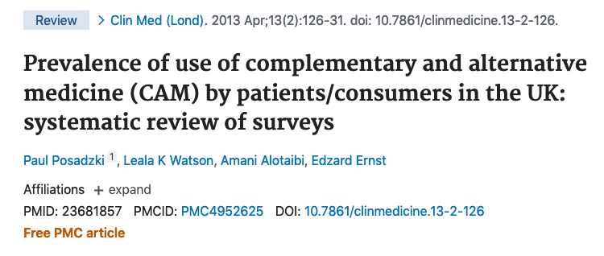

Slide 8
Summary of findings
(Posadzki et al., 2013)
This systematic review aimed to estimate the prevalence of use of complementary and alternative medicine (CAM) in the UK.
Eighty-nine surveys were included, with a total of 97,222 participants.
Across surveys on CAM in general, the average one-year prevalence of use of CAM was 41.1% and the average lifetime prevalence was 51.8%. In methodologically sound surveys, the equivalent rates were 26.3% and 44%, respectively.
Herbal medicine was the most popular CAM, followed by homeopathy, aromatherapy, massage and reflexology.

Slide 9
Discussion
Many patients and consumers in the UK use CAM, therefore, what is the role of healthcare professionals in ensuring patients’ safety?

Slide 10
What are the reasons for individuals using CTs?
Complex, no single determinant
E.g. consider as a scenario a patient with AIDS and a patient who is worried about their fitness levels – discussion
CT is usually a first choice of treatment or the last – discuss: how do you understand it?

Slide 11
Motivations for trying CTs – positive
Perceived effectiveness
Perceived safety
Philosophical congruence: “Zeitgeist”; spiritual dimension; emphasis on holism; embracing all things natural; active role of patient; explanations intuitively acceptable
Control over treatment
“High touch, low tech”
Good patient/therapist relationship: enough time available; on equal terms; emotional factors; empathy
Non-invasive nature
Accessibility
Pleasant therapeutic experience
Affluence.

Slide 12
Motivations for trying CTs – negative
Dissatisfaction with (some aspects of) conventional health care: ineffective for certain conditions; serious adverse effects; poor doctor - patient relationship; insufficient time with doctor; waiting lists; “high tech, low touch”
Rejection of science and technology
Rejection of “the establishment”
Desperation.

Slide 13
Why people use complementary therapies? (according to Cancer Research)
Using therapies to help you feel better (to cope with a disease or with a treatment), e.g. reducing stress, increasing sense of wellbeing
Reducing symptoms or side effects (e.g. acupuncture can help to relieve sickness caused by some chemotherapy drugs or post surgery pain)
Feeling more in control (often doctors take decisions about the treatment, so individual do not feel like they have control over their own health)
Natural and healing therapies (seem natural, non-toxic, so safe; but interaction with conventional medicine needs to be consider).

Slide 14
Why people use complementary therapies? (according to Cancer Research)
Comfort from touch, talk and time (good therapist can be very supportive during treatment, e.g. caring aromatherapist can take the time to make an individual feel cared for)
Staying positive (positive outlook for the future)
Boosting your immune system (e.g. to help the immune system fight the disease; feeling good, increasing quality sleep and reducing stress boosts the immune system)
Looking for a cure (e.g. either instead of conventional treatment or when there is no hope, like in advanced disease).

Slide 15
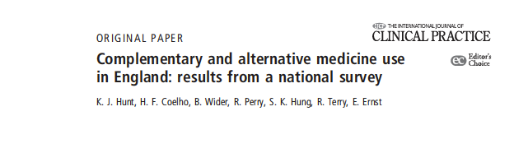
Characteristics of CTs / CAM users

Slide 16
Activity
Students should read the Results section of the paper and answer in three groups the following questions:
Which therapy had the highest lifetime prevalence?
Which therapy had the highest prevalence of male users?
Were osteopathy users older or younger?
What are the demographic characteristics of CTs / CAM users according to the results of this study?
Were users with higher or lower BMI the most common users of CTs / CAM?
Were users with pain using CTs significantly more than those without pain?
Users not taking medication were more frequently using CTs / CAM. True or False?
Nearly 60% of CTs / CAM users suffer from depression or anxiety. True or False?
Is there a difference in % of CTs / CAM users between individuals who are and are not members of religious groups? If yes, what is the difference?
What is % of CTs / CAM users consuming less than 5 portions of fruit and vegetables per day?
Notes:
discuss the significant of these resukts

Slide 17
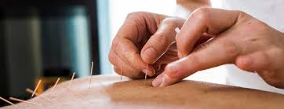
The analysis of CT, based on the example of acupuncture

Slide 18

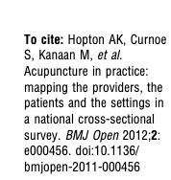

Slide 19
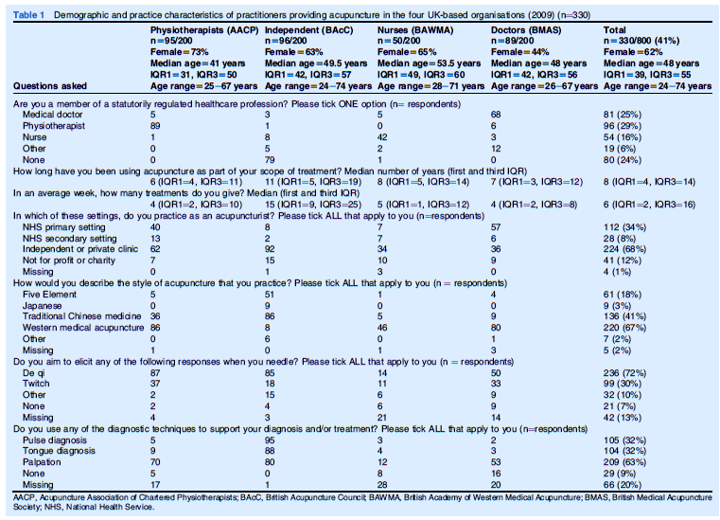

Slide 20
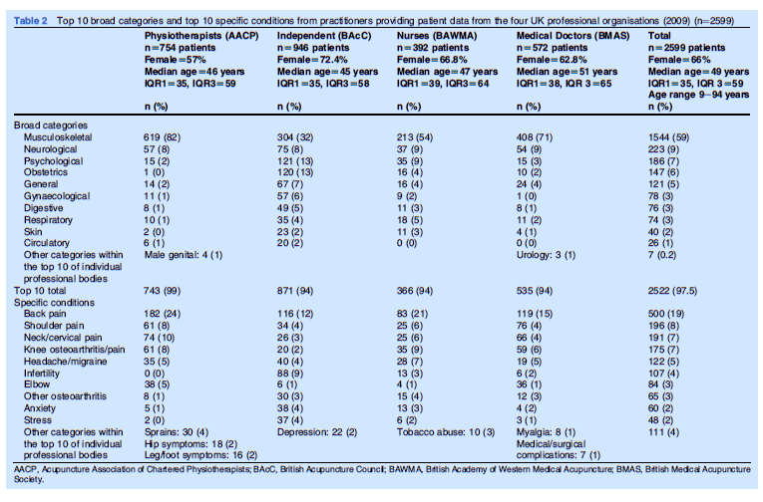

Slide 21
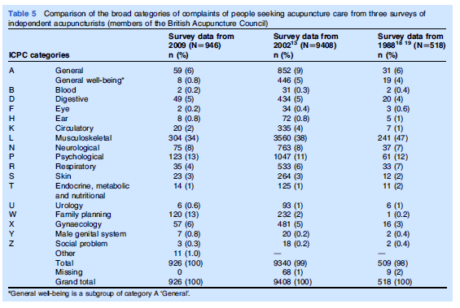

Slide 22
Answer questions based on the study results:
Which group of practitioners used acupuncture, as the part of their treatment, the longest?
What is % of practitioners working from independent or private clinics?
What is the most popular style of acupuncture?
What is the most / the least popular diagnosis and treatment?
What are the three most common conditions patients use acupuncture treatment?
When looking at 1998, 2002, 2008 surveys, which types of complaints are on a rise amongst those seeking acupuncture treatment?

Slide 23
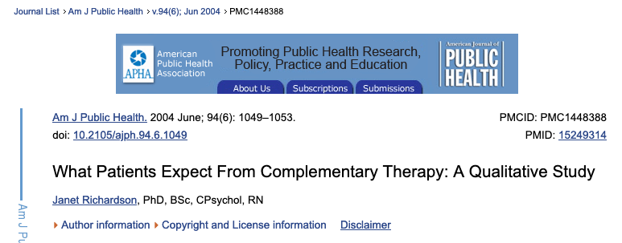
Patients’ expectations from CTs / CAM
Read the results section from the paper below and discuss what are the patients’ expectations. Note the differences in expectations.

Slide 24
Treatments
Body (touch)
Diet / nutrients / herbs
Mind
Energy
Senses

Slide 25
Body (touch)
Has been used in medicine since the early days of medical care.
Healing by touch is based on the idea that illness or injury in one area of the body can affect all parts of the body. If, with manual manipulation, the other parts can be brought back to optimum health, the body can fully focus on healing at the site of injury or illness.
Body techniques are often combined with those of the mind. Examples of body therapies include:
  Chiropractic and osteopathic medicine
  Massage
  Body movement therapies
  Tai chi
  Yoga

Slide 26
Diet and herbs
Over the centuries, man has gone from a simple diet consisting of meats, fruits, vegetables, and grains, to a diet that often consists of foods rich in fats, oils, and complex carbohydrates.
Nutritional excess and deficiency have become problems in today's society, both leading to certain chronic diseases.
Many dietary and herbal approaches attempt to balance the body's nutritional well-being. Dietary and herbal approaches may include:
  Dietary supplements
  Herbal medicine
  Nutrition/diet.

Slide 27
Mind
Even standard or conventional medicine recognises the power of the connection between mind and body.
Studies have found that people heal better if they have good emotional and mental health.
Therapies using the mind may include:
  Meditation
  Biofeedback
  Hypnosis.

Slide 28
External energy
From objects or other sources directly affect a person's health. An example of external energy therapy is:
  Electromagnetic therapy
  Reiki
  Qigong

Slide 29
Senses
Touch, sight, hearing, smell, and taste.
Examples of therapies incorporating the senses include:
  Art, dance, and music
  Visualization and guided imagery.

Slide 30
Tools / equipment / questionnaires used in CT
Discussion – think about your experiences from CT? Have therapists used any tools? Equipment? questionnaires?

Slide 31
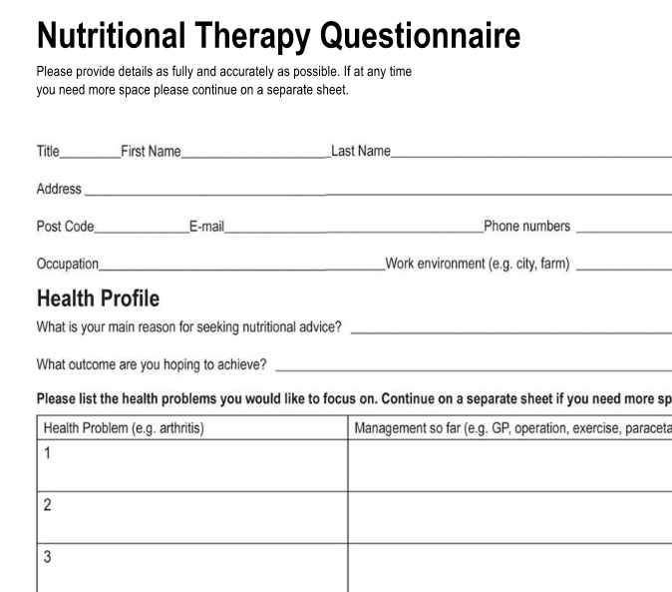
Activity
Look at the Nutritional Therapy Questionnaire available on Moodle and prepare yourself for a discussion on the following:
What are advantages and disadvantages of using questionnaires in CT?
What are advantages and disadvantages of this questionnaire?
Do you think information provided can give a therapist a good overview of person’s health?
Look at the questions provide in the questionnaire – are thee any questions which might be too difficult to answer? Why?

Slide 32
Physical and Psychological effects
Discussion
What physical benefits can patients have from CTs?
What psychological benefits can patients have from CTs?

Slide 33
Physical and Psychological effects
Tai chi – pain relief, mobility improvement, improvement in the quality of life
Gingko Bilboa for memory
Vitamins and minerals – feeling better, weight loss
Physical manipulation (chiropractors, osteopaths, massage) – movements, physical pain relief, mental health improvement
Yoga – movement, physical pain, stress.

Slide 34
Any Questions?

