Slide 1

PRISONS- REHABILITATIVE CULTURE

Slide 2
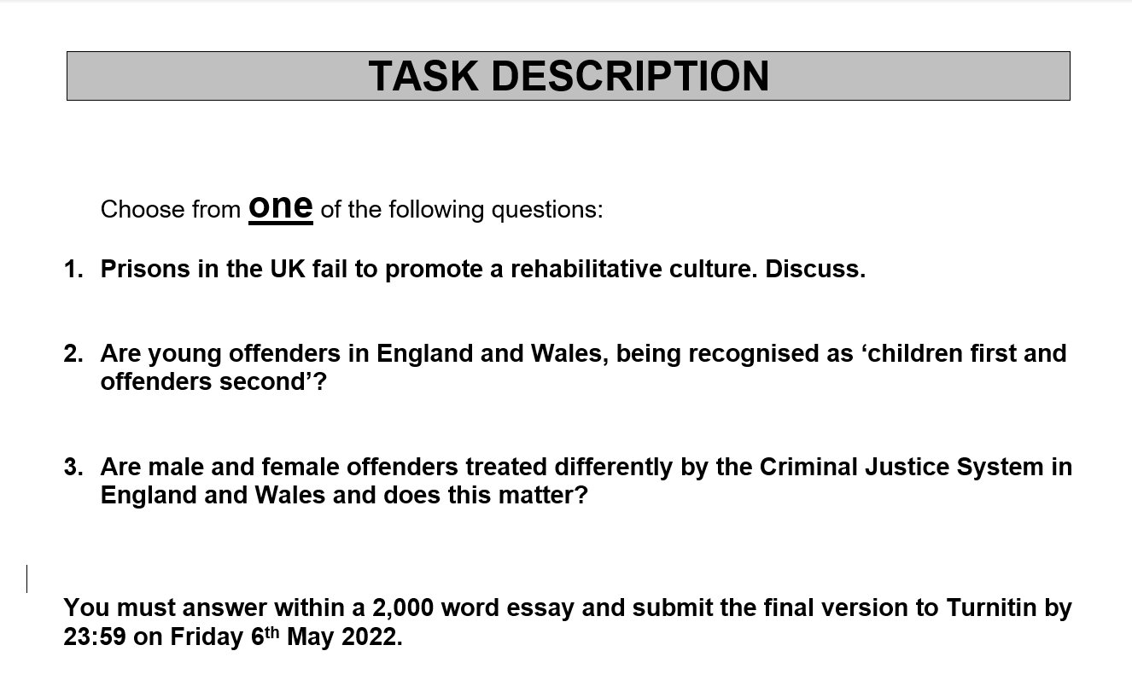
Assignment 2

Slide 3
Recap from lecture
Why do we need prisons?
What does our prison population look like?
What are some of the key issues with prisons in England and Wales?
Recommendations for reform?
Dutch and Norwegian models?
Notes:
Why do we need prisons?
What does our prison population look like?
Prolific criminals dominate the prison population
Non-violent prisoners tend to be the most prolific
First time offenders account for less than 8% of prison sentences
Those incarcerated for drug offences are overwhelmingly supplying drugs
What are some of the key issues with prisons in England and Wales?
Lack of training
Drugs
Self-harm and suicide
Overcrowding
Funding
Corruption
Staff numbers are down (even more so because of Covid)
High levels of violence
Recommendations for reform?
Why do we need prisons?
What does our prison population look like?
What are some of the key issues with prisons in England and Wales?
Recommendations for reform?

Slide 4
Rehabilitative culture in prisons
A rehabilitative prison culture supports hope, change, progression, and desistance. Desistance is how people with a previous pattern of offending abstain from crime.
A simple example is telling a prisoner they can get out in 5 years if they keep their head down. This is a positive message, but a better one is to ask:
“What do you want to achieve to give you the best chance for a better life when you get out in 5 years?”
Staff can then help the prisoner to work out and achieve a realistic plan for their own success. Success can be as simple as making the decision to change.
Her Majesty's prison and probation service (2019)
Notes:
https://www.gov.uk/guidance/rehabilitative-culture-in-prisons
An organisation or institution has a rehabilitative culture when it:
encourages its people to think with hope about their futures
supports them to plan and prepare for a different lifestyle
provides opportunities to change their attitudes and habits and try out new identities
reward them when they do good things
What does a rehabilitative culture look like?
a clear purpose, values, and shared vision of rehabilitation across the organisation
leadership, selection, coaching, dialogue and training to support the rehabilitative vision
strong visual images, posters, messages and careful use of language encouraging new identities
a wide range of evidence-based activities and interventions to meet peoples’ needs
sentence planning and activities based on risks and needs will ensure people benefit most

Slide 5
REHABILITATIVE CULTURE
- Imprisonment does not usually reduce reoffending, and in some research studies it has been shown to increase it.
- The word ‘rehabilitation’ is usually used to mean processes and activities that encourage people who have committed crime to cease offending and embark on a law-abiding life.
- Rehabilitation is often spoken about as being the responsibility of a particular team or department, but in fact, everyone in prisons has a role in rehabilitation and the whole regime has the potential to support or undermine this outcome. For example, small or routine experiences, such as how a property application is answered or how a search is conducted, can reinforce or help challenge someone’s attitudes towards authority.
Prison service journal 2018
Notes:
https://www.crimeandjustice.org.uk/sites/crimeandjustice.org.uk/files/PSJ%20235%20January%202018.pdf

Slide 6
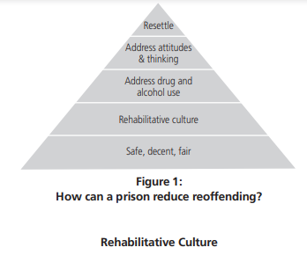
Notes:
Model for prisons to become a place that reduces reoffending:
1. Decent and procedurally fair places – If prisoners do not feel as though they are being treated fairly, they can easily develop a sense of grievance and alienation against the authorities, a state of mind which does not easily enable rehabilitation.
2. Strong relationships between staff and prisoners.
- staff have hope
- people speak courteously to one another
- staff coach people to make the right decisions

Slide 7

PENAL LEGITIMACY
Over representation of young men for BAME background
Females dealt with in a system primarily designed for men
https://www.bbc.co.uk/news/uk-wales-57720484
What effect does this have on public confidence in prisons?
Notes:
http://eprints.lse.ac.uk/29676/1/Legitimacy_and_procedural_justice_(LSERO_version).pdf
https://medcraveonline.com/FRCIJ/FRCIJ-06-00248.pdf
https://journals.sagepub.com/doi/epub/10.1177/0011128716687291

Slide 8
VULNERABLE OFFENDERS
Drug and alcohol addiction
Mental health vulnerabilities
Young adult offenders (those who have just turned 18)
Learning difficulties
Notes:
https://www.gov.uk/government/news/vulnerable-offenders-steered-towards-treatment

Slide 9
SUPPORT FOR PRISONERS LEAVING JAIL
https://www.theguardian.com/society/2020/aug/30/homelessness-among-prison-leavers-will-rise-as-covid-support-ends - Homelessness among prison leavers
Notes:
https://www.justiceinspectorates.gov.uk/cjji/media/press-releases/2017/06/throughthegate2/

Slide 10
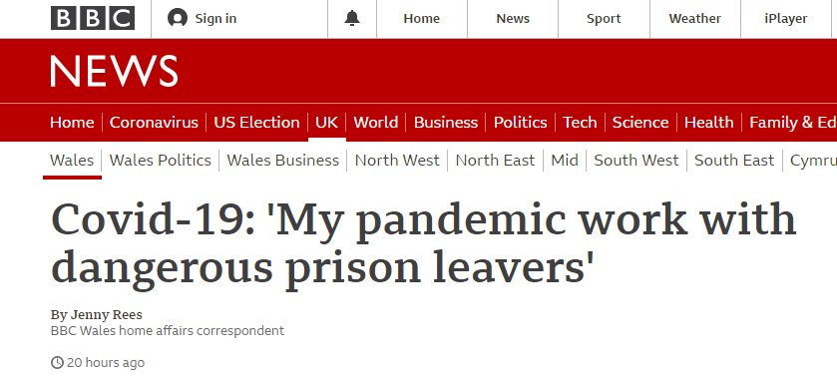
Notes:
https://www.bbc.co.uk/news/uk-wales-54795465

Slide 11
Does prisoner rehabilitation work?
The question of prisoner rehabilitation is back in the spotlight after a former director general of the Prison Service said rehabilitation of those in jail does not work and should be abolished.
Notes:
https://www.theweek.co.uk/104032/does-prisoner-rehabilitation-work

