Slide 1

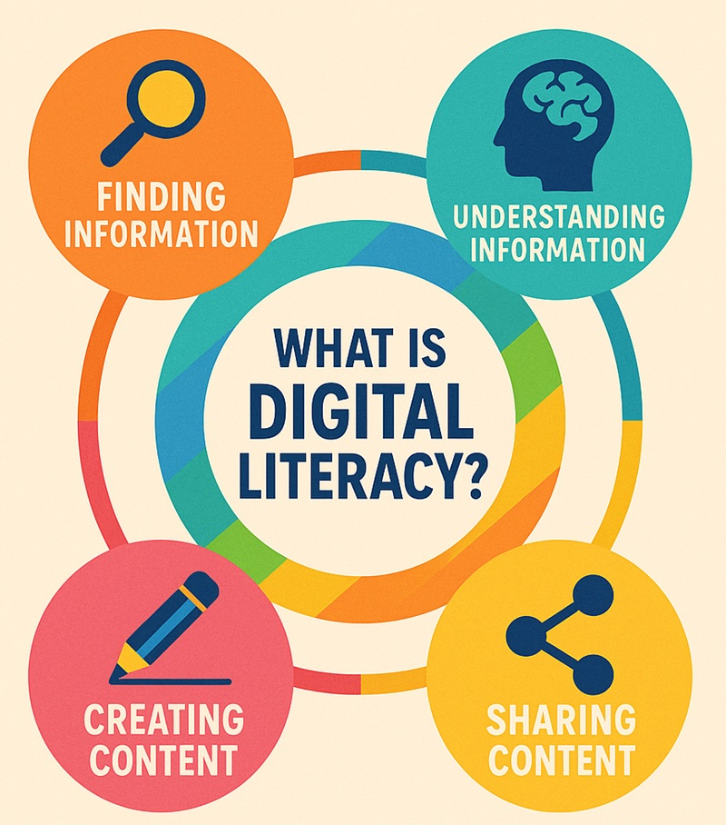
Module Code: BMSW4013
Module Name: Academic Skills for the Digital Era
Component 3: Academic Poster: Communicating Academic Skills
Introduction
Digital learning is central to modern higher education.
Students need skills beyond traditional study methods to succeed online.
The shift to e-learning has increased the importance of self-regulated study habits.
Academic success now depends on combining technological competence with effective learning strategies.
Time Management
Effective time management is positively associated with academic achievement in distance learning institutions (Ahmad, Batool and Choudhry, 2019).
Online learning requires greater self-discipline due to flexible and less structured schedules (Ahmad, Batool and Choudhry, 2019).
Poor time management can lead to procrastination and reduced academic performance (Ahmad, Batool and Choudhry, 2019).
Students can apply this skill by creating structured study timetables, prioritising tasks, and setting measurable academic goals (Ahmad, Batool and Choudhry, 2019).
Why These Skills Matter
Digital literacy ensures informed and critical engagement with academic content (Udeogalanya, 2022).
Time management supports sustained academic productivity in flexible learning contexts (Ahmad, Batool and Choudhry, 2019).
21st-century digital skills foster adaptability in rapidly evolving technological environments (Carabregu-Vokshi et al., 2024).
Together, these competencies directly influence academic performance and persistence in higher education (Udeogalanya, 2022).
Digital Literacy
Digital literacy enhances students’ ability to access, evaluate, and use online information effectively (Udeogalanya, 2022).
Strong digital literacy skills are directly linked to improved academic success in online environments (Udeogalanya, 2022).
E-learning environments can actively develop students’ digital competencies when effectively designed (Carabregu-Vokshi et al., 2024).
Students can apply digital literacy by critically assessing online sources, managing digital content responsibly, and engaging confidently with virtual platforms (Udeogalanya, 2022).
Conclusion
Digital learning requires structured academic skills for success.
Digital literacy, time management, and 21st-century skills are essential.
Developing these skills enhances performance, adaptability, and resilience.
Students equipped with these skills are better prepared for future digital challenges.
References
Ahmad, S., Batool, A., & Choudhry, A. H. (2019). Path Relationship of Time Management and Academic Achievement of Students in Distance Learning Institutions. Pakistan Journal of Distance and Online Learning, 5(2), 191-208.
Carabregu-Vokshi, M., Ogruk-Maz, G., Yildirim, S., Dedaj, B., & Zeqiri, A. (2024). 21st century digital skills of higher education students during Covid-19—is it possible to enhance digital skills of higher education students through E-Learning?. Education and Information Technologies, 29(1), 103-137.
Mountain, T.P. (2026). Time Management: 10 Strategies for Better Time Management | CAES Field Report. [online] CAES Field Report. Available at: https://fieldreport.caes.uga.edu/publications/C1042/time-management-10-strategies-for-better-time-management/ [Accessed 27 Feb. 2026].
Udeogalanya, V. (2022). Aligning digital literacy and student academic success: Lessons learned from COVID-19 pandemic. International Journal of Higher Education Management, 8(2).
Valcheva, S. (2025). 20 Digital Literacy Examples for Work, School, Daily Life. [online] Blog For Data-Driven Business. Available at: https://www.intellspot.com/digital-literacy-examples/ [Accessed 27 Feb. 2026].
Time Mangement (Mountain, 2026)
21st Century Digital Skills
21st-century digital skills include critical thinking, collaboration, communication, and technological proficiency (Carabregu-Vokshi et al., 2024).
E-learning environments during COVID-19 demonstrated potential to enhance these competencies (Carabregu-Vokshi et al., 2024).
Students with stronger digital skills adapt more effectively to online academic demands (Carabregu-Vokshi et al., 2024).
These skills can be applied through active participation in virtual discussions, collaborative projects, and problem-solving tasks within digital platforms (Carabregu-Vokshi et al., 2024).
Digital Literacy (Valcheva, 2025)

