Slide 1
Cyber Security
Lecture 3
Malware and Malicious Code
Dr. Carlene Campbell

Slide 2
lecture 3 - Objectives
Malware and Malicious Code
        Differentiate the types of malware and malicious code.
Trickery
          Describe the tactics, techniques and procedures used by cyber criminals.
Attacks
    Compare the different methods used in social engineering.
    Compare different types of cyberattacks.
Notes:
2
Your computing devices store your data and are the portal to your online life. Below is a short list of steps you can take to protect your computing devices from intrusion:
Keep the Firewall On – Whether it is a software firewall or a hardware firewall on a router, the firewall should be turned on and updated to prevent hackers from accessing your personal or company data. Click Windows 7, Window 8, or Windows 10 to turn on the firewall in the respective version of Windows. Click here to turn on the firewall for Mac OS X devices.
Use Antivirus and Antispyware – Malicious software, such as viruses, Trojan horses, worms, ransomware and spyware, are installed on your computing devices without your permission, in order to gain access to your computer and your data. Viruses can destroy your data, slow down your computer, or take over your computer. One way viruses can take over your computer is by allowing spammers to broadcast emails using your account. Spyware can monitor your online activities, collect your personal information, or produce unwanted pop-up ads on your web browser while you are online. A good rule is to only download software from trusted websites to avoid getting spyware in the first place. Antivirus software is designed to scan your computer and incoming email for viruses and delete them. Sometimes antivirus software also includes antispyware. Keep your software up to date to protect your computer from the newest malicious software.
Manage Your Operating System and Browser – Hackers are always trying to take advantage of vulnerabilities in your operating systems and your web browsers. To protect your computer and your data, set the security settings on your computer and browser at medium or higher. Update your computer’s operating system including your web browsers and regularly download and install the latest software patches and security updates from the vendors.
Protect All Your Devices – Your computing devices, whether they are PCs, laptops, tablets, or smartphones, should be password protected to prevent unauthorized access. The stored information should be encrypted, especially for sensitive or confidential data. For mobile devices, only store necessary information, in case these devices are stolen or lost when you are away from your home. If any one of your devices is compromised, the criminals may have access to all your data through your cloud-storage service provider, such as iCloud or Google drive.
IoT devices pose an even greater risk than your other computing devices. While desktop, laptop and mobile platforms receive frequent software updates, most of the IoT devices still have their original firmware. If vulnerabilities are found in the firmware, the IoT device is likely to stay vulnerable. To make the problem worse, IoT devices are often designed to call home and require Internet access. To reach the Internet, most IoT devices manufacturers rely on the customer’s local network. The result is that IoT devices are very likely to be comprised and when they are, they allow access to the customer’s local network and data. The best way to protect yourself from this scenario is to have IoT devices using an isolated network, sharing it only with other IoT devices.

Slide 3



Malware and Malicious Code
Types of Malware
Cyber criminals target user’s end devices through the installation of malware.
Viruses - A virus is malicious executable code attached to another executable file, such as a legitimate program. Most viruses require end-user initiation, and can activate at a specific time or date.
Worms - Worms are malicious code that replicates by independently exploiting vulnerabilities in networks. Worms usually slow down networks. Whereas a virus requires a host program to run, worms can run by themselves. Other than the initial infection, worms no longer require user participation.
Trojan horse - A Trojan horse is malware that carries out malicious operations under the guise of a desired operation such as playing an online game. This malicious code exploits the privileges of the user that runs it. A Trojan horse differs from a virus because the Trojan binds itself to non-executable files, such as image files, audio files, or games.

Slide 4
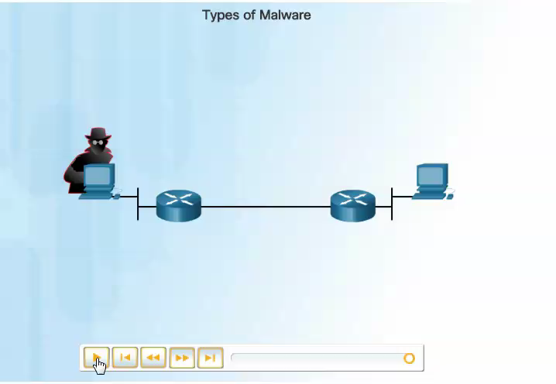

Slide 5

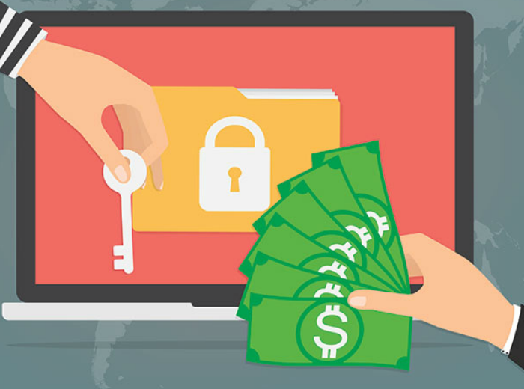

Types of Malware (Cont.)
Logic Bomb - A logic bomb is a malicious program that uses a trigger to awaken the malicious code. For example, triggers can be dates, times, other programs running, or the deletion of a user account. The logic bomb remains inactive until that trigger event happens. Once activated, a logic bomb implements a malicious code that causes harm to a computer.
Ransomware - Ransomware holds a computer system, or the data it contains, captive until the target makes a payment. Ransomware usually works by encrypting data in the computer with a key unknown to the user.
Backdoors and Rootkits - A backdoor or rootkit refers to the program or code introduced by a criminal who has compromised a system. The backdoor bypasses the normal authentication used to access a system. A rootkit modifies the operating system to create a backdoor. Attackers then use the backdoor to access the computer remotely.

Slide 6


Email and Browser Attacks (Cont.)
Email is a universal service used by billions worldwide. As one of the most popular services, email has become a major vulnerability to users and organizations.
Spam - Spam, also known as junk mail, is unsolicited email. In most cases, spam is a method of advertising. However, spam can send harmful links, malware, or deceptive content.
Spyware - Spyware is software that enables a criminal to obtain information about a user’s computer activities. Spyware often includes activity trackers, keystroke collection, and data capture. In an attempt to overcome security measures, spyware often modifies security settings.

Slide 7


Email and Browser Attacks (Cont.)
Adware - Adware typically displays annoying pop-ups to generate revenue for its authors. The malware may analyze user interests by tracking the websites visited. It can then send pop-up advertising pertinent to those sites.
Scareware - Scareware persuades the user to take a specific action based on fear. Scareware forges pop-up windows that resemble operating system dialogue windows.

Slide 8

Email and Browser Attacks (Cont.)
Phishing - Phishing is a form of fraud. Cyber criminals use email, instant messaging, or other social media to try to gather information such as login credentials or account information by masquerading as a reputable entity or person. Phishing occurs when a malicious party sends a fraudulent email disguised as being from a legitimate, trusted source. The message intent is to trick the recipient into installing malware on his or her device or into sharing personal or financial information.
Spear phishing - Spear phishing is a highly targeted phishing attack. While phishing and spear phishing both use emails to reach the victims, spear phishing sends customized emails to a specific person.

Slide 9

Email and Browser Attacks (Cont.)
Vishing - Vishing is phishing using voice communication technology. Criminals can spoof calls from legitimate sources using voice over IP (VoIP) technology. Victims may also receive a recorded message that appears legitimate.
Pharming - Pharming is the impersonation of a legitimate website in an effort to deceive users into entering their credentials.
Whaling - Whaling is a phishing attack that targets high profile targets within an organization such as senior executives.

Slide 10
Email and Browser Attacks (Cont.)
Plugins - The Flash and Shockwave plugins from Adobe enable the development of interesting graphic and cartoon animations that greatly enhance the look and feel of a web page. Plugins display the content developed using the appropriate software.
SEO Poisoning - Search engines such as Google work by ranking pages and presenting relevant results based on users’ search queries. Depending on the relevancy of web site content, it may appear higher or lower in the search result list. SEO, short for Search Engine Optimization, is a set of techniques used to improve a website’s ranking by a search engine. While many legitimate companies specialize in optimizing websites to better position them, SEO poisoning uses SEO to make a malicious website appear higher in search results.
Browser Hijacker - A browser hijacker is malware that alters a computer's browser settings to redirect the user to websites paid for by the cyber criminals' customers. Browser hijackers usually install without the user's permission and is usually part of a drive-by download.

Slide 11
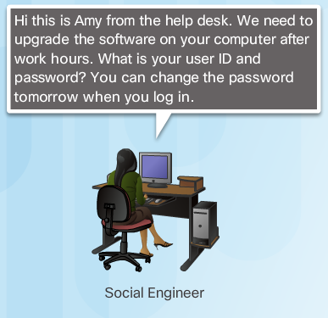
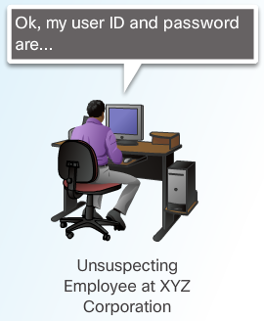
The Art of Trickery
Social Engineering - Social engineering is a completely non-technical means for a criminal to gather information on a target. Social engineering is an attack that attempts to manipulate individuals into performing actions or divulging confidential information.
Social engineers often rely on people’s willingness to be helpful but also prey on people’s weaknesses. These are some types of social engineering attacks:
Pretexting - This is when an attacker calls an individual and lies to them in an attempt to gain access to privileged data. An example involves an attacker who pretends to need personal or financial data in order to confirm the identity of the recipient.
Something for Something (Quid pro quo) - This is when an attacker requests personal information from a party in exchange for something, like a gift.

Slide 12

Types of Trickery
Shoulder Surfing and Dumpster Diving – refers to picking up PINs, access codes or credit card numbers. An attacker can be in close proximity to his victim or the attacker can use binoculars or closed circuit cameras to shoulder surf.
Impersonation and Hoaxes - Impersonation is the action of pretending to be someone else. For example, a recent phone scam targeted taxpayers. A criminal, posing as an IRS employee, told the victims that they owed money to the IRS.
Piggybacking and Tailgating - Piggybacking occurs when a criminal tags along with an authorized person to gain entry into a secure location or a restricted area. Tailgating is another term that describes the same practice.
Online, Email, and Web-based Trickery - Forwarding hoax emails and other jokes, funny movies, and non-work-related emails at work may violate the company's acceptable use policy and result in disciplinary actions.

Slide 13
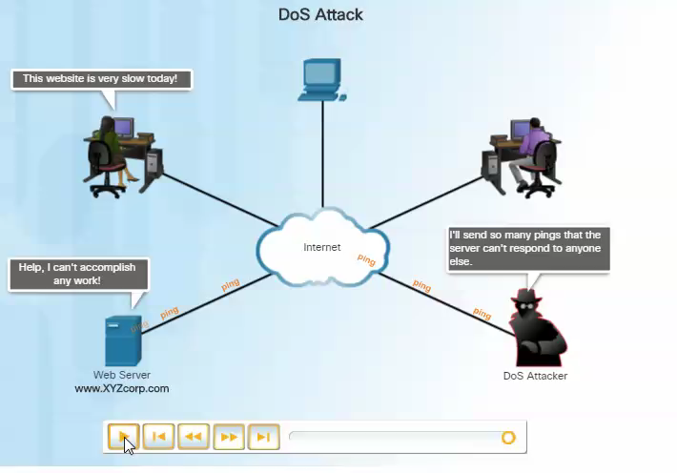
Types of Cyber Attacks
Denial-of-Service (DoS) Attacks - are a type of network attack. A DoS attack results in some sort of interruption of network services to users, devices, or applications. DoS attacks are a major risk because they can easily interrupt communication and cause significant loss of time and money. These attacks are relatively simple to conduct, even by an unskilled attacker.

Slide 14
Types of Cyber Attacks
Sniffing - Sniffing is similar to eavesdropping on someone. It occurs when attackers examine all network traffic as it passes through their NIC, independent of whether or not the traffic is addressed to them or not. Criminals accomplish network sniffing with a software application, hardware device, or a combination of the two.
Spoofing - Spoofing is an impersonation attack, and it takes advantage of a trusted relationship between two systems. If two systems accept the authentication accomplished by each other, an individual logged onto one system might not go through an authentication process again to access the other system.

Slide 15
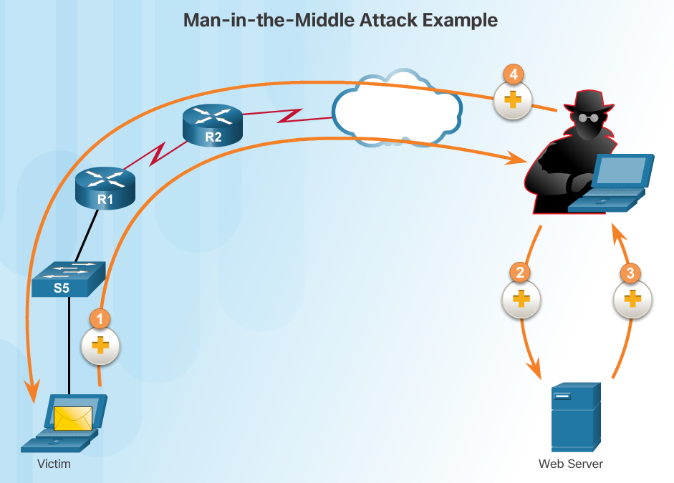
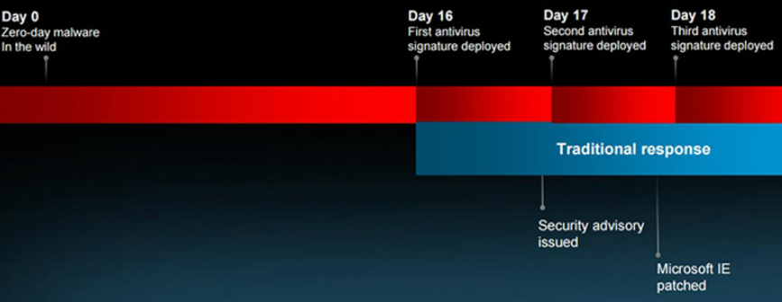
Types of Cyber Attacks
Man-in-the-middle - A criminal performs a man-in-the-middle (MitM) attack by intercepting communications between computers to steal information crossing the network. The criminal can also choose to manipulate messages and relay false information between hosts since the hosts are unaware that a modification to the messages occurred. MitM allows the criminal to take control over a device without the user’s knowledge.
Zero-Day Attacks - A zero-day attack, sometimes referred to as a zero-day threat, is a computer attack that tries to exploit software vulnerabilities that are unknown or undisclosed by the software vendor. The term zero hour describes the moment when someone discovers the exploit. https://www.youtube.com/watch?v=-BIANfzF43k
Keyboard Logging - Keyboard logging is a software program that records or logs the keystrokes of the user of the system. Criminals can implement keystroke loggers through software installed on a computer system or through hardware physically attached to a computer. The criminal configures the key logger software to email the log file. The keystrokes captured in the log file can reveal usernames, passwords, websites visited, and other sensitive information.

Slide 16

Wireless and Mobile Attacks (Cont.)
Grayware and SMiShing
Grayware includes applications that behave in an annoying or undesirable manner. Grayware may not have recognizable malware concealed within, but it still may pose a risk to the user. Grayware is becoming a problem area in mobile security with the popularity of smartphones.
SMiShing is short for SMS phishing. It uses Short Message Service (SMS) to send fake text messages. The criminals trick the user into visiting a website or calling a phone number. Unsuspecting victims may then provide sensitive information such as credit card information. Visiting a website might result in the user unknowingly downloading malware that infects the device.
https://www.youtube.com/watch?v=7v9f51tKDQc
Notes:
Wireless networks allow Wi-Fi enabled devices, such as laptops and tablets, to connect to the network by way of the network identifier, known as the Service Set Identifier (SSID). To prevent intruders from entering your home wireless network, the pre-set SSID and default password for the browser-based administrative interface should be changed. Hackers will be aware of this kind of default access information. Furthermore, you should encrypt wireless communication by enabling wireless security and the WPA2 encryption feature on the wireless router. Optionally, the wireless router can also be configured not to broadcast the SSID, which adds an additional barrier to discovering the network, however this should not be considered adequate security for a wireless network.

Slide 17

Wireless and Mobile Attacks (Cont.)
Rogue Access Points - A rogue access point is a wireless access point installed on a secure network without explicit authorization. A rogue access point can be set up in two ways.
RF Jamming - Wireless signals are susceptible to electromagnetic interference (EMI), radio-frequency interference (RFI), and may even be susceptible to lightning strikes or noise from fluorescent lights. Wireless signals are also susceptible to deliberate jamming. Radio frequency (RF) jamming disrupts the transmission of a radio or satellite station so that the signal does not reach the receiving station.
Bluejacking and Bluesnarfing - Bluejacking is the term used for sending unauthorized messages to another Bluetooth device. Bluesnarfing occurs when the attacker copies the victim's information from his device. This information can include emails and contact lists.

Slide 18
Wireless and Mobile Attacks (Cont.)
WEP and WPA Attacks
Wired Equivalent Privacy (WEP) is a security protocol that attempted to provide a wireless local area network (WLAN) with the same level of security as a wired LAN. Since physical security measures help to protect a wired LAN, WEP seeks to provide similar protection for data transmitted over the WLAN with encryption.
WEP uses a key for encryption.
There is no provision for key management with WEP, so the number of people sharing the key will continually grow.
Wi-Fi Protected Access (WPA) and then WPA2 came out as improved protocols to replace WEP. WPA2 does not have the same encryption problems because an attacker cannot recover the key by observing traffic.
WPA2 is susceptible to attack because cyber criminals can analyze the packets going between the access point and a legitimate user.
Cyber criminals use a packet sniffer and then run attacks offline on the passphrase.

Slide 19
Wireless and Mobile Attacks (Cont.)
Defending Against Wireless and Mobile Device Attacks
There are several steps to take to defend against wireless and mobile device attacks.
Most WLAN products use default settings. Take advantage of the basic wireless security features such as authentication and encryption by changing the default configuration settings.
Restrict access point placement with the network by placing these devices outside the firewall or within a demilitarized zone (DMZ) which contains other untrusted devices such as email and web servers.
WLAN tools such as NetStumbler may discover rogue access points or unauthorized workstations. Develop a guest policy to address the need when legitimate guests need to connect to the Internet while visiting. For authorized employees, utilize a remote access virtual private network (VPN) for WLAN access.

Slide 20
Application Attacks
Cross-site scripting (XSS) - is a vulnerability found in web applications. XSS allows criminals to inject scripts into the web pages viewed by users. This script can contain malicious code. Cross-site scripting has three participants: the criminal, the victim, and the website. The cyber-criminal does not target a victim directly. The criminal exploits vulnerability within a website or web application. Criminals inject client-side scripts into web pages viewed by users, the victims.
Code Injections Attacks - One way to store data at a website is to use a database. There are several different types of databases such as a Structured Query Language (SQL) database or an Extensible Markup Language (XML) database. Both XML and SQL injection attacks exploit weaknesses in the program such as not validating database queries properly.
Buffer Overflow - A buffer overflow occurs when data goes beyond the limits of a buffer. Buffers are memory areas allocated to an application. By changing data beyond the boundaries of a buffer, the application accesses memory allocated to other processes. This can lead to a system crash, data compromise, or provide escalation of privileges.

Slide 21
Application Attacks
Remote Code Executions vulnerabilities allow a cybercriminal to execute malicious code and take control of a system with the privileges of the user running the application. Remote code execution allows a criminal to execute any command on a target machine.
ActiveX Controls and Java controls provide the capability of a plugin to Internet Explorer.
ActiveX controls are pieces of software installed by users to provide extended capabilities. Third parties write some ActiveX controls and they may be malicious. They can monitor browsing habits, install malware, or log keystrokes. Active X controls also work in other Microsoft applications.
Java operates through an interpreter, the Java Virtual Machine (JVM). The JVM enables the Java program’s functionality. The JVM sandboxes or isolates untrusted code from the rest of the operating system. There are vulnerabilities, which allow untrusted code to go around the restrictions imposed by the sandbox.

Slide 22
Application Attacks
Defending Against Application Attacks
The first line of defense against an application attack is to write solid code.
Regardless of the language used, or the source of outside input, prudent programming practice is to treat all input from outside a function as hostile.
Validate all inputs as if they were hostile.
Keep all software including operating systems and applications up to date, and do not ignore update prompts.
Not all programs update automatically, so at the very least, always select the manual update option.

Slide 23
Best Practices (Cont.)
Understanding the different cyber threats is a critical skill for cybersecurity professionals. Get familiar with the following websites:
Cyber Threats | URL Address
8 Computer Viruses That Brought the Internet to Its Knees | http://www.whoishostingthis.com/blog/2015/06/01/8-worst-viruses/
7 Ways to Secure Your Web Browser Against Attacks | http://www.howtogeek.com/228828/7-ways-to-secure-your-web-browser-against-attacks/
Most Recent Scam Alerts | https://www.consumer.ftc.gov/scam-alerts
Spam | https://www.consumer.ftc.gov/articles/0038-spam
Malpedia - Ransomware | http://www.exterminate-it.com/malpedia/ransomware-category
InformIT - Top 10 Social Engineering Tactics | http://www.informit.com/articles/article.aspx?p=1350956
Notes:
23

Slide 24
Summary
Threats, vulnerabilities, and attacks are the central focus of the cybersecurity wizards.
This lecture discussed the various cybersecurity attacks that cyber criminals launch.
The lecture explained the threat of malware and malicious code.
The lecture discussed the types of trickery involved with social engineering. Maneuvering explained the types of attacks that both wired and wireless networks experience.
Finally, the lecture discussed the vulnerabilities presented by application attacks.
Understanding the types of possible threats allows an organization to identify the vulnerabilities that make it a target. The organization can then learn how to defend itself against cybersecurity trickery and maneuvering.
Notes:
3.4.1 - Summary

Slide 25
Questions?

Slide 26
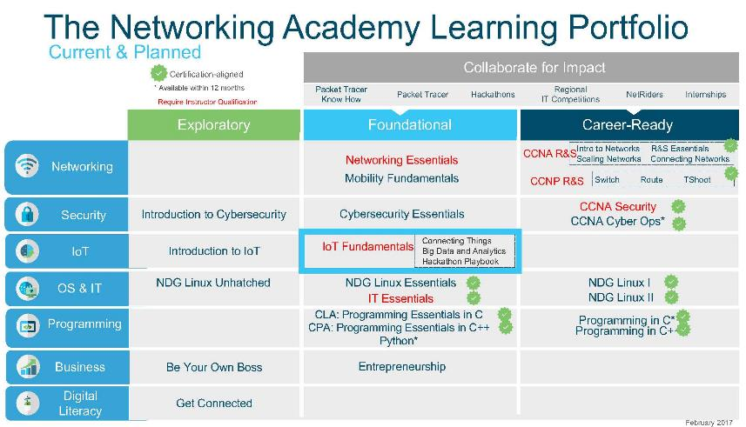
Cisco Networking Academy

Slide 27
Cisco Networking Academy

Slide 28


