Slide 1



Organisational Consultancy
“Life is one big project. The trick is managing it.” (Anon.)
Lecture 1
Notes:
1

Slide 2
Teaching Team
Module Leaders:
Dr Roisin Mullins
Available
Monday 13:00-14:00
Thursday 10:00-12:00
Notes:
2

Slide 3
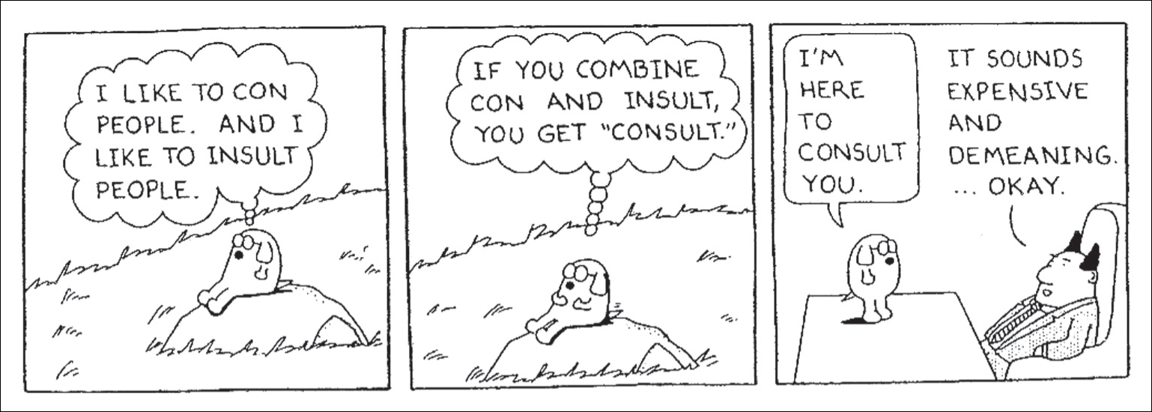
Skills of the Consultant
The consultant must always convince the client that the service on offer
is of real value!
Source: Copyright © Scott Adams, Inc./Dist by UFS, Inc. Reproduced by permission.
Notes:
3

Slide 4

The Module Organisational Consultancy
20 credit module
87.5% self directed/ independent learning
Notes:
4

Slide 5
Today’s Objectives
Overview of module
Benefits for you
Assessment process and key dates
Expectations
Notes:
5

Slide 6

A typical consultant at work?
Are you familiar with any management consultants?
Notes:
6

Slide 7
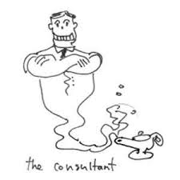
Are you considering a career as a
management consultant?
This module puts you in that role for an organisation of your choice.
Notes:
7

Slide 8
Module Aims:
Introduce you to the process of consultancy and project management processes
Enable you to work actively and critically in a professional environment
To demonstrate how consultants can contribute to the effective management of change
To enhance understanding of the world of work and develop skills and competencies which are sought by employers
Notes:
8

Slide 9
Module Aims
Identify the role of a management consultant and initiate and carry out a project that is of strategic relevance to an organisation.
Undertake a systematic analysis of data and produce a report that critically evaluates arguments and assumptions, draws realistic conclusions and makes sound and informed judgements to achieve a solution(s).
Notes:
9

Slide 10
What you have to do
Draw on your entire course knowledge and expertise (Level 6 module)
Research new areas
Become an agent for change
Become an organisational asset
Maybe get your ‘foot in the door’?
Notes:
10

Slide 11
What you have to do
Regularly attend lectures and tutorials
Research for and write a 2000 word Project Initiation Document (PID)
Submit an Ethics form for your project (if necessary)
Research and write a 3000 to 4000 word Consultancy Project Report
Notes:
11

Slide 12
Assessment Process
Produce a Project Initiation Document (PID) that conveys clear aim and objectives; demonstrates a business case justification to realistically facilitate and sustain organisational change; and a cost effective and time efficient plan to undertake the project.
By means of a project report, demonstrate skills in time management, critical thinking and the ability to present an evidence-based argument in which statements of “fact” will be supported by appropriate, authoritative and up-to-date sources that support change within their chosen organisation.
Notes:
12

Slide 13
Module Assessment Deadlines
Assignment 1 - 12th January 2018
Assignment 1 - 20th April 2018
Notes:
13

Slide 14
Choices open to participants
Work alone
Individually assessed contribution
Report: 3000 words per person
Notes:
14

Slide 15
What we do
Mix of lectures and tutorials (see lecture schedule)
Introduction to life case studies for project ideas
Integration of employers as speakers
Moodle site as active support
Notes:
15

Slide 16
Definition
“A consultant is an independent advisor who adds value by helping managers to identify and achieve beneficial change appropriate to their situation”
(Newton, 2010:6)
Notes:
Consultants enter an existing organisation and undertake specific projects for it. This can be for the private and public sectors.
They can be involved in any part of the business that requires help and the project can be short-term or long-term.
A consultant will only be brought in if he or she adds value.
16

Slide 17

No organisation can depend on genius; the supply is always scarce and unreliable.
It is the test of an organisation to make ordinary human beings perform better than they seem capable of, to bring out whatever strength there is in its members, and to use each one's strength to help all the others perform.
The purpose of an organisation is to enable common people to do uncommon things.
(Peter Drucker)
Notes:
The quotes highlight the importance of change in our lives. For business, change is something that is ever-present. No business or business environment ever stands still. It follows from this that every business has to cope with change.
At the front line of most change in business will be humans. The workforce will be the ones who have to adapt to new situations and to the effects of changes inside and outside the business. Making sure that they are suitably trained to be able to cope with these changes is an important part of the leadership and management process.
17

Slide 18
Management Consultant
Considered a method
Referred to as a profession
“An assumed role in knowledge transfer”
(Peter Drucker)

Slide 19
As consulting is a managerial role, it can be viewed in the same way with regard to its functions:
Planning – deciding on the business’s future
Organising – defining roles and responsibilities
Staffing – right people in the right place
Directing – managers’ responsibilities
Controlling – efficient use of resources.

Slide 20











Organisations
Notes:
Why kind of consultancy would these business require?
20

Slide 21
How will learning about organisational consultancy benefit you?
Develop awareness, knowledge and understanding of the processes of consultancy, change and project management including:
the roles of organisational consultants
reasons for change within organisations
situations where consultant intervention may be beneficial
the advantages arising from independent, professional intervention
project identification, planning & implementation
practical work related skills including research requirements, data handling & report writing
the expectations of future employers
Notes:
21

Slide 22

Teaching Strategies
Participative
Inclusive
Lectures
Discussions
Case Studies
Presentations
Notes:
22

Slide 23
Reading List Essential Texts
Cameron, E. & Green, M. (2015) Making Sense of Change Management, 4th edition, London:
Kogan Page
Saunders, M & Lewis, P (2012) Doing Research in Business & Management, Harlow: Prentice Hall
Wickham, L & Wilcock, J (2012) Management Consulting, 4th edition, Harlow: Pearson
Notes:
23

Slide 24
Reading List Background Reading
Baron, A. and Armstrong, M. (2007) Human capital management. London: Kogan Page.
Biggs, D (2010) Management Consulting: A Guide for Students, Andover: Cengage
Brierley, E. (2006) Talent on tap: getting the best from freelancers, interims and consultants. London: Chartered Institute of Personnel and Development.
Brown, D, Caldwell, R, & White, K. (2004) Business partnering: a new direction for HR. A guide. London: CIPD.
Burnes, B (2014) Managing Change, 6th edition, New York: Prentice Hall
Buttrick, R. (2005) The Project Workout, London: Prentice Hall (ebook on library website)
Gardiner, P. (2005) Project Management: A Strategic Approach, Basingstoke, Palgrave.
Johnson, M. (2005) The Independent Consultant’s Survival Guide, London:CIPD.
Maylor, H. (2010) Project Management, 4th edition, Harlow: Prentice Hall.
Newton, R (2010) The Management Consultant: Mastering the Art of Consultancy, Harlow: Pearson
Notes:
24

Slide 25
Other useful resources
Electronic Journals (via library website)
British Journal of Management
Coaching at Work
Harvard Business Review
HRM Review
Human Resource Management Journal
International Journal of Employment Studies
Journal of Organisational Behaviour
Management Today
People and Strategy: Journal of the HR Planning Society
People Management Magazine
Public Personnel Management
Strategic HR Review
Work Employment and Society
Notes:
25

Slide 26
Other useful resources
Useful Websites:
Project Management Institute www.pmi.org/uk
Chartered Management Institute www.cmi.org.uk
Chartered Institute of Personnel and Development www.cipd.co.uk
Management Consultancies Association www.mca.org.uk
www.mckinsey.com
Institute of Consulting www.iconsulting.org.uk
www.pwc.co.uk ; www.accenture.com ; www.deloitte.com
Notes:
26

Slide 27
My expectations
Weekly Attendance at lectures and tutorials is vital
Enthusiastic participation, interaction and teamwork
Student engagement with the module
Mutual support and encouragement
Adherence to classroom etiquette
Independent reading and study above and beyond course notes and recommended texts
Positive engagement with external organisations
Delivery of work in line with deadlines
Continuous dialogue on any issues of concern
That will make you successful! ☺
Notes:
27

Slide 28
Your Expectations?
Notes:
28

Slide 29


Questions
What would you like to research?
Notes:
29

