Slide 1
Electrical
and Electronic Principles
(ACDA4006)
Lecture - 12

Slide 2
Content
Energy Band
Semiconductors
Intrinsic
Extrinsic
  P-type
  N-Type

Slide 3
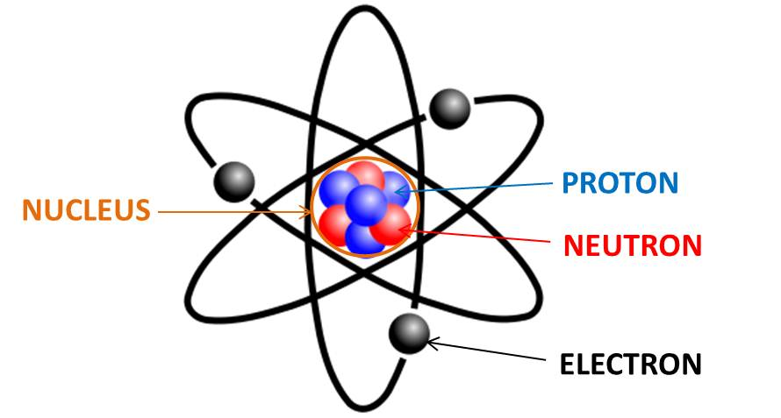
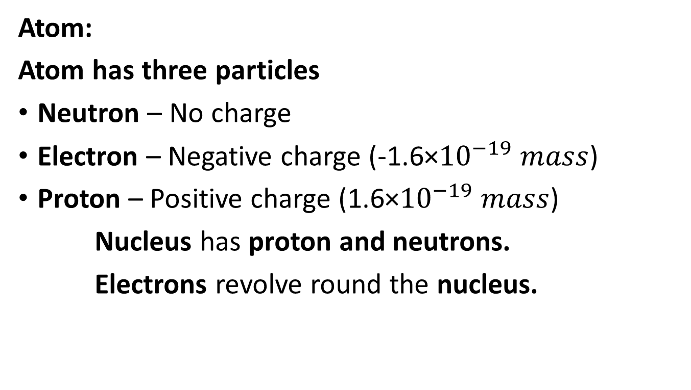
Semiconductors
Atom:
Atom has three particles
Neutron – No charge
Electron – Negative charge (-1.6×${10}^{−19} mass$)
Proton – Positive charge (1.6×${10}^{−19} mass$)
Nucleus has proton and neutrons.
Electrons revolve round the nucleus.
UWTSD Lectures / ACDA4006 - Electrical and Electronic Principles

Slide 4
Classification of matters
Matter has mass and occupies space
Matter
Gas
Liquid
Solid
Non- Crystalline
Crystalline
Insulator
Semiconductor
Conductor

Slide 5
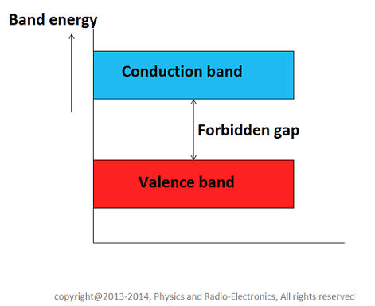
Energy band in solids
The three types of energy bands in solids are
Valence Band
Conduction band
Forbidden band

Slide 6
Energy band in solids
Valence Band
Electrons occupying the outermost orbit or shell of an atom are called Valence electrons. Electrons in the valence band has higher energy.
This band may be completely or partially filled. Valence electrons are responsible for forming atomic bonds.
Conduction band
The free electron which are responsible for the conduction of current is known as conduction electrons.

Slide 7
Energy band in solids
Forbidden band
The gap between the valence band and the conduction band is called as forbidden band or forbidden energy gap.
Greater the energy gap, more tightly the valence electrons are bounded to the nucleus.
To push electron from the valence to the conduction band, external energy equal to the forbidden gap must be supplied.

Slide 8
Classification of Solids based on Energy band theory
Solids are classified as
Insulators
Conductors
Semiconductors

Slide 9
Classification of Solids based on Energy band theory
Insulators
Insulators are materials in which the valence electrons are bound very tightly to the parent atom.
It requires large electric field to remove valence electron from the attraction of their bound state due to the large forbidden energy gap.
Insulator have
  Full valence band
  Empty conduction band
  Large forbidden gap
At room temperature, electron cannot jump from valence to conduction band.
If temperature is increased, valence electrons may acquire energy and move from conduction to the valence band.
Eg: Glass, wood…

Slide 10
Classification of Solids based on Energy band theory
Conductors
Conducts current easily.
Plenty of free electrons are available for electric conduction.
Electrons are loosely bound with the nuclei. So, it can easily break away from the atom.
Conduction band and valance bands are overlapped.
No forbidden energy gap.
Eg: Copper, Aluminium, iron

Slide 11
Classification of Solids based on Energy band theory
Semi-Conductors
Electrical properties lies between the insulator and good conductor.
It has a very narrow energy gap at room temperature. The valence band and conduction band are nearly filled.
At low temperature, the valence band is completely filled and the conduction band is empty. So, a semiconductor behaves like insulator.
when temperature is increased, Valence electrons cross over to the conduction band and the conductivity increases (i.e) Conductivity increases with rise in temperature.
Eg) Germanium and Silicon

Slide 12
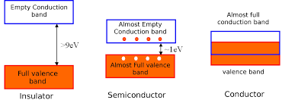
Classification of Solids based on Energy band theory

Slide 13
Types of Semiconductor
Types of semiconductor
Intrinsic Semiconductor
Extrinsic Semiconductor
    P- Type semiconductor
    N-Type semiconductor

Slide 14
Types of Semiconductor
Intrinsic Semiconductor
The Pure form of semiconductor is called an intrinsic semiconductor.
There is no free charge carrier or may have few at room temperature.
It does not conduct current in room temperature. It conducts current when the temperature is increased
Eg: Pure Germanium, Pure Silica
Extrinsic Semiconductor
The impure form of semiconductor is called as the extrinsic semiconductor.
Eg: Impure form of germanium, Impure form of silica.

Slide 15
Types of Semiconductor
Doping:
Doping is the process of adding impurity to the semiconductor
Procedure:
Melt the semiconductor (Molten semiconductor will be melted to liquid form)
Add pentavalent impurity to increase the free electrons
Add trivalent electron to increase the holes (Positive charge).
Cool the silicon to reform its solid crystal structure.

Slide 16
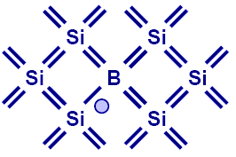
Types of Semiconductor
P- Type semiconductor
The impure form of semiconductor in which the doping is done with the trivalent impurity (Boron(B), Aluminium(Al) etc..) is called P- Type semiconductor.
In P- Type semiconductor the majority charge carriers are Holes (+ive charge) and minority charge carriers are electrons (- ive).

Slide 17
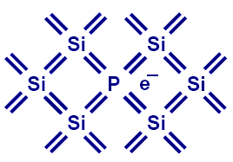
Types of Semiconductor
N- Type Semiconductor
The impure form of semiconductor in which the doping is done with the pentavalent impurities (Phosphorus (P), Antimony(sb) (etc..) is called N- Type semiconductor.
In N- Type semiconductor the majority charge carriers are Electrons (-ive charge) and minority charge carriers are Holes (+ ive).

Slide 18
Types of Semiconductor
Conduction in N type semiconductor
When voltage is given to the N- type semiconductor, free electron which are available due to the added impurity, move in a direction, towards the positive terminal of applied voltage. This movement leads to the flow of current.
In this semiconductor, holes are less in number and Electrons are large in number. Hence electron current dominated over the hole current.

Slide 19
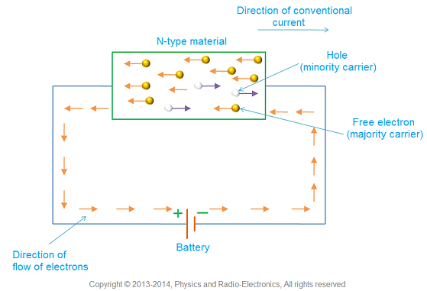
Types of Semiconductor

Slide 20
Types of Semiconductor
Conduction in P type semiconductor
When voltage is given to the P- type semiconductor, Holes moves towards the negative side of the battery, the electrons move towards the positive side of the battery
In this semiconductor, holes are large in number and Electrons are few in number. Hence hole current dominated over the electron current.

Slide 21
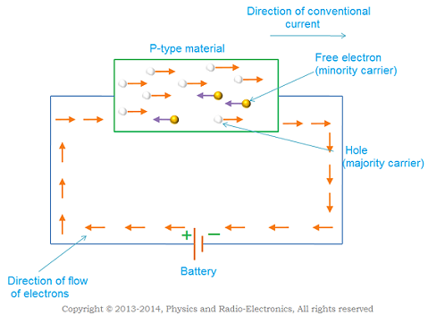
Types of Semiconductor

Slide 22
Comparison of semiconductors
Sl.no | Intrinsic semiconductor | Extrinsic semiconductor
1 | Pure form of semiconductor | Impure form of semiconductor
2 | Number of electrons and holes are equal | Number of electrons and holes are not equal
3 | Conductivity is poor | Conductivity is improved

Slide 23
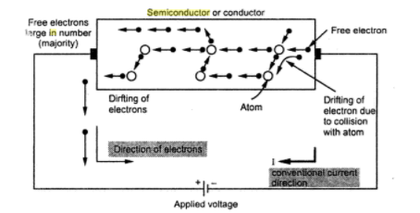
Transport phenomena in semiconductors
Semiconductors
Semiconductor subjected to electrical potential drift, electrons in opposite direction of current and hole in direction of current. The total current due to the drift is called the drift current.
UWTSD Lectures / ACDA4006 - Electrical and Electronic Principles

Slide 24
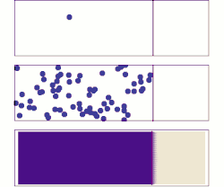
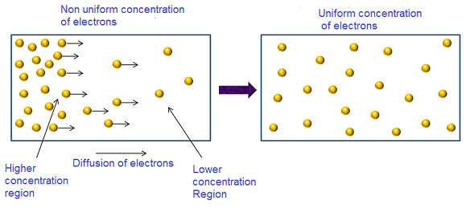
Transport phenomena in semiconductors
Semiconductors
Diffusion current
Motion of charge carriers from region of higher concentration to the region of lower concentration is called diffusion and the resulting current is called diffusion current.

Slide 25
References:
[1] J. W. Nilsson and S. A. Riedel, Electric Circuits, 12th ed. Upper Saddle River, NJ: Pearson, 2019.
[2] J. Bird, Electrical Circuit Theory and Technology, 7th ed. London: Routledge, 2021.

Slide 26
Thank You

