Slide 1
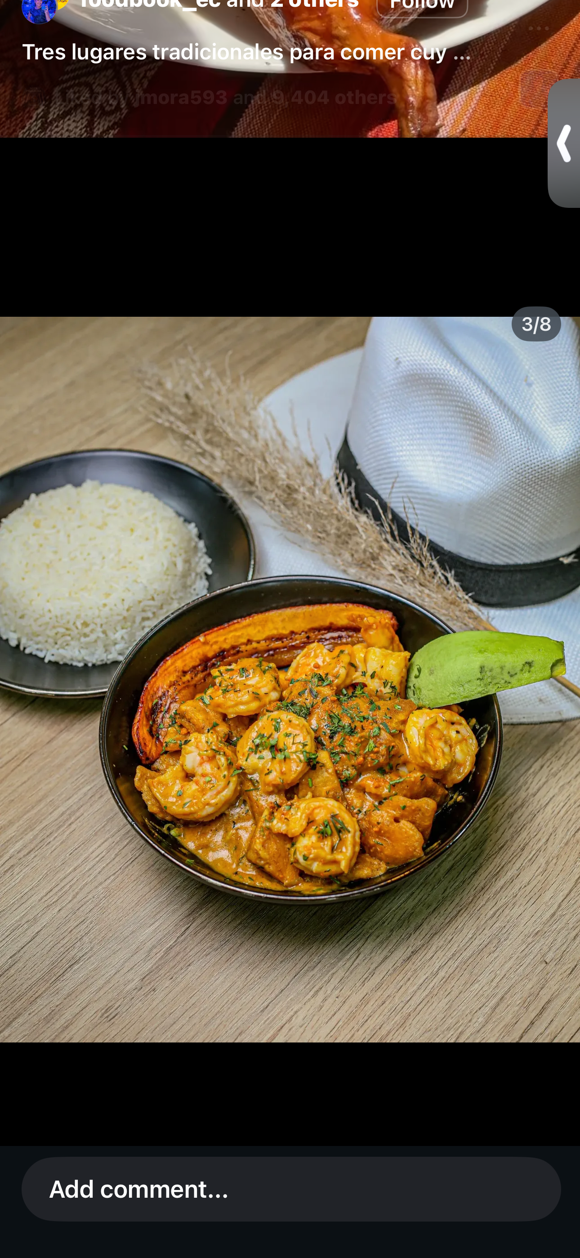

PURO SABOR
Authentic Ecuadorian & Colombian Restaurant
Business Proposal & Investor Pitch
Between Amigos, Eat • Meet • Repeat
University of Wales Trinity Saint David
Managing Enterprise
June 2026
Esther Moran Avila
Student Number: 2508069
Module Code: BMSW4011

Slide 2
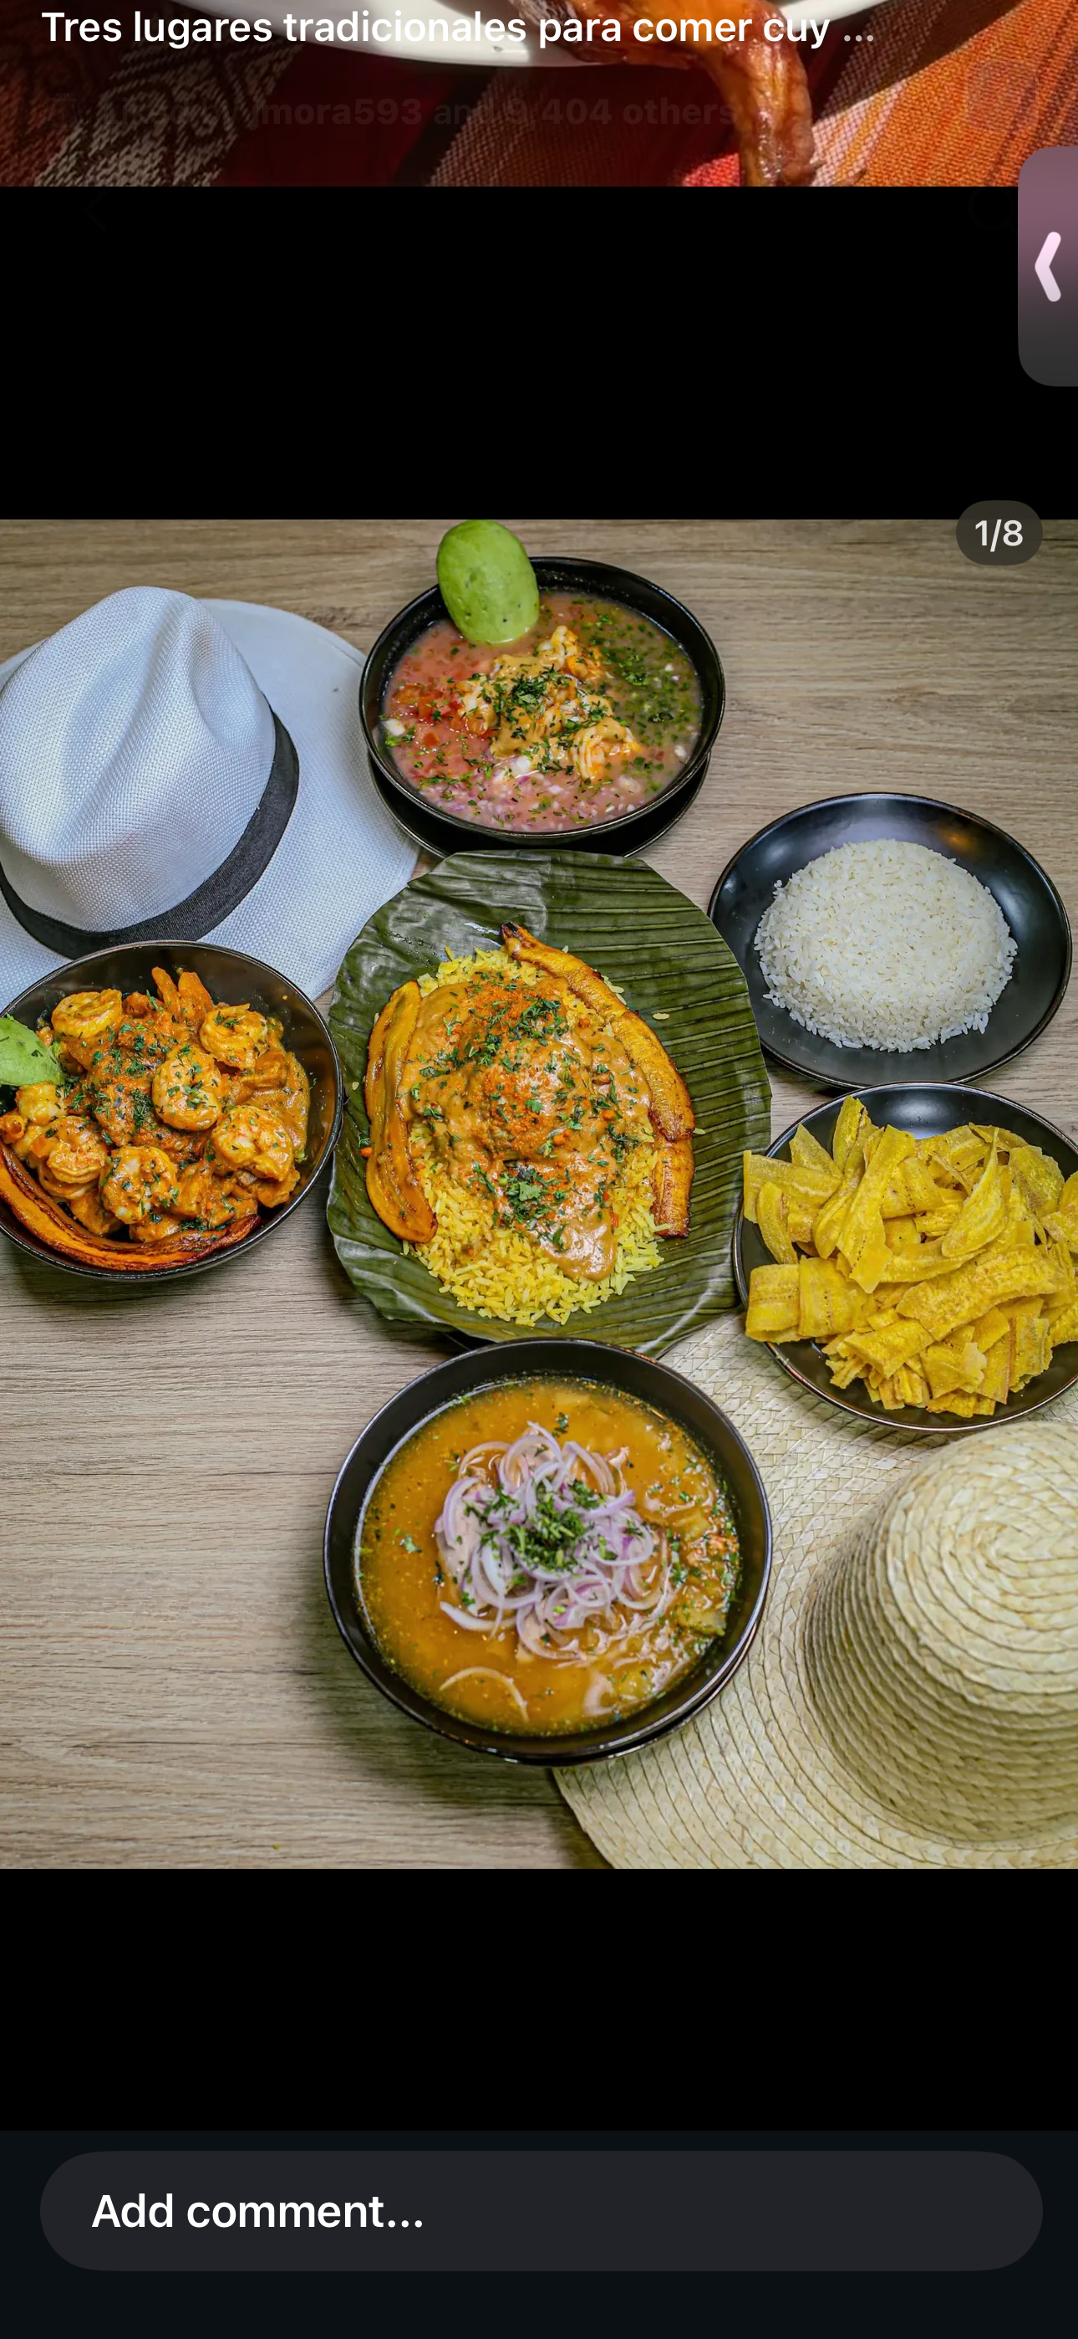
CONTENTS
1. Company Overview
2. Product & Service Description
3. My Story & Inspiration
4. Legal Structure
5. Mission Statement
6. Location
7. Human Resources
8. Marketing Strategy
9. Market Research
10. SWOT Analysis
11. Financial Resources
12. Meet the Founder
13. Why Invest in Puro Sabor?
14. References

Slide 3

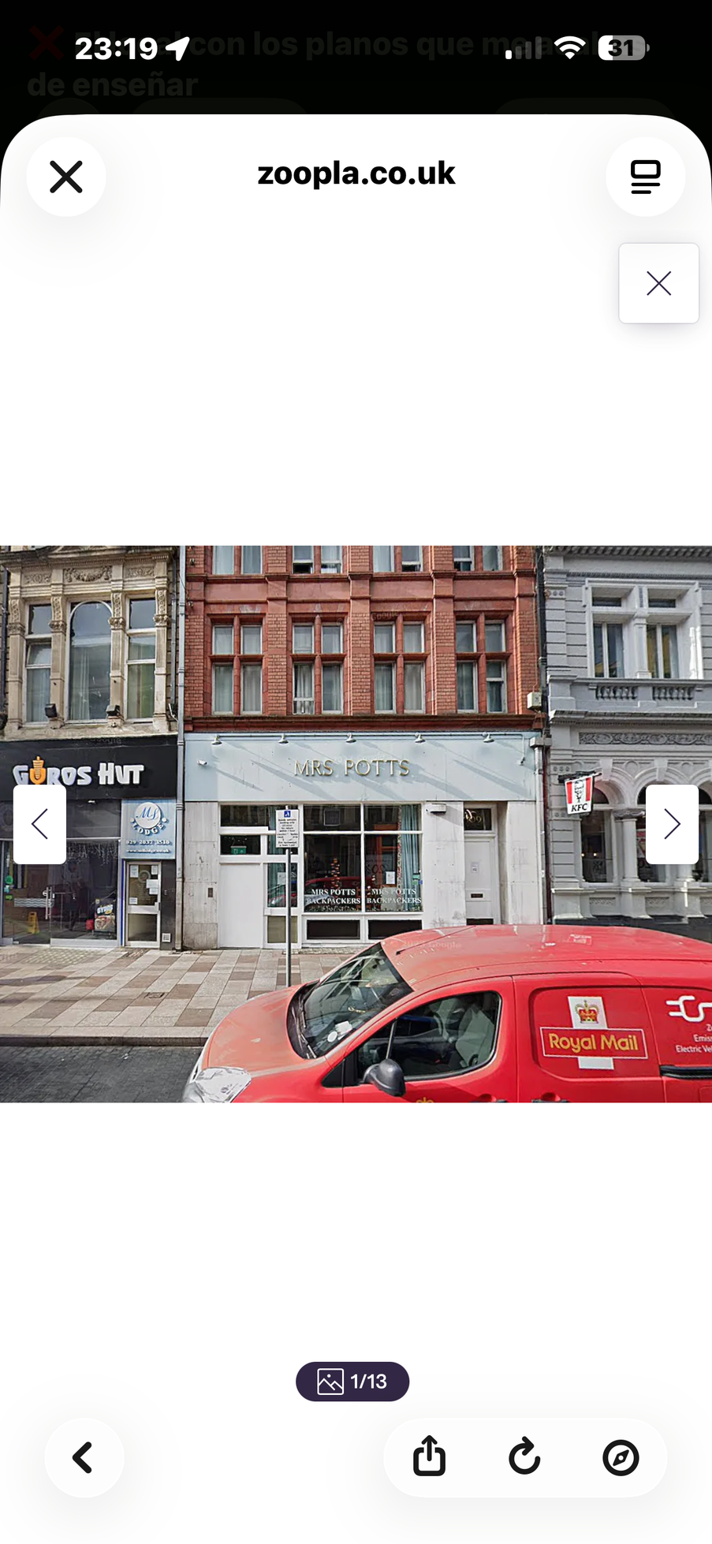
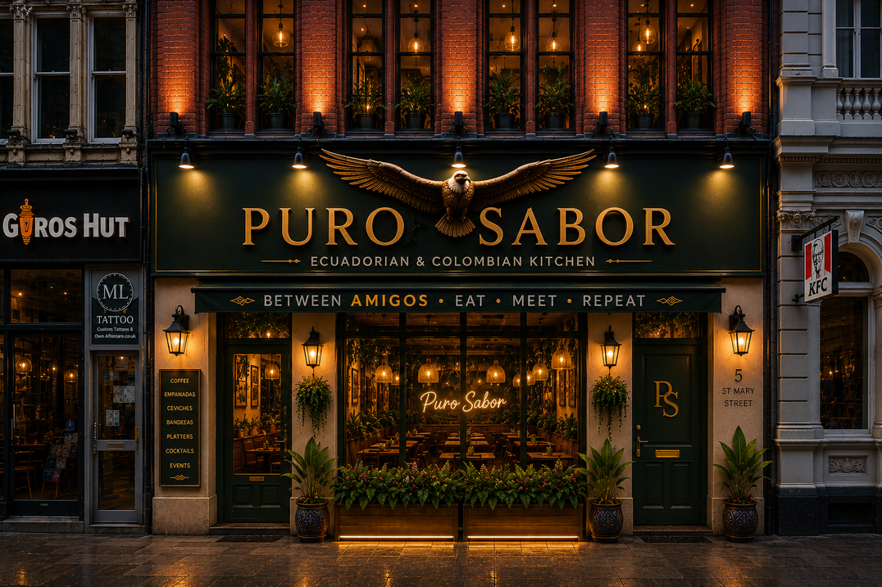
COMPANY OVERVIEW
CURRENT PREMISES
PURO SABOR VISION
Puro Sabor is a proposed Ecuadorian and Colombian restaurant in Cardiff, Wales.
Authentic South American food, culture and hospitality for the local community.
Cardiff offers a large student population, multicultural community and growing hospitality sector (Visit Cardiff, 2024).
The UK restaurant industry shows strong demand for diverse international food experiences (Statista, 2024).
Proposed Location
St Mary Street, Cardiff
Family Restaurant | Takeaway | Delivery | Private Events

Slide 4
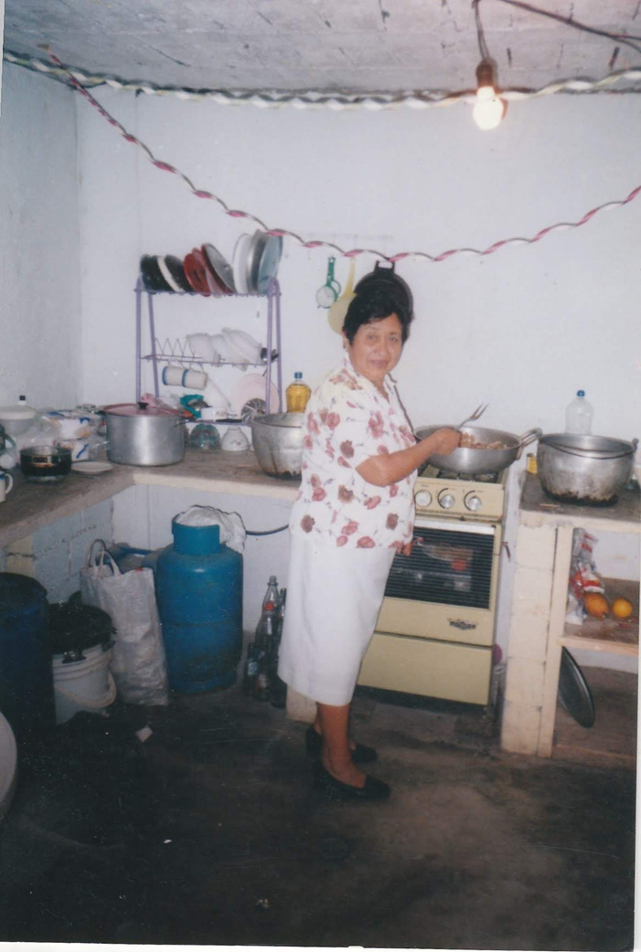
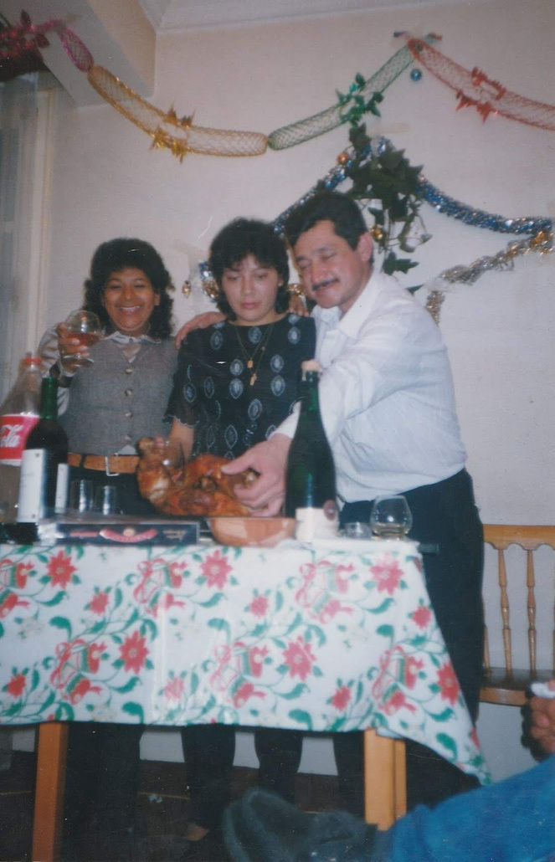
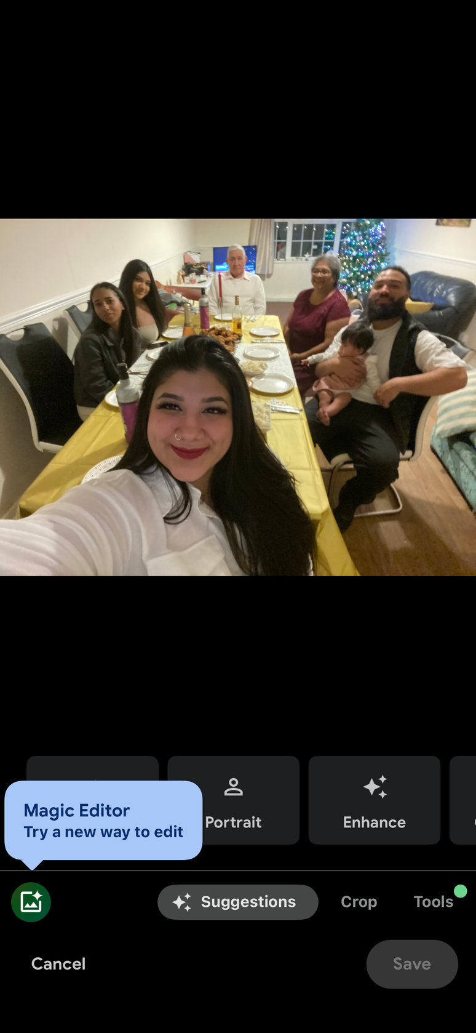
MY STORY & INSPIRATION
Family Roots
Growing Up Around Food
The Inspiration Behind Puro Sabor
My passion for food started in Ecuador, where I grew up surrounded by family recipes and homemade meals. My grandmother taught me that food is more than nutrition; it brings people together, creates memories and strengthens communities. This reflects the importance of culture and shared experiences in consumer behaviour (Kotler et al., 2021).
Family meals were an important part of my childhood. Celebrations and everyday dinners brought everyone together around the table, helping preserve traditions and strengthen family connections. These experiences inspired my vision of creating a restaurant where people can share authentic food and meaningful moments.
After moving to Cardiff, I noticed a growing interest in international cuisine and independent hospitality businesses. Research shows that consumers increasingly value authentic cultural experiences and local businesses (FSB, 2024). This inspired me to create Puro Sabor as a place where people can enjoy authentic Ecuadorian and Colombian food while connecting with others.
Personal Motivation
Puro Sabor is more than a business idea. It is a project inspired by my family history, cultural heritage and entrepreneurial ambitions. My goal is to build a successful restaurant while sharing Ecuadorian and Colombian traditions with the Cardiff community and creating a welcoming space for families and friends.

Slide 5
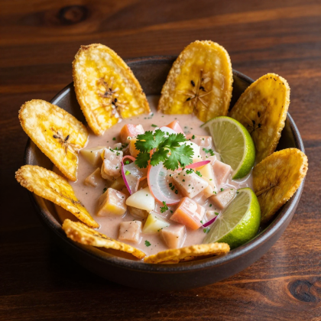
LEGAL STRUCTURE
Advantages
✔ Easy Setup
✔ Full Control
✔ Low Cost
Owner
Decisions
Profits
Disadvantages
Liability
Tax
⚠ Unlimited Liability
⚠ Personal Assets at Risk
⚠ More Financial Risk
SOLE TRADER
One Owner = Full Responsibility
Why Sole Trader?
Puro Sabor will start as a Sole Trader because it is simple, low-cost and gives the owner full control during the early stages of the business (GOV.UK, 2024).

Slide 6
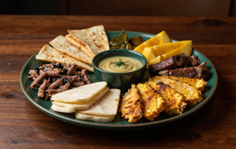
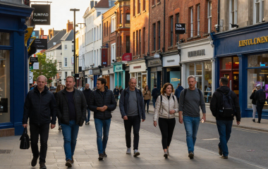
SWOT ANALYSIS
💪 STRENGTHS
⚠️ WEAKNESSES
• Unique Concept
• Authentic Ecuadorian &
Colombian Food
• Live Music & Latin Events
• High Start-up Costs
• New Business with No
Brand Recognition
• Dependence on
Customer Awareness
🌍 OPPORTUNITIES
⚡ THREATS
• Growing Interest in
Latin Cuisine
• Students and Tourists
in Cardiff
• Community Events
and Partnerships
• Competition from
Established Restaurants
• Inflation and Rising Costs
• Economic Uncertainty
References: Primary Research Survey (2025) | ONS (2025)

Slide 7
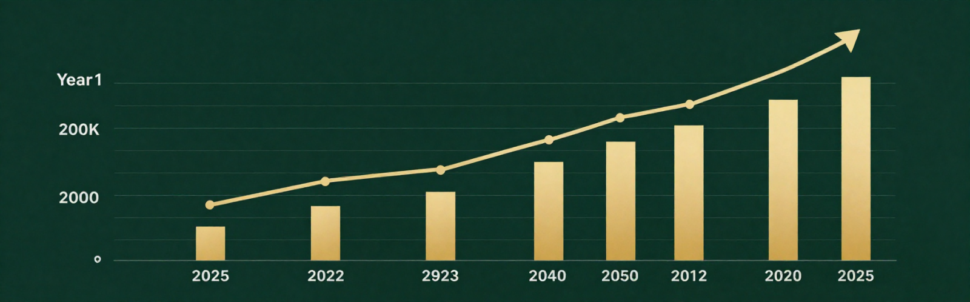
FINANCIAL RESOURCES
💰 START-UP COSTS
📊 MONTHLY COSTS
£99,996
£25,916
📈 YEAR 1 REVENUE
🏆 YEAR 1 PROFIT
£345,000
£27,004
"Projected profitability achieved during Year 1 through increasing sales and customer growth."
References: Primary Financial Forecast (2025)

Slide 8

MEET THE FOUNDER
👩 ABOUT ME
⭐ STRENGTHS
Single Mother
Full-time Business Student
Founder of Puro Sabor
Organised
Creative
Determined
🚀 ENTREPRENEURIAL SKILLS
🎯 VISION
Hard-working
Resilient
Passionate
To create a unique Ecuadorian
and Colombian dining experience
in Cardiff through food, music
and community.
"I am passionate about creating a unique dining experience that brings Ecuadorian and Colombian culture to Cardiff through food, music and community."

Slide 9
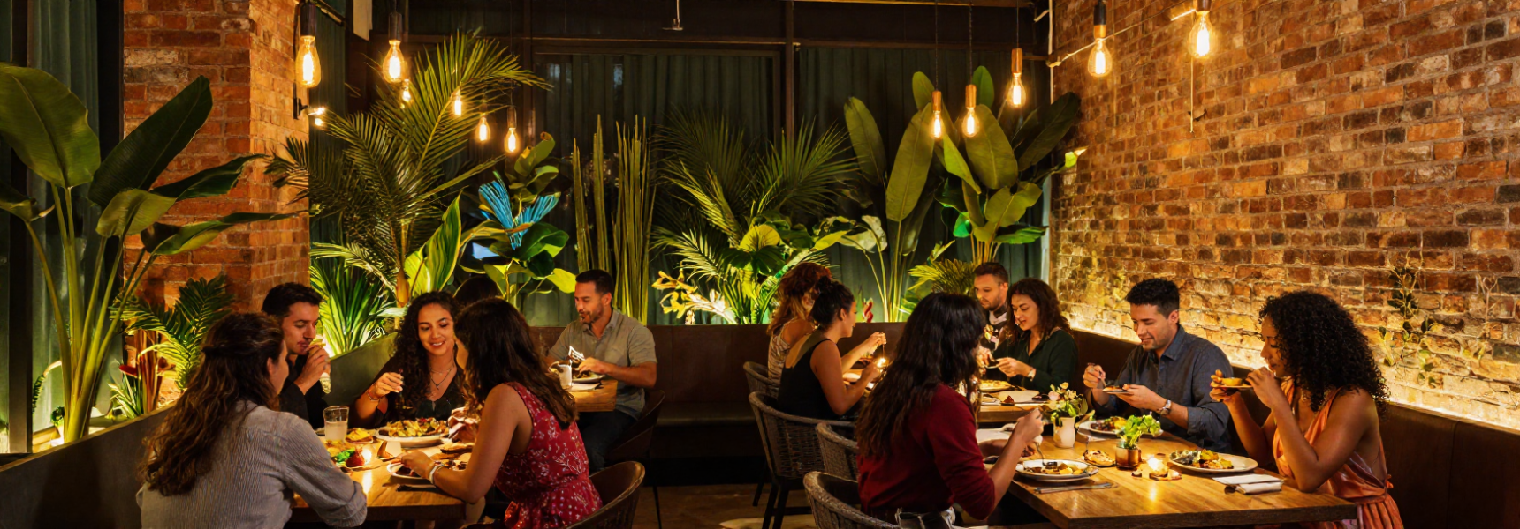
WHY INVEST IN PURO SABOR?
✅ Unique Concept
✅ Strong Branding
✅ Market Opportunity
Ecuadorian & Colombian
restaurant with Latin
music nights.
Clear identity, logo,
social media presence
and themed events.
Primary research showed
strong customer interest
and demand.
✅ Authentic Experience
✅ Passionate Founder
Food, culture, music and
community in one venue.
Dedicated founder who developed
the full business plan while
studying full-time.
References: Market Research (2025); Primary Research Survey (2025).

Slide 10
REFERENCES
ACAS (2025) Employee Training and
Workplace Guidance.
CIPD (2025) People Management and
Employee Development.
FSB (2024) Small Business Market Trends.
GOV.UK (2024) Sole Trader Business
Structure.
Instagram Business (2025) Social Media
Marketing Tools.
Kotler, P., Armstrong, G. and Opresnik, M.
(2021) Principles of Marketing.
Market Research Survey (2025) Primary
Research Conducted by Author.
Meta Business (2025) Digital Marketing
Resources.
ONS (2025) UK Population and Consumer
Trends.
Primary Financial Forecast (2025) Business
Financial Projections.
Statista (2025) UK Restaurant Industry
Statistics.
TikTok Business (2025) Marketing and
Advertising Solutions.
Visit Cardiff (2024) Cardiff Tourism and
City Centre Information.

