Slide 1
Contemporary Themes in the Hotel and Hospitality Sector
Module code: BMIH6001
The future of work: Artificial Intelligence and human collaboration in hotel and hospitality
AI for guest service
Student name: Darius Raul Condescu
Student ID: 2212965
Module Lead: Dr. Ernest Balutie Wavei

Slide 2
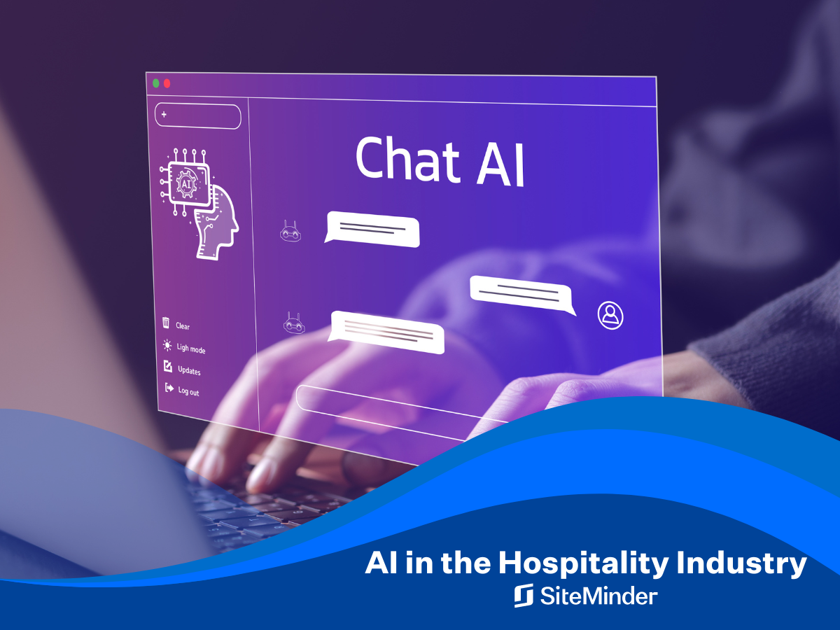
INTRODUCTION
AL IN HOSPITALITY
AI is transforming hotel operations with tools such as chatbots, virtual systems, and automated check-ins (Ivanov & Webster,2019).
It improves efficiency, personalised services, and reduces routine tasks ;
AI adoption is crucial considering the growing demands of guests and workforce shortages (Tussyadiah, 2020).
Al assists employees by handling responsibility for routine duties to ensure employees can concentrate on more complex and emotional functions.
This study explores how AI and staff can enhance guest experiences.

Slide 3
LITERATURE REVIEW
AI in hotels:
Enhancing the Tourists’ Experiences by:
a)Creating customised meals and room suggestions based on guest data;
b)Adapts room temperature and lighting to individual preferences (MDPI, 2024);
c) Faster and more secure check-ins using fingerprints and visual identification (Tussyadiah, 2020)
Assisting employees by:
a)Chatbots that offer 24/7 multilingual assistance;
b)Tracking real-time customer reviews and reporting to employees when something needs proper attention.

Slide 4
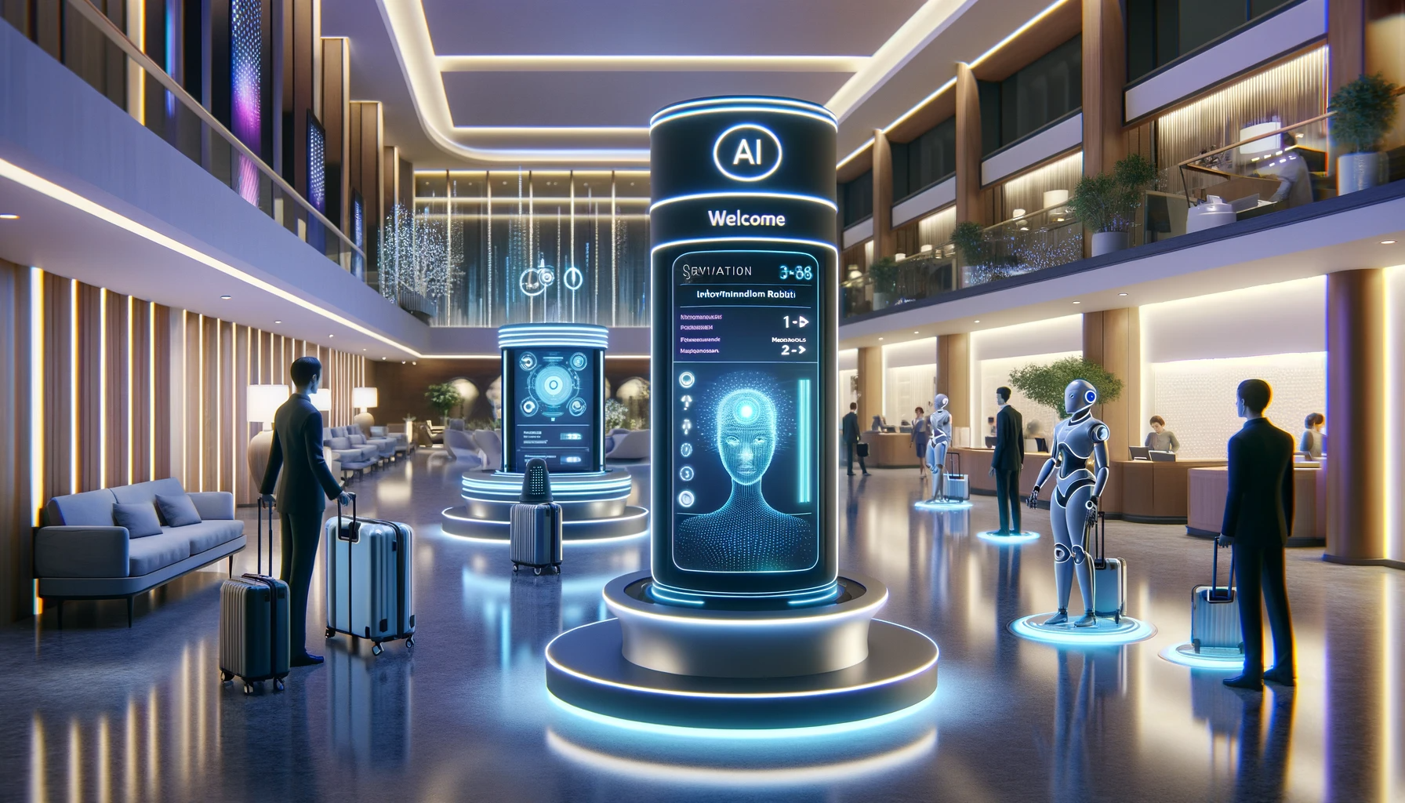
Challenges of AI Integration in Hospitality
Data privacy is crucial, and GDPR compliance and open data are necessary(Ranco Makivik et al., 2024)
High costs of AI systems and ongoing maintenance challenge small hotels.
The employee may worry about losing their job.
There is a need for technological abilities, training, and staff adaptability.

Slide 5

METHODOLOGY
Sources: Academic Journals, case studies, industry reports;
Databases: Google Scholar, university library, hospitality journals;
Keywords: “Al in Hospitality”, “hotel automation”.

Slide 6
Theme impact analysis: PEST Analysis
Political Factors:
Data privacy laws: GDPR requires strict data protection.
Government regulation may delay AI automation to protect jobs.
Economic Factors
Al improves efficiency and reduces labor costs.
High initial investment and inflation may slow adoption.

Slide 7
Social Factors
Al lacks human warmth, empathy, and emotional intelligence.
Teenagers may welcome AL, but the elderly may find it impersonal and hard to use.
Technological Factors
Availability 24/7, with chatbots, mobile check-ins, and smart room controls.
Use of facial recognition.
Technology improves speed, consistency, and convenience.

Slide 8

CONCLUSION
Al is a valuable tool in improving hospitality operations and guest services.
Al should not replace human engagement, even when it increases productivity, speed, and customisation.
Emotional connection, a friendly greeting, a genuine smile, and a compassionate service are never supposed to take possession of another person’s touch.

Slide 9

RECOMMENDATION
AI should be used for boosting personnel as opposed to simply substituting them;
Ensure strong data privacy and security, GDPR
Offer both Al and traditional service options.

Slide 10
REFERENCES
European Union. (2016). Regulation (EU) 2016/679 of the European Parliament and of the Council of 27 April 2016 on the protection of natural persons with regard to the processing of personal data and on the free movement of such data (General Data Protection Regulation). Official Journal of the European Union, L119, pp.1–88. Available at: https://gdpr-info.eu/ [Accessed 19 May 2025].
Ivanov, S. and Webster, C. (eds.) (2019) Robots, Artificial Intelligence, and Service Automation in Travel, Tourism and Hospitality. Preliminary pages, pp. i–xxii. Bingley: Emerald Publishing. Doi: https://doi.org/10.1108/978-1-78756-687-320191014.
‌MDPI. (2024). AI Impact on Hotel Guest Satisfaction via Tailor-Made Services. Information, 15(11), 700. Retrieved from https://www.mdpi.com/2078-2489/15/11/700 (Accessed 14 May 2025).
‌Morch, A. (2024). Impact of AI on Hotels: A New Skill Set for the Future. [online] Hospitality Net. Available at: https://www.hospitalitynet.org/opinion/4123766.html [Accessed 19 May 2025].
Ranko Makivić, Dragan Vukolić, Veljović, S., Minja Bolesnikov, Lóránt Dénes Dávid, Ivanišević, A., Silić, M. and Gajić, T. (2024). AI Impact on Hotel Guest Satisfaction via Tailor-Made Services: A Case Study of Serbia and Hungary. Information, [online] 15(11), pp.700–700. doi:https://doi.org/10.3390/info15110700.
Tussyadiah, I. (2020) ‘A review of research into automation in tourism: Launching the Annals of Tourism Research Curated Collection on Artificial Intelligence and Robotics in Tourism’, Annals of Tourism Research [online], 81, 102883. Available at https://doi.org/10.1016/j.annals.2020.102883.

Slide 11



