Slide 1
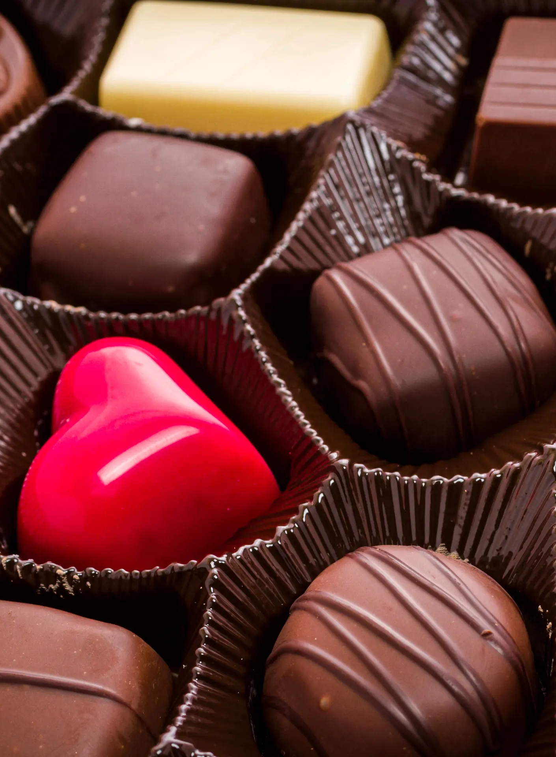
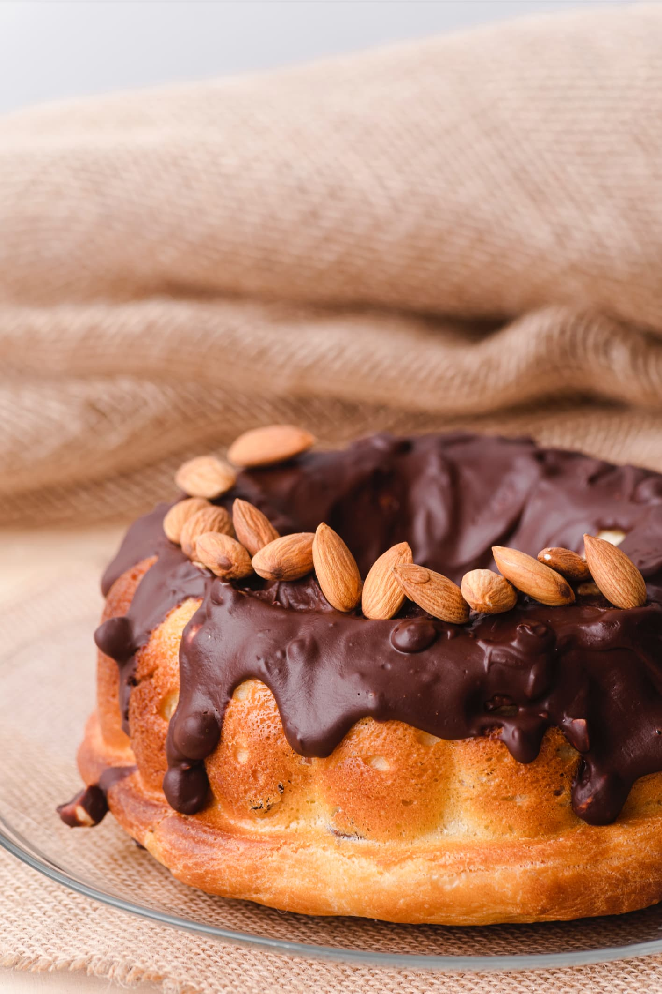
SweetBalance
"A Taste of Joy and Health in Every Bite.“
By Salma Farache
(New Atlas ,2024)

Slide 2
Introduction – The Heart of the Idea
" SweetBalance”, a dessert business born from both culture and compassion.
Based on a chocolate and Arabic dessert brand inspired by my Lebanese heritage.
Inspired by my volunteering experience.
Especially with children who have diabetes and elderly people facing food restrictions.
Dessert could bring joy, dignity, and a sense of normalcy.
In this Journey I have applied what I learned in this Module especially in :
Market Research
Digital Marketing
Financial Planning
Entrepreneurship
This experience helped me develop both business and digital skills

Slide 3
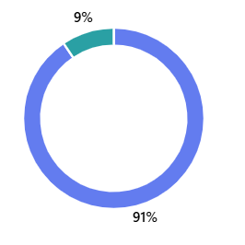
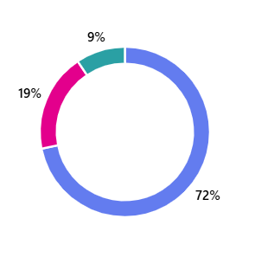
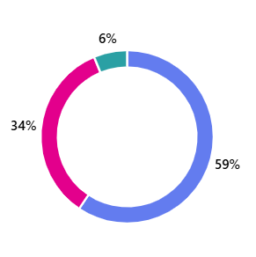
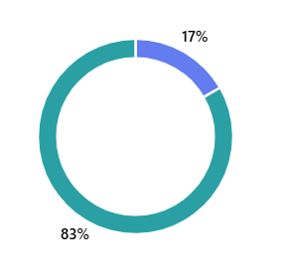
Market Research – Understanding People
I used Microsoft Forms to collect 17-question survey data. Key insights:
90% want handmade desserts
71% prefer
low-sugar
options
58% support using natural sweeteners
Like dates
Attention- question
83% answered correctly
Chaffey and Ellis-Chadwick (2019) support using such measures to ensure data quality .
(Microsoft Forms,2025)

Slide 4
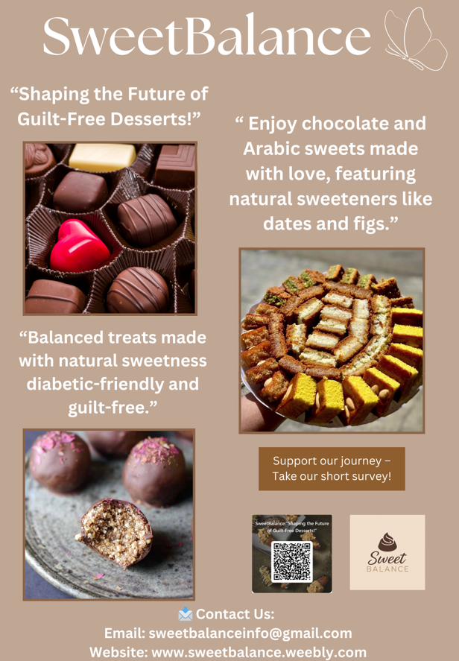
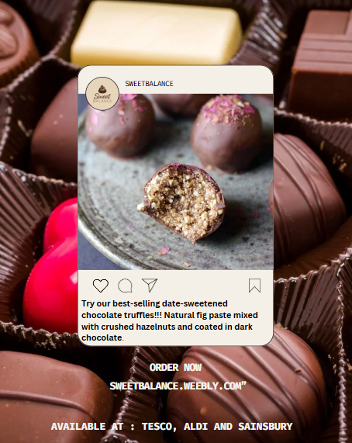
From Data to Brand – SweetBalance
Date-filled chocolate truffles, sugar-free Baklava, Oat&fig bars
SweetBalance: Where balance means health and happiness in every bite
Supermarket names included in social media posts.
(Canva,2025)

Slide 5
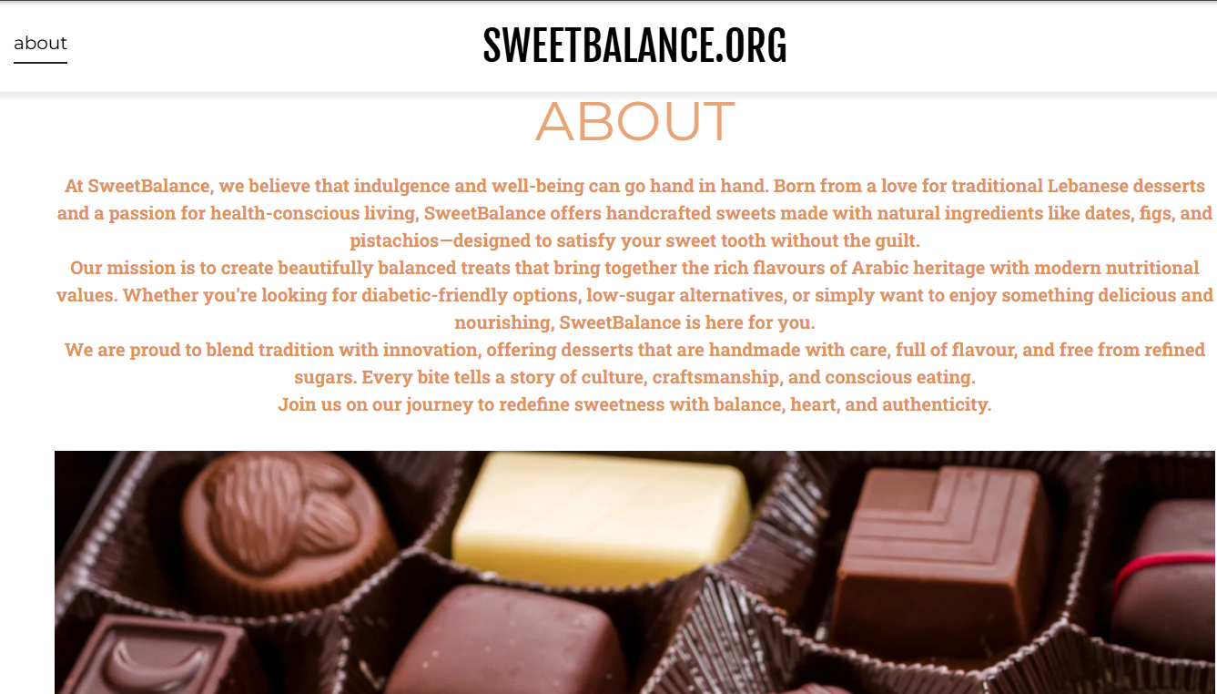
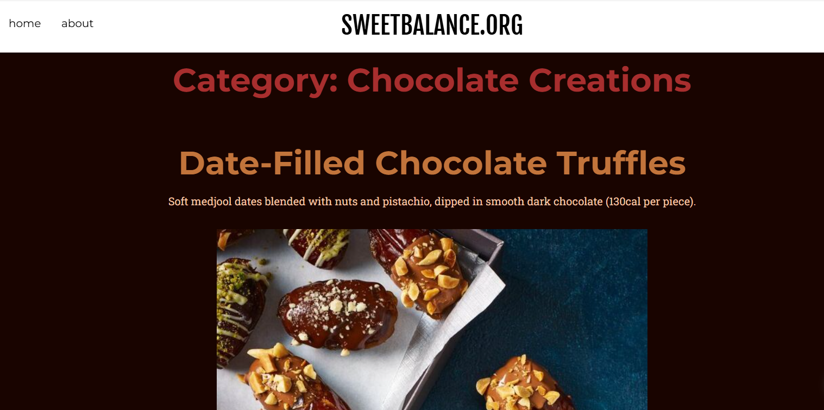
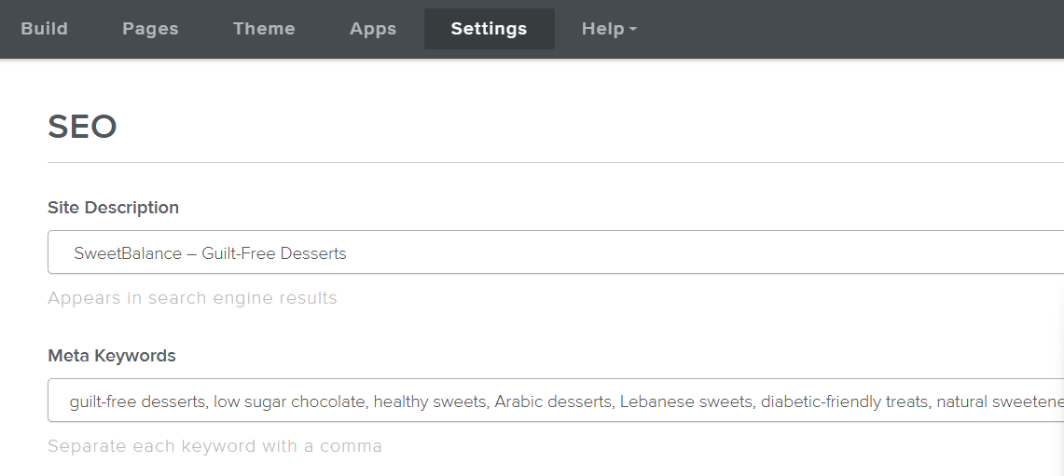
Website and SEO – Being Seen Online
I Built two pages using Weebly
Diabetic-friendly chocolate.
Alt-text on images to improve visibility .
Homepage shares the brand origin story and highlights ingredients
The Product page shows full menu
Look clean and welcoming
(Weebly,2025)

Slide 6
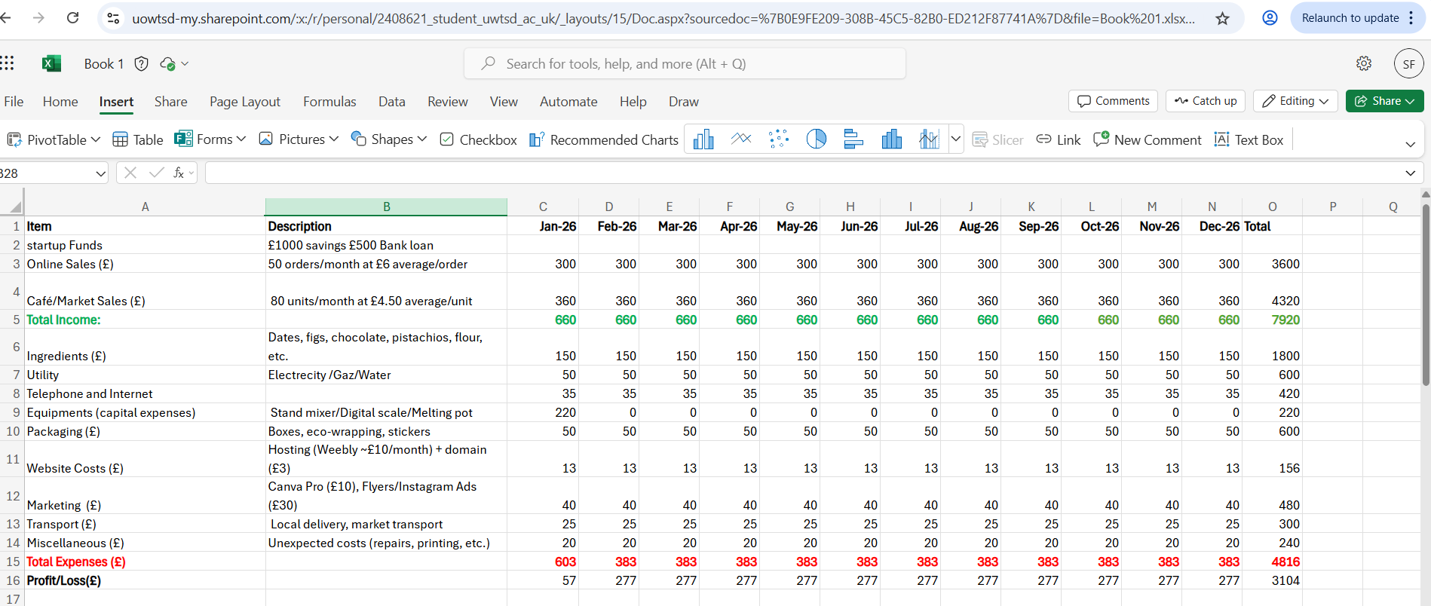
Excel and Bar Chart – Financial Planning
I used Microsoft Excel to build a 12-month cash flow forecast.
Excel for income/expenses and profit tracking.
(Microsoft Excel,2025)

Slide 7
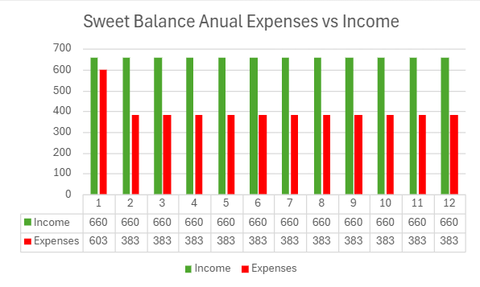
Excel and Bar Chart – Financial Planning
I used Microsoft Excel to build a 12-month cash flow forecast.
Created bar chart comparing monthly income vs expenses.
(Microsoft Excel,2025)

Slide 8
Time to watch!

Slide 9
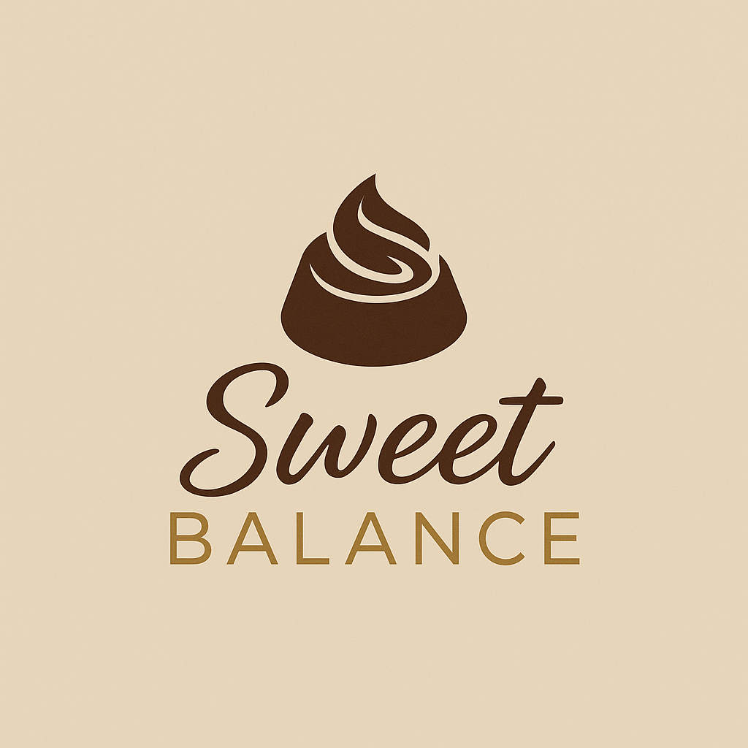
Video Advertisement – Communicating the Brand
SweetBalance
Video created with TikTok:
Starts with me introducing the brand
Shows my son enjoying the dessert
Message: ‘Naturally sweet handmade with Care
It reflects love, culture, and health - key insights from the survey.
(YouTube, 2024)
https://youtube.com/shorts/oz9GEbJRtWg?si=KtX3yUvu-Q1Cn3ar
(Canva,2025)

Slide 10
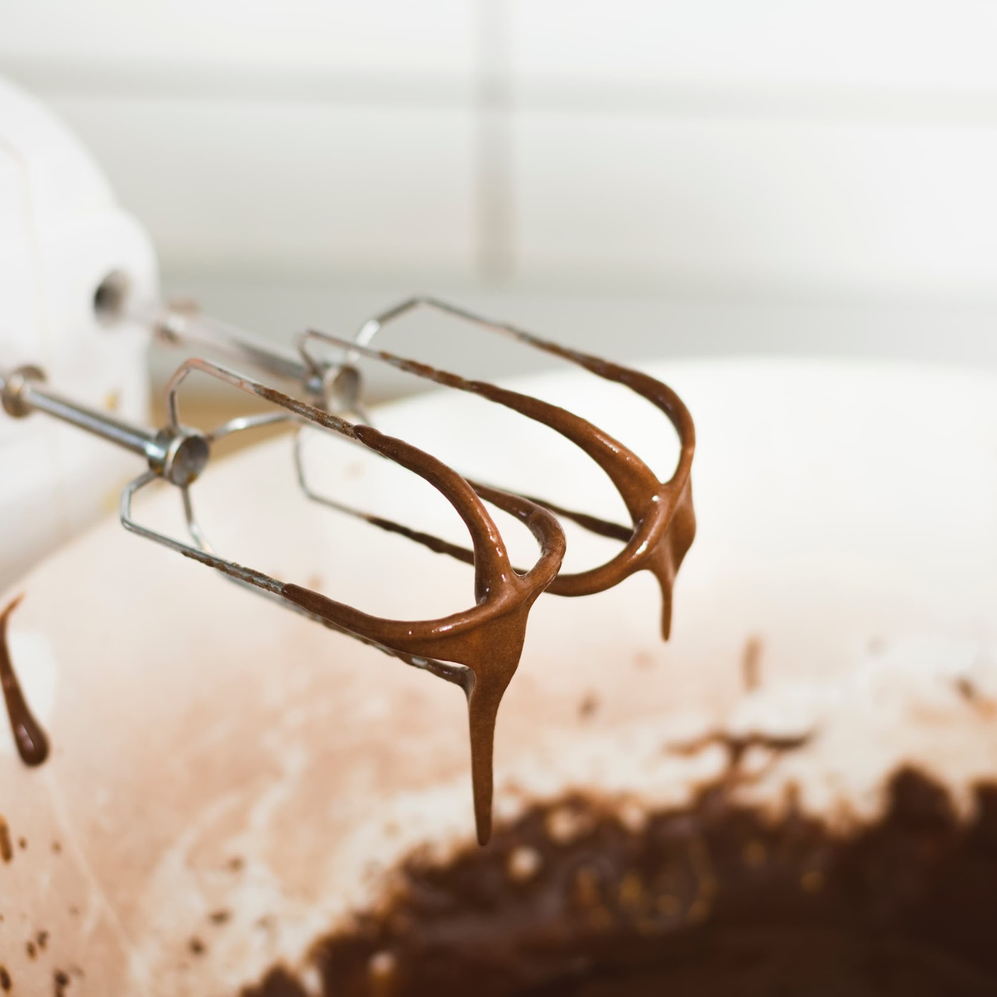

Digital Tools and Skills Gained
01
02
04
05
Microsoft Forms for surveys
Excel for data and finance
03
Canva for designing marketing materials
Weebly for building a website
TikTok for video ad
Skills: research, branding, time management, digital literacy.
(VirtualSpeech, 2023)

Slide 11

Skills I Need to Develop
01
02
04
Advanced Excel (dashboards, formulas)
Canva( professionl marketing design)
03
Public speaking for investor pitches and networking events
Email marketing to build a loyal customer base
(MyPerfectResume, 2023)
By developing these skills: I'll be better prepared to grow SweetBalance with confidence and creativity.

Slide 12
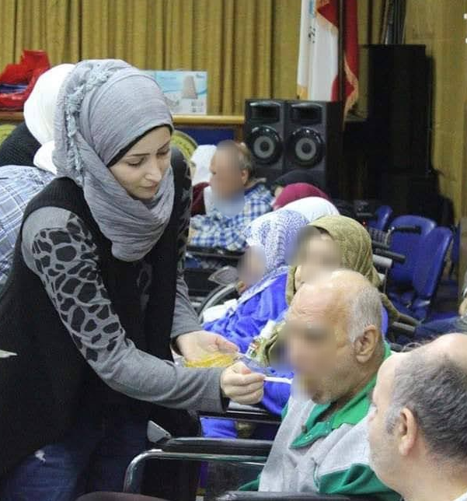
Conclusion
"Why SweetBalance Matters“
I believe in SweetBalance not just because I love dessert
but because I’ve seen what food can mean to people.
I’ve stood beside children who couldn’t enjoy cake like others. I’ve cooked for people who felt forgotten. And I’ve seen how a small, beautiful thing like a piece of chocolate can offer comfort, love, and connection .
(Farache, 2025)

Slide 13
—Salma Farache-
“Thank you so much for listening!”

Slide 14
References
Chaffey, D. and Ellis-Chadwick, F. (2019) Digital Marketing. 7th edn. Harlow: Pearson Education.
Delicious Magazine (n.d.) Chocolate‑dipped stuffed dates. Available at: https://www.deliciousmagazine.co.uk/recipes/chocolate-dipped-stuffed-dates/ (Accessed 5 June 2025).
Etsy (2024) Lebanese Sfouf SweetFamous Arabic cake – listing 1210255312. Available at: https://www.etsy.com/uk/listing/1210255312/lebanese-sfouf-sweetfamous-arabic (Accessed 3 June 2025).
Farache, S. (2025) SweetBalance promotional image. Personal photograph.
MyPerfectResume (2023) What skills have you acquired from work experience? Available at: https://www.myperfectresume.com/career-center/interviews/questions/what-skills-have-your-acquired-from-work-experience (Accessed: 25 June 2025).
New Atlas (2024) Chocolate can now be made from cocoa jelly: new type of chocolate explained. Available at: https://newatlas.com/good-thinking/chocolate-new-type-cocoa-jelly/ (Accessed 7 June 2025).
SweetBalance (2025) Financial Table for SweetBalance. Microsoft Excel Spreadsheet. Unpublished internal document.
SweetBalance (2025) Promotional Image for SweetBalance. Created using Canva. Unpublished internal document.
SweetBalance (2025) Promotional Image for SweetBalance. Created using Weebly. Unpublished internal document.
The Tasty Spoonful (n.d.) Healthy fig and banana rolls. Available at: https://thetastyspoonful.com/healthy-fig-and-banana-rolls/ (Accessed 5 June 2025).
VirtualSpeech (2023) Skills for career development: 10 key skills you need to grow professionally. Available at: https://virtualspeech.com/blog/skills-career-development (Accessed: 25 June 2025).
YouTube (2024) [Short video: Sweet Balance: Naturally Sweet, Handmade with Care]. YouTube Shorts. Available at:https://youtube.com/shorts/oz9GEbJRtWg?si=KtX3yUvu-Q1Cn3ar (Accessed: 28 June 2025).

