Slide 1
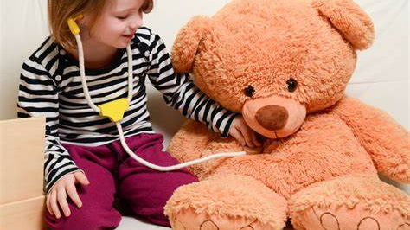
Play Therapy
With Katie Ruddy

Slide 2
According to the British association of play therapists (BAPT) Play Therapy is…
‘…the dynamic process between child and Play Therapist in which the child explores at his or her own pace and with his or her own agenda those issues, past and current, conscious and unconscious, that are affecting the child’s life in the present. The child’s inner resources are enabled by the therapeutic alliance to bring about growth and change. Play Therapy is child-centred, in which play is the primary medium and speech is the secondary medium.’

Slide 3

Introduction to Play Therapy

Slide 4
What is Play Therapy?
Play Therapy is an effective therapy that helps children modify their behaviours, clarify their self-concept and build healthy relationships. In Play Therapy, children enter into a dynamic relationship with the therapist that enables them to express, explore and make sense of their difficult and painful experiences. Play Therapy helps children find healthier ways of communicating, develop fulfilling relationships, increase resiliency and facilitate emotional literacy.
Children use play as a form of communication. So often children referred to Play Therapy do not have the words to describe their thoughts, feelings and perceptions of their internal and external world.

Slide 5
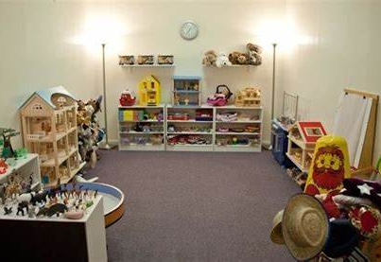
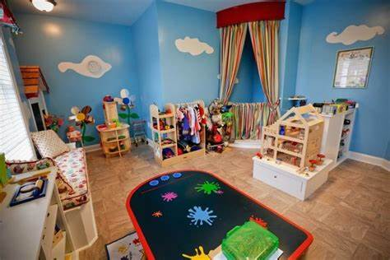
Play Therapy Rooms

Slide 6
How does Play Therapy help children?
Play is vital to every child’s social, emotional, cognitive, physical, creative and language development. It helps make learning concrete for all children and young people including those for whom verbal communication may be difficult.
Play Therapy helps children in a variety of ways. Children receive emotional support and can learn to understand more about their own feelings and thoughts. Sometimes they may re-enact or play out traumatic or difficult life experiences in order to make sense of their past and cope better with their future. Children may also learn to manage relationships and conflicts in more appropriate ways.
The outcomes of Play Therapy may be general e.g. a reduction in anxiety and raised self-esteem, or more specific such as a change in behaviour and improved relations with family and friends.

Slide 7
What do Play Therapists do?
Play therapists work with children aged between three and eleven years of age, and occasionally adolescents, suffering from a range of psychological difficulties and complex life experiences. Psychological difficulties include depression, anxiety, aggression, learning difficulties and ADHD. Difficult life experiences include abuse, grief, family breakdown, domestic violence and trauma. A professionally trained play therapist helps a child to increase insight, to decrease internal conflict and to increase resiliency, coping and emotional literacy. Play therapists work closely with the child’s parents/carers throughout the play therapy intervention and occasionally undertake parent-child relationship interventions.

Slide 8
How long does Play Therapy take?
Some children will respond to a short term intervention (for example up to 12 sessions). However, when problems have persisted for a long time or are complicated a longer-term intervention may be required. In these circumstances some Play Therapists have worked with children for two years or more. Sessions are usually once a week and consistency on a regular day and at the same time and place is very important for developing a trusting relationship. Unplanned missed sessions may disrupt the progress.

Slide 9
Confidentiality in Play Therapy
Information that you share about your child and family will usually be kept confidential. A Play Therapist may share information with other colleagues and professionals for the benefit of your child with your permission. A Play Therapist must share information with other professionals if they are concerned that a child is being harmed, hurting others or themselves. They will usually talk to you about this first.
Your child’s Play Therapist will meet with you at regular intervals to discuss progress in therapy sessions and any changes and developments you have witnessed or experienced at home. However the Play Therapist will not disclose specific details of what your child has played. This is important in order to maintain your child’s trust and feelings of safety with the therapist.

Slide 10

Pause for Reflection – your own play history

Slide 11
Thoughts and Reflections…
It is in playing and only in playing that the individual child or adult is able to be creative and to use the whole personality, and it is only in being creative the individual discovers the self” (Winnicott, 1971).

Slide 12
Play Therapy with Adults…
“It is utterly wonderful work because it brings an enormous depth to the process. Often, when talking, we only see the ‘now’ while hearing about the ‘then.’ Engrossed in play, however, the ‘then’ comes fully into the room. Look into the eyes of the person smashing clay and you see the moment and truth of the pain, not just the memory. It is awesome.” –Charles Schaefer (Play Therapy with Adults)

Slide 13
Benefits of play and creativity to heal trauma
Stress levels increase cortisol levels.
Cortisol affects the rate at which neurons are either added or subtracted from the hippocampus.
The hippocampus (located in the mid-brain) is the central organ for learning and can be reduced in size when neurons are lost. This means duration of stress or trauma has a direct impact on an individual’s ability to learn and retain information. Another part of the brain, the amygdala, is important to discuss and understand as it is involved in processing fear. The amygdala develops the slowest and actually increases in volume when exposed to trauma and stress. Stress can cause it to modify the direction of brain development. If the adult client experienced trauma as a child, the effects of modified brain development might not become apparent for years until the brain’s synaptic organization is complete (Gross, 2013). This means that adults can show latent effects of childhood trauma.
Play helps to restore brain chemistry and causes the whole brain to operate in a more efficient way.
Physical motion also invites release of stress/tension

Slide 14
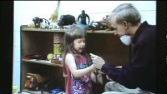
In session with Gary Landreth

Slide 15
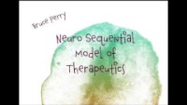
The Neurosequential Model of Therapeutics

Slide 16

Trauma and Play Therapy
Paris Goodyear Brown

