Slide 1

Effective Team Work and Communication
(BMSW4002)
Lecturer : Ejiro Esohwode
Students
1.Mirela Adamache (2115392) – Benefits of Team working
2.Cristina Daniela Besa (2115351) – Stages of Development
3.Corina Faramita (2115775) – Team Roles
4.Sergiu Gore (2115201) – Managing Conflict
5.Oscar Cevallos Cajamarca (2115385) – Succssesfull Team Development
6.Rozalinda Kasperowicz( 2115658) - Conclusion

Slide 2
  Benefits of Team working
The team work in management of organisation have own benefits for performing task and help organisation to achieve the target. The benefits of team working are:
Better Problem Solving
Increased Potential Motivation
Notes:
If any problem arises in the work then discuss with the all the people of group find a solution which help to solve the problem easily. This will show how they have a good communication skill with each employees.
In team work each employee help to increase the motivation level of each employee in the group for doing task effectively. This is very important in organisation that each employee is having motivation for his responsibility which organisation assign to perform.

Slide 3
Smarter Risk Taking
Expand Creativity
Notes:
If the employees have good team work then team easily able to tackle the risk in organisation because if anything gone wrong then team members help that employee take out from this risk factor situation. If you are taking risk alone then no one is helping to take out from this risk factor situation you have to own make solution and come out this is will proof very dangerous for that employees.
In a group of employees, each employee has different mind when they come together then something innovative ideas is generate for the performing the task of an organisation and help to organisation to grow. This is very effective way to generate new ideas and perform task in organisation

Slide 4
Boosted Productivity
More People = Greater Ideas
Notes:
The employees can boost the productivity level by getting a motivation and support from group of employees in organisation. The group of employees in organisation is play very important role because group of employees help other employees to give motivation and increase the production level for organisation.

Slide 5
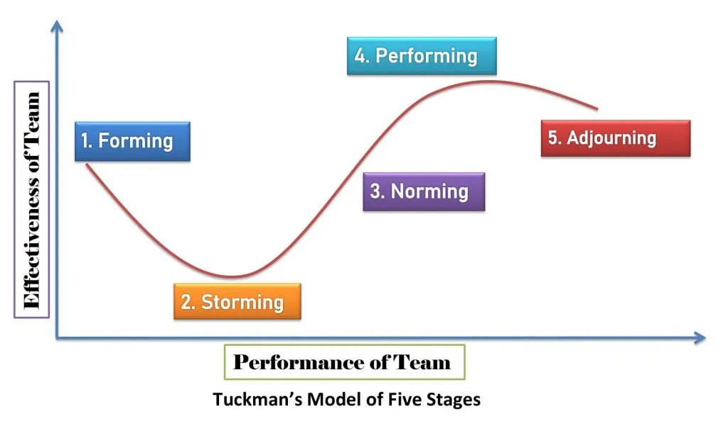
  Stages of Team Development
There are many different types of tasks which have to be performed in organisation which required effective team work to perform the task and complete. There are different types of development of team stages and this stages are introduced by Tuckman (1956).
Notes:
This will help the organization to archive the target effectively and efficiently. This will help organisation's team group to accomplish the objectives of organisation. This is very important theory for the development of team in organisation. There are 5 stages of team Development by Bruce Wayne Tuckman theory.

Slide 6

Forming:
forming the groups
discuss what to achieve
Storming:
difficult stage
compete the competitors
Notes:
It is the initial stage where management introduces all team members with each employee in a group. Discuss each employee potential skills so that it is easy that what they are able to perform best in that field. It helps other employees in a group to know that what is a potential of each employee in organisation. In this the project is also assign to perform and assign the responsibility of each employee in the project.
In this, all the employees in a group, share their ideas for completing the assign task. The ideas of an employees give opportunity to stand out in the organisation and the ideas must be accepted by all employees in group. The Team leader help the group that all employees to make plan to complete the task and team leader manage the competition level of employees and must be communicate between all employees in a group and examine every time that project must be going in right direction.

Slide 7
Norming: The team is established to perform the task effectively and efficiently.
Performing: All the employees of individual group to perform and get work done.
Notes:
The employees must be clear that they don't have own personal internal competition with other employees, responsibility and goals must be clear by each employee in organisation. If all the employees are working in an organisation to achieve common goals, then employees must know how to share ideas with other employee and each employee must be work more efficiently and employees must take feedback of their work so they learn and perform the best in next task.
In the organization there is very high level of unity and trust between all employees in a group. The employees performing the responsibility and increase the efficiency of doing work without the support of team leaders. The employees have to prepare and plan the strategy to perform the assign task it is very important that each employee have to give their best by give responsibility by an organization. If the team groups are performing best, then it automatically help the organization to grow in the market or if the team groups are not performing the assign responsibility sincerely then it will indirectly impact the business organization growth and profits.

Slide 8
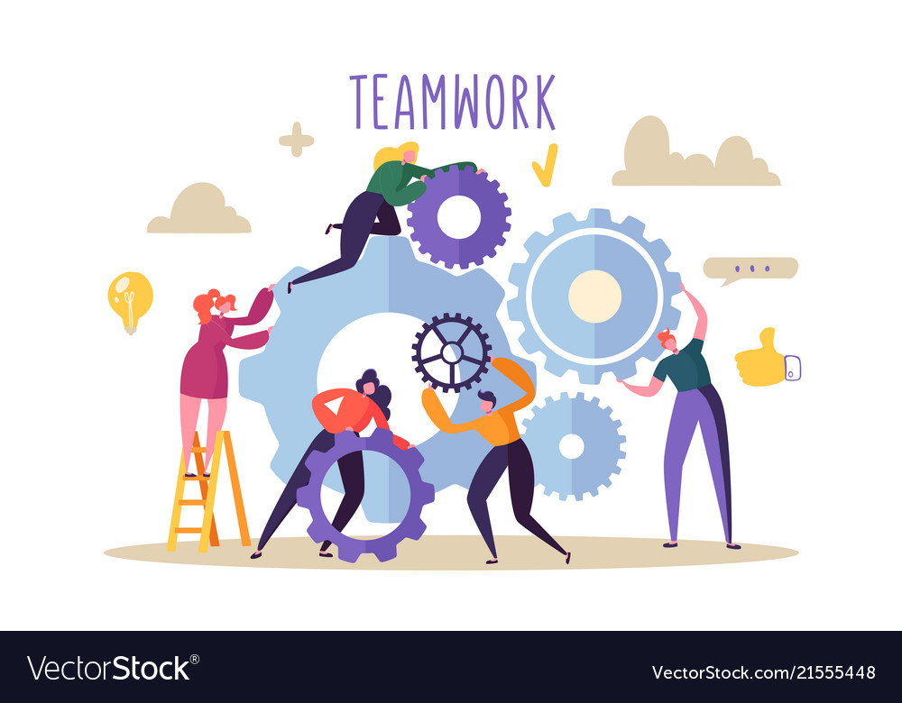
Adjourning:
final stage
work completed
new project assigned
Notes:
This final stage of team development is where the project is completed and examine the report again and remember all the points which we learn while preparing the project and check what could be improved in your future projects.

Slide 9
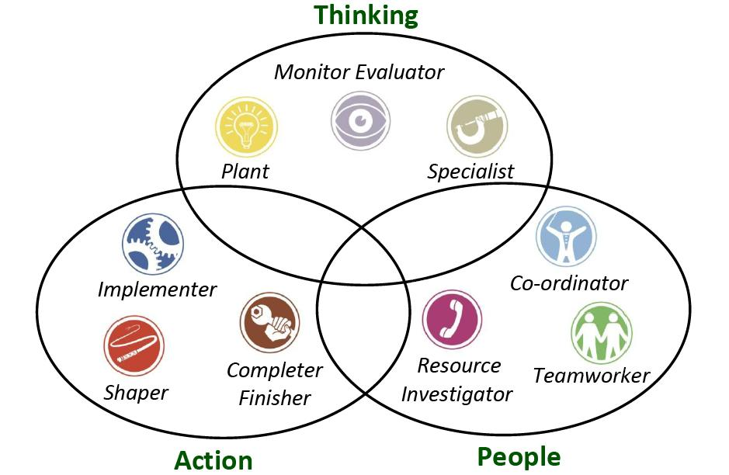
  Team Roles
The team roles are introduced by Belbin's theory of team role which help in organisation in each sector and tell the importance of team in organisation.
Notes:
There are nine Belbin's team roles.

Slide 10
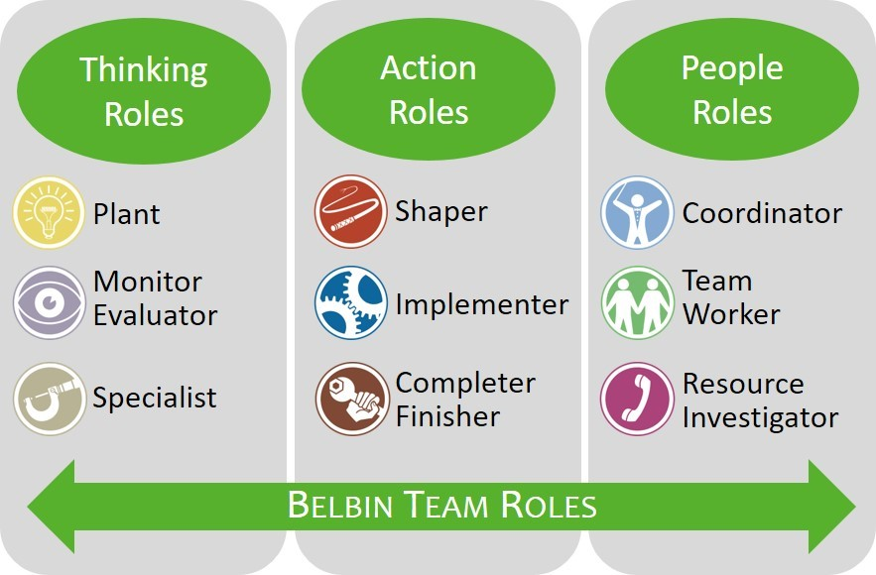
Resource Investigator
Team worker
Notes:
The management use the employee’s curiosity nature behaviour, to generated ideas which help them to become a member of team. This strength of employees will use to develop opportunities and contact for the organization but there is also a negative impact also when the employee loose the interest or change their mind-set for working then it will negatively impact the organisation in the market. Sometimes it possible that they forget to follow their leads which will impact the organization.
The team worker helps other employee in a group to help the to complete the work for organisation. In the team work the best part is that all the employees in a group is trust everyone decision and ideas which help the organisation and they corporate with each other in the group, which help them to do the work effectively.

Slide 11
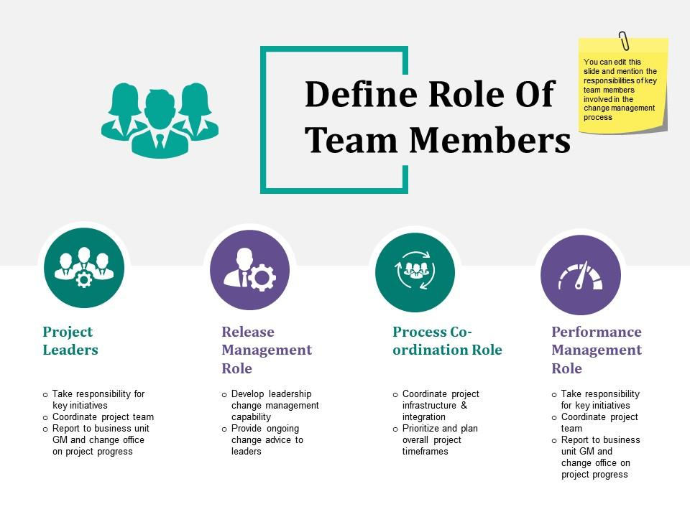
Co-ordinators
Plant
Notes:
The employees need to focus on their work and the objective which the team group has to achieve. The employees need to be mature, confident, clearly defines the goals which is achieve in future. Sometimes it gives a bad impact to the organization of an employee while manipulating the employees it gives negative impact and give his work to other employees in the group.
The employee now has the potential and ability to face the problem and make the solution of a problem by his own. They have ability to think creatively, generates ideas and solve the problems which arise in the organisation while completing the task.

Slide 12
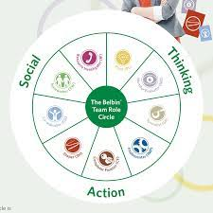
Monitor Evaluator
Speciality
Notes:
The team leader gives an impartial judgement to the group employees where required. The team have unbiased with each member of employee in a group. In the organisation the team leaders pass the wrong judgement to the member of an employee in a group.
In a group each employee has own specialization skills and knowledge which help the team to perform the different task for organisation. Each employee is very dedicated to their responsibility. The team leader gives over work to that employees to perform and this is very demotivated for the employees.

Slide 13
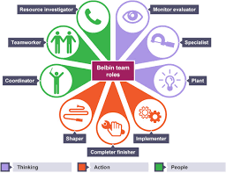
Shaper
Implementer
Notes:
The team leader has to examine all the time that the team is doing well and keep moving ahead and don't lose the focus to achieve the organisation. The employees ready to face the challenge and have the ability to adopt the dynamic changes which is occur in organisation. The team leader hurt the feelings of employees sometimes which is created in organisation, this will change the mind set of employees for working.
The strategy which is prepare must be practically possible to implement in the future in the organization. The management of an organization set a goals must be feasible and able to achieve in given time frame. The objectives which is set to achieve sometimes is not practically possible to achieve due to unconditional circumstances.

Slide 14
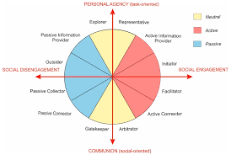
Completer finisher
Notes:
The management of an organisation examine all the negative and positive impact of the task for an organisation. The team leader has to check all the errors which is occurred while completing the task and fix all the error so that it will not repeat in future.

Slide 15

  Managing Conflict
The managing conflict is very dangerous for the organisation which will impact the organisation in negative way and this conflict is arise in management when the employees have different ideas for performing the task and have different own objectives which they working.
Notes:
This will create a conflict between all the employees in organisation and the objectives of an organization is not able to achieve by employees and this will give the bad impact on the organization development in the market areas. The management of an organization had to take care that all employees have to work for one objective only with team work. The employees have to achieve the objectives by given time period only. This is very important that employees must work with one mind set which is given by the team leader. This help the organization to grow in the business market areas.

Slide 16
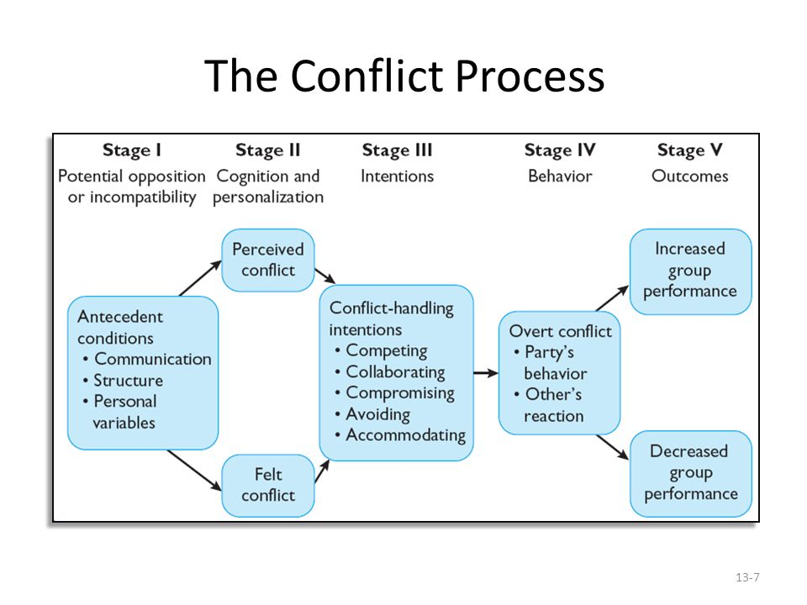
5 Stages Conflict Process are
Potential Opposition or Incompatibility. Cognition and Personalization. Intentions. Behavior. Outcomes.
Notes:
1. The existence of conflict-friendly situations is the first phase. These cause or exacerbate internal tension. They don't have to clash, but one of them must be met. 2. Parties to a conflict must perceive it. Perception is the second step in the Conflict Process. No one knows of a disagreement, hence there is no conflict. Perceived conflict is not customized. 3. Intentions are decisions to act. They connect perception and action. Two characteristics of conflict-handling intentions: cooperativeness (how much one side seeks to solve the other's issues) and assertiveness (how much one party tries to satisfy their own concerns). 4. At this level, disagreement is obvious. The conduct stage involves the opposing parties' remarks, actions, and reactions. These conflict actions usually reflect each party's goals. 5. Interactions between opposing parties have consequences. These outcomes may be functional, improving group performance, or dysfunctional, lowering group performance. Conflict is constructive when it improves decision-making, encourages creativity and invention, and sparks group interest and curiosity.

Slide 17
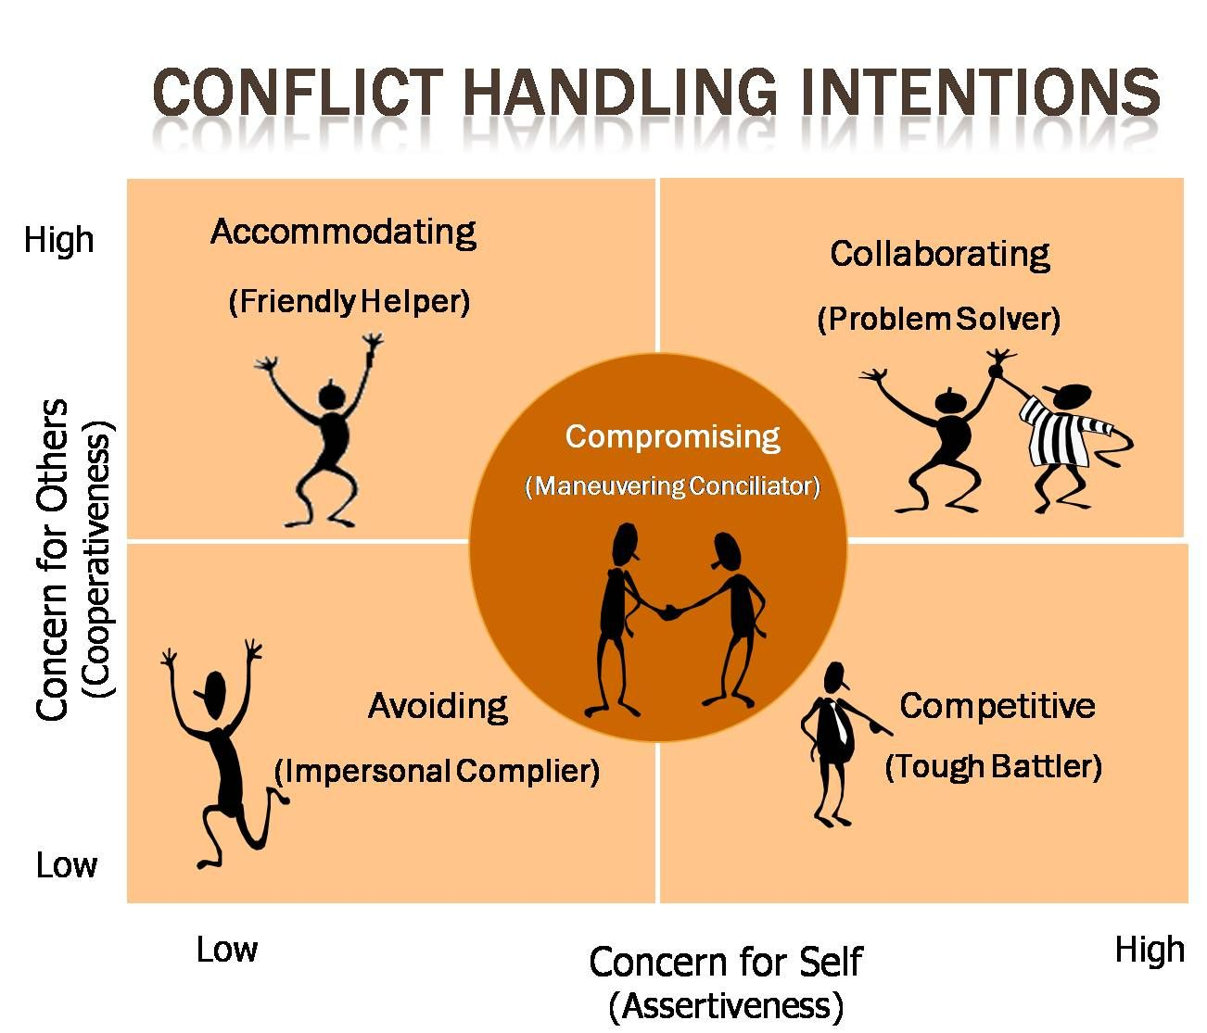
5 Conflict-Handling Intention
Competing (I Win, You Lose),
Collaborating (I Win, You Win),
Avoiding (No Winners, No Losers),
Accommodating (I lose, You win), and
Compromising (You Bend, I Bend).
Notes:
1.When rapid action is required. On significant issues need unpopular actions. When it comes to important topics and when you know you're right Against noncompetitive behavior. 2.Finding a solution for both groups. In order to learn. combining multiple viewpoints' wisdom Embrace issues to gain commitment. To repair a broken connection. 3. A minor issue's urgency When you can't fix problems. When the risks exceed the drawbacks. To relax and focus. When data gathering wins over speed. The issue is resolved by others. When difficulties are visible. 4. A better position can help you study and demonstrate your rationality. When others' happiness and cooperation trump your own. Future social issues? Avoid losing when outmatched. Allow subordinates to make mistakes. 5. Proactive tactics aren't worth the work or interruption. When equal-power opponents pursue mutually exclusive agendas. To temporarily resolve a problem. To locate quick solutions in a hurry. When cooperation and competition fail.

Slide 18

  Successful Team Development
The first rule of team building is an obvious one to lead a team effectively, you must first establish your leadership with each team member. that the most effective team leaders build their relationships of trust and loyalty, rather than fear or the power of their positions.

Slide 19
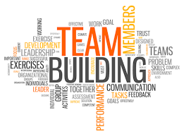
Assemble the team.
Determine the goals.
Establish expectations from day one.
Engender connections within the team.
Practice emotional intelligence.

Slide 20
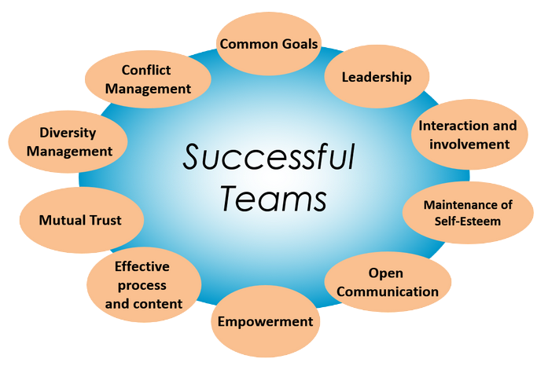
Set expectations
Monitor and review
Practice Performance
Team meetings
observation and revaluation progress

Slide 21

Celebrate and reward
Celebrate the success
Take an honest look at what didn’t go well and pinpoint
Print out unique awards for each team member and schedule an awards ceremony

Slide 22
CONCLUSION
From the above report it has been concluded that effective team work and communication is very important aspect for the organisation. The team work helps the organisation to achieve the target effectively and this will help the organisation to grow and develop the business in market areas. This report also includes the brief discussion on Benefits of team working in this we learn that how team can affect the company in positive way and stages of team development.
Notes:
in this we learn the theory of Tuckman theory that how we will develop the stages of team in organisation and Team roles in this we apply the theory of Belbin's that we prepare plan and strategy to achieve the target in given time frame and managing conflicts in this we have learn that how we manage and reduce all the conflicts which arise in the organisation and Successful Team Development in the we learn how an organisation become successful by team work in the organizations.

Slide 23
REFERENCES
Baik, D. and Zierler, B., 2019. RN job satisfaction and retention after an interprofessional team intervention. Western journal of nursing research, 41(4), pp.615-630.
Barton, G., Bruce, A. and Schreiber, R., 2018. Teaching nurses teamwork: Integrative review of competency-based team training in nursing education. Nurse education in practice, 32, pp.129-137.
Brunges, M. and Hughes, T.E., 2020. Using virtual human technology in perioperative team training simulations. AORN journal, 111(6), pp.617-626.
Cao, X. and Ali, A., 2018. Enhancing team creative performance through social media and transactive memory system. International Journal of Information Management, 39, pp.69-79.
DeFranco, J.F. and Laplante, P., 2018. A software engineering team research mapping study. Team Performance Management: An International Journal.
Notes:
Gharaveis, A., Hamilton, D.K. and Pati, D., 2018. The impact of environmental design on teamwork and communication in healthcare facilities: a systematic literature review. HERD: Health Environments Research & Design Journal, 11(1), pp.119-137.
Harris, T.E. and Sherblom, J.C., 2018. Small group and team communication. Waveland Press.
Johnson, C.E. and Hackman, M.Z., 2018. Leadership: A communication perspective. Waveland Press.
Kowalski, K., 2018. Building effective teams. Leading and Managing in Nursing-E-Book, p.336.
Menor, M.R., 2021. Improving the organizational communication of the management team.
Muszyńska, K. and Swacha, J., 2021. Periodic Indicators for Graphical Monitoring of Team Communication in Information System Development Projects.
O’Dwyer, L., 2019, April. Ill communication: effective team handovers. In BSAVA Congress Proceedings 2019 (pp. 202-202). BSAVA Library.
Shah, B.J., 2019. How to deliver safer and effective patient care: tips for team leaders and educators. Gastroenterology, 156(4), pp.852-855.
Vortman, R., 2020. Using Simulation‐Based Education to Improve Team Communication During a Massive Transfusion Protocol in the OR. AORN journal, 111(4), pp.393-400.

Slide 24
REFERENCES
Baik, D. and Zierler, B., 2019. RN job satisfaction and retention after an interprofessional team intervention. Western journal of nursing research, 41(4), pp.615-630.
Barton, G., Bruce, A. and Schreiber, R., 2018. Teaching nurses teamwork: Integrative review of competency-based team training in nursing education. Nurse education in practice, 32, pp.129-137.
Brunges, M. and Hughes, T.E., 2020. Using virtual human technology in perioperative team training simulations. AORN journal, 111(6), pp.617-626.
Cao, X. and Ali, A., 2018. Enhancing team creative performance through social media and transactive memory system. International Journal of Information Management, 39, pp.69-79.
DeFranco, J.F. and Laplante, P., 2018. A software engineering team research mapping study. Team Performance Management: An International Journal.
Driskell, J.E., Salas, E. and Driskell, T., 2018. Foundations of teamwork and collaboration. American Psychologist, 73(4), p.334.
(No Data), 5 Stages of Conflict Process: How it Work in Organization,
Available at: https://www.iedunote.com/5-stages-conflict-process (Access it at: 27th April 2022)

Slide 25
REFERENCES
Gharaveis, A., Hamilton, D.K. and Pati, D., 2018. The impact of environmental design on teamwork and communication in healthcare facilities: a systematic literature review. HERD: Health Environments Research & Design Journal, 11(1), pp.119-137.
Harris, T.E. and Sherblom, J.C., 2018. Small group and team communication. Waveland Press.
Johnson, C.E. and Hackman, M.Z., 2018. Leadership: A communication perspective. Waveland Press.
Kowalski, K., 2018. Building effective teams. Leading and Managing in Nursing-E-Book, p.336.
Menor, M.R., 2021. Improving the organizational communication of the management team.
Muszyńska, K. and Swacha, J., 2021. Periodic Indicators for Graphical Monitoring of Team Communication in Information System Development Projects.
O’Dwyer, L., 2019, April. Ill communication: effective team handovers. In BSAVA Congress Proceedings 2019 (pp. 202-202). BSAVA Library.
Shah, B.J., 2019. How to deliver safer and effective patient care: tips for team leaders and educators. Gastroenterology, 156(4), pp.852-855.
Vortman, R., 2020. Using Simulation‐Based Education to Improve Team Communication During a Massive Transfusion Protocol in the OR. AORN journal, 111(4), pp.393-400.

