Slide 1
GROUP NAME
ANTHONIA AKPAN: 2026998
SOCORRO ALAM: 2029042
LECTURER :RACHEAL RIVERS
MODULE CODE: BMHP 5004 - BIRM
MODULE TITLE: CHILDREN, YOUNG PEOPLE AND FAMILIES
ASSIGNMENT TITLE: PRESENTATION FAMILY B

Slide 2

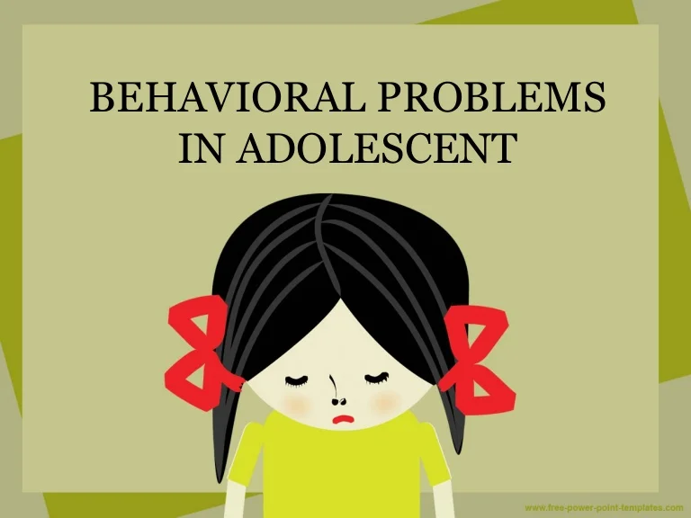
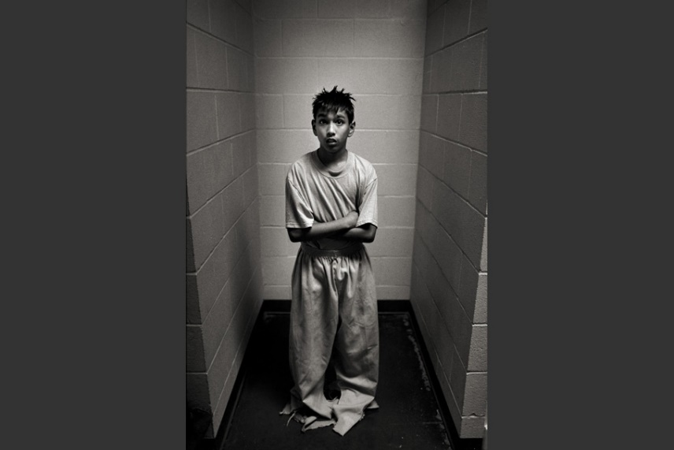
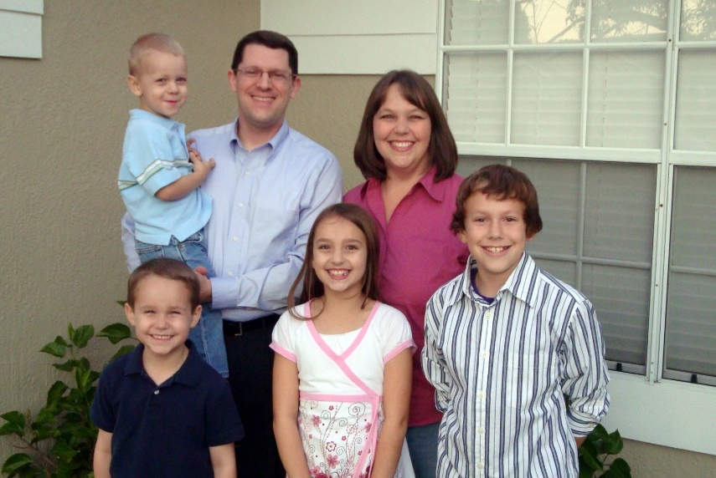
INTRODUCTION
This Photo by Unknown Author is licensed under CC BY-NC-ND
This Photo by Unknown Author is licensed under CC BY-SA-NC
MOTHER PARNER
CHILD 1= YOUTH OFFENDER WITH BEHAVIOR PROBLEM
CHILD 2= TEENAGER DAUGHTER
CHILD 3= TEENAGE R DAUGTHER
CHILD 4= DAUGHTER IN PRIMARY SCHOOL
CHILD 5= SON ON PRIMARY SCHOOL

Slide 3

BEHAVIORAL PROBLEMS
SELF INJURY
PHYSICAL AGGRESSION
TEMPER TANTRUMS
NOT FOLLOWING ORDER OR DIRECTION
ARGUMENTATIVE WITH PARENTS
This Photo by Unknown Author is licensed under CC BY

Slide 4

RISK FACTORS FOR FAMILIES
UNSTABLE FAMILY INCOME
BROKEN HOME
MENTAL HEALTH OF PARENTS
YOUNG MOTHER
NUMBER OF CHILDREN IN THE FAMILY
\PARENTAL PAST
STRENGHTENING FAMILY’S PROTECTIVE FACTORS ( SFPF)
PARENTAL RESILENCE= PARENTS DEVELOP THEMSELVES FROM STRUGGLES & DIFFICULTIES.
SOCIAL CONNECTIONS= CONNECTION WITH FAMILY, FRIENDS,CO-WORKER. INTERACTION WITH PEOPLE INSTEAD OF ISOLATING ONESELF.
CONCRETE SUPPORT IN TIMES OF NEEDS. CONNECTING WITH FAMILY’S WITH CONCRETE SUPPORT.
KNOWLEDGE OF PARENTING & CHILD DEVELOPMENT.
SOCIAL & EMOTIONAL COMPETENCE OF CHILDREN.

Slide 5
POLICY AND LEGISLATION
SASFEGUARDING CHILDREN, YOUNG PEOPLE AND FAMILIES
HUMAN RIGHT ACT 1998
NATIONAL CHILDREN STRATEGY (NCS)
CHILDREN ACT 1989
CHILDREN ACT 2014
CARE STANDARD ACT 2000
WORKING TOGETHER 2018
CHILD PROTECTION AND SAFEGUARDING POLICY2020
COMMON ASSESSMENT FRAMEWORK (CAF)
EQUALITY ACT 2010
SOCIAL MODELS
UNITED NATIONS CONVENTION ON THE RIGHTS OF THE CHILD (UNCRC)
EVERYONE WHO COMES INTO CONTACT WITH CHILDREN, YOUNG PEOPLE AND FAMILIES ARE THE TO RECEIVE THE RIGHT HELP AT THE RIGHT TIME.

Slide 6
IMPACT OF ZERO TOLERANCE POLICIES ON A VULNERABLE CHILD
The zero -tolerance policy was mainly for eliminating people who endangered the learning institution.(Henson,2012).
It was created to help schools good policing method of student's conducts by meting out tough disciplinary actions.
This policy fails to contain the fact that most of these behaviors shown by people with disabilities or emotional problems are beyond their control (Alnaim, 2018).
The young man in family B cannot cater for his family due to poverty and financial instability which are not caused by him.
The emotional and behavioral problems he is facing is as a cause of these factors which are beyond his control.

Slide 7
INVOLVING AND ENGAGING BOTH PARENT AS WELL AS SEEKING INPUT OF BOTH
Negative and inconsistence parenting can lead to emotional and behavioural problem in young people(Barlow, Parsons, and Stewart-Brown 2004)
The advice given to a child or young person at a tender age can help reduce emotional and behavioural problems.
Good parental upbringing can shape a child’s attitude towards development positively while growing up.
The young man in family B, having only mother might not have gotten the right upbringing to lead to his well- being and also his family member.

Slide 8
RECOMMENDETION AND PROFESSIONAL INTERVERNTION TO ENHANCE WELL-BEING
Children and young people with emotional and behavioural problems need help from the government and professionals to ensure their well-being.
Human rights should be assessed by all the less privilege, like in case of the young man in family B.
Agencies should be set up by the government to safeguard and promote the welfare of children and young people.
This is the Local Safeguarding Children Boards. The Government Green pepper (Every Child Matters) Children’s act 2004.
These agencies manage individual cases, child welfare of vulnerable children and young people.( The Stationary Office, 2006)
These agencies can assist family B come out of the situation , thereby reducing the emotional and behavioural problems the young man is facing.

Slide 9
CONCLUSION
A person’s well-being is influence by all aspect of one’s life.
When one is free of emotional problems, behavioural problem become lesser.
In the absence of depression, anxiety and other financial related problems , the well- being of a person is guaranteed, especially as a child or young person.
This case study deduced that childhood trauma, lack of both parents input on raising a child, poverty and financial instability can lead to emotional and behavioural problems.

Slide 10
REFERENCES
Alnaim, M.(2018) The impact of zero tolerance policy on children with disabilities. World journal of education, 8(1), pp.1-5.
Barlow, J. Parsons, J. And stewart‐brown, S. (2005) Preventing emotional and behavioural problems: The Effectiveness of Parenting Programmes with children less than 3 years of age. Child: care, health and development, 31(1), pp.33-42.
Department of children & youth affairs (2015). National strategy on children & young people’s participation in decision making 2015-2020. Dublin: Government publications.
Department of Education ( July 2021). The children act 1989 Guidance & regulations.
Douglas. V. (2021). Safeguarding Children, young people and families. Sage Publishing.
Herston. J. (2018). Five factors to make your family amazing. Circle of care.
Matters, E.C. (2006) Working together to safeguard children. London: the st
ationery office
Paper. G. (2003). Every child matters.

