Slide 1
The evolution of Greco-Roman sculpture between the Greek Archaic period and the reign of Augustus
By Cameron Smith

Slide 2
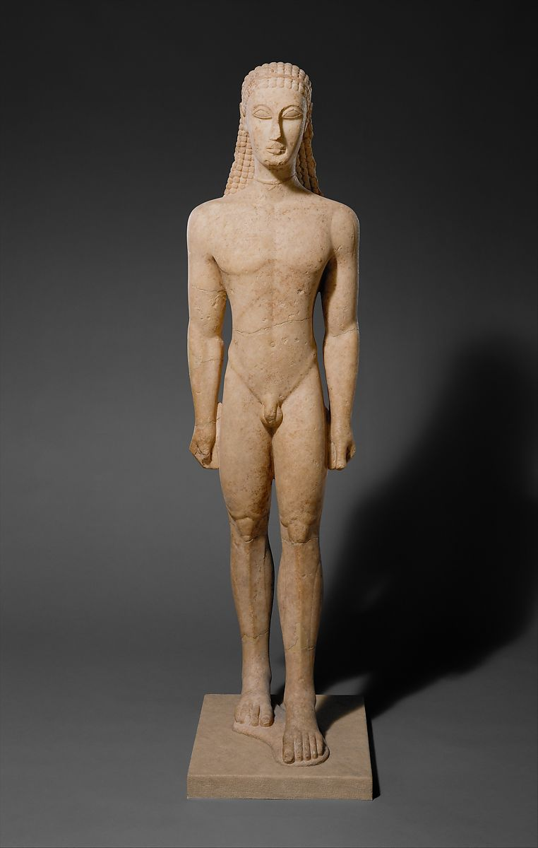
Sculpture in the Archaic Greek period
The kouros is inspired by Egyptian art of the time. (Gunther, Y H and Bagna-Dulyachinda, S)
The Met Museum, 2021

Slide 3
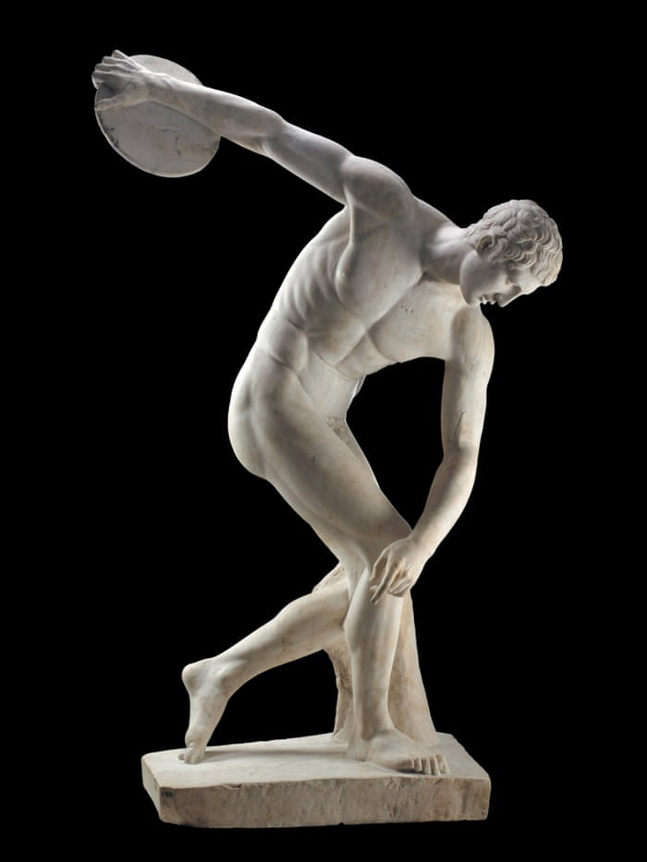
Sculpture in the Classical Greek period
First sculptures to depict realistic human bodies are created in this era. (Gunther, Y H and Bagna-Dulyachinda, S)
Davidson, 2015

Slide 4
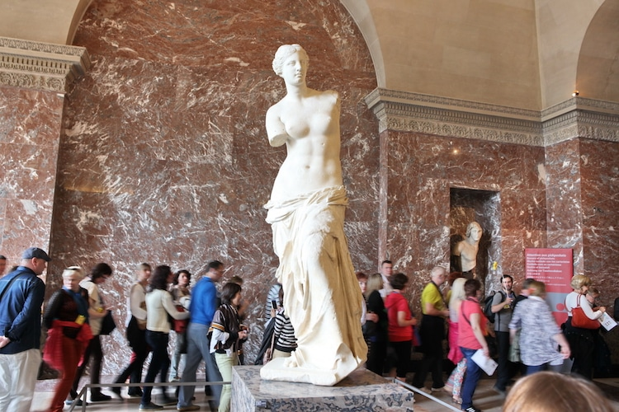
Sculpture in the Hellenistic period
Builds on the classical Greek artform with more focus on realism. (Richman-Abdou, K)
My Modern Met, 2021

Slide 5
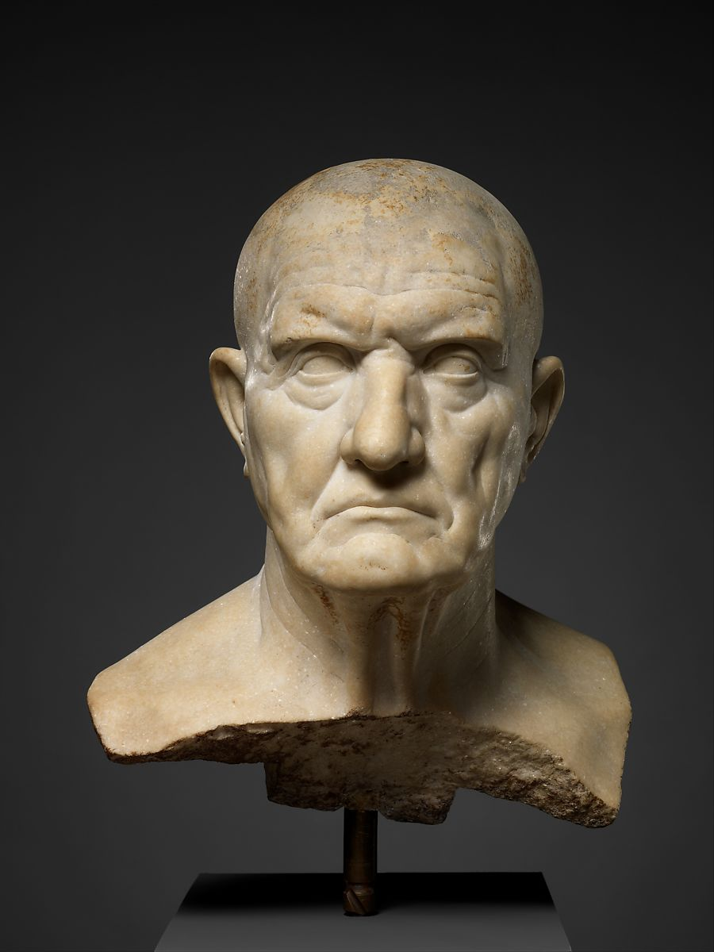
Greek influences on Republican era Roman sculpture
Statues in the roman republic were characterised by the focus on realism including every wrinkle and imperfection. (Trentinella, R)
The Met, 2021

Slide 6
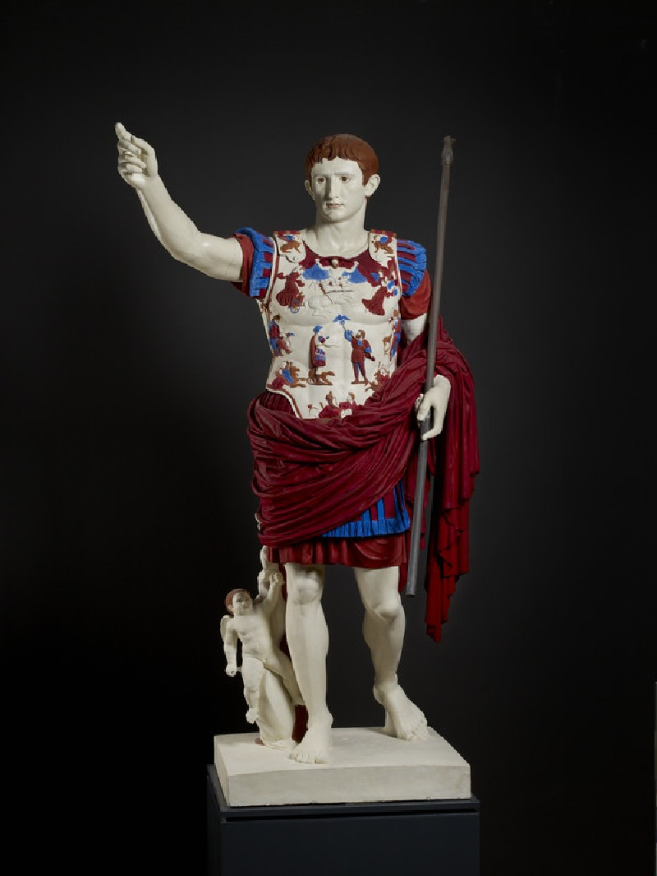
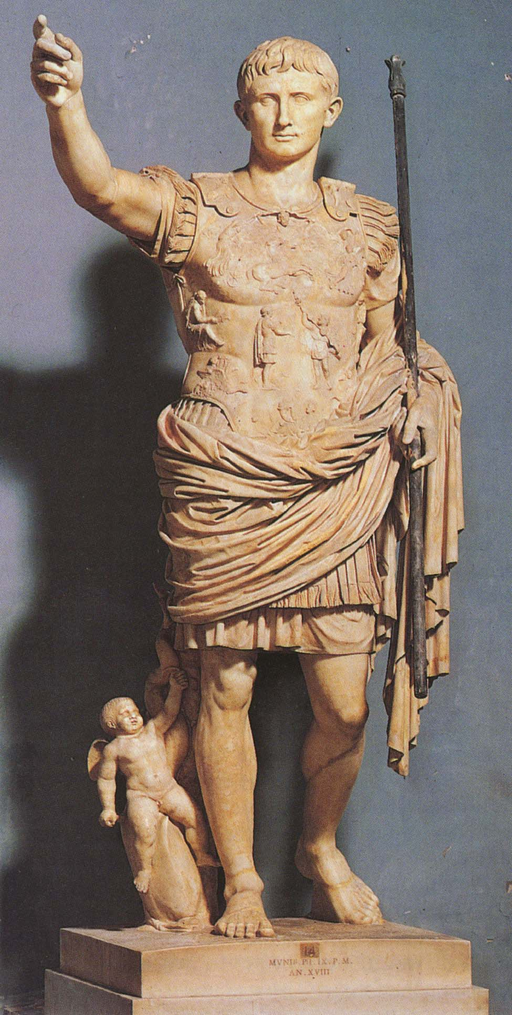
Greek influence on sculpture during the early Roman Imperial era
The art style of the early imperial era was heavily influenced by Greek art with the statue known as the Augustus of Prima Porta even being based off of an older Greek statue called the Doryphoros of Polykleitos. (Veltri, D)
Historians. org, 2021
The Ashmoleon, 2021

Slide 7
References
The Met Museum (2021) Marble statue of a kouros (youth). Available at: https://collectionapi.metmuseum.org/api/collection/v1/iiif/253370/538327/main-image (Accessed on: 6th October 2021)
Davidson, J The Gaurdian 2015 Discus-thrower of Myron Available https://www.theguardian.com/artanddesign/2015/mar/20/naked-ambition-why-the-greeks-first-stripped-nude (Accessed on 6th October 2021)
Richman-Abdou K Mymodernmet.com 2019 Available at https://mymodernmet.com/what-is-hellenistic-sculpture-history/ (accessed on 5th October 2021)
Trentinella, R Metmuseum.org 2003 Marble bust of a man Available at https://www.metmuseum.org/toah/hd/ropo2/hd_ropo2.htm (Accessed on 5th October 2021)
Historians.org 2021 Available at
https://www.historians.org/teaching-and-learning/teaching-resources-for-historians/teaching-and-learning-in-the-digital-age/images-of-power-art-as-an-historiographic-tool/augustus-caesar (Accessed on 6th October 2021)
Collections.ashmolean.org 2021 Available at https://collections.ashmolean.org/collection/browse-9148/object/176175 (Accessed on 6th October 2021)
Gunther, Y H and Bagna-Dulyachinda, S Literature & Aesthetics, From Realism to Idealism: Ancient Greece in the Classical period 2019 page 162-163 Available at https://openjournals.library.sydney.edu.au/index.php/LA/article/viewFile/14271/12770 (Accessed on 5th October 2021)
Gunther, Y H and Bagna-Dulyachinda, S Literature & Aesthetics, From Realism to Idealism: Ancient Greece in the Classical period 2019 page 164-165 Available at https://openjournals.library.sydney.edu.au/index.php/LA/article/viewFile/14271/12770 (Accessed on 5th October 2021)
Richman-Abdou, K Mymodernmet.com 2019 Available at https://mymodernmet.com/what-is-hellenistic-sculpture-history/ (Accessed on 5th October 2021)
Trentinella, R Metmuseum.org 2003 Available at https://www.metmuseum.org/toah/hd/ropo2/hd_ropo2.htm (Accessed on 5th October 2021)
Veltri .D Scholarly Journal, The politics of culture: the revival of Greek classicism in Augustan art 2010 page 43 Available at https://www.proquest.com/docview/1514897051?pq-origsite=gscholar&fromopenview=true (Accessed on 6t October 20221)

