Slide 1
Practice-based Research
Introduction to Research
LCHS7008
Week 2

Slide 2

SESSION EXPECTATIONS ctd
Ensure to arrive on time (late arrivals= marked as late)
Leaving the classroom before the end and/ or for an extended period of time will result in being marked as late.
Engagement= regular use of Moodle, Teams platforms, in class attendance,..
Mobile phones keep them in your bag (unless when part of an activity or emergency)
Feeling Sleepy? No sleeping in a classroom
Required use of English during the conversations in class to meet LO’s
Let your lecturer know if you cannot make the sessions
Respect universities Student Code of Conduct

Slide 3

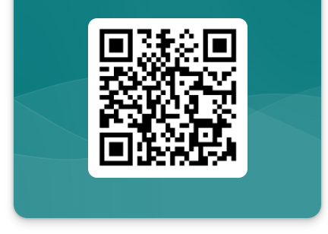
What did you select?
Deadline 12th October, 2PM
https://forms.office.com/e/5zFXxX6ete

Slide 4
Important activities and timelines
Task | Deadlines
2 compulsory meetings with your allocated supervisor during term 2 | Meeting 1 (week 3 – 6) Meeting 2 (week 7 – 10)
Create Test Presentation Recording on Panopto | Friday 16th October by 2pm, (Week 3)
Book your slot for the Study Room | Friday 16th October, (Week 3)
Submit Poster (topic, aims, objectives, impact) on Turnitin | Monday 26th October by 2pm, (Week 5)
Complete Poster Presentation using Panopto Final link | Monday 26th October by 2pm, (Week 5)
Submit Written research proposal (methodology) | Monday 7th December by 2pm, (week 11)
Draft final ethics form ready | Monday 30th November, (week 10)
Submit ethics form (Moodle link) | Wednesday 9th December by 2pm, (week 11)

Slide 5
Aims of the Session
To understand:
The qualitative research approach
The mixed method research approach
The Systematic Review
The meta-analysis
Formulating a research question, aims and objectives
The steps involved with writing your Literature Review

Slide 6
Qualitative research
Qualitative research is a “type of research that explores and provides deeper insights into real-world problems.
Helps generate hypotheses as well as further investigate and understand quantitative data (Moser and Korstjens, 2017).
It is a process of research that does not require any statistical procedure or form of quantification to arrive at a desirable result, since they utilise “non-numerical data
Requires active participation of the researcher in a study by thoroughly listening, recording and contextualizing people’s action, thought and live experiences.

Slide 7
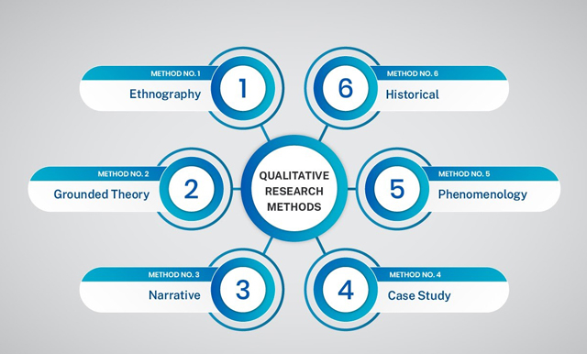
Qualitative research design
Non-numerical data to understand people’s, persons, communities, or group’s opinions, views, behaviours,
e.g., why did certain people in the UK did not want to comply with the COVID-19 lockdown?

Slide 8
Qualitative research comprises of
Focus groups
In-depth/informal interview
Surveys
Simple Observation
  To collect data

Slide 9
A focus group discussion….
FGD is defined as a form of informal discussion among designated group of people about a specific topic (Wilkinson, 2004).
This method is primarily used to explore peoples’ views and perception through discussion among group members.
FGD allows people to express their opinion and explore their knowledge and experiences about the topic of discourse.
… provides an opportunity for the participants to critically comments on the topic of discourse and allows group members to share common experiences and feelings, thus generating a deep and enriched data during the interactive session.

Slide 10
In-depth interview
An in-depth interview is an open-ended, discovery-oriented method to obtain detailed information about a topic from a stakeholder/participant.
In-depth interviews are a qualitative research method;
their goal is to explore in depth a respondent's point of view, experiences, feelings, and perspectives.

Slide 11

So what is mixed methods..?

Slide 12
Mixed methodology involves….
…. the combination of both the quantitative and qualitative methodological approaches (i.e. combination of both numbers and words) to answer a research question.
Using such research methodological approach (mixed methods) to conduct research that is predominantly of quantitative design could complement,
Providing a comprehensive investigation and enrich the findings of a study.
Using the strengths and reducing the weaknesses of both the quantitative and qualitative research methods.

Slide 13
Summary: Activity
Watch the video below then discuss
Quanti/Quali video:
https://www.youtube.com/watch?v=a-XtVF7Bofg
Feedback to the whole class

Slide 14
So what is Systematic Review?

Slide 15
Systematic Review is
…a review of a clearly formulated question that uses systematic and reproducible methods to identify, select and critically appraise all relevant research, and to collect and analyse data from the studies that are included in the review
Wood and Hedges, 2019

Slide 16
Systematic Review
A systematic review is often written by a panel of experts after reviewing all the information from both published and unpublished studies.
The comprehensive nature of a systematic review distinguishes it from traditional literature reviews which typically examine a much smaller set of research evidence and present it from a single author’s perspective.
Systematic reviews originated in the biomedical field and currently form the basis of decision-making in Evidence-Based Treatment (EBT) and evidence-based behavioural practice (EBBP).

Slide 17
What are the pros and cons of systematic literature reviews (7min)
Pros
?
?
?
?
Cons
?
?
?
?

Slide 18
Pros and cons of systematic literature review
Pro’s
Provide a clear and comprehensive view of available (current) evidence on a given topic
Help identify research gaps in the understanding of a field
Helps inform future research in the area
Produces reliable conclusions
Enable contrasting and comparison of results
Refine and reduce large amounts of data and information into one document, clinical decisionsProvide strong evidence regarding benefits or harms of a particular intervention.
Con’s
Subject to bias as a retrospective research project
Vital use of rigorous research methods
Quality depends on the skills of the research

Slide 19
Activity
Working in groups choose one of the examples of a systematic review paper.
Research the aim and the findings of the systematic review and the databases that were used to search for relevant articles
Feedback your findings to the whole class

Slide 20
For example
Association of domestic abuse and post partum depression
https://www.ncbi.nlm.nih.gov/pmc/articles/PMC6970613/
Association of fish consumption and the risk of dementia
Fish consumption and the risk of dementia: Systematic review and meta-analysis of prospective studies - ScienceDirect
Association of vegetable consumption and the risk of stroke
Fruits and vegetables consumption and risk of stroke: a meta-analysis of prospective cohort studies - PubMed

Slide 21
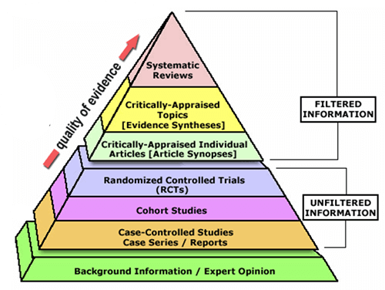
Evidence pyramid
Levels of evidence analyzed in a systematic review (Trustees of Dartmouth College and Yale University, 2006)

Slide 22
Systematic review protocol (identify)
Create a document proof of action, includes:
Research question,
Inclusion and exclusion criteria,
Intervention/exposure,
Quality assessment/appraisal method,
Analysis plan
To be provided to your supervisor

Slide 23
Systematic literature review
(collecting data)
Quantitative | Systematic Literature Review
Questionnaire/ survey Structured interview Experiment Content analysis | Search strategy Searching databases Import results to a library Export to Excel sheet Title/Abstract screening Full text screening Extract data Quality appraisal Data checking (Statistical/Narrative) Analysis

Slide 24
Current challenges with systematic literature review
Unclear formulated research question(s)
Literature from limited resources is searched, utilised
The quality of selected articles is not assessed or no use of validated checklist
Statistical heterogeneity is not assessed
An insufficient narrative synthesis of the evidence/ findings is presented.

Slide 25
Important Review Process
Be aware a very intense schedule (dissertation)
Students/researchers must manage
  Readings relevant to their review
  Workload
  Setting milestones
  Setting deadlines
  Create and maintain literature matrix (Excel)
  Using bibliographic management software
  Creating figures, tables,…
  Procrastination to start the systematic review will affect the quality of the review!

Slide 26
Steps of the systematic review
Framing the research question
Identifying relevant work
Assessing the quality of studies
Summarizing the evidence
Interpreting the findings
Can a systematic literature review still be considered 'systematic' if one of these stages is
poorly executed?

Slide 27
Meta-analysis involves
A statistical analysis that combines the results of multiple scientific studies.
When there are multiple scientific studies addressing the same question, with each individual study reporting measurements that are expected to have some degree of error.
Then is to use approaches from statistics to derive a pooled estimate closest to the unknown common truth based on how this error is perceived.

Slide 28
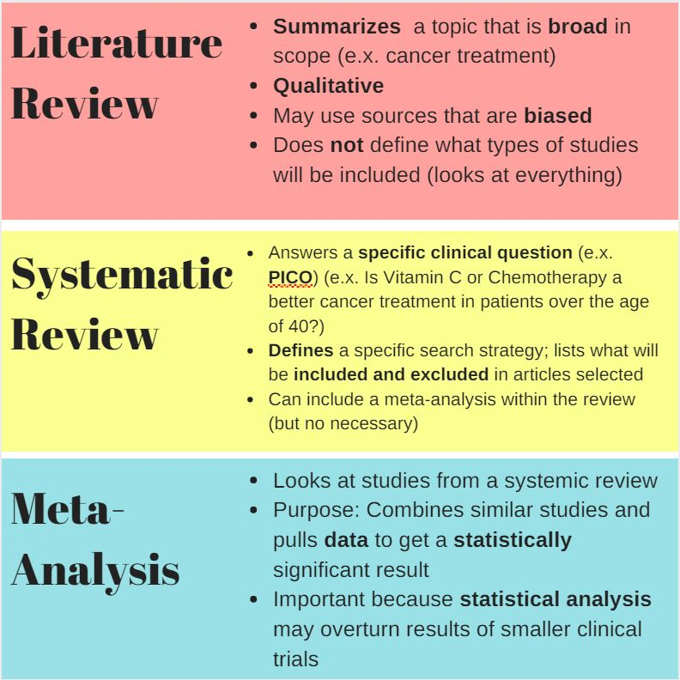
Summary

Slide 29
Activity
Working in groups research the term
Research questions.
Feedback your findings to the whole class
5mins

Slide 30
Research question
A research question is 'a question that a research project sets out to answer’.
A research question is the question around which you centre your research.
It is the bedrock of the research that is central and guiding argument for the research
It should be clear
It must provide enough specific information that one's audience can easily understand its purpose without needing additional explanation.
Note: Choosing a research question is an essential element of both
Quantitative, qualitative and Systematic Review research.

Slide 31

A good research question 1
Builds on existing knowledge
Based on gaps in the literature
Contribute to theory development
Defines and gives focus to a research
It is answerable and researchable

Slide 32
A good research question 2
Essential to guide your research paper, project or thesis. It pinpoints exactly what you want to find out and gives your work a clear focus and purpose.
All research questions should be:
  Focused on a single problem or issue
  Researchable using primary and/or secondary sources
  Feasible to answer within the timeframe and practical constraints
  Specific enough to answer thoroughly
  Complex enough to develop the answer over the space of a paper or thesis
  Relevant to your field of study and/or society more broadly
Start with asking open-ended questions.
  E.g. How, What, Why, questions.
  Example: What are the effects of smoking (or social media) on mental health?

Slide 33
Examples of research questions
Problem –
Covid-19 has been known to have significantly affected more people from ethnic minority groups, especially Black, Asians and Ethnic Minority (BAME) staff at the NHS. While there are many suggestions for this, we still don’t know why this is.
Possible research questions –
  What factors were responsible for the high mortality rate of NHS BAME staff due to Covid-19?
  Why were ethnic minorities more likely to die from Covid-19?

Slide 34
Research aim & Objectives
Research aim
Focuses on what the research project intends to achieve in the field of Public Health, Health and Social Care in practice.
  Is relatively broad.
Research objectives
Focuses on how the aim will be achieved by breaking it into smaller steps.
  Are specific.

Slide 35
Research aim
The aim is the overall purpose of your research. It is generally written in the below format:
  The aim of this study is to determine…
  This project aims to explore……
  This study aim to investigate/examine…
Research objectives
The objectives are the concrete steps you will take to achieve the aim: For example:
  Qualitative methods will be used to identify…
  Surveys will be used to collect…
  Using statistical analysis, the research will measure…..

Slide 36
Literature Review
The ability to critically review, and to report relevant literature is a key academic skill.
A literature review is a survey of scholarly sources on a specific topic. Highlighting the key findings and debates on the topic.
It provides an overview of current knowledge, allowing you to identify relevant theories, methods, and gaps in the existing research.
It allows to showcase your talents of: understanding, interpretation, analysis, clarity of thought, synthesis, and development of argument.
()

Slide 37
Write your literature review
Like any other academic text, your literature review should have
  an introduction,
  a main body, and
  a conclusion.
  What you include in each depends on the objective of your literature review.
Notes:
The introduction should clearly establish the focus and purpose of the literature review. Stand-alone literature review
If you are writing a stand-alone paper
give some background on the topic and its importance, discuss the scope of the literature you will review (for example,
the time period of your sources),
and state your objective.
What new insight will you draw from the literature?
reiterate your central problem or research question and give a brief summary of the scholarly context.
You can emphasise the timeliness of the topic (“many recent studies have focused on the problem of x”) or highlight a gap in the literature (“while there has been much research on x, few researchers have taken y into consideration”).
Body
Depending on the length of your literature review, you might want to divide the body into subsections.
You can use a subheading for each theme, time period, or methodological approach.
As you write, make sure to follow these tips:
Summarise and synthesise: give an overview of the main points of each source and combine them into a coherent whole.
Analyse and interpret: don’t just paraphrase other researchers – add your own interpretations, discussing the significance of findings in relation to the literature as a whole.
Critically evaluate: mention the strengths and weaknesses of your sources.
Write in well-structured paragraphs: use transitions and topic sentences to draw connections, comparisons and contrasts.
Conclusion
In the conclusion, you should summarise the key findings you have taken from the literature and emphasise their significance.
Stand-alone literature review
If you are writing a stand-alone paper, you can discuss the overall implications of the literature or make suggestions for future research based on the gaps you have identified.

Slide 38
Steps to Write a Literature Review
These main steps include:
  Make a list of keywords, synonyms (link to your research question)
  Evaluate relevant sources (e.g., uni library, e-journals, databases,..)
  Search for relevant literature related to your research objectives and questions
  Identify themes, debates and gaps
  Outline the structure
  Write your literature review
Notes:
Search for relevant:
Trends and patterns (in theory, method or results): do certain approaches become more or less popular over time?
Themes: what questions or concepts recur across the literature?
Debates, conflicts and contradictions: where do sources disagree?
Pivotal publications: are there any influential theories or studies that changed the direction of the field?
Gaps: what is missing from the literature? Are there weaknesses that need to be addressed?
As you begin to gather the literature, you will want to critically read for what has, and has not, been learned from the research.
Use the Discussion and Future Research sections of the articles to understand what the researchers have found and where they point out future or additional research areas.
Continue to ask critical questions of your topic – who, what, when, where and how – about the population or setting, conditions or variables, methods or analysis, and measurement or outcomes.

Slide 39
More examples of research questions
How does the use of AI-driven filters on social media platforms affect body image and self-esteem among Generation Z?
What are the risk factors contributing to obesity among American teenagers in rural low-income communities?
What is the impact of depression on the physical health, economic productivity, and social relationships of middle-aged women in the United Kingdom?

Slide 40
Keywords example for the research question:
How does the use of AI-driven filters on social media platforms affect body image and self-esteem among Generation Z?
Social media: Facebook, Instagram, Twitter, Snapchat, TikTok
Body image: self-perception, self-esteem, mental health
Generation Z: teenagers, adolescents, youth
Notes:
Use your keywords to begin searching for sources using different databases.
Some databases to search for journals and articles include:
Your university’s library catalogue
Google Scholar
JSTOR
EBSCO
Medline (life sciences and biomedicine)
PubMed

Slide 41
Evaluate and select sources
Make sure the sources you use are credible, and make sure you read any landmark studies and major theories in your field of research.
You can find out how many times an article has been cited on
  Google Scholar – a high citation count means the article has been influential in the field
  and should certainly be included in your literature review.

Slide 42
Examples to search for relevant literature
You can use Boolean operators to help narrow down your search:
  AND to find sources that contain more than one keyword (e.g. social media AND body image AND generation Z
  OR to find sources that contain one of a range of synonyms (e.g. generation Z OR teenagers OR adolescents)
  NOT to exclude results containing certain terms (e.g. apple NOT fruit)

Slide 43
Activity
Working independently search for a journal article (preferably linked to your selected research topic for your assessment) and read the abstract section
Read the abstract
Identify the research aims.
What methods were used?
What were the most important findings?
Feedback your findings to the whole class
10mins
Notes:
for each publication, ask yourself:
Is the Abstract useful, did it summarised/describe, aim, question, methodology, key findings and conclusion
What question or problem is the author addressing?
What are the key concepts and how are they defined?
What are the key theories, models and methods?
Does the research use established frameworks or take an innovative approach?
What are the results and conclusions of the study?
How does the publication relate to other literature in the field?
Does it confirm, add to, or challenge established knowledge?
How does the publication contribute to your understanding of the topic?
What are its key insights and arguments?
What are the strengths and weaknesses of the research?

Slide 44

Common Errors
Review isn’t logically organised
Review doesn’t relate literature to the study
Too few references or outdated references cited
Review reads like a series of disjointed summaries
Review doesn’t argue a point
No real evidence of critical consideration

Slide 45
Summary of how to organise/structure
Literature reviews
Types | Description
Thematic Literature review | Reviews organised based on themes or theoretical concepts that are relevant to the topic being studied
Chronological Literature review | Reviews based on progressive & successive development of knowledge about a topic starting from the earliest to the latest
Systematic Literature review | It is based on systematic method of collecting secondary data, then critically identify their findings to make new conclusions
Methodological Literature review | Reviews based on the methods of research

Slide 46

Structuring your literature review
The funnel approach
Introduction (scope and structure)
Background, more to do with your topic area than your research question
Distantly related to your work
Closer to what you are doing but not matching directly
Narrow categories; you may find you are dealing with sources in more detail
Research that is particularly pertinent to your work
Categories close to your research; you may find you are looking at a few key papers in detail
Your study/current research issues

Slide 47
Critical writing of a literature review
Descriptive writing | Critical /Analytical writing
States what happened | Identifies the significance
States what something is like | Evaluates (judges the value) strengths and weaknesses
Gives the story so far | Weighs one piece of information against another
Explains what a theory says | Shows why something is relevant or suitable
States the different components | Weighs up the importance of component parts
States links between items | Shows the relevance of links between pieces of information
Gives information | Draws conclusions
Adapted from Moon, cited in Cottrell 1999:23
Notes:
Comparing and contrasting different theories, concepts etc and indicating the position you are taking for your own work
Showing how limitations in others work creates a research gap for you.
Strategic and selective referencing to support the underpinning arguments which form the basis of your research
Synthesising and reformulating arguments from various sources to create new/more developed point of view
Agreeing with/defending a point of view or finding
Accepting current viewpoints have some strengths but qualifying your position by highlighting weaknesses
Rejecting a point of view with reasons (e.g. Lack of evidence)
Making connections between sources
Adapted from RIDLEY, D 2008. The literature review: a step-by- step guide for students. London: Sage

Slide 48
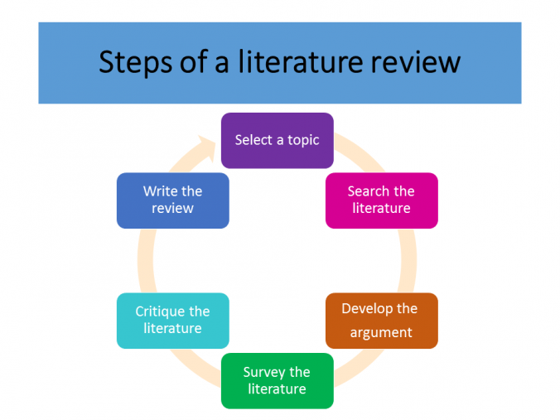

Slide 49
Types of Literature Review
There are three types of literature reviews
Traditional/Narrative Literature Review
Systematic Literature Review
Meta-analysis
(Cronin et al., 2008)

Slide 50
In class activity (30 min)
Formulate your research question, aim and objectives
Independently
Take some minutes to think about your identified area of research and which topic you want to research. Write it down.
Formulate your Research question (use a question word to start)
Formulate what will be the Aim (purpose) of your research.
Break down your aim in 3 -4 Objectives (e.g., to identify, to evaluate, to assess, to recommend,....)
The lecturer will ask about what you have written down so it can be approved/modified before submitting it on the link/QR code.

Slide 51

What did you learn?
Skills, knowledge,….

Slide 52
References
Creswell JW, Creswell JD. (2017). Research design: qualitative, quantitative and mixed method approaches. (Edn: 5th). Sage Publications Inc: London.
Creswell, J.W. (2008). Educational Research: Planning, conducting, and evaluating quantitative and qualitative research (3rd ed.). Upper Saddle River: Pearson
Cronin, P., Ryan, F. and Coughlan, M. (2008). Undertaking a Literature review: a step-by-step Approach. British Journal of Nursing, [online] 17(1), pp.38–43. doi:https://doi.org/10.12968/bjon.2008.17.1.28059.
Hirt, J., Nordhausen, T., Appenzeller-Herzog, C., & Ewald, H. (2020). Using citation tracking for systematic literature searching - study protocol for a scoping review of methodological studies and a Delphi study. F1000Research, 9, 1386. https://doi.org/10.12688/f1000research.
Maxwell JA. (2012). Qualitative Research Design: An Interactive Approach: 41 (Applied Social Research Methods). Sage Publications Inc: London.
McCombes, S. (2022, October 10). Research Design | Step-by-Step Guide with Examples. Scribbr. Available at: https://www.scribbr.co.uk/research-methods/research-design/ (Accessed date 9th January 2022).
Moser A, Korstjens I. (2017) Series: Practical guidance to qualitative research. Part 1: Introduction. European Journal Gen Practical 23(1), pp. 271-273.

