Slide 1

Student name: Marinela Braganca
Student number : 2328116
BMHP6029
Psychopathological Classifications and Provisions Component
Acknowledgement of the use of AI tools
I confirm that I have not used any AI tools in the research and creation of this assignment. I confirm that I have not presented any AI generated materials as my own work. I confirm I have copies of my drafts, notes, and other resources I used, which I may be asked to provide in evidence
PLEASE DELETE GUIDANCE TEXT IN RED

Slide 2


(Title - name of the chosen mental disorder)
NAME OF DISORDER : Eating Disorders
Eating disorders affect how people think about food, body and weight. People may eat too little, too much, or engage in unhealthy behaviours. In the UK, over 725,000 people are affected. About 90 per cent are female, but up to 25 per cent are male. They often start in adolescence and can harm physical and mental health (NICE, 2017). One example is ARFID. Avoidant Restrictive Food Intake Disorder is an eating disorder where a person eats a very limited range of foods over a long time, which can affect their physical and mental health. It is more serious than picking eating. ARFID was officially recognised as a diagnosis in 2013 by the American Psychiatric Association(Unicef.org, 2025).
Classification/Category: Feeding and Eating Disorders
ARFID is included in Chapter 6 of the ICD-11 under Feeding and Eating Disorders. Here, the ICD-11 discriminate ARFID from anorexia nervosa by removing the requirements of weight-shape overvaluation, and this also revealed a shift from cognitive-distortion models toward functional impairment and nutritional risk as diagnostic importance (Sader et al. 2025).
However, this classification identifies the heterogeneity in restrictive eating behaviours. Moreover, the debate remains regarding diagnostic overlap with autism spectrum disorder and anxiety disorders, increasing the approach to boundary validity.
Introduction:
Historical Perspectives and Critical Analysis
How Were People with ARFID Viewed
In the Past?
Individuals now diagnosed with ARFID were frequently
misclassified before the formal identification
Failure to thrive, Anorexia nervosa (atypical presentations) (Bjørndal et al. 2026)
Feeding disorder of infancy and childhood”
Without weight concern, restrictive eating was meanwhile
dismissed as “picky eating,” poor parenting and the behavioural
defiance. Since the eating disorders were encapsulated basically by the weight and body image framework, encouraged by the sociocultural pressures surrounding thinness. Consequently, individuals without
Body dissatisfaction was excluded from services.
How common is the disorder? How many people are diagnosed with this disorder? ARFID affects a small number of children, but it may be more common than it seems.
Studies in countries like Switzerland, Germany, and Portugal show that 3% to 15% of children have ARFID symptoms. In the general population, about 0.3% to 3.2% of children and adolescents are affected.
In clinical settings, the numbers are higher, with 5% to 14% meeting ARFID criteria, and up to 8% to 20% in autistic populations.
However, official diagnoses are rare — around 1 in 50,000 children. Even so, ARFID is a common cause of serious eating problems, especially in specialist clinics (UNICEF; Wronski et al., 2025).
Medical and Professional Views
Before its inclusion in diagnostic manuals, restrictive intake was connected to
the sensory sensitivity or fear of aversive challenges was often treated
within: Gastroenterology
Behavioural psychology (Golding et al. 2026)
Paediatric medicine
These fragmented perspectives have been explored in a biomedical bias,
which is mainly focused on the physical symptoms over the emotional
Disturbance.
The recognition of ARFID into diagnostic systems (DSM-5 in 2013; later
ICD-11) was referred to as a professional and political shift, acknowledging
gaps in psychiatric classification.
Moreover, critics argue that enlarging diagnostic categories risks
medicalising normative childhood behaviours and also improving the
pathologisation.
Diagnosis
The diagnosis requires an essential nutritional
or emotional disturbance, exclusion of
culturally sanctioned dietary restriction and
body image disturbance (Fonseca et al. 2024).
There is no biological test or diagnosis
depends on clinical judgement, increasing
issues of reliability and potential
underdiagnosis.
Causes: There is no single reason that has been identified, and the research assists the
biopsychosocial model:
Psychological: anxiety disorders and traumatic feeding experiences
Biological: neurodevelopmental differences and sensory sensitivity (Nicholls-Clow
et al. 2024)
Social: family feeding practices, cultural norms
Social, Cultural and Political Context
Since the eating disorders discourse has been key to adolescent
females and thinness ideals. ARFID challenges this narrative, as it:
Impacts the males at comparable rates
Meanwhile, presents in childhood (McNaught et al. 2022)
Is prevalent among autistic individuals
This broader profile has covered the structural inequalities in service
provision, as the eating disorder services were historically structured
by the anorexia nervosa models.
Politically, deinstitutionalisation and community-based mental health
Care was transformed into responsibility for outpatient services. Still, the
funding is disproportionately assigned towards the high-mortality
eating disorders, restricting the ARFID-specific pathways.
Symptoms: Ignore due to sensory characteristics
Fear of gagging
Nutritional deficiency (Van Buuren et al. 2023)
Psychosocial impairment
Essential weight loss or failure to gain weight
Extreme food selectivity

Slide 3
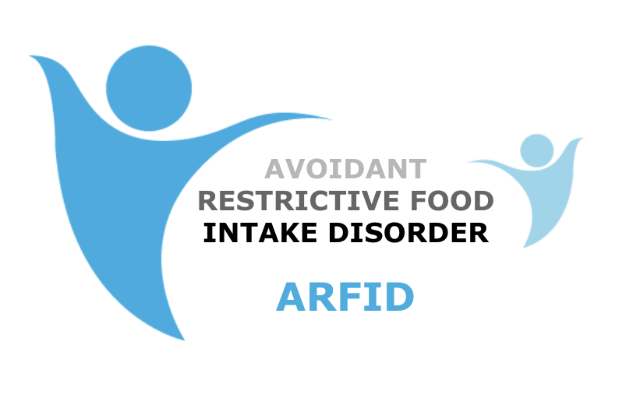
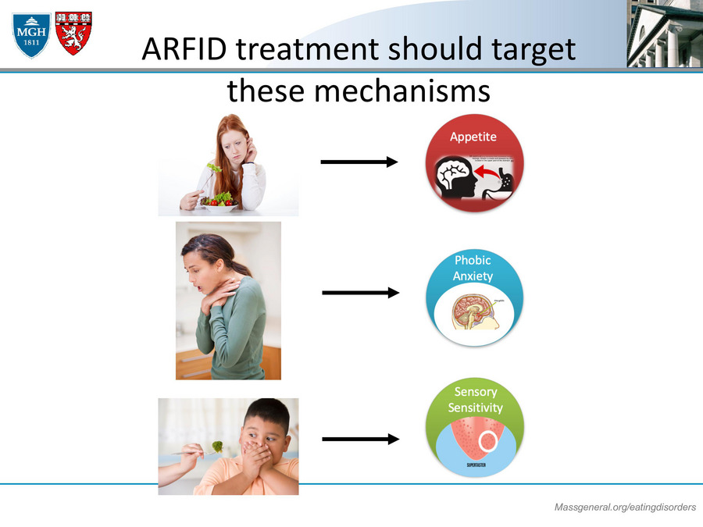
Current Services and Treatments
Future research and services should focus on improving understanding and support for ARFID. More training is needed so clinicians can better recognise and treat ARFID. Services should be more connected, especially between neurodevelopmental conditions and eating disorders. There should also be more funding for early support and intervention.
More long-term research is needed to understand outcomes in adults (Van Buuren et al., 2023). ARFID should be included more in public health policies. Finally, diagnostic systems should continue to improve so ARFID is clearly defined, without labelling normal behaviours as a disorder.
Recommendations
Treatment depends on each person’s symptoms and needs. People are usually referred through a GP or specialist services. Support is available for both children and adults (NHS, Inform).
Common Treatments: Cognitive Behavioural Therapy (CBT)
Family-Based Therapy (FBT), Exposure therapy (trying new foods slowly)
Anxiety management and behavioural support
Nutritional Support: Support from a dietitian to improve eating
Help to increase food variety and nutrition
Support for sensory problems with food
Multidisciplinary Care Treatment often involves different professionals working together, such as:
Therapists
Dietitians, Occupational therapists (for sensory sensitivity)
(Kambanis and Thomas, 2023). Despite developing the recognition, access to specialist ARFID
services remains inconsistent (Golding et al. 2026). Therefore,
many eating disorder pathways continue to prioritise anorexia
nervosa as high mortality risk (standardised mortality ratio ≈ 5–6),
resulting in delayed or inappropriate referrals for ARFID.
Inequality and Stigma
ARFID reveals the gaps in the
traditional eating disorder
infrastructure
Males remain underrepresented in
services (Fonseca et al. 2024).
Autistic individuals face
diagnostic overshadowing.
Socioeconomically disadvantaged
families experience longer
waiting times.
Stigma persists, as restrictive
eating without a weight approach
is trivialised as behavioural
fussiness, and this also explores
enduring cultural beliefs about
food choice and parental
responsibility.
Additionally, service models
shaped around weight restoration
may inadequately address sensory
or trauma-related drivers of
ARFID.
Key Insights (Critical Analysis)
ARFID was recognised later than other eating disorders
Diagnosis is influenced by culture, not only science
Social and political factors affect how disorders are classified
ARFID shows that diagnostic systems can change over time
There is still debate about how ARFID should be defined (Walsh et al., 2026)
ARFID explores an important evolution in feeding and eating disorder classification within the
ICD-11. Its emergence has been explored in psychiatric diagnoses as structured by the shifting
scientific evidence, political priorities and social values.
Since left and misclassified, ARFID now occupies a recognised diagnostic category. Moreover,
inequities in service provision and ongoing debates in terms of classification validity demonstrate
that psychopathological systems remain dynamic and contested.
A critical understanding of ARFID therefore needs to investigate the symptoms and treatment, but
is also concerned about the broader socio-cultural forces shaping mental health care.
Conclusion

Slide 4
Bjorndal, L.D., Corfield, E.C., Hannigan, L.J., Ayorech, Z., Bulik, C.M., Watson, H.J., Dinkler, L., Chawner, S.J., Johansson, S., Andreassen, O.A. and Ask, H., 2026. Prevalence, characteristics and genetic architecture of avoidant/restrictive food intake phenotypes. JAMA Pediatrics, 180(1), pp.45–55.
Cleveland Clinic, 2023. What is ARFID (Avoidant/Restrictive Food Intake Disorder)? Available at: https://my.clevelandclinic.org/health/diseases/24869-arfid-avoidant-restrictive-food-intake-disorder⁠ (Accessed: 20 March 2026).
Eating Recovery Center, 2025. ARFID statistics 2025: How common is ARFID? Available at: https://www.eatingrecoverycenter.com/resources/arfid-statistics-factshow-common-is-arfid⁠ (Accessed: 20 March 2026).
Fonseca, N.K., Curtarelli, V.D., Bertoletti, J., Azevedo, K., Cardinal, T.M., Moreira, J.D. and Antunes, L.C., 2024. Avoidant restrictive food intake disorder: recent advances in neurobiology and treatment. Journal of Eating Disorders, 12(1), p.74.
Golding, S., Slevin, H., McCulloch, A.S., Birch, E., Nikiforovski, A., Sharif, N., Ochando, D.C. and Elvins, R., 2026. Avoidant/restrictive food intake disorder in children and young people: an update for clinicians. BJPsych Advances, pp.1–12.
Kambanis, P.E. and Thomas, J.J., 2023. Assessment and treatment of avoidant/restrictive food intake disorder. Current Psychiatry Reports, 25(2), pp.53–64.
McNaught, E., Treasure, J. and Pollard, N., 2022. Eating disorders. Oxford: Oxford University Press.
NICE, 2017. Eating disorders: recognition and treatment. Available at: https://www.nice.org.uk/guidance/ng69/chapter/Context⁠(Accessed: 20 March 2026).
Nicholls-Crow, R., Simmons-Buckley, M. and Waller, G., 2024. Avoidant/restrictive food intake disorder: systematic review and meta-analysis demonstrating the impact of study quality on prevalence rates. Clinical Psychology Review, 114, p.102502.
Sade, M., Weston, A., Buchan, K., Kerr-Gaffney, J., Gillespie-Smith, K., Sharpe, H. and Duffy, F., 2025. The co-occurrence of autism and avoidant/restrictive food intake disorder (ARFID): a prevalence-based meta-analysis. International Journal of Eating Disorders, 58(3), pp.473–488.
UNICEF, 2025. ARFID or picky eating? Here’s how to know. Available at: https://www.unicef.org/eca/stories/arfid-or-picky-eating-heres-how-know⁠(Accessed: 20 March 2026).
Van Buuren, L., Fleming, C.A.K., Hay, P., Bussey, K., Trompeter, N., Lonergan, A. and Mitchison, D., 2023. The prevalence and burden of avoidant/restrictive food intake disorder (ARFID) in a general adolescent population. Journal of Eating Disorders, 11(1), p.104.
Wroński, M.L., Kuja-Halkola, R., Hedlund, E., Martini, M., Lichtenstein, P., Lundström, S., Larsson, H., Taylor, M.J., Micali, N., Bulik, C.M. and Dinkler, L., 2025. Mental and somatic conditions in children with the broad avoidant restrictive food intake disorder phenotype. JAMA Pediatrics, 179(4),
References

