Slide 1

Leading digital & strategic change
BMSW7003
Enablers & Risk Management
GWYNETH JONES
March 2026

Slide 2
This week we will focus on…
Topics:
  Introduction to strategy and strategic management
  Strategic analysis
  Competitive strategy
  Managing capabilities
  Organisational structure
  Incentives
  Enablers
  Risk management

Slide 3
Key enablers for strategy implementation
Key Enablers:
  Organisational Culture
  Implementation of Strategic Planning
  Planning for Strategic Response

Slide 4
leadership Styles and Strategic Change
Digital transformation, artificial intelligence, data analytics, and automation are reshaping industries and redefining competitive landscapes.
Organisations that successfully integrate these technologies can enhance operational efficiency, improve decision-making through data insights, and create innovative products and services.
However, adopting new technologies is not merely a technical process; it involves significant organisational change, including adjustments in structures, processes, skills, and culture.
Leadership is therefore essential in translating strategic vision into practical implementation. Without clear leadership direction, technological initiatives may fail due to lack of alignment, inadequate communication, or resistance from employees.

Slide 5
Transformational leadership theory
Transformational leadership theory, developed by James MacGregor Burns and later expanded by Bernard M. Bass, emphasises the ability of leaders to inspire and motivate employees to achieve organisational change and innovation.
Four key components:
Idealised influence – leaders act as role models who build trust and credibility.
Inspirational motivation – leaders communicate a clear and compelling vision.
Intellectual stimulation – leaders encourage creativity and innovation.
Individualised consideration – leaders support employee development and learning.

Slide 6
Transformational leadership theory
Transformational leadership is particularly relevant to digital transformation strategies, because technological change often requires employees to adopt new working practices, develop digital skills, and adapt to evolving organisational structures.
Transformational leadership helps create a shared vision and encourages employees to embrace innovation rather than resist technological change.
However, some scholars argue that transformational leadership alone may not fully address the technical complexity of digital transformation. Leaders must also possess digital competence and strategic technological understanding.

Slide 7
Transformational leadership example – steve jobs
Created a strong vision
Jobs had a clear vision of creating innovative technology that was simple and beautifully designed. This vision guided Apple’s strategy and inspired employees to work toward revolutionary products.
Inspired employees
Transformational leaders motivate people to go beyond normal expectations. Jobs encouraged Apple teams to push boundaries and create products that could change entire industries.
Drove major organisational change
When Jobs returned to Apple in 1997, the company was struggling. He transformed the company by focusing on a small number of innovative products - ipod, iphone,ipad, iwatch etc
Changed company culture
Jobs created a culture focused on innovation, creativity, and high standards, which continues to influence Apple today.

Slide 8
Transactional leadership theory
Transactional leadership focuses on the management of organisational performance through structured systems of rewards, monitoring, and accountability.
Leaders adopting this approach establish clear expectations, set measurable objectives, and ensure that employees meet defined performance standards.
Transactional leadership can play an important role during the implementation phase of technological initiatives. Introducing new digital systems often requires careful project management, adherence to timelines, and coordination between multiple departments.
However, this leadership style has limitations in technology-driven environments that require innovation and adaptability. Because transactional leadership focuses primarily on maintaining existing systems and processes, it may discourage experimentation and creative problem-solving.

Slide 9
Transactional leadership example – jeff bazos
Strong focus on performance metrics
Amazon’s culture is heavily based on data, targets, and measurable results. Employees are expected to meet strict performance standards, particularly in areas such as logistics and delivery efficiency.
Clear rewards for performance
Transactional leadership relies on rewards when employees meet objectives. At Amazon, employees can receive bonuses, promotions, or recognition when they meet productivity targets.
Strict monitoring and accountability
Bezos emphasised constant monitoring of performance, especially in Amazon’s fulfilment centres and operations. Systems track productivity to ensure workers meet company targets.
Structured processes and rules
Amazon uses clear systems and procedures to maintain efficiency across its operations, including services like Amazon Prime, which require highly organised logistics and strict operational control.

Slide 10
strategic leadership theory
Strategic leadership refers to the ability of leaders to influence organisational direction by aligning long-term strategy, organisational resources, and external environmental factors.
Leaders adopting a strategic leadership approach focus on anticipating future challenges, identifying emerging opportunities, and positioning the organisation to achieve sustainable competitive advantage.
Digital strategies often involve significant investment decisions and long-term planning. Strategic leaders must evaluate technological trends, understand their potential impact on the organisation, and determine how digital capabilities can support overall strategic objectives.
Strategic leadership also requires balancing innovation with risk management. Technological investments can involve substantial uncertainty, and leaders must assess potential benefits while mitigating financial and operational risks. Effective strategic leaders therefore combine visionary thinking with analytical decision-making.
.

Slide 11
strategic leadership example – elon musk
Vision for the future
Musk develops strategies based on long-term industry trends, such as electric vehicles, sustainable energy, and space exploration. His vision guides both Tesla’s and SpaceX’s strategic directions.
Innovation-driven strategy
He focuses on disruptive technologies, such as battery innovation, autonomous driving, reusable rockets, and AI integration, positioning his companies ahead of competitors.
Risk-taking and bold initiatives
Strategic leaders make calculated long-term decisions. Musk invests heavily in projects that may take years to pay off, like Gigafactories and Starship development, aligning resources with his strategic goals.
Aligning organisation with strategy
Musk shapes culture and organisational structures to support ambitious, high-impact projects, ensuring employees work toward his strategic vision.

Slide 12
adaptive leadership theory
Technology integration often presents adaptive challenges because it requires employees to modify established behaviours, develop new competencies, and rethink existing business processes.
Adaptive leadership encourages experimentation and learning, recognising that organisations may need to test different solutions before identifying the most effective strategy.
Rather than providing all the answers, adaptive leaders facilitate problem-solving by empowering employees to participate in the transformation process.
This approach can enhance organisational resilience and help organisations remain responsive to evolving technological developments.
However, adaptive leadership may create ambiguity for employees who prefer clear direction and structure. Leaders must therefore balance flexibility with sufficient guidance to ensure that organisational objectives remain clear.
.

Slide 13
adaptive leadership example – ken olisa (royal mail)
Responding to market disruption
During his tenure, Olisa guided Royal Mail through challenges such as digital communication reducing letter volumes and the rise of e-commerce, adapting strategy to focus on parcel delivery and logistics growth.
Promoting cultural change
He worked to modernise the organisational culture, encouraging innovation, operational efficiency, and employee engagement to support new strategic directions.
Navigating regulatory and operational challenges
Olisa ensured that Royal Mail adapted to regulatory changes and competitive pressures from private courier companies while maintaining public service obligations.
Balancing short-term and long-term goals
He managed immediate operational needs while investing in automation, digital solutions, and logistics infrastructure to position Royal Mail for the future.

Slide 14
Distributed or collaborative leadership theory
Distributed leadership, sometimes referred to as collaborative or shared leadership, recognises that leadership responsibilities do not reside solely with senior executives. Instead, leadership is shared across different levels of the organisation, enabling individuals with relevant expertise to contribute to decision-making.
This approach is particularly valuable when implementing technology-driven strategies, as digital transformation often requires input from specialists in areas such as information technology, data analytics, operations, and customer experience. By distributing leadership responsibilities, organisations can leverage diverse expertise and encourage cross-functional collaboration.
Collaborative leadership also promotes employee engagement and innovation, as individuals feel empowered to contribute ideas and solutions. This can be especially beneficial in digital transformation initiatives where creativity and problem-solving are essential.
However, distributed leadership may present challenges in maintaining clear accountability and decision-making authority. Leaders must ensure that governance structures are in place to coordinate efforts and maintain alignment with strategic objectives.
.

Slide 15
distributive leadership example – Carolyn Mccall (easyjet)
Delegating decision-making
McCall empowered managers across EasyJet to take responsibility for their departments, including operations, customer service, and pricing strategies, rather than centralising all decisions at the executive level.
Encouraging collaboration
She fostered a culture where teams across airports and functions could share insights and propose solutions, creating a network of leadership rather than a single top-down approach.
Accountability and ownership
Managers were expected to own outcomes for their areas, driving performance while aligning with the company’s overall strategic goals.
Building a resilient organisation
Distributed leadership under McCall helped EasyJet respond quickly to operational challenges, such as fluctuating passenger demand and regulatory changes, by leveraging leadership throughout the organisation.

Slide 16
distributive leadership example – Carolyn Mccall (itv)
Delegating authority across departments
McCall gave managers of different divisions—such as digital, broadcast, and production—autonomy to make strategic decisions for their areas, rather than centralising every choice at the top.
Encouraging collaboration
She fostered a cross-functional culture where teams shared insights and coordinated on major initiatives like the expansion of ITV Hub and the company’s streaming strategy.
Accountability and ownership
By allowing divisional leaders to own outcomes, she ensured that innovations and improvements in content delivery were implemented efficiently and responsively.
Outcome
This distributed approach enabled ITV to adapt quickly to the rise of streaming platforms and changing viewer behaviour, maintaining competitiveness in a rapidly evolving media landscape.

Slide 17

Organisational culture
Organisational culture refers to the shared values, beliefs, behaviours, practices, and norms that shape the way employees interact and work together within an organisation.
It’s like the personality of the organisation, influencing how people communicate, make decisions, solve problems, and approach work.
Culture is often shaped by the organisation's leadership, history, and the people who work there, and it can evolve over time.

Slide 18
Organisational culture
There are several aspects to organisational culture, including:
Values and Beliefs: The core principles that guide how people in the organisation behave and make decisions.
Norms and Practices: The unwritten rules about how things are done within the Organisation
Communication Style: Whether communication is open and transparent, hierarchical, or informal.
Work Environment: The physical and psychological environment in which employees work, including whether it's collaborative or competitive.
Leadership Style: How leaders in the organisation lead and interact with their teams, whether through mentorship, directive management, or empowerment.
A positive organisational culture can lead to high employee engagement, productivity, and retention, while a negative culture can result in disengagement, high turnover and poor performance.

Slide 19
Organisational culture
Effective organisational design also concerns building strong relationships in the organisation:
  Between management and employees
  Between the employees
Organisational /Corporate Culture:
  Collectively shared values, norms and practices that occur within organisation
  ‘Values’ = what is important to employees
  ‘Norms’ = what constitutes appropriate employee attitudes and behaviour

Slide 20

Organisational culture
Organisational Culture:
  Reflected in ‘artefacts’, e.g. office design or workplace symbols or slogans
  Cultures permeate the corporation through socialisation:
    employees are immersed through day-to-day activities, relationships and interactions with co-workers
  A strong organisational culture is present when values and norms are widely shared, resulting in stronger relationships
  All organisations possess some form of culture, whether it is directed by management or not.

Slide 21

Organisational culture
Organisational Culture:
  Reflected in ‘artefacts’, e.g. office design or workplace symbols or slogans…
  TASK
  How would you describe the ‘artefacts’ of your organisation? How does it feel?

Slide 22

Imprinting of culture – by founder
Founder Imprinting:
  Often, the organisation’s founder defines an organisational culture through their decisions, directives, and personality
  Their created organisational culture often lasts long after they leave
Imprinting of Culture
  Culture is imprinted:
    Explicitly: through founder’s intentional, strategic attempts to build positive workplace culture
    Implicitly: through the decisions, communications, and working style in which they carry out the company's management and leadership

Slide 23

Founder imprinting example: apple
Example of Founder Imprinting:
Steve Job’s unique drive, creativity and perseverance led many to idolise him, even after his passing
His legacy: a very strong lasting corporate culture
  Strong organisational culture can be a strategic asset that differentiates and may contribute to a sustained competitive advantage
  Can you think of any other founders who had a profound effect on their organisation’s culture – how?

Slide 24
How Steve Jobs shaped the culture at apple
How it Shaped Apple: Jobs instilled a culture of innovation, risk-taking, and relentless pursuit of excellence, which became fundamental to Apple’s identity. This culture allowed Apple to dominate in product design and user experience, influencing the tech industry at large.
Impact on Culture: Steve Jobs is often credited with creating a culture of innovation, perfectionism, and boldness at Apple. His obsession with design, simplicity, and creating products that were both beautiful and functional became core values at the company. Jobs fostered a culture where challenging the status quo and thinking differently was celebrated. His leadership style also emphasised the importance of hiring top talent and empowering them to achieve excellence, while maintaining high expectations. His demanding nature created a sense of urgency and pride but also led to intense work environments.

Slide 25
Organisational change is correlated with interest in oganisational culture
Interest in organisational culture is often greatest during times of organisational change, e.g. due to:
  Change of leadership
  Change of strategic agenda
  Performance management related issues (e.g. culture becomes a hinderance)
  Structural changes, incl. diversification, mergers and acquisitions
For strategic change to succeed, culture must align with the new strategy

Slide 26

Organisational culture can be influenced by various factors
Such factors include:
  Organisation’s founder
  Business development stage (maturity / size etc.)
  Organisational structure
  Internal control mechanisms (e.g. incentives and rewards)
  External market environment / industry
Organisational culture needs to fit with the strategic business direction because it shapes how employees behave and make decisions. When culture aligns with strategy, it supports implementation and improves the chances of success. When it conflicts, it can create resistance and cause strategic failure.

Slide 27

The cultural web
Culture can be a rather ‘elusive’ thing that is difficult to analyse or measure…
‘The Cultural Web’ is a fantastic model for analysing and changing an organisation’s culture
  It was developed by Gerry Johnson and Kevan Scholes (1992)
  It captures six elements that influence the ‘Paradigm’ of Culture
  Each element can be analysed to gain a thorough understanding of the culture as a whole

Slide 28
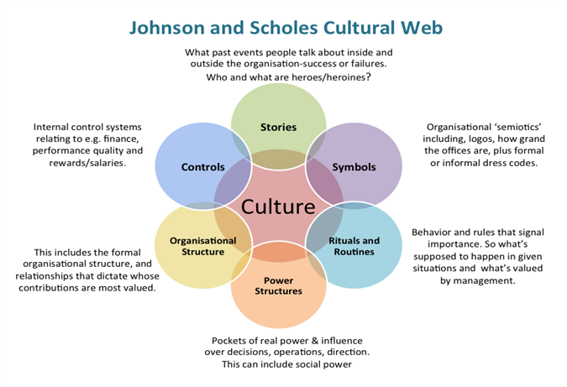
The cultural web

Slide 29
Tasks for our next session
Decide on an organisation (e.g. your current/past employer)
Have a go at completing The Cultural Web for this organisation
What are your key observations?

Slide 30

Implementation of strategic planning

Slide 31
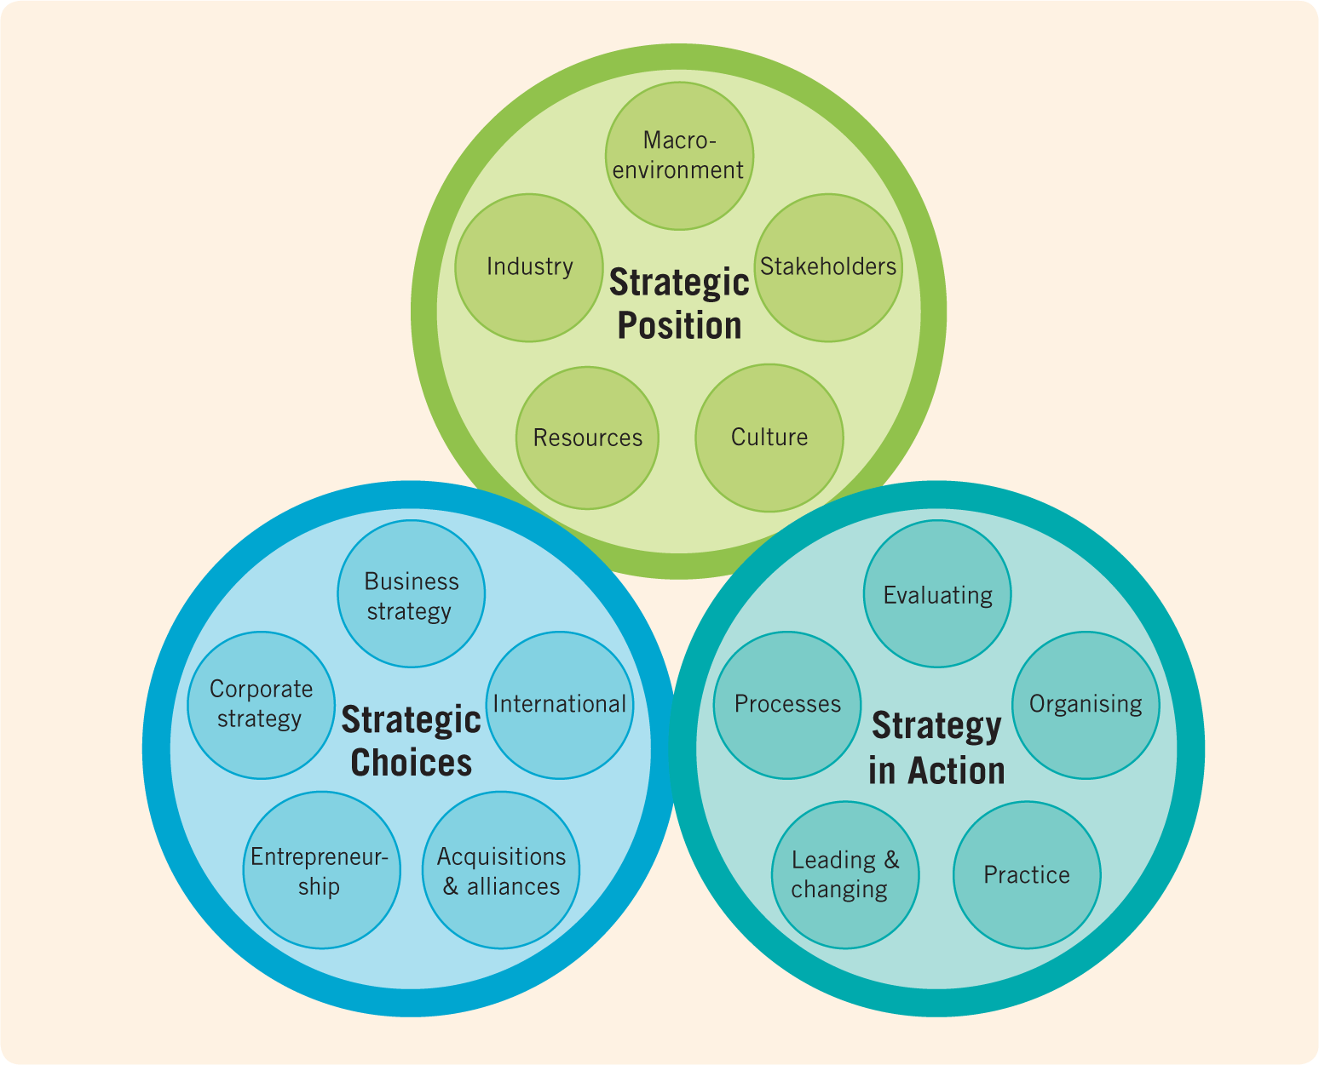

The exploring
Strategy framework
&
Planning
Planning
Johnson, Whittington, Scholes, Angwin, Regner (2017)

Slide 32
What % of strategies fail?
Approximately 70% of strategies fail due to poor execution

Slide 33

Strategy implementation/execution
Implementation may not be the most exciting thing to talk about.
However, it is a fundamental managerial practice that’s critical for any business strategy to take hold.
Organisations can gain competitive advantage through implementation, if done effectively.
The process must involve all team members, who should know their responsibilities and be committed.

Slide 34

Strategic plan implementation
  Provides the roadmap needed to pursue a specific strategic direction, achieve performance goals, deliver customer value, and to be successful
  Encompasses various activities, resources, staffing and personnel considerations
Strategic Plan – addresses the what and why of activities
Implementation – addresses the who, where, when, and how
Both are critical to success and need awareness and managing

Slide 35

reasons why strategy execution fails
No or insufficient communication
Lack of commitment
Insufficient or inadequate resources
Isolated and fragmented actions
Ambiguous or conflicting goals
No or unclear strategy
No clear priorities
Ambiguous responsibilities
Lack of performance information
Silo behaviour and sub-optimisation
Wrong or ineffective culture
Resistance to change
Over-complexity
Insufficient management capabilities
Delay, plans are not met
Budget is exceeded
Lack of middle management support
Strategy is not adapted to changes
Poor leadership

Slide 36
Requirements for successful implementation
Requirements surrounding successful implementation can be grouped into
STRUCTURAL = Organisational Requirements and
BEHAVIOURAL = Employee Requirements
Organisational Requirements (Structural) | Employee Requirements (Behavioural)
Importance of a market-oriented structure (with no functional silos and isolation) Corporate culture enables flexibility and co-operation Appropriate policies, procedures, control systems | Adequate employee motivation ‘Internal marketing’: developing programs to win support for new strategies Employee programmes (action plans) translating strategies to frontline employees

Slide 37

GUIDELINES FOR SUCCESSFUL STRATEGY IMPLEMENTATION
  Requires a comprehensive and systematic approach.
  Change routine, do not be afraid to think differently and do things differently.
  Identify your own management tactics / leadership styles to achieve the goals.
  Without direct involvement of each and everyone in the company, successful strategy implementation is impossible.
  Motivate your team and use their full potential.
  Provide adequate resources – human, financial, technical etc.
  Follow-up on the assigned task and seek responsibility.
  Identify relationships between projects and keep an eye on their contribution to the achievement of your goals.
  Build a good foundational company culture.

Slide 38

planning for strategic response
In addition to choosing what strategic direction to take and aligning internal capabilities, you also have to decide whether to respond to moves made by rivals.
This is often one of the most challenging decisions… with many variables and factors to consider.
The smallest strategic mistake in rival engagement could spell disaster for your operations and marketing.

Slide 39
Factors determining likelihood of a competitive move
Three key factors determine the likelihood that an organisation will respond to a competitor’s move:
Level of Awareness
Level of Motivation
Level of Capability
The organisation must continuously monitor competitors and anticipate their potential moves:
What competitor actions are possible?
What is most likely – now and in the future?
The organisation’s motivation to respond is likely to be high when a competitor has made a competitive move. But…:
How high is their motivation?
Are they likely to respond?
In what situations are they likely to respond?
The organisation must have plans and resources to respond to the move of their competitor:
How capable is the organisation to respond?
How will they achieve their ‘attack’?
What resources do they have to assist them?

Slide 40

If an organisation is going to respond to a competitor’s move, speed is important.
Competitors can capitalise on any delays and then use them in turn to counter-attack.

Slide 41



First mover advantage
‘First Mover’:
  Organisation that is the first to establish itself in a given market or industry
  Hopes to gain sustainable competitive advantage by establishing themselves before anyone else
  Building on strategic resources (e.g. protected technology and innovations) makes it difficult for rivals to imitate, examples:
First Mover Advantage:
  Occurs when initial move into a market allows an organisation to establish a dominant position that other organisations will struggle to overcome.
First Mover Risks:
  Customers might not embrace the new offering (organisation had no previous market or industry knowledge and did not fully understand customer needs)
  High costs of developing the product and educating customers on product or service
Choose wisely: how likely is it that this move will provide my organisation with a sustainable competitive advantage?

Slide 42

risk management
We will explore:
  Business Risk
  Enterprise Risk Management
  Balanced Scorecard

Slide 43

business risk
Risk is defined as any situation involving exposure to danger, harm or loss
Business Risks include:
Legal liabilities
Financial risks
Natural disaster
Competitive attacks
Technology failure

Slide 44

business risk mitigation
Business Risk Mitigation is a systematic stepped approach:
  Identify threats
  Assess the danger of the threats
  Assess the probability of risk
  Identify solutions
  Prioritise Risk Reduction measures based upon strategy

Slide 45
1. Identify threats
  This is a highly important step
  Must assess the threat from several perspectives:
    Internal threats, e.g. weakness in skill-sets, over-reliance upon a few individuals
    External threats, e.g. competitive rivals, loss of stakeholder support, natural disasters
  For identification, you could use simple “risk charting” to start with:
    chart out what could be threatened, the nature of the threat, potential damage that those threats may inflict etc.
Simple Risk Charting
What could be threatened | Nature of Threat | Potential Damage
A
B
C

Slide 46
2. Assess the Danger of the threats
  Try to estimate full effect of a potential threat, incl. most likely cost or damage if potential threat occurs
3. Assess the probability of risk
  Assign probability of the chances of the perceived threats occurring
  This helps with Prioritisation of Risk

Slide 47
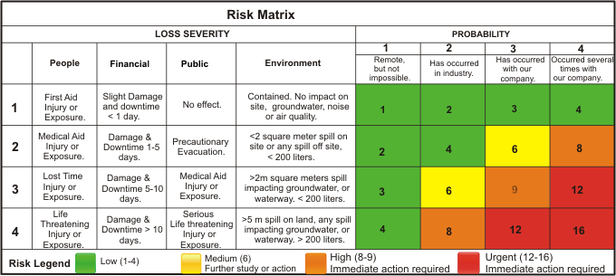
Risk probability & impact matrix – an example

Slide 48

4. Identify solutions
Most solutions may be categorised as follows:
  Avoiding the threat: by withdrawing from an activity or taking another strategic direction
  Reducing the threat: by attempting to mitigate it with countermeasures or buying insurance
  Sharing the threat: by partnering with another stakeholder or outsourcing the endeavor completely (to reduce the likelihood and impact of uncertainty)
  Retention of the threat: proceeding with the activity despite the threat and integrating the potential risk into budgetary planning

Slide 49

5. Prioritise solutions
  Involves integrating all of the prior steps
  Includes the objective analysis of threats
  Entails objective interpretation of the importance of the strategic endeavour to the organisation

Slide 50

balanced scorecard – managing risk by managing strategy performance
Is a strategy performance management tool
Introduced by Robert Kaplan and David Norton (1992)
Incorporates various internal and external performance metrics
Enables alignment and appropriate governance, and supports risk management
A top-down approach, starting with Vision & Strategy
Aims to balance financial and non-financial goals
Identifies an organisation’s Key Performance Indicators (KPIs)

Slide 51
The Balance Score Card
A Balanced Scorecard (BSC) is a strategic planning and management tool used by organisations to align business activities with their vision and strategy, improve performance, and track the effectiveness of various business activities. It was developed by Robert Kaplan and David Norton in the 1990s to provide a more comprehensive view of organisational performance beyond traditional financial measures.
The Balanced Scorecard typically involves tracking performance across four key perspectives:
Financial Perspective:
Customer Perspective
Internal Process Perspective
Learning and Growing Perspective

Slide 52
The Balance Score Card
How the Balanced Scorecard Works:
The idea is that by monitoring these four perspectives, organisations can gain a more balanced and holistic view of performance. Traditionally, organisations have focused primarily on financial results, but the Balanced Scorecard ensures that they are also paying attention to customer needs, internal processes, and employee development.
Benefits of the Balanced Scorecard:
Holistic View: It gives a well-rounded picture of performance by incorporating financial, customer, process, and growth perspectives.
Strategic Alignment: It helps organisations align their operations and activities with strategic goals.
Improved Decision Making: By monitoring a range of indicators, managers can make more informed decisions based on comprehensive data.
Clear Communication: It helps communicate strategy and performance expectations across the organisation

Slide 53

Balanced scorecard
Robert S. Kaplan is an American accounting academic, and Emeritus Professor of Leadership Development at the Harvard Business School
Watch this video and take notes:
  What are the key messages that you take away from this?
  We will discuss this together after the video.
https://youtu.be/4xXwFwQmRIM?si=vndzzX6BwOCSQRpx

Slide 54
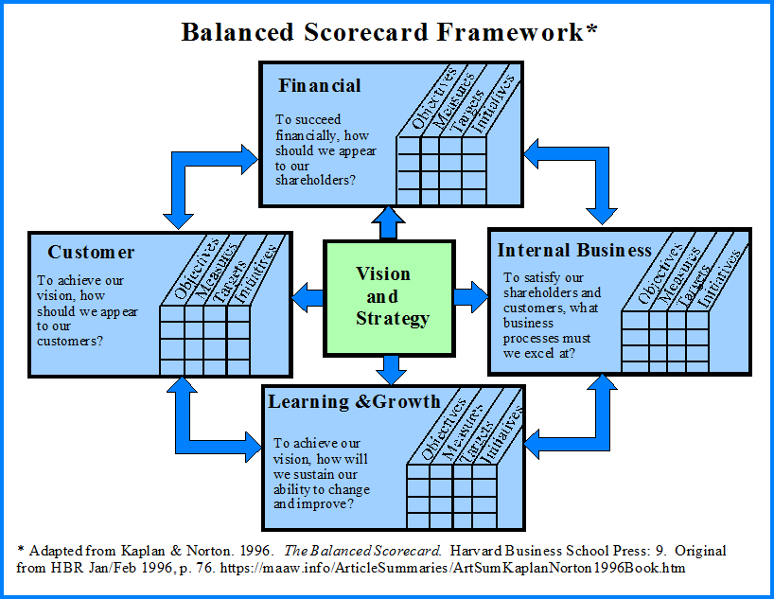
The balanced scorecard
Consists of four perspectives to assess an organisation’s health:
Customers – How do customers view us?
Learning & Growth / Innovation – How do we create value?
Internal Business – What core competencies and processes do we need?
Financial – How do shareholders view us?

Slide 55

balanced scorecard – financial
How do shareholders view us?
  Focus on the financial objectives
  Assess organisation’s financial strength from the perspective of a shareholder, an owner of the company with a financial stake in the increase of the company's value
  You do not need to have shareholders for this analysis
  You can assess organisation from the perspective of a potential shareholder
  Includes assessment of standard accounting metrics (e.g. cash flow, operating returns, return on equity, ROI, Profit margins etc.)

Slide 56

balanced scorecard - customers
How do customers view us?
  Determine how customers view products and services:
    How do customers perceive value of our products and services?
    How much are they are willing to pay for those products and services?
    Quality? Delivery? Price? Etc.
    Customer loyalty, Market share, Customer Engagement, Customer retention, NPS etc

Slide 57

balanced scorecard – internal business
What core competencies do we need?
  Focus upon core competencies needed to achieve strategic objectives –efficiency, quality control etc
  Develop business processes that enable employees to hone and develop the core competencies required
    Example: a car manufacturer may distinguish itself with the core competencies of making fuel-efficient engines with futuristic designs. These core competencies may be utilised for strategic expansion initiatives (e.g. into motorcycle development).

Slide 58

balanced scorecard – learning & growth / innovation
How do we create value?
  Focus on organisation’s processes and structures that create value
  Focus on activities that enhance competitiveness, innovation and organisational learning and development
  Develop key metrics focusing on any one of the aforementioned areas. Employee satisfaction, training and development etc.
    Example: A technology company may develop a measure of the revenue generated from their most recent product launches, perhaps over the past two years, to understand the effects of innovation and constant improvement.

Slide 59
This is the end of our session ☺

