Slide 1
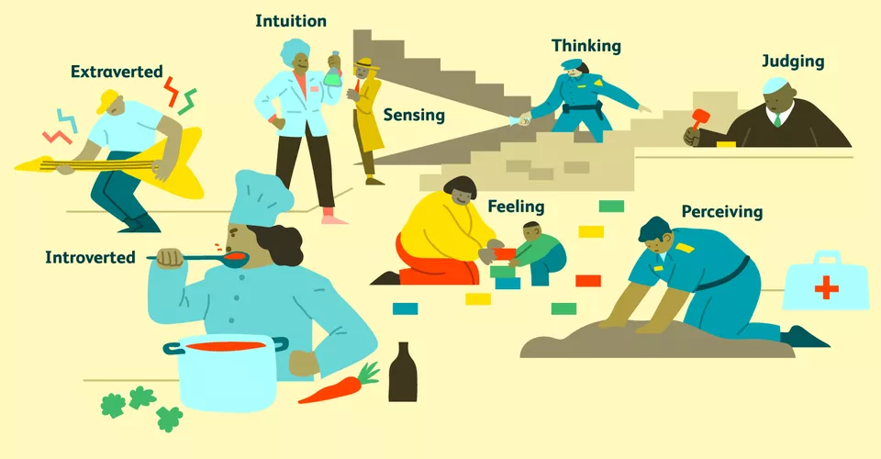
Myers-Briggs Type Indicator
By Megan Genevieve Pearson
1900634.

Slide 2
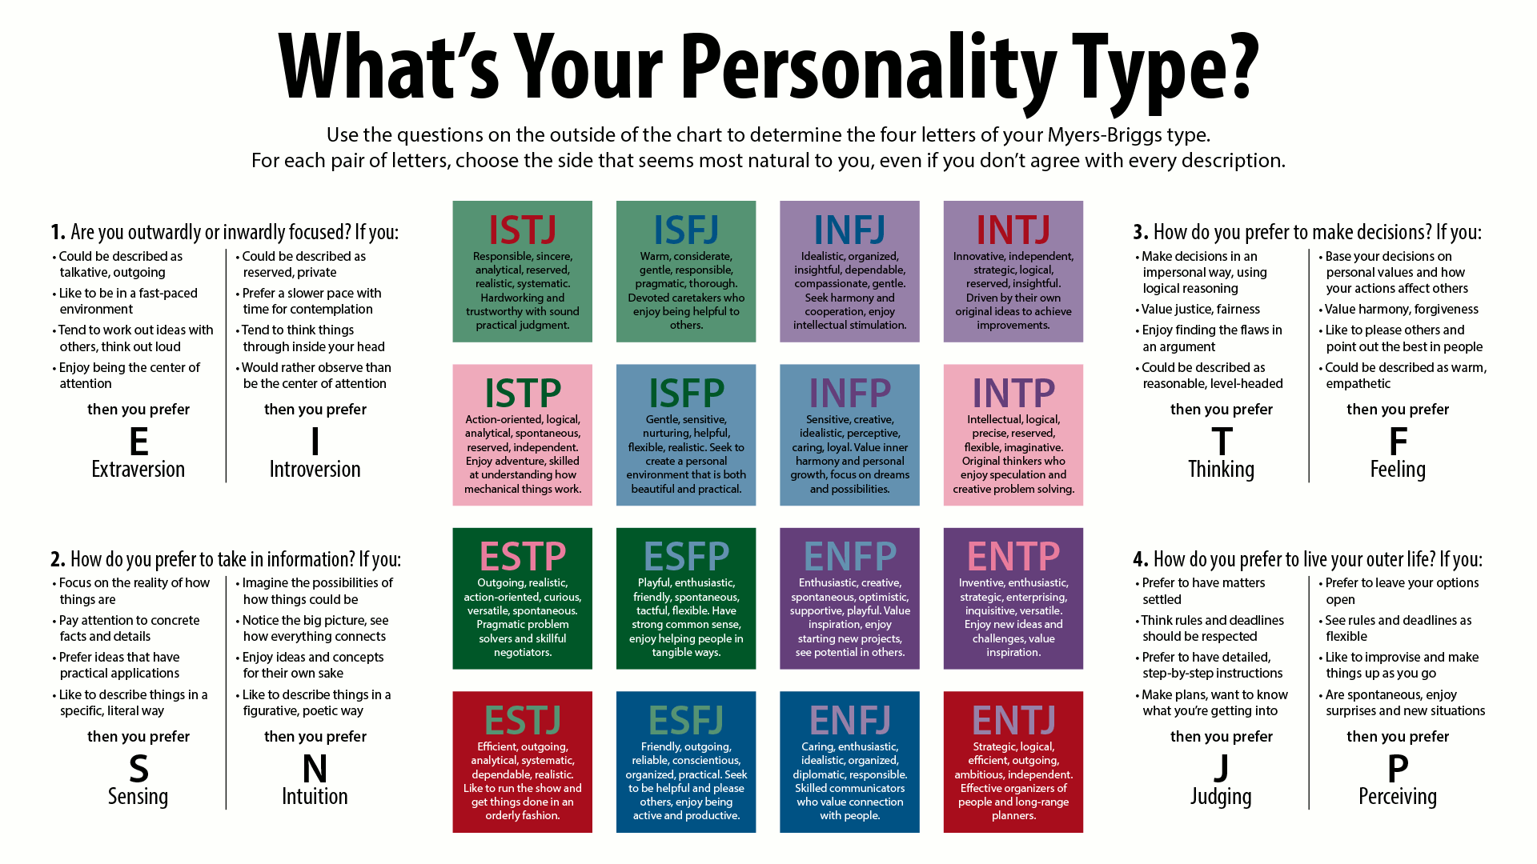

Slide 3
What is the Myers-Briggs Type Indicator?
The Myers-Briggs Type Indicator (MBTI) is a self-help assessment tool and questionnaire that helps people understand more about themselves and how they function. It is a framework for developing relationships, creating optimism, and attaining success.
The MBTI model is concerned with an individual's preferences rather than their skills. This is a crucial distinction. Everyone is capable of using all styles, but they will have a favoured style that they will utilise the majority of the time.
It is the world’s most widely used personality assessment test.

Slide 4
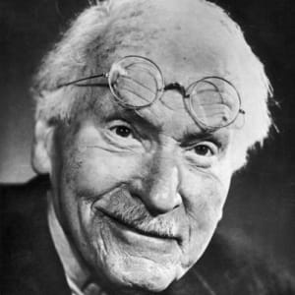
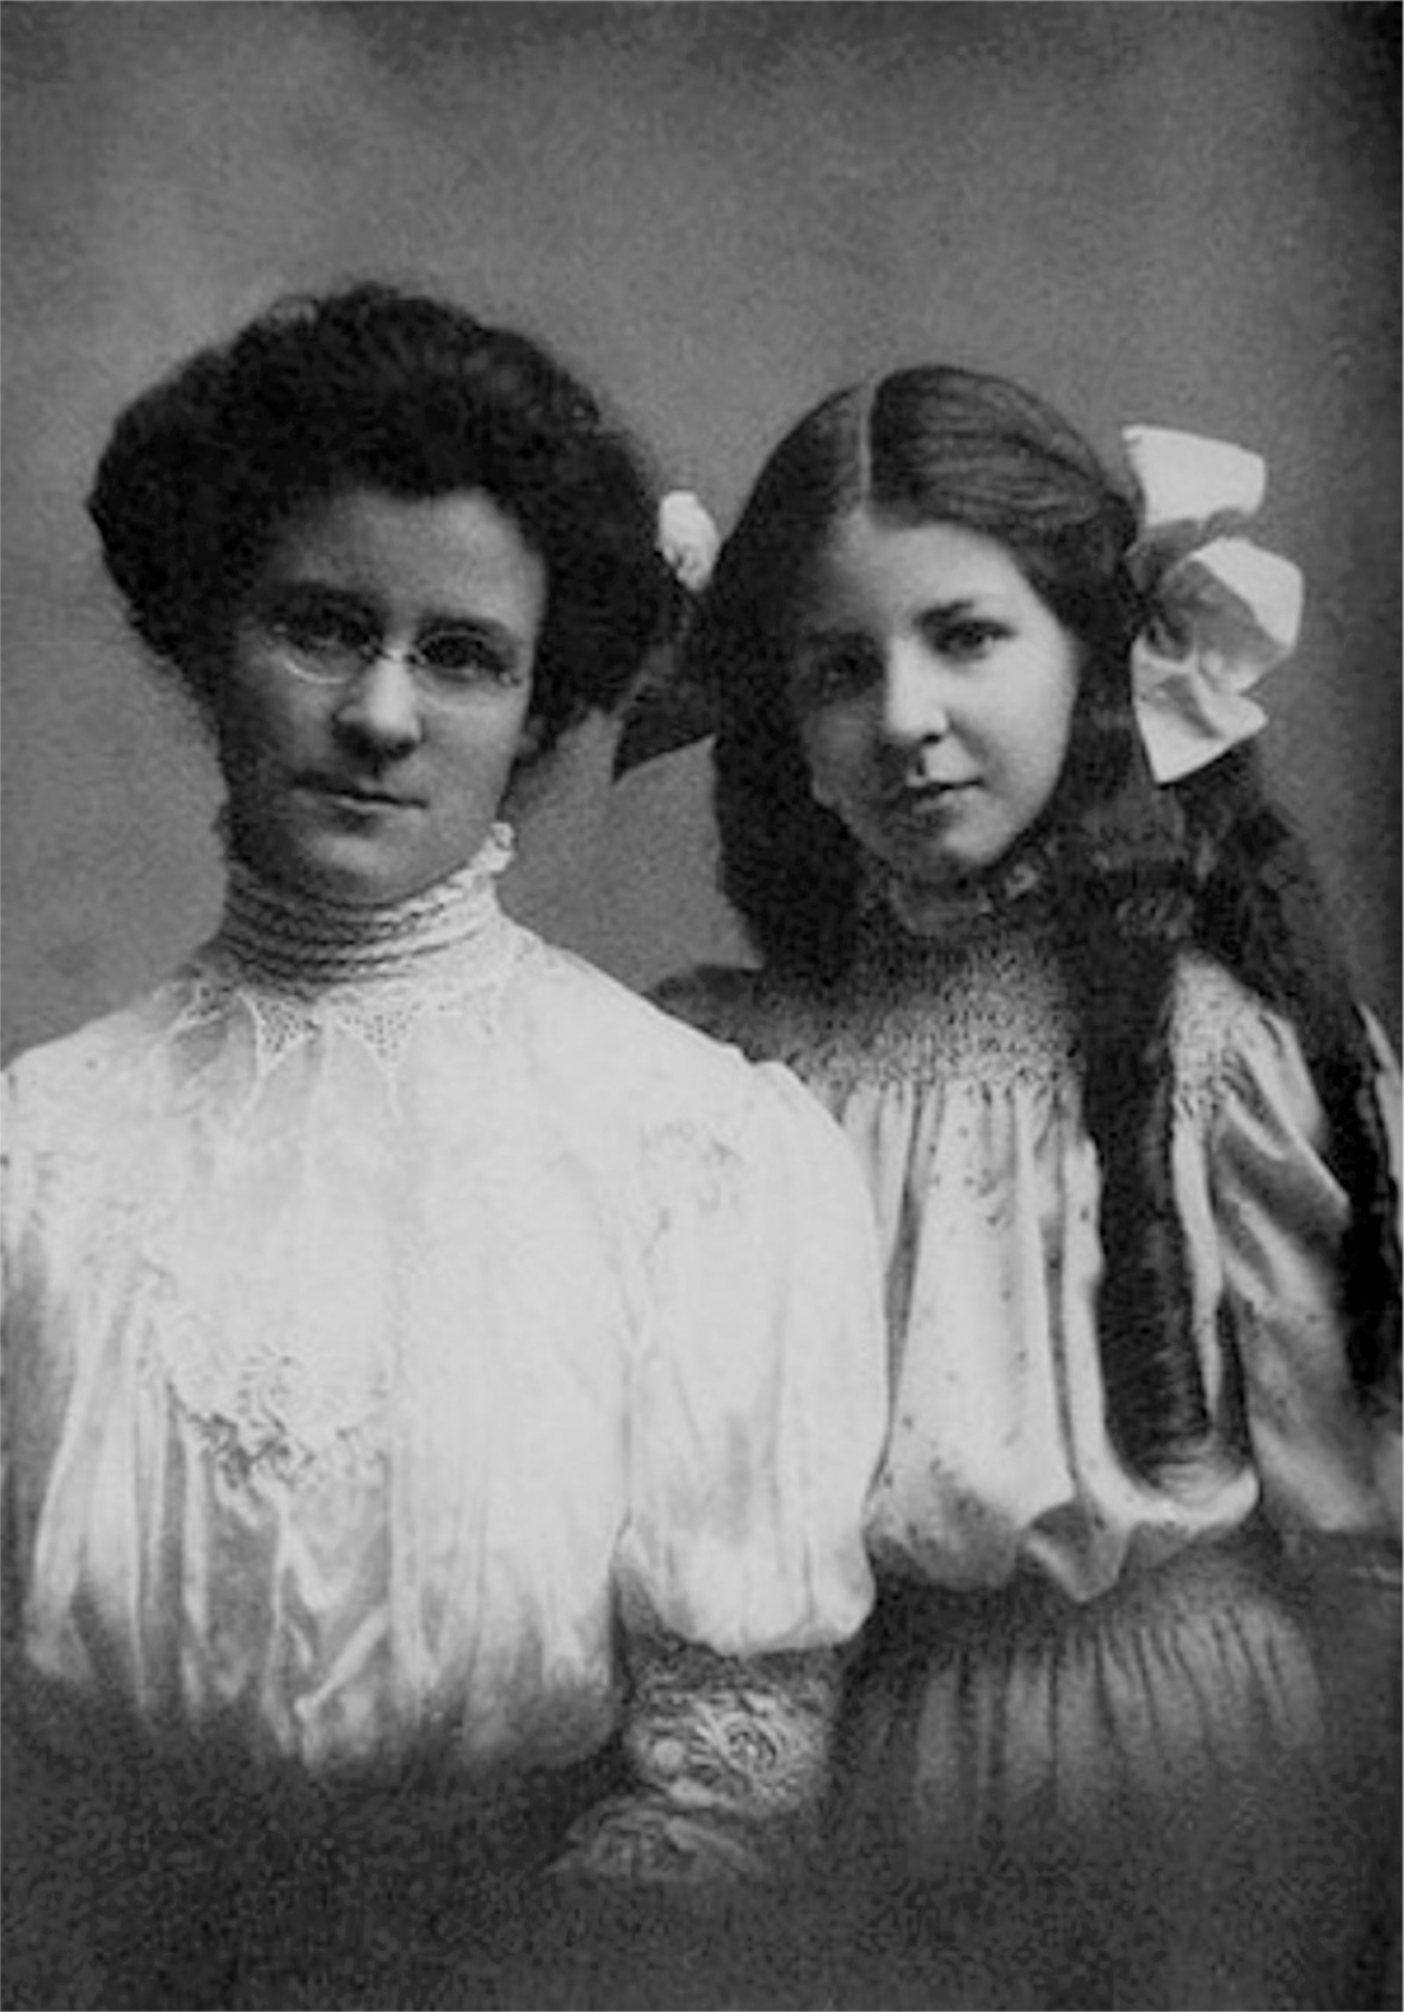
Who created the MBTI assessment?
The questionnaire was developed by Isabel Myers and her mother Katherine Briggs, during the early mid-twentieth century in the United States of America.
When Briggs met Isabel's future husband, Clarence Myers, she was encouraged to investigate personality type theory. She observed he had a unique perspective on life. This piqued her interest enough for her to begin a literature research to better comprehend different temperaments.
Carl Jung's work and "Psychological Type" serve as the foundation for MBTI.

Slide 5
What is Jung’s influence on MBTI theory?
In 1921, Carl G Jung released his novel Psychological Types. Katherine Briggs studied the English version in 1923 and noticed parallels in their thinking. Carl G Jung's conceptions of personal difference, on the other hand, were far more evolved.
Both, Briggs and Myers believed Jung's work was so valuable that they set out to make it available to a larger market.

Slide 6
How does it work?
In Myers and Briggs' theory, personality types are described in terms of four-letter codes, like ESTJ or INFP. Each of the four letters signifies a key aspect of an individual's personality.
This is a popular technique for helping people understand their own communication preferences and how they connect with others. Knowing what MBTI is will help you adjust your interpersonal approach to various situations and audiences. MBTI, on the other hand, should never be employed in a recruiting process.

Slide 7
Examples of a Question
For example; you will have a preference to use one hand rather than the other to write. In the space below write your name with your preferred hand. Then switch to your non-preferred hand to write your name.
Preferred hand: …………………………………………………………..
Non-preferred hand: …………………………………………………………
You are capable of writing your name with both; however your preferred hand was easier to use, the outcome was better and it felt natural. Using your non-preferred hand meant the result wasn’t quite as good, you had to concentrate more and it probably took longer. It will get better with practice, however it is likely you will out of habit go back to your preferred hand. It is the same with type.
The purpose of MBTI is to raise awareness of your own preference and recognise where the other styles could add value, thinking about how you could do this. No one style is better than the others. An understanding of all increases flexibility and adaptability.

Slide 8
When was the MBTI assessment first published?
World War II had a significant impact on the project's progress. Isabel Myers felt that if individuals knew each other better, they would be able to work together more effectively and with less friction. She believed that the world after WWII might and hopefully be a better one.
Myer’s was motivated to discover a means to provide individuals with information about their psychological type. This sparked the concept for a type indicator, and she then spent the rest of her life working and developing the MBTI on it.
Isabel Myer’s spent the next two decades asking questions and confirming the instrument and concept. In 1962, the MBTI instrument was finally released.

Slide 9
The 16 MBTI personality types
The MBTI questionnaire sorts people into one of 16 different personality types.
The Myers-Briggs Type Indicator® (MBTI®) is a personality assessment tool. Step I is based on Carl Jung's psychological type theory. It reveals your personality preferences across four dimensions:
Where you focus your attention – Extraversion (E) or Introversion (I)
The way you take in information – Sensing (S) or INtuition (N)
How you make decisions – Thinking (T) or Feeling (F)
How you deal with the world – Judging (J) or Perceiving (P)

Slide 10
The 16 MBTI personality types
Extraversion vs. Introversion
The Extraversion/Introversion dichotomy describes how a person gets their energy.
Introverts are energized by spending quiet time alone or with a small group. They tend to be more reserved and thoughtful.
Extraverts are energized by spending time with people and in busy, active surroundings. They tend to be more expressive and outspoken.
Sensing vs. Intuition
The Sensing/Intuition dichotomy describes how a person takes in information.
Sensors focus on their five senses and are interested in information they can directly see, hear, feel, and so on. They tend to be hands-on learners and are often described as "practical."
Intuitives focus on a more abstract level of thinking; they are more interested in theories, patterns, and explanations. They are often more concerned with the future than the present and are often described as "creative."
Thinking vs. Feeling
The Thinking/Feeling dichotomy describes how a person makes decisions.
Thinkers tend to make decisions with their heads; they are interested in finding the most logical, reasonable choice.
Feelers tend to make decisions with their hearts; they are interested in how a decision will affect people, and whether it fits in with their values.
Judging vs. Perceiving
The Judging/Perceiving dichotomy describes how a person organizes their world.
Judgers appreciate structure and order; they like things planned, and dislike last-minute changes.
Perceivers appreciate flexibility and spontaneity; they like to leave things open so they can change their minds.

Slide 11
Common uses for MBTI include:
• Developing yourself
• Working with teams
• Understanding stress reactions
• Career development
• Working relationships
• Communication style
• Resolving conflict
• Leadership style
• Managing change
• Valuing diversity
• Considering team and organisational culture
• Problem-solving

Slide 12
Advantages of the MBTI:
The MBTI's principal benefit is as a tool for self-awareness and tolerance of others. This may be used in a variety of ways. For example, if the test reveals that you are an INFP or "dreamer," you may not be productive or happy in a position that requires an ESTP or "persuader." Knowing your own personality type can help you decide which jobs are right for you and which you should avoid. If you know another person's MBTI type, you'll have a clear grasp of why the two of you might not always agree.

Slide 13
Disadvantages of the MBTI:
The MBTI's principal benefit is as a tool for self-awareness and tolerance of others. This may be used in a variety of ways. For example, if the test reveals that you are an INFP or "dreamer," you may not be productive or happy in a position that requires an ESTP or "persuader." Knowing your own personality type can help you decide which jobs are right for you and which you should avoid. If you know another person's MBTI type, you'll have a clear grasp of why the two of you might not always agree.
According to the Myers & Briggs Foundation, the MBTI meets accepted standards of reliability and validity. However, additional research indicates that the instrument's reliability and validity have not yet been satisfactorily proved.
According to studies, between 40% and 75% of participants obtain a different outcome after doing the questionnaire a second or third time.
According to a 1992 publication by The Committee on Techniques for Enhancing Human Performance and the National Evidence Council, "There is insufficient well-designed research to warrant the use of MBTI in career counselling programmes. Much of the present research is based on flawed methodology."

Slide 14
How MBTI Differs From Other Instruments
First and foremost, the MBTI is not a "test." There are no correct or incorrect replies, and one type is not superior to another. The indicator's objective is not to assess mental health or to provide a diagnosis.
Furthermore, unlike some of the other forms of psychological assessments, your outcomes are not compared to any norms. Instead than comparing your findings to those of other individuals, the instrument's purpose is to simply provide more information on your own distinct character.

Slide 15
References
Cherry, K., 2020. Myers-Briggs Type Indicator: The 16 Personality Types. [online] Verywell Mind. Available at: <https://www.verywellmind.com/the-myers-briggs-type-indicator-2795583> [Accessed 1 June 2021].
Molly Owens, M., 2021. The History of Katharine Briggs, Isabel Myers, and the MBTI®. [online] Truity. Available at: <https://www.truity.com/myers-briggs/story-of-mbti-briggs-myers-biography> [Accessed 1 June 2021].
Owens, M., 2021. Other Challenges to the MBTI®. [online] Truity. Available at: <https://www.truity.com/book/other-challenges-mbti> [Accessed 1 June 2021].
The Economic Times. 2021. What is Myers-briggs Type Indicator? Definition of Myers-briggs Type Indicator, Myers-briggs Type Indicator Meaning - The Economic Times. [online] Available at: <https://economictimes.indiatimes.com/definition/myers-briggs-type-indicator> [Accessed 1 June 2021].
Thompson, S., 2019. Advantages & Disadvantages of Jungian Personality Assessment. [online] Theclassroom.com. Available at: <https://www.theclassroom.com/advantages-disadvantages-of-jungian-personality-assessment-12084176.html> [Accessed 1 June 2021].
Imperial.ac.uk. 2021. MBTI. [online] Available at: <https://www.imperial.ac.uk/media/imperial-college/administration-and-support-services/staff-development/public/impex/MBTI.pdf> [Accessed 1 June 2021].

