Slide 1

High Intensity Interval Training
(HIIT)
ASSINGMENT 1: EVIDENCE BASED PRACTICE
Notes:
.

Slide 2

Participant
Gender: Male
Age: 22 Year/old
Recreationally active individual
Works 5 days a week
HR max: 220-22= 198 bpm
This Photo by Unknown Author is licensed under CC BY-NC

Slide 3

Training background.
Sports: Gymnastics, Rowing, Rugby and Football.
Challenges: ‘Pembrokeshire Coast Path Challenge’, running the full Pembrokeshire coast path in 7 days (186 miles). Accounted to a around a marathon a day.
Participated in a local triathlon in a team, whereby he completed the run (10km)
This Photo by Unknown Author is licensed under CC BY
Notes:
Sports = gymnastics, rowing, rugby and football
Challenges= pembrokeshrie coast path challenge- 7 days 186 miles running
Triathlon= completed the run

Slide 4
Current fitness level/routine
Current sport= Football 1x training session per week & 1x game per week.
Recreational training=
2x runs per week
1x turbo trainer sessions per week
1x resistance exercise in the gym
Notes:
The Client currently Plays football, whereby he attends weekly training sessions on a Thursday and Plays the football match on a Saturday.
Alongside this he focuses on his cardiovascular fitness and uses his spare time to train on his turbo trainer and to go running as well spend 1 session a week in the gym focusing on resistance exercise.

Slide 5
Participant goals
Improve football performance
Improve aerobic and anaerobic fitness
Notes:
The Participants current fitness goals are to:
Improve football performance, specifically related to the sprint and acceleration bouts that are frequently performed during a match
Improve overall aerobic and anaerobic fitness

Slide 6
Pre-program experimental test
The participant took part in a 6-minute run test before starting any training sessions.
This was used to test his performance at the start of the 3-week program.
And to calculate maximal aerobic speed (MAS) which is defined as the velocity at VO2 max (Baker & Heaney, 2015).
Time | Average speed (mph) | Max speed (mph) | Average pace (min/mi) | Distance (miles) | Maximal Aerobic speed = distance divided by time
6 minutes 03 seconds (360 seconds) | 9.6 mph | 12.6 mph | 6.15 min/mi | 0.97 miles | 0.97 divided by 360 seconds = 4.77 meters per second (m/s)
Notes:
A pre-experimental test was conducted on the participant before starting any training sessions.
This involved a 6-minute run test, whereby the participant had to run as far as he could in 6 minutes.
From this test, time spent running, maximal speed, distance, average pace and average speed were recorded.
This then allowed the participants heart rate zones to be predicted by using his HR max as well as calculating maximal aerobic speed.

Slide 7
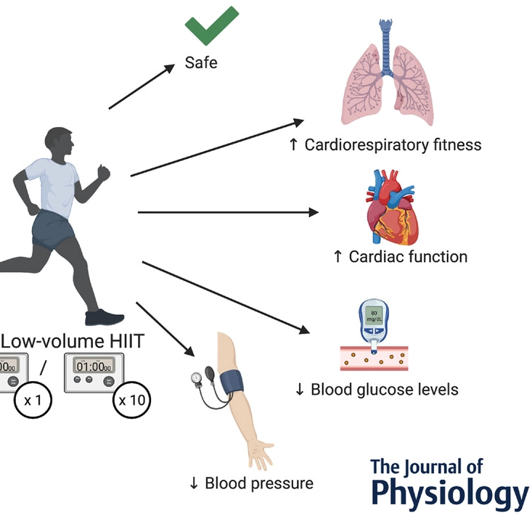
Training program rationale
What is High Intensity Interval Training (HIIT)?
HIIT is frequently referred to as “ bursts of high-intensity submaximal exercise followed by rest intervals”.
Low-volume HIIT typically involves less than 15 minutes of exercise per session and has grown popular in both healthy and clinical populations due to its time-efficiency and significant health benefits, which include:
Cardiorespiratory fitness
Glucose control
Blood pressure
Cardiac function
Low-volume HIIT has been shown to be safe and well-tolerated in adults with high exercise adherence (Sabag et al., 2022)
Notes:
HIIT = bursts of high-intensity submaximal exercise followed by recovery/rest intervals
Benefits= safe, increase in cardiorespiratory fitness, increase in cardiac function, decrease in blood glucose levels and decrease in blood pressure
Well-tolerated in adults who exercise regularly !

Slide 8
ADDITONAL POINTS
HIIT a burst and recover cycle is suggested to be an alternative to the traditional approach of continuous endurance training, with the aim of enhancing aerobic fitness (Zuhl and Kravitz, 2012).
HIIT, has been shown to improve endurance performance more than continuous training alone, in sedentary-recreational individuals (Laursen & Jenkins, 2002).
This is due to the up-regulated contribution of aerobic and anaerobic metabolism to the energy demand. (Rodas et al., 2000).
Notes:
Hiit a burst and recovery cycle can be an alternative to continuous endurance training- aim of enhancing aerobic fitness
Has proven to improve endurance performance more than continuous training alone- in sedentary individuals
Due to the up-regulated contribution of aerobic and anaerobic metabolism to the energy demand.

Slide 9
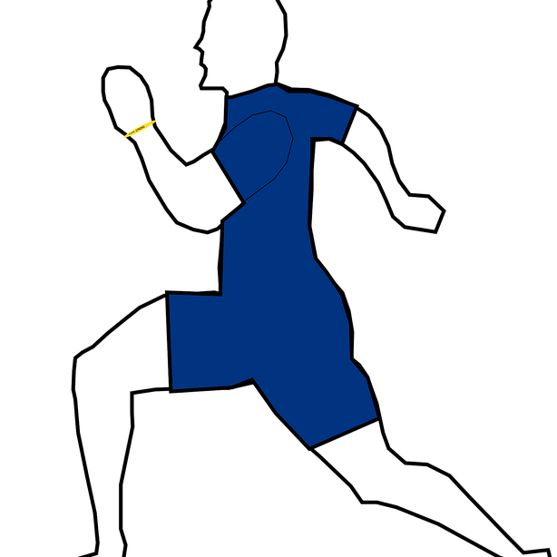
Training program rationale
Why choose HIIT?:
HIIT has proven to be an effective way of increasing VO2 max and improving cardiovascular health, when compared to moderate intensity continuous training (MICT) (Karlsen, 2017).
Physical activity barrier = ‘lack of time’.
HIIT can be more useful due to the reduced volume, and lower time commitment compared to MICT (Poon et al., 2021).
Notes:
Why choose hit?
Proven to be an effective way of increasing VO2mx and improving cardiovascular health
Reduced volume and lower time commitment- linked to the physical activity barrier known as lack of time

Slide 10

CHOSEN METHOD- sprint interval training
Based on participants goals:
improve football performance
Improve aerobic and anaerobic fitness.
A form of HIIT known as Sprint Interval Training (SIT) was chosen:
Sprint interval training (SIT) consists of 'all out' efforts lasting 8-30 seconds which require large non-oxidative energy contributions followed by light recovery intervals or no exercise between intervals (Sabag et al., 2022).
SIT has been used in other studies and has been proven to produce aerobic and anaerobic adaptations (Sabag et al., 2022).
This Photo by Unknown Author is licensed under CC BY
Notes:
Sprint interval training was the chosen method for the 3 week training program
based off participants goals to 1) improve football performance and 2) improve aerobic and anaerobic fitness.
SIT consists of ‘all out’ efforts lasting 8-30 seconds
This requires large non-oxidative energy contributions followed by light recovery intervals or rest intervals
Rest intervals can last around 2 minutes
SIT has been used in other studies and has proven to produce aerobic and anaerobic adaptations

Slide 11
Evidence from literature findings
A study by Denham, Feros and O’Brien (2015) demonstrates that four weeks of sprint interval training improves 5km run performance and cardiorespiratory fitness in untrained young men.
Others have demonstrated that recreationally active individuals improve 2km run performance after 6 weeks of sprint interval training and/or moderate intensity continuous training (Denham, Feros and O’Brien, 2015).
Hazell et al., (2010) identified that performing 4-6 rep’s of 10s duration with 2-4 minute recovery intervals 3x a times a week for 2 weeks improved VO2 max, Winggate power output, and 5km time trial performance in young adults.
Notes:
4 weeks of SIT improves 5km run performance and cardio fitness in untrained men
Recreational active individuals improve 2km run performance after 6 weeks of SIT
4-6 reps of 10s duration with 2-4 min recovery intervals 3 times a week can improve VO2max, winggate power output and 5km time trial performance in young adults

Slide 12
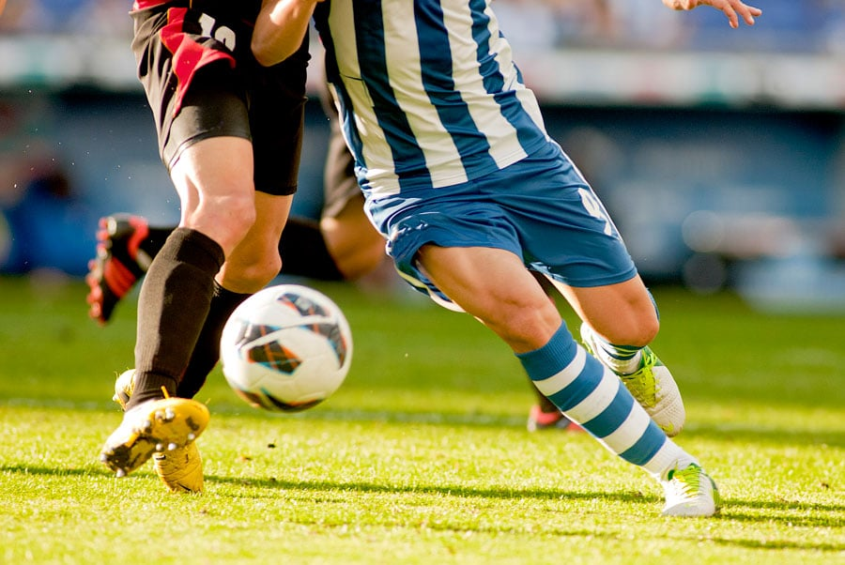
Research related to football-
The physical demands of football include the ability to perform:
short-duration sprints
High-intensity running at different speeds
Jumping
Tackling
Shooting
Controlling the ball
With an average game intensity ranging from 80-90% of an individuals HR max
Therefore, coaches have used various training methods to improve players’ physical capacity required for football matches including HIIT
(Arslan, Orer and Clemente, 2020)
This Photo by Unknown Author is licensed under CC BY-NC-ND
Notes:
The development of this program was based on the participants goals, one being improve football performance:
Therefore, as football involves
short-duration sprints,
High-intensity running at different speeds,
Jumping
Tackling,
Shooting
HIIT has been used by coaches to improve players’ physical capacity required for a football match.

Slide 13
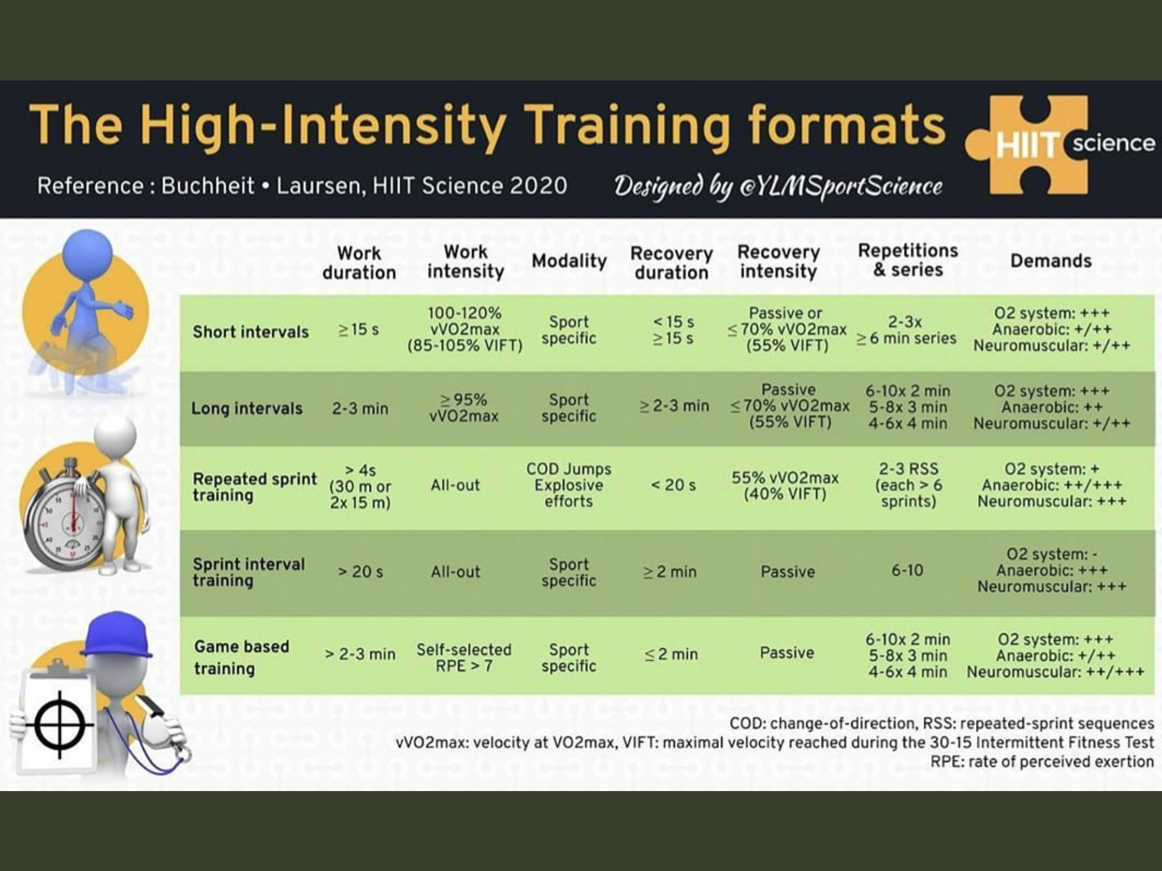
Development of Training program
Buchheit & Laursen, HIIT Science (2020) training formats.
The chosen session for the participants program= sprint interval training (SIT).
E.g. 6-10 reps of 20s all out sprints followed by 2 min passive recovery.
Notes:
The development of the 3 week program came from buchhiet and laursen HIIT training formats
Sprint interval training
4-8 reps of 20s all out sprints
2 minute recovery
We did it 2x a week for a total of 2 weeks along with 1 week based on game based training sprints in his football sessions.

Slide 14
Summary OF THE training program
3 weeks in total: 2x SIT sessions for 2 weeks
2x sprint sessions during football training
5min RAMP warm up followed before each session.
Sprint interval training (SIT) 4-8 reps of 20s all out sprints followed by 2-minute passive recovery.
RPE (Haff and Triplett, 2016) and HR measured after each sprint - taken from the client’s heart rate chest strap (Garmin).
Notes:
This High Intensity Interval Training program consisted of a total of 3 weeks,
with 2 session in each week.
One performed on a Wednesday morning and a Sunday morning (based on the client’s availability).
Each session began with a 5-minute ramp warm up, consisting of 2-3 minutes of jogging and 2 minutes of activations and mobilizations.
The chosen session to focus on for this client was based on a sprint interval training approach,
involving high intensity sprint bursts followed by passive recovery.
This was the most appropriate session to include in this program based on the clients chosen sport, which is football and football does involve a lot of short rapid bursts of acceleration/sprints.
Each session was based off Buchheit, Laursen, HIIT Science (2020) training formats.
Whereby 4-8 reps of 20s all out sprints were performed, followed by 2 minutes of passive recovery.
Throughout each session, Ratings of Perceived Exertion was measured after each sprint burst, as well as a measurement of Heart Rate, which was taken from the client’s heart rate chest strap (Garmin).

Slide 15
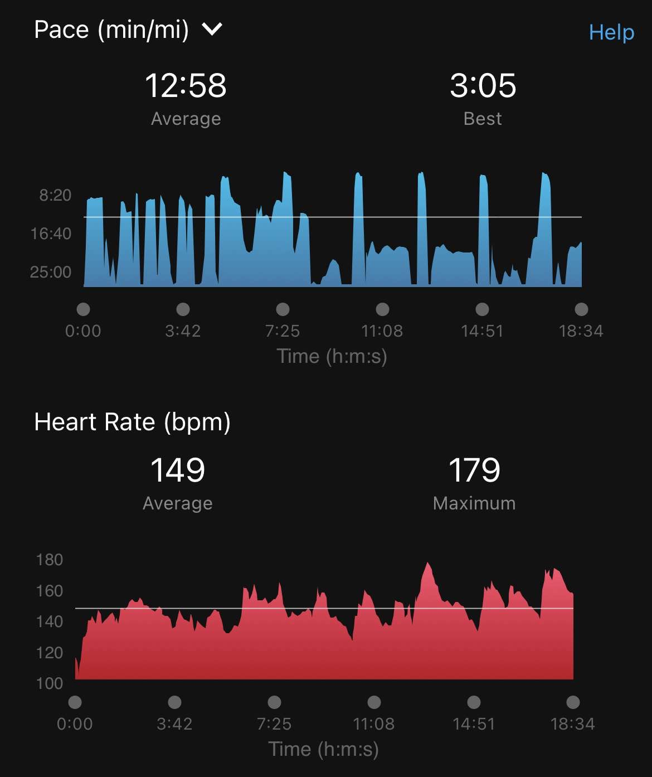
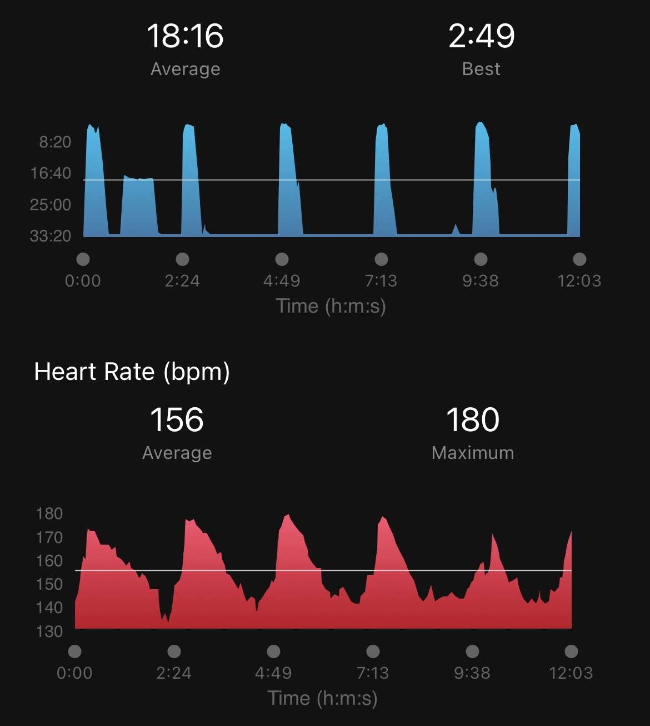
REPS | RPE | HR (BPM)
1 | 5 | 137
2 | 6 | 147
3 | 7 | 161
4 | 7 | 162
5 | 8 | 170
6 | 10 | 179
WEEK 1
Session 1 & 2
= 6 x 20s all out sprints followed by 2 min passive recovery between sprints
REPS | RPE | HR (bpm)
1 | 4 | 170
2 | 4 | 174
3 | 7 | 178
4 | 8 | 180
5 | 9 | 170
6 | 10 | 172
Notes:
Week 1 & session 1 =
6 reps of 20s all out sprints
2 minute passive recovery (complete rest)- to allow him to recover so he is able to complete the next rep
Spent the last couple of reps in Zone 4 (80% hr max)
RPE increased to 10 for last rep
Week 1 & session 2 =
6 reps of 20s all out sprints
2 minute passive recovery
Spent most of the session in zone 4
RPE a bit lower to start with compared to session 1 – psychologically may have been easier

Slide 16
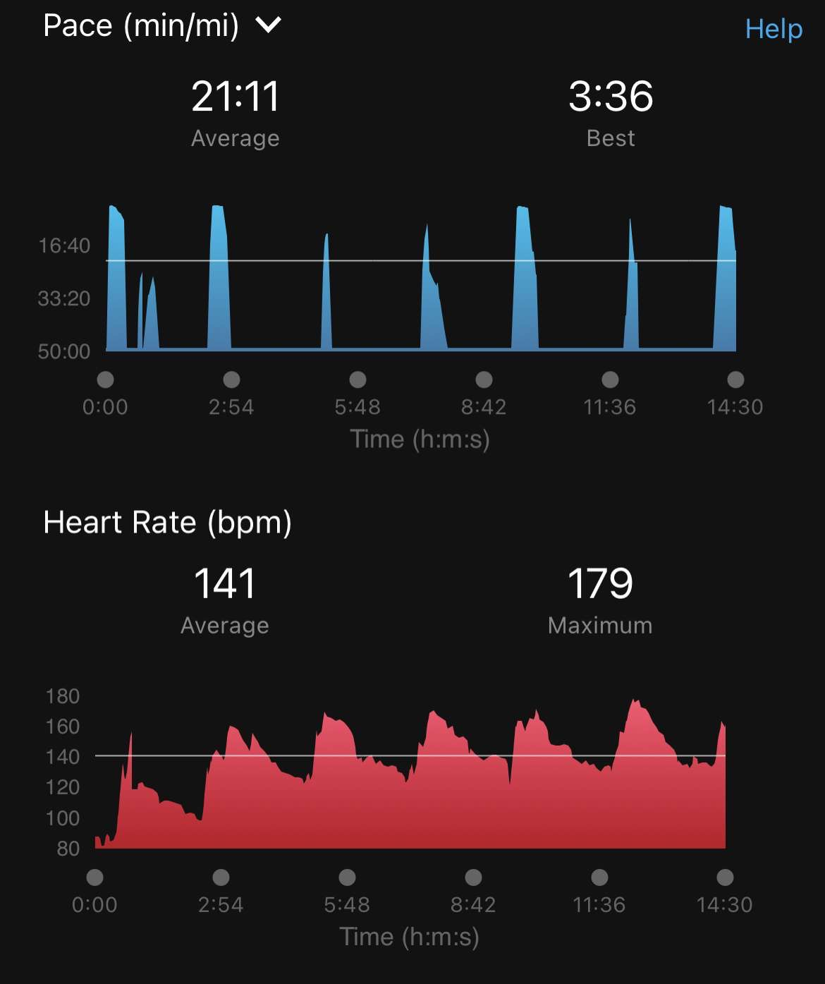
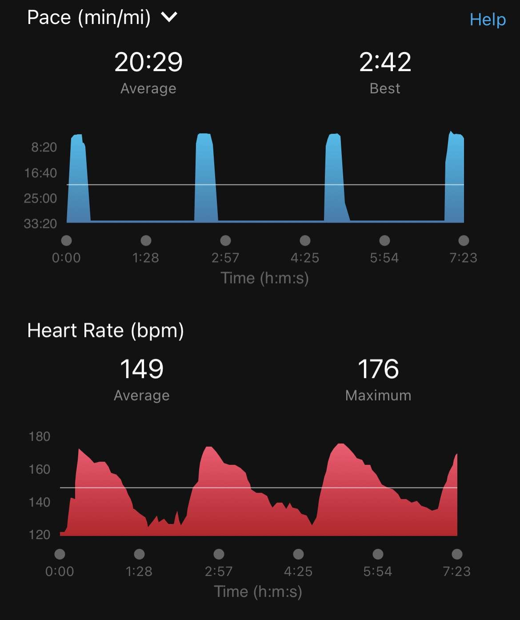
REPS | RPE | HR (BPM)
1 | 4 | 136
2 | 4 | 160
3 | 5 | 166
4 | 5 | 168
5 | 7 | 170
6 | 8 | 179
7 | 9 | 175
WEEK 2
Sessions 3 & 4
= 4-7x 20s all out sprints with a 2minute passive recovery between each sprint.
REPS | RPE | HR (BPM)
1 | 6 | 169
2 | 7 | 163
3 | 10 | 176
4 | 10 | 176
Notes:
In week two, the same sessions were completed however, the client was able to perform 7 reps of the 20s all out sprints followed by 2-minute recovery. 80-90% of HR max was reached in reps 4-7 during one session.
However, in the second session of week 2 the client could only perform 4 reps due to an injury that he sustained during his football match = RPE higher due to injury not because it felt that hard. (comment from participant)

Slide 17
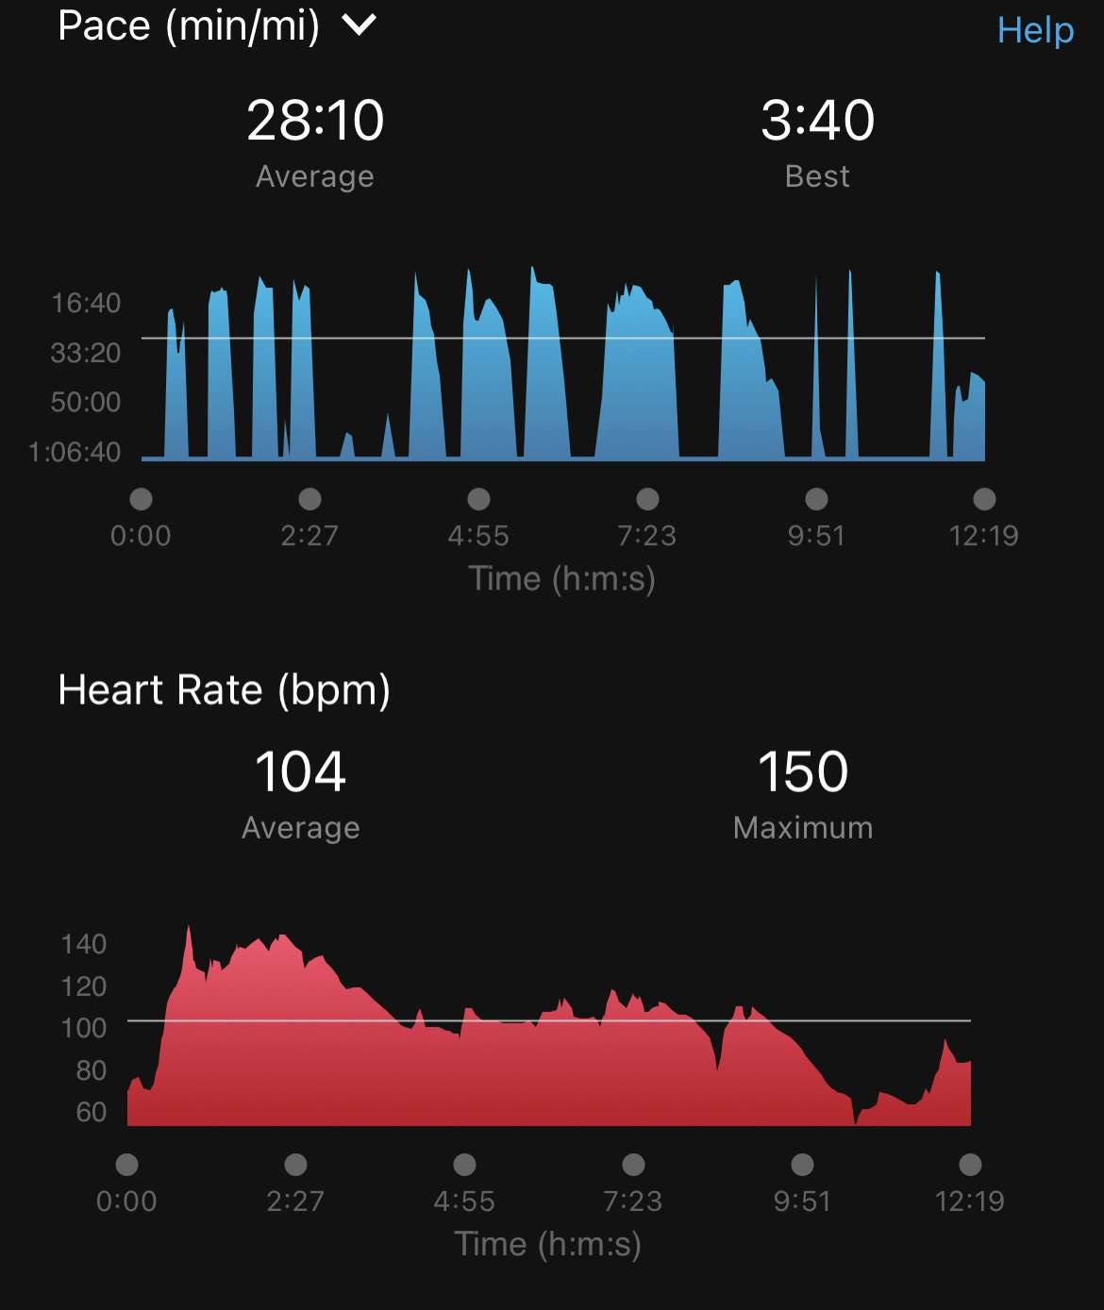
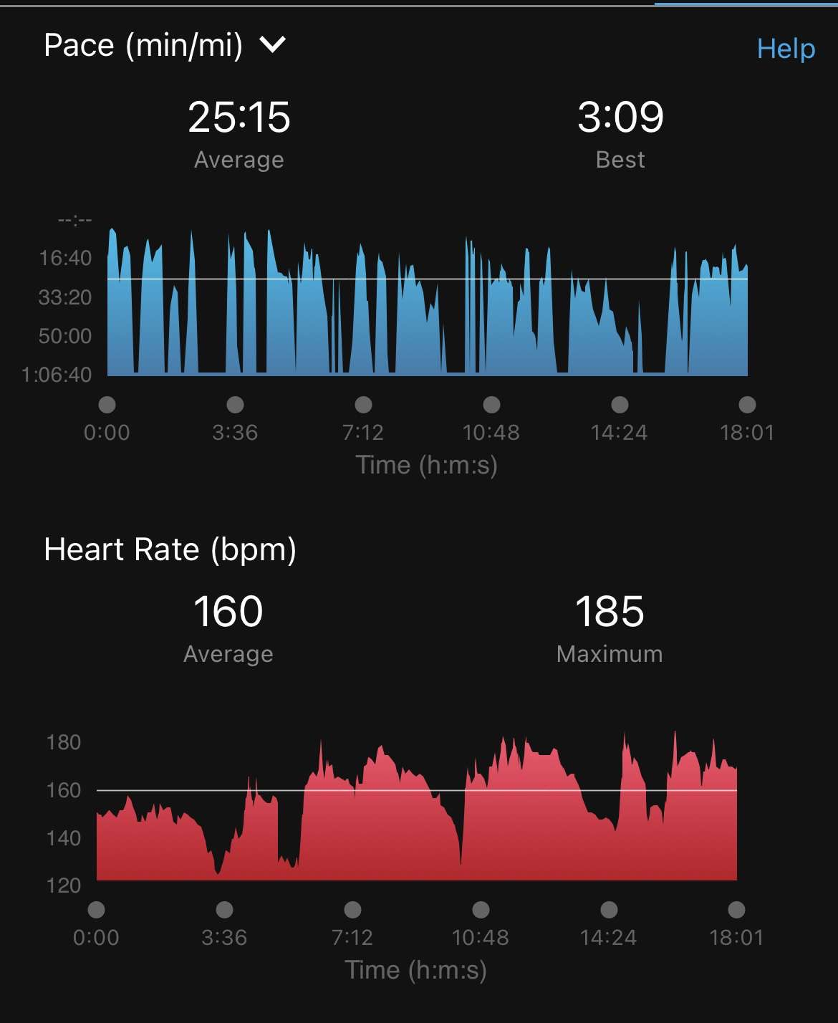
Session 5
WEEK 3
Sessions 5 & 6 took place during football training.
This was done to try to mix up the sessions and make them more engaging and fun, as well as to relate it to his goals of improving football performance (sport specific sprints/travel)
The participant noted that it felt easier performing the sprints during this week - RPE was not recorded within these sessions.
Session 6
Notes:
Week 3 =
Sprint sessions in football training 12-15 minute sessions
10m sprint forwards followed by backwards travel back to starting cone
5 x followed by minute rest
This was repeated for a time of up to 15 minutes
(RPE not recorded in these session, however, participant said it felt easier while sprinting in these sessions)

Slide 18
POST PROGRAM – 6 MINUTE RUN
Time | Average speed (mph) | Max speed (mph) | Average pace (min/mi) | Distance (miles) | Maximal Aerobic speed = distance divided by time
6 minutes | 9.8 mph | 12.8 mph | 6.09 min/mi | 1 mile | 4.8 meters per second (m/s)
After completing the 3 week SIT program,
The participant completed another 6 minute run test and managed to run a mile. He stated:
“this felt a lot more comfortable when running compared to the first test”
Notes:
Post program 6 minute test
Improved to a mile this time
Speed increased also
And it felt easier to complete compared to the first test- this could be a psychological improvement?

Slide 19
Effectiveness of HIIT
Advantages | Disadvantages
Reduced time commitment to exercise – links to a perceived barrier known as ‘lack of time’ Can be seen as enjoyable and produces greater physiological adaptations compared to MICT (Ataman et al., 2021). Used in football to improve field based performance and high-intensity actions such as single and repeated sprints (Manuel Clemente et al., 2020). Has shown to improve aerobic and anaerobic performance after only a few sessions (Nalcakan, 2014). | Strong motivation is needed due to the high-exertion exercise intervals – very fatiguing and might not be suitable for sedentary individuals (Ataman et al., 2021). ‘feel good effect’ is unlikely during a HIIT session – (Biddle & Muntrie, 2007). Although SIT is used by many athletes, regular exercises could be intimidated by the strenuous high-intensity bouts, which could produce negative affective states (Tritter, 2013).
Notes:
Advantages =
Reduced time commitment – supports the barrier of lack of time
Can be enjoyable and may produce greater physiological adaptions compared to MICT
Used in football to improve field based performance- single and repeated sprints
Improves aerobic and anaerobic performance after only a few sessions
Disadvantages=
- strong motivation is needed due to the high-exertion exercise intervals (fatiguing and not suitable for sedentary populations)
Feel good effect is unlikely
Regular exercises can be intimidated by the high-intensity bouts, can produce negative affective states.

Slide 20
Individual and participants observations:
Participant observations:
It was not enjoyable
It required a lot of motivation to complete the sessions
After the first two sessions it became a lot easier
The time commitment was great, especially during the week, easy to fit around a busy schedule
Performed better in the morning compared to evening
During football, I felt like I performed better during match day on the last week
Individual observations:
Does not seem enjoyable
Could work for a short period of time, but I don’t think commitment rates would be high
Very easy to perform in terms of equipment, can be done outside, on a treadmill or on a track if its based around running
Less time commitment compared to MICT
May cause injury, or is not suitable to complete when injured

Slide 21
Program limitations
More planning and preparation is needed, could’ve implemented a 6 week training program with better organization. This might have resulted in greater gains.
The participants heart rate chest strap was not used for every session. This does not show consistency of heart rate results.
Could’ve incorporated another pre/post test measure such as a 300yrd test (football performance) or a 5km trial run too add to the existing research findings.
Anthropometric measure could have also been of use in this study, to measure any changes post program.
Notes:
Limitations =
More planning and preparation needed- maybe a 6 week training program could’ve produced greater benefits
Participants heart rate chest strap was not used in every session- this is not consistent with heart rate measurements
Maybe another pre/post test could have been used such as a winggate power output test or 5km trial run to add to the existing research findings
Anthropermetiric measurements could have been used to measure any physiological changes such as weight.

Slide 22
Reference list A-K
Ataman, M.M., Li, Y., Koşar, Ş.N., Turnagöl, H.H. and Yan, X., (2021). Evidence-based effects of high-intensity interval training on exercise capacity and health: A review with historical perspective. International journal of environmental research and public health, 18(13), p.7201.
Arslan, E., Orer, G. and Clemente, F., (2020). Running-based high-intensity interval training vs. small-sided game training programs: effects on the physical performance, psychophysiological responses and technical skills in young soccer players. Biology of Sport, 37(2), pp.165-173.
Baker, D. and Heaney, N., (2015). Review of the literature normative data for maximal aerobic speed for field sport athletes: a brief review. Journal of Australian Strength and Conditioning, 23(7), pp.60-67.
Buchheit, M. and Laursen, P.B., (2013). High-intensity interval training, solutions to the programming puzzle: Part I: cardiopulmonary emphasis. Sports medicine, 43(5), pp.313-338.
Biddle, S. and Mutrie, N., (2007). Psychology of physical activity: Determinants, well-being and interventions. Routledge.
Denham, J., Feros, S.A. and O'Brien, B.J., (2015). Four weeks of sprint interval training improves 5-km run performance. The Journal of Strength & Conditioning Research, 29(8), pp.2137-2141.
Hazell, T.J., MacPherson, R.E., Gravelle, B.M. and Lemon, P.W., (2010). 10 or 30-s sprint interval training bouts enhance both aerobic and anaerobic performance. European journal of applied physiology, 110(1), pp.153-160.
Karlsen, T., Aamot, I.L., Haykowsky, M. and Rognmo, Ø., (2017). High intensity interval training for maximizing health outcomes. Progress in cardiovascular diseases, 60(1), pp.67-77.)

Slide 23
Reference list l-z
Laursen, P.B. and Jenkins, D.G., (2002). The scientific basis for high-intensity interval training. Sports medicine, 32(1), pp.53-73.
Manuel Clemente, F., Ramirez-Camillo, R., Nakamura, F.Y. and Sarmiento, H., (2021). Effects of high-intensity interval training in men soccer player’s physical fitness: A systematic review with meta-analysis of randomized-controlled and non-controlled trials. Journal of Sports Sciences, 39(11), pp.1202-1222.
Nalcakan, G.R., (2014). The effects of sprint interval vs. continuous endurance training on physiological and metabolic adaptations in young healthy adults. Journal of human kinetics, 44, p.97.
Poon, E.T.C., Wongpipit, W., Ho, R.S.T. and Wong, S.H.S., (2021). Interval training versus moderate-intensity continuous training for cardiorespiratory fitness improvements in middle-aged and older adults: a systematic review and meta-analysis. Journal of Sports Sciences, 39(17), pp.1996-2005.
Rodas, G., Ventura, J.L., Cadefau, J.A., Cussó, R. and Parra, J., (2000). A short training programme for the rapid improvement of both aerobic and anaerobic metabolism. European journal of applied physiology, 82, pp.480-486.
Sabag, A., Little, J.P. and Johnson, N.A., (2022). Low‐volume high‐intensity interval training for cardiometabolic health. The Journal of physiology, 600(5), pp.1013-1026.
Tritter, A., Fitzgeorge, L., Cramp, A., Valiulis, P. and Prapavessis, H., (2013). Self-efficacy and affect responses to sprint interval training. Psychology of Sport and Exercise, 14(6), pp.886-890.
Zuhl, M. and Kravitz, L., (2012). HIIT vs continuous endurance training: battle of the aerobic titans. IDEA Fitness journal, 9(2), pp.34-40.

