Slide 1


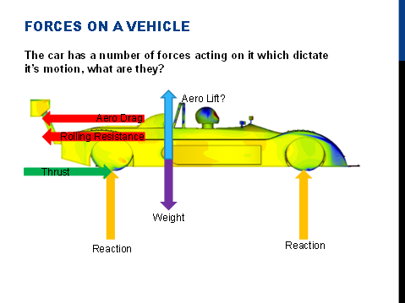
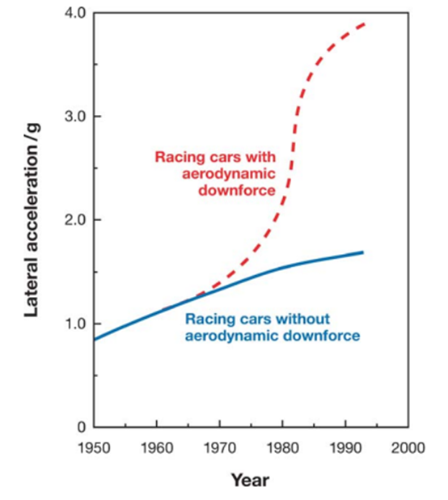
Rhien Williams, 1901571
Andrew Noble
School of Engineering
BEng Motorcycle Engineering
Motorsport Aerodynamics
Introduction
What are the six forces acting on a car?
Aerodynamic Testing
In this poster, you will be informed on basics of Motorsport Aerodynamics, this subject is vast so this poster shall incorporate just the following aspects which include;
What is aerodynamics?
Different forces which act on the vehicles.
Bernoulli’s Principle
Aerodynamic Testing
There are two different types of Aerodynamic testing the race teams use, these are;
Wind Tunnel Testing – Wind Tunnel Testing also known as Empirical Testing involves clamping down a race vehicle into a chamber which blows wind over the vehicle (smoke is sometimes used to help visualize the flow) and then measures how the forces react when flowing past the vehicle. The downside to using a wind tunnel is that errors are created due to a non- moving floor. F1 teams use the wind tunnel as well as CFD to get multiple different results so that they can compare the digital and real results to get the best out of the car.
Computation Fluid Dynamics – CFD is a virtual wind tunnel which uses computers to simulate the fluid flow around an object. This manages to simulate the flow by breaking up complex geometry into small simple shapes in which these shapes solve equations at millions of different points to find the velocity and pressure. These results can vary from a real wind tunnel results due to separate defining factors
Reference: (Tudor,2020)
What is Aerodynamics?
Aerodynamics is the study of how air flows through and around the vehicle in motion. This is used in all varieties of vehicles including cars, planes, motorbikes and even push bikes.
The Graph below demonstrates how much the lateral exclamation has improved due to improvements with aerodynamic downforce.
There are 6 different forces acting on the vehicle when in motion these are; Drag Force; Tractive Force; Gravity; Rolling Resistance ;Lift;Reaction Force
These are demonstrated by the image above (Tudor,2020)
What is Bernoulli’s Principle?
Bernoulli’s Principle is just an expression for the 1st law of thermodynamics. This is that there are 3 different form of energy in a fluid;
Kinetic Energy -1/2mv² -> 1/2pv²
Potential Energy – mgh -> pgh
Pressure Energy – (Pstatic)
It is not possible for energy to be created or destroyed!
From what we’ve gained from the 3 forms of energy an equation is created from them;
Pstatic + 1/2pv² + pgh = Constant
So, what does all this mean?
“If you increase the speed, the pressure will drop.”
“If you decrease the speed the pressure will rise.”
“If you increase the pressure the speed will drop.”
“If you decrease the pressure the speed will increase.”
Reference: (Tudor,2020)
Conclusion
I hope you have found this poster on Motorsport Aerodynamics informative. This is just a small portion of the vast and ever expanding subject with many interesting aspects.
References
BRIDGESTONE, 2020-last update, What is Tire Rolling Resistance?. Available: https://www.bridgestonetire.com/tread-and-trend/tire-talk/tire-rolling-resistance# [1st December, 2020].
COX, E., 2020-last update, Action and Reaction Forces: Law & Examples. Available: https://study.com/academy/lesson/action-and-reaction-forces-law-examples-quiz.html [2nd December, 2020].
NASA, Aug 27, 2001-last update, Racing Physics. Available: https://www.nas.nasa.gov/About/Education/Racecar/physics.html [1st December, 2020].
REAL WORLD PHYSICS PROBLEMS, 2020-last update, Drag Force. Available: https://www.real-world-physics-problems.com/drag-force.html#:~:text=A%20drag%20force%20is%20the,a%20fluid%20is%20given%20by [2nd December, 2020].
TUDOR, T., 2020. Introduction to Aerodynamics.
Graph Reference: (Tudor 2020)

