Slide 1
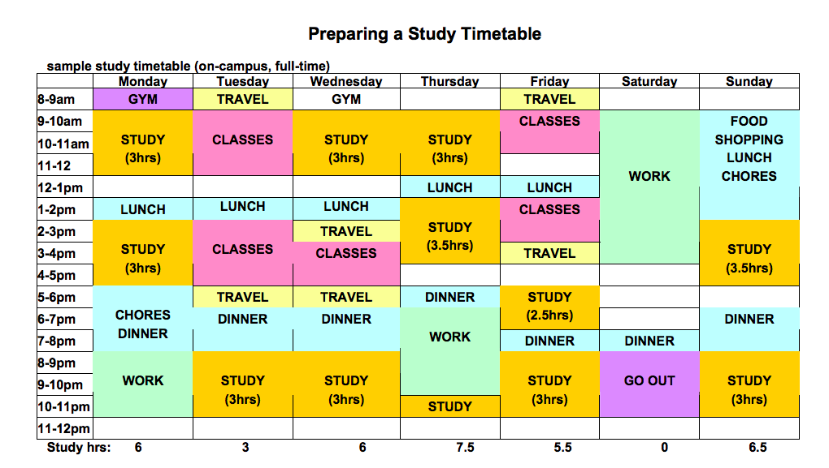

Critical Thinking in Education
What Is Critical Thinking?
According to (Cottrell, 2019, p.259) critical thinking is observing how something appears, and looking more in depth to understand the underlying cause or effect. There are a number of ways an individual can be a critical thinker; some being note taking, referencing and time management. It is important for individuals to have the ability to think critically so that they are able to assess information given, and understand the importance of how and why things are the way they are. Critical thinking enables individuals to think of ways around an issue, and how to solve it in a more in-depth way, rather than getting straight to the point and sticking to it. Reading into the situation more, will help gain a better understanding and a more long-lasting effect.
Note Taking
Referencing and Paraphrasing
Time Management
Note taking is an essential part of education, it allows an individual to look back and further develop their knowledge. According to (Stacey, 2015) note taking is an individual activity, and not every student will take the same information away from a lecture, as they can all interpret the exact same information in different ways. This depends on how an individual thinks, and whether or not they are evaluating the information holistically, or with bias and judgement.
There are two ways a student can make notes in a lecture. They are called note taking and note making. They vary as note taking is copying from a presentation from a lecturer, pretty much word for word. Whereas note making, is paraphrasing what they have already learnt from the lecture (Barrow and Westrup, 2019).
Note taking helps to introduce a person to think critically, without actually realising they are doing it. For example, taking notes from a lecture, and then discussing individuals opinions within a group, will allow a person to give their opinions, and listen to others views. Therefore, allowing individuals to alter their notes, and develop their understanding.
In the 21st century, note taking does not just have to be done by writing on a piece of paper. There a multiple ways to take notes these days such as, using apps to make notes on any electronic device, like a mobile phone for example.
Referencing and paraphrasing go hand-in-hand when it comes to critical thinking. Using skills such as referencing and paraphrasing are vital in order to avoid plagiarism. Plagiarism is using work somebody else has written, and using it in their own work without given the original person any credit (Smith, N et al 2010).
Firstly, it is important to reference any work that has been written by somebody other than the person using it to show understanding of what has been written. Simply just copy and pasting information is not enough to show the learner understands what is being talked about. Saying this, even if an individual copy and pastes, then references, this would still not be good enough to prove a good understanding. Instead, learners must paraphrase what they have read, and then reference.
There are many different ways to reference, and lots of styles, such as Harvard and Oxford referencing. Different types of references are needed when different sources are being used. For example, if the source was a book, the reference structure should be Author surname, initial. ( Year) Book title. City: Publisher (Caulfield, 2020).
(Darr, T2019) Suggests that the sole way to avoid plagiarism is practice and deliberate instruction. When an individual knows what they are looking for, and how to do it, not only will their reading get better, but their writing and researching skills too.
The final critical thinking skill that will be discussed is Time management. This is possibly the most important skill of all when it comes to critical thinking. As Cottrell (2019) states, only the minority of a students time will be spent in lectures. Most time will be spent on researching, assignments, and reading. These skills require a lot of time to do correctly, meaning that the student would need to be able to manage their time efficiently. This is difficult to do, as an individual will likely have other priorities in their life such as, family, social and other day-to-day activities. These are all important things, and a person should still be able to enjoy these without stressing over university and education. That is why time management is crucial to success.
There are many ways to organise a persons time efficiently and fairly, one being to make a timetable. The timetable should enable a person to see where their spare time is, and use that to study. Getting little bits of work done at a time can be less stressful, so it is encouraged that this approach is taken.
As a result of not having the ability to manage time sufficiently, an individual may become stressed which can develop into more serious, long-term conditions. To avoid these, Bedford (2013) suggest maintaining a healthy and balanced diet and to do moderate exercise.
(inkfactorystudio.com)
(dnevnik.bg)
Conclusion
To summarise, all three of the skills discussed are vital to be a successful critical thinker. Becoming a critical thinker is not an easy process, and requires practice, time, and effort. However, if an individual takes the time to attempt to think critically, it will be very beneficial for them in the future.

Slide 2
Reference List
Cottrell, Stella. (2019) The Study Skills Handbook. 5th edn. London: Bloomsbury Publishing Plc.
STACY, E.M. et al. (2015) Note-taking and Handouts in The Digital Age. Kentucky: American journal of pharmaceutical education.
Charlotte B, Rebecca, W. (2019) Writing Skills for Education Students. London: Bloomsbury Academic.
Neal S, Kathleen R. Wren. (2010) Ethical and Legal Aspects Part 2: Plagiarism—“What Is It and How Do I Avoid It?”. 5th edn. Orlando: Elsevier Inc.
Caulfield, J. (2020) Referencing Books in Harvard style. Scribbr.
Daily Study Timetable For Students - - Blogosphere (dnevnik.bg) (image)
VleReader
7 High Tech Tools for Great Visual Digital Note Taking — Ink Factory (inkfactorystudio.com)
Darr, T. (2019) Combating Plagiarism: a Hands-On Guide for Librarians, Teachers, and Students. California: ABC-CLIO, LLC.

