Slide 1
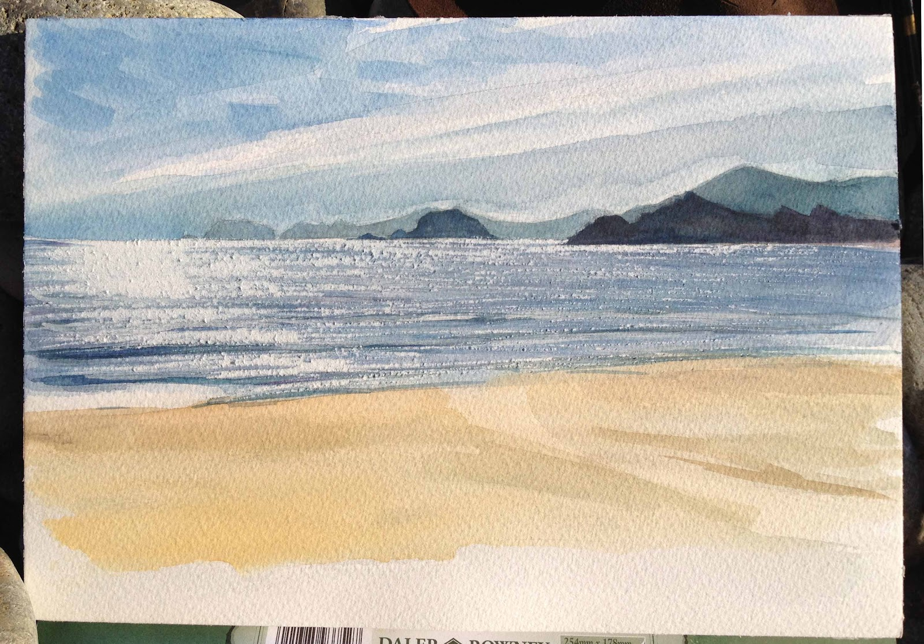
Conservation OR Development
Function analysis:
a strategic coastal management technique?
Haskett, T Newgale

Slide 2

Contents
Shoreline Management
Beaches Surveyed
Function Analysis
Exercise
Methodology
Results
Conclusions
Haskett, T

Slide 3
Introduction
In many coastal locations there is an emphasis on social value and development value
  Therefore recreational / industrial value is important and conservation is of limited significance (Micallef & Williams pers. comm. 2014)
In pairs answer the following in relation to beaches you know:
  How do you measure value/importance? Ecological, social, economic, cultural, historical? Give examples of each.
  What are the functions of coastal locations?
  How do they vary and why?
  What are the coastal environment’s inherent characteristics?
  Do these influence the functions? How? Give Examples.
  How do they change through time and space?
  Is sustainability an issue? Why? How?
  Is an understanding of function important for CZM plans?
  Is an understanding of value important for CZM plans? How?
DISCUSSION

Slide 4
Functions
Environmental goods and services uses Environmental Function Analysis
  Planning and decision making tool
4 principal functions (de Groot, 1992, Micallef & Williams, 2003):
  Production functions: renewable and non-renewable resources
  Carrier functions: space and substrate for human activities
  Information functions: reflection, spiritual and cognitive benefits
  Regulation functions: capacity of ecosystems to regulate essential processes which = healthy environments (e.g. air, soil, water quality)
These 2 lead to major change and are mainly economic value with a direct use
Refer to table on next slide) These 2 are mainly conservation value but include intrinsic and ethical values. Usually need Qualitative analysis)

Slide 5

Regulation and information functions (Micallef & Williams, 2003: 148)
Do you agree?
Any others?

Slide 6
Human natural interaction (van der Meulen, 2009)
Provision of goods and services
Production of risks & hazards
Production of neg- human impacts
Development of human management of nature
Hence the ability of an ‘environment’ to provide services is a product of its characteristics.

Slide 7
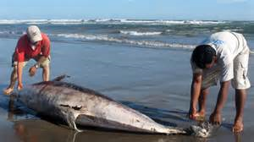
Measure characteristics
Research tried to ‘measure’ / scientifically evaluate these characteristics (Cendrero & Fischer, 1997)
4 stages
Definition of area/boundary
Identification of characteristics
Allocation of values
Comparison of ecological and economic/social value

Slide 8
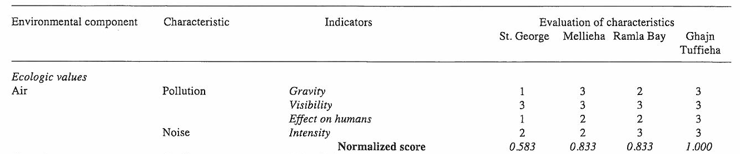
Function analysis scoring
Normalised scores are calculated:
Actual/ Max / i.e. 7/12=0.583

Slide 9
These beach scores are plotted on the matrix

Slide 10
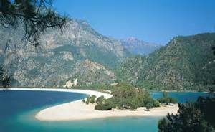
Function analysis Exercise
Fill in the table (Handout)
Give each indicator a score 1-3 (1 Low - 3 high)
Plot your total scores on a matrix
Summarise findings
Construct a Shoreline Management Plan for the 4 beach area
Assess methodology and application of results

Slide 11
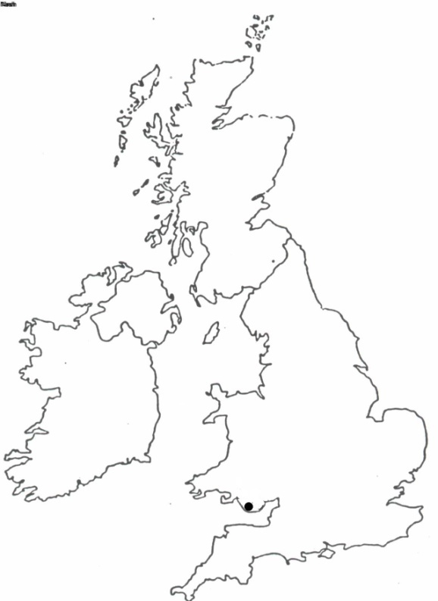
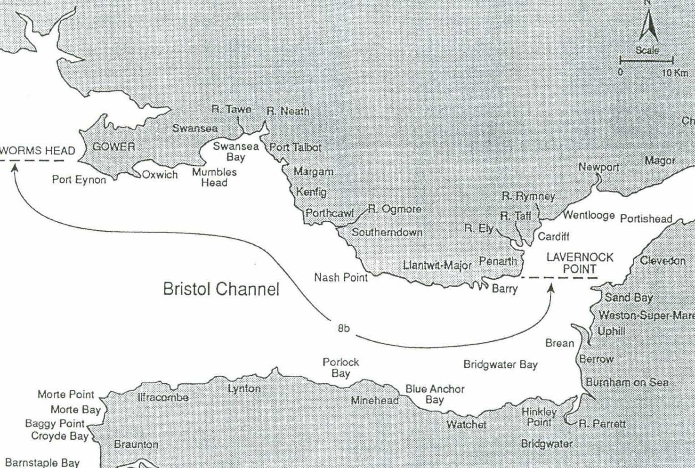
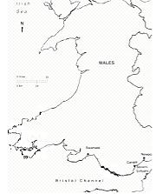
Swansea Bay Shoreline Plan - Sub-Cell 8b

Slide 12
Swansea Bay Shoreline Management Plan – Sub-Cell 8b
Boundaries – Worms Head (West) to Lavernock Point (East)
Administrative - 4 Local / Planning Authorities (Swansea, Neath-Port Talbot, Bridgend and Vale of Glamorgan County Councils)
Environmental Designations - include SACs, Heritage Coasts, AONB, NNRs, numerous SSSIs etc.

Slide 13

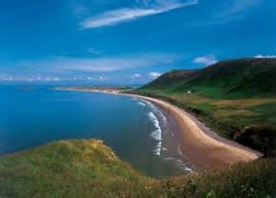
Beaches Surveyed
Rhossili Bay (W)
Port Eynon
Horton
Oxwich Bay
Caswell Bay
Langland Bay
Swansea Bay
Aberavon
Porthcawl (Rest Bay)
Porthcawl (Coney Beach)
Merthyr Mawr
Southerndown
Nash Point
Llantwit Major
Barry Island (E)

Slide 14
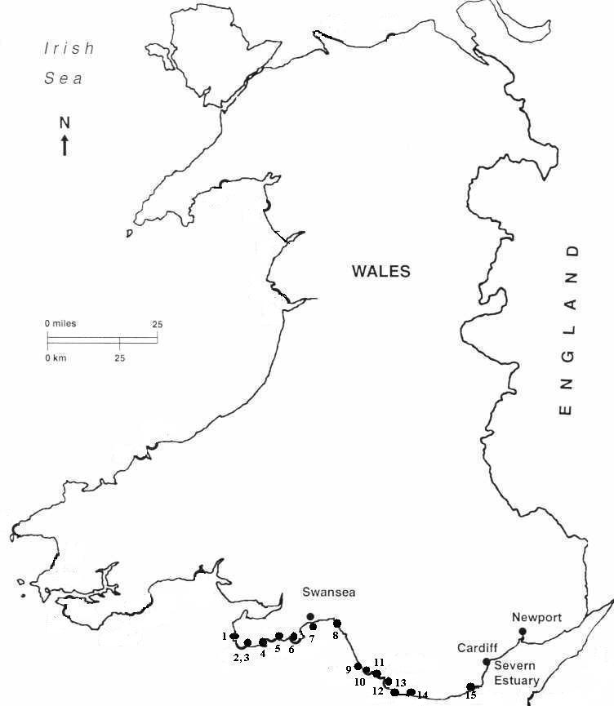
Key to Beaches
Rhossili | 1
Port Eynon | 2
Horton | 3
Oxwich | 4
Caswell | 5
Langland | 6
Swansea Bay | 7
Aberavon | 8
Rest Bay | 9
Coney Beach | 10
Merthyr Mawr | 11
Southern-down | 12
Nash Point | 13
Llantwit Major | 14
Barry Island | 15

Slide 15
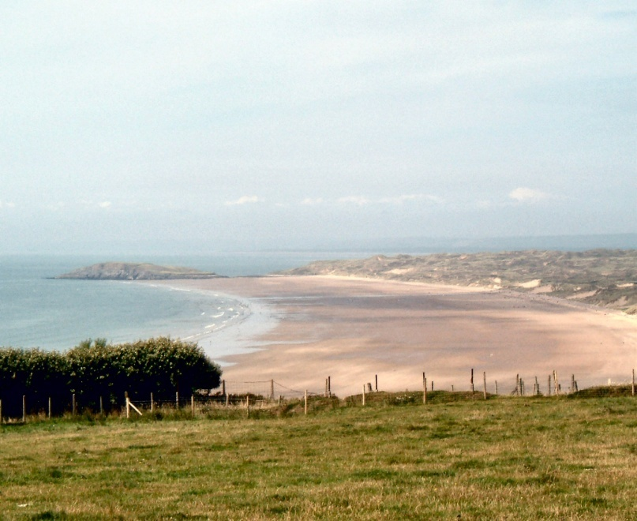
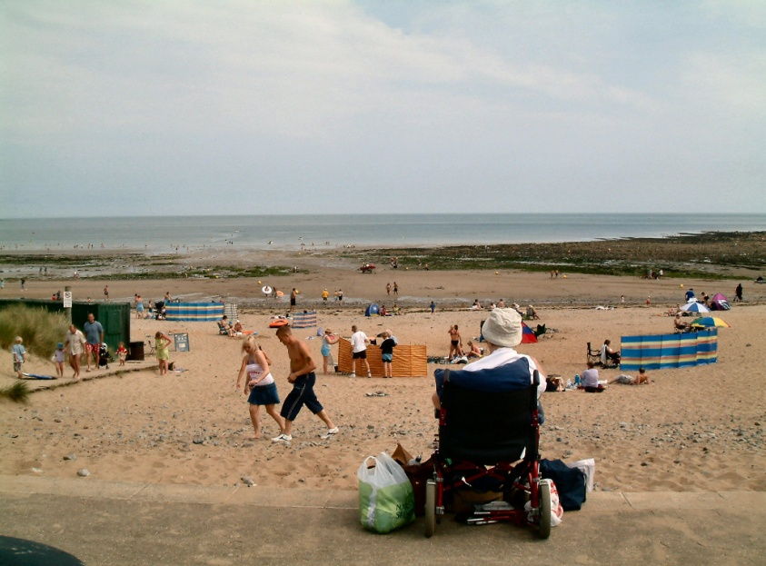
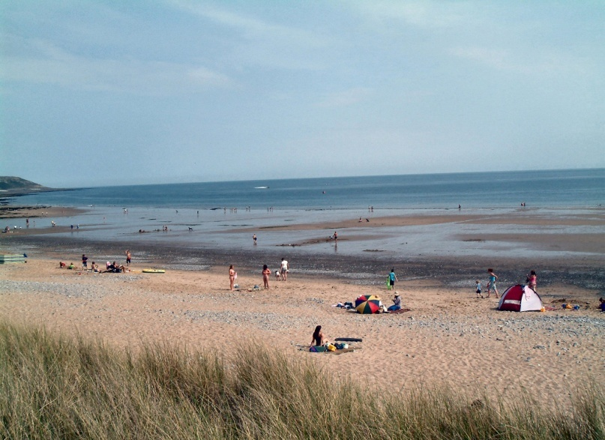
Rhossili Bay – AONB, Archeological Interest, Heritage Coast and sports.
Port Eynon – AONB, Nature Reserve, MCS and Blue Flag designations.
Horton – AONB with beach popular for surfing and wind sport activities.

Slide 16
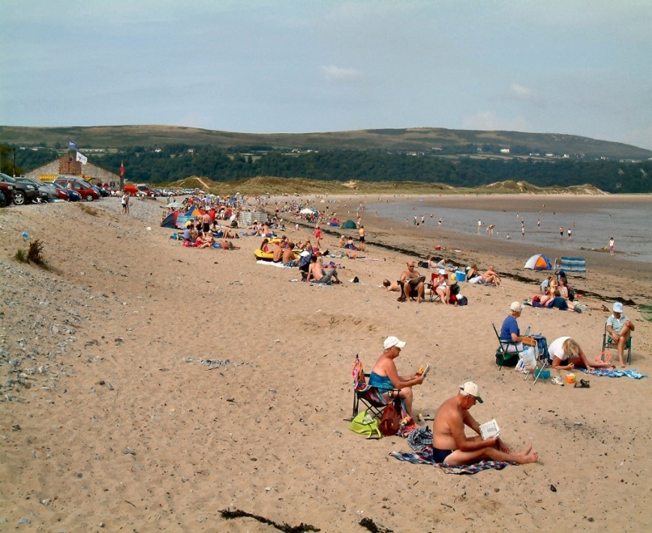
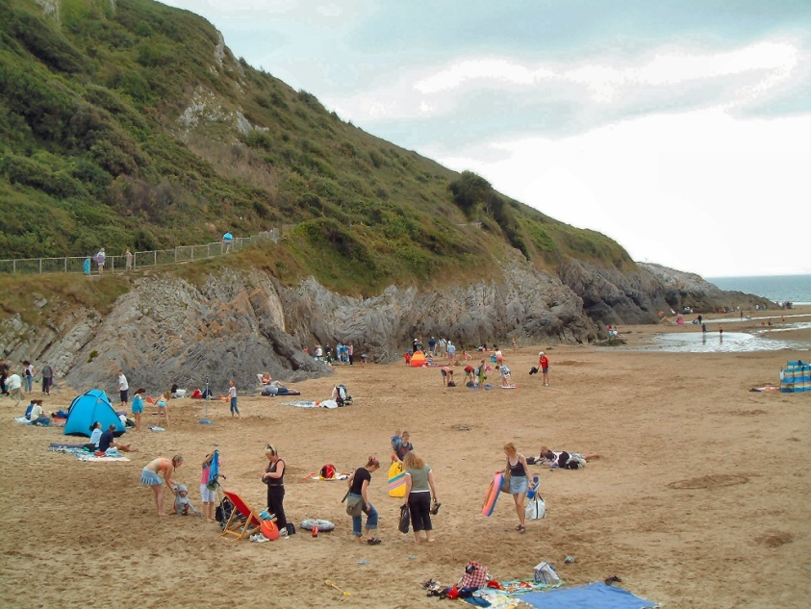
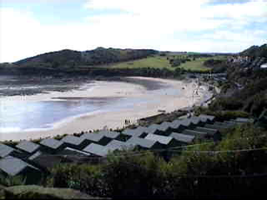
Oxwich Bay – AONB, SSSI, NNR and MCS beach designations.
Caswell Bay – AONB with Blue Flag status since 2002.
Langland Bay – AONB with Blue Flag status since 2002.

Slide 17
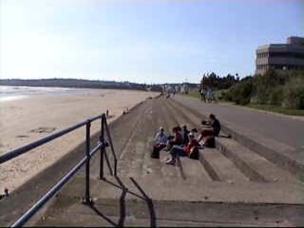
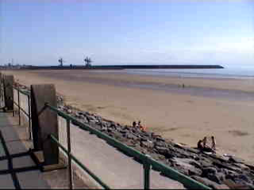
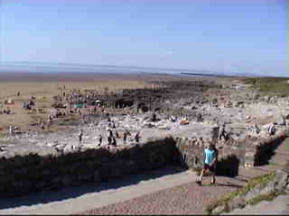
Swansea Bay – Urban beach adjacent to City centre.
Aberavon – Urban beach in industrial area with no designations.
Rest Bay – Blue Flag beach popular for surfing.

Slide 18
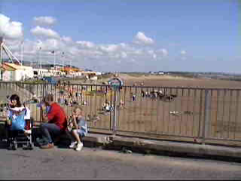
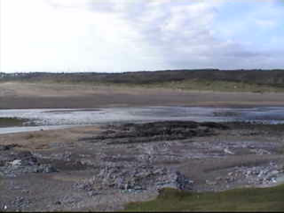
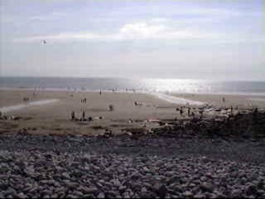
Coney Beach – Resort beach with MCS beach designation.
Merthyr Mawr – SSSI designations for sand dunes and salt marshes.
Southerndown – Glamorgan Heritage Coast, MCS and SSSI designations.

Slide 19
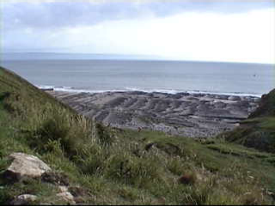
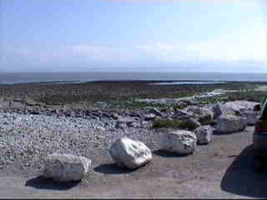
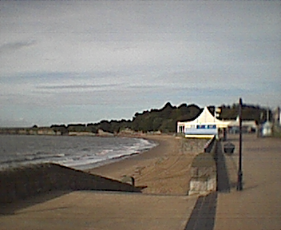
Nash Point – Glamorgan Heritage Coast and SSSI designation (geology).
Llantwit Major – Glamorgan Heritage Coast with MCS designated beach.
Barry Island – Resort beach with no environmental desisnations.

Slide 20
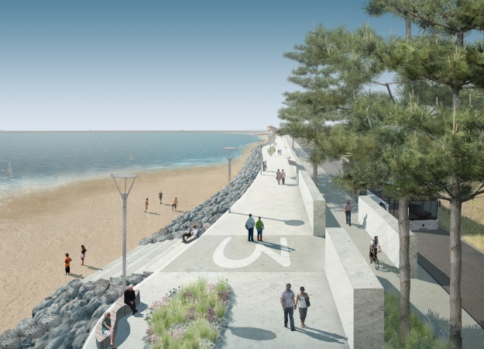
Function Analysis
Methodology a modification of:
Van der Maarel (1978, 1979)
De Groot (1992) - Functions of Nature
Cendrero and Fisher (1997) - Assessing Environmental Quality of Coastal Areas for Planning and management
Van der Weide et al (1999) – Assessing the value of coastal wetlands
Micallef and Williams (2003)- Maltese bathing waters
Phillips, M.R. (2007)- Coastal management tool

Slide 21
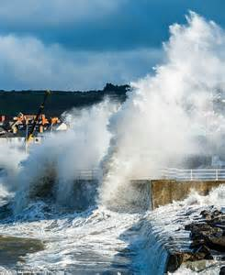
Environmental Indicators
Air
Hazards
Resources
Fresh Water
Marine Biota
Coastal Water
Terrestrial Biota
Geological and Topographical Features
These indicators were sub-divided into 35 components

Slide 22
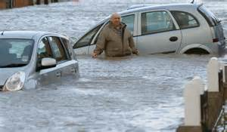
Socio-economic indicators
Potential for use
Human well-being
These 2 indicators were sub-divided into 18 components

Slide 23
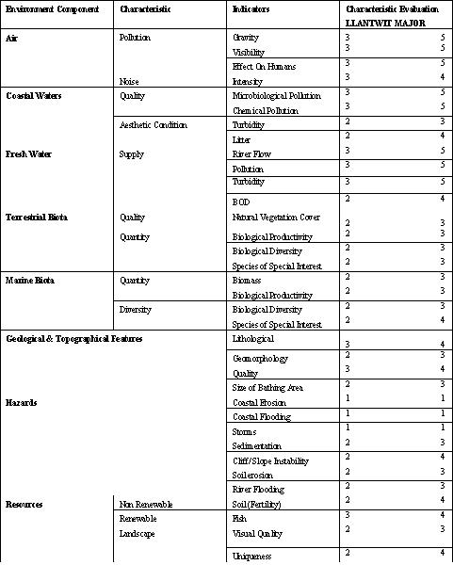
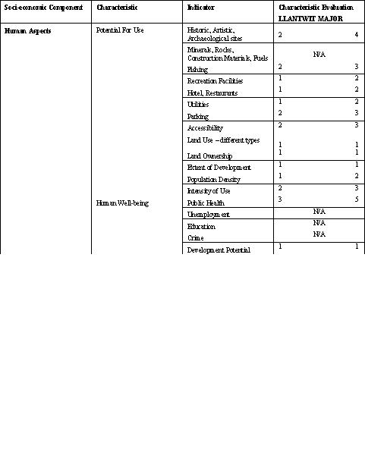

Slide 24
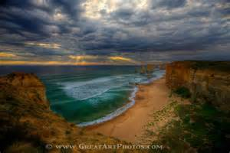
Methodology
Components were determined for each indicator and analysed for every beach
Score allocated to each component within the range from 1 (worst) to 5 (best)
Component scores ‘normalised’ for each indicator (environmental and socio-economic)
Environmental and socio-economic indicators normalised overall to produce conservation / development matrix

Slide 25
Normalised Scores for Natural and Socio-economic Beach Indicators

Slide 26
Site comparisons based on normalised scores for both ecological and socio-economic indicators

Slide 27
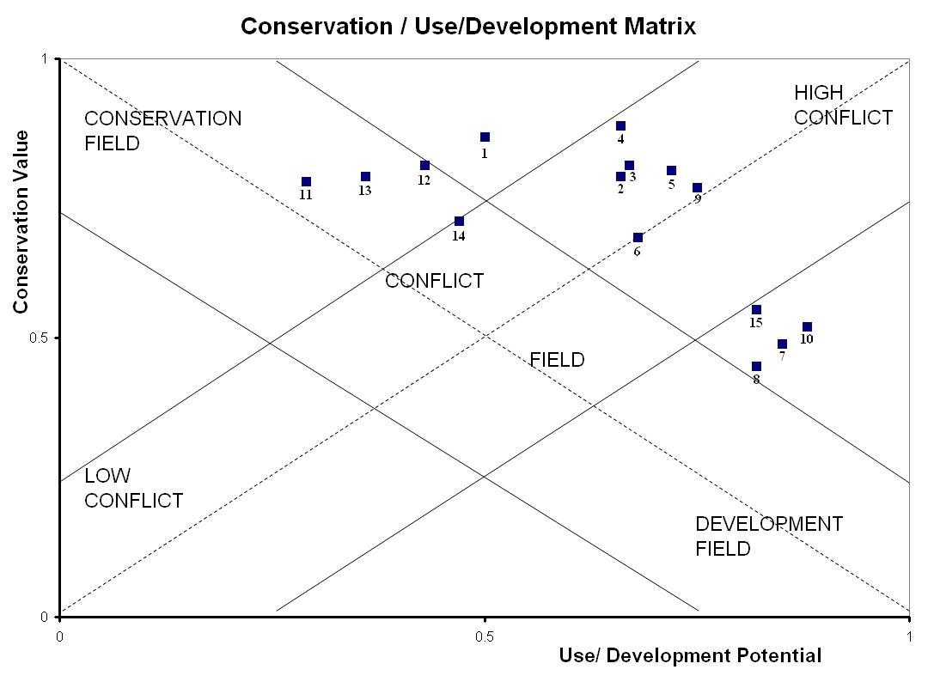
Key to Beaches
Rhossili | 1
Port Eynon | 2
Horton | 3
Oxwich | 4
Caswell | 5
Langland | 6
Swansea Bay | 7
Aberavon | 8
Rest Bay | 9
Coney Beach | 10
Merthyr Mawr | 11
Southern-down | 12
Nash Point | 13
Llantwit Major | 14
Barry Island | 15
Interpret these findings: What do they mean for a SMP?
Matrix: Cendrero and Fisher, 1997

Slide 28

Conservation
Rhossili
Merthyr Mawr
Southerndown
Nash Point

Slide 29
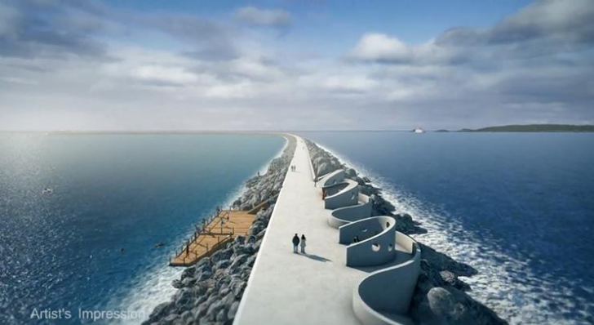
Development
Swansea Bay
Aberavon
Porthcawl (Coney Beach)
Barry Island

Slide 30
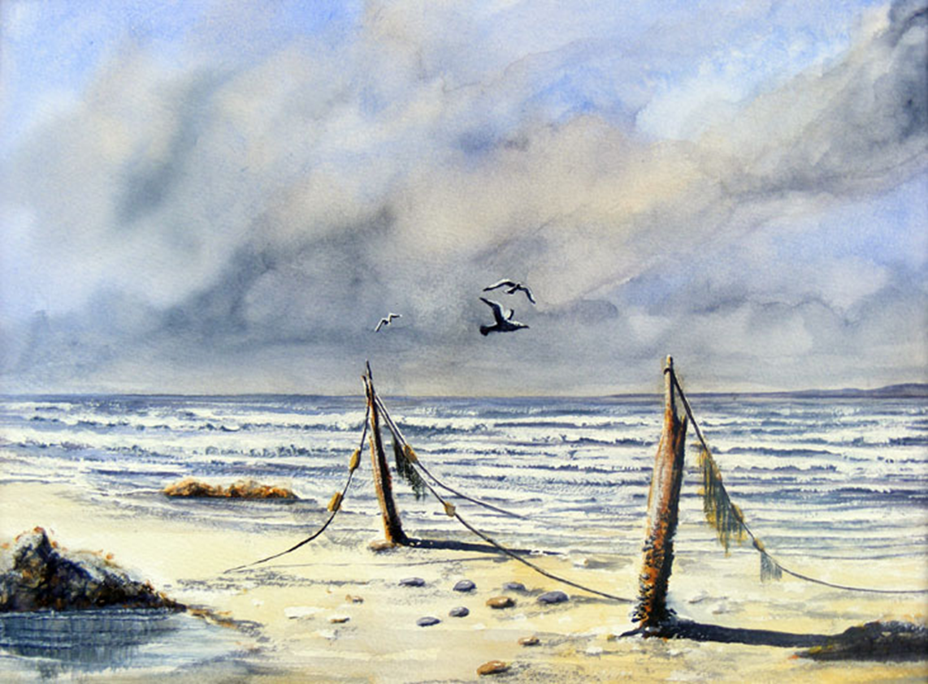
Conflict
Port Eynon
Horton
Oxwich Bay
Caswell Bay
Langland Bay
Porthcawl (Rest Bay)
Llantwit Major
Haskett, T Hastings

Slide 31
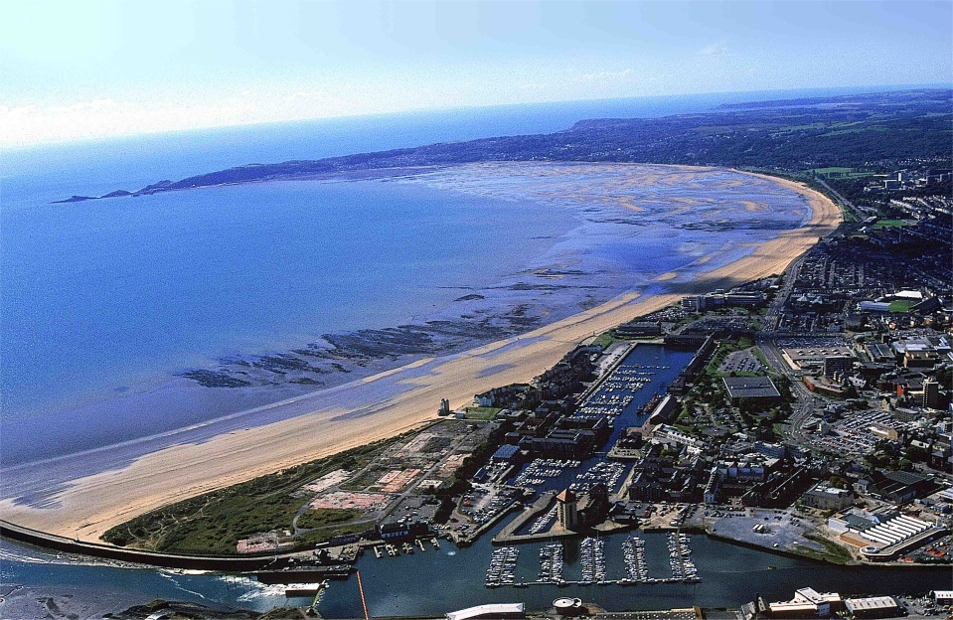
Conclusions
Function Analysis provides a useful tool to identify conflict and evaluate change
Conservation and Development areas are clearly defined
Areas of potential conflict can be identified with significance of appropriate indicators
Shoreline Management Plans and Planning Legislation are seen as significant in controlling conflict

