Slide 1

Interim Viva
Adam Thomas
225473

Slide 2
Introduction
This viva consists of the various topics and sub-topics surrounding sports therapy and more importantly how it is applied in applications.
The title is called “An investigation into how software can support sports therapists and their clients”.
This research project will look at how applications will benefit the sports therapy industry, especially in the current pandemic where patients cannot go to see therapists.

Slide 3
Aims and objectives
The aim of this project is to investigate how software can support sports therapists and their clients.
Objectives
Conduct an initial literature review into the subject area of sports therapy and analyse the sub-topics in question. These topics consist of:
  Sports therapy
  Injuries and preventions
  Recovery
  Current applications available
  Analyse existing research into sports therapy and the links to applications.
Develop an application guided by the research conducted into the topic areas.
Evaluate the final application with the client, and report back with any future iterations needed.

Slide 4
Literature review – What is sports therapy?
According to the governing body, the society of sports therapists, sports therapy is:
“An aspect of healthcare that is specifically concerned with the prevention of injury and the rehabilitation of the patient back to optimum levels of functional, occupational and sports specific fitness, regardless of age and ability” (1).
Notes:
This suggest that sports therapy is looking into human anatomy, studies the injuries and then gives a diagnosis. With this expert knowledge, they will then give a rehabilitation plan to their clients, that will get them recovered and back to normal as efficient as possible.
This quote was used as it was from the biggest governing body of sports therapists, and the client is a member of this body. This was a reliable source as it is direct from the governing body of sports therapists, so this did not need to be craap tested.

Slide 5
Literature review – Typical injuries
After conducting an initial literature review into injuries, it was found that muscular injuries were the most common, typically hamstring.
A paper was found called ‘using platelet-rich plasma in treating muscular injuries’ suggested that :
“Over the course of each competitive season, a team of elite footballers consisting of 25 players may expect 4–6 injuries of hamstring muscles alone – these are the most common football-related injuries” (2).
Notes:
This suggests that hamstring injuries are one of the most common muscular injuries out of any sport. This will be one of the more common injuries that the client will have to diagnose.
This paper was used as it was conducted by Eduard Bezuglov who is a hamstring expert and a Doctor of Medicine in Moscow medical university. This was from an academic source, so CRAAP testing did not need to be conducted. He has also written a paper called “The Effect of Training Experience and Leg Dominance on the Prevalence of Asymptomatic Intraarticular Changes of the Knee Joints”. This also looked at hamstring injuries and the next popular injury of the knee.

Slide 6
Literature review – Typical injuries
After conducted further research into typical injuries, another common injury that will need to be diagnosed is joint injuries, especially the knee. Knee pain is a common complaint for sport participants.
“Cartilage damage is a relatively common type of injury. It often involves the knees, although joints such as the hips, ankles and elbows can also be affected” (3).
On the NHS website, a common injury that their physiotherapy staff commonly treat is joint pain, especially knee injuries. Cartilage damage is one of the most major knee injuries, and if left untreated, major damage can occur.

Slide 7
Literature review – Typical injuries
A common injury that therapists are likely to see is rotator cuff injuries. A paper found conducted by Harvard medical school suggests:
“Rotator cuff tears affect a significant portion of the tendon, cause weakness of the shoulder, limiting your ability to hold your arm out to one side or to lift an object” (4).
Harvard medical school suggests that having a rotator cuff injury can limit the movement of the shoulder and the arm. This needs to be looked at by a therapist to try and diagnose the issue and get the patient back to optimum health.
Notes:
This source found was reliable as it was conducted by Harvard medical school, who are one of the best universities for medicine in the world.

Slide 8
Literature review – Treatments and recovery
To gain better knowledge into building an application for the client, typical treatments and recovery for the most common injuries was explored.
After researching the treatments available after injury, an article was found by ‘NHS UK’ called “hamstring injuries”.
To treat this type of injury, one should:
“During the first 2 or 3 days, you should care for your injury using RICE therapy: Rest, Ice, Compression and elevation” (5).
Notes:
This urges that after injury, the client should rest the muscle and apply cold packs to the surrounding area. After this is completed, they should bandage it to try and prevent any other swelling. After this, they should keep the leg raised, so swelling is reduced. This was the best possible treatment for hamstring injuries.
This source was reliable as it was conducted by the National Health Service and did not need to be CRAAP tested. This was fact checked, and it was updated in December 2020.

Slide 9
Literature review – Treatments and recovery
After an interview with Mr Kerry Nicholas – Owner of Next Step Sports Therapy and professional sports therapist and lecturer, suggested that:
“Proprioceptive treatment is an exercise-based rehabilitation where you will use equilibrium techniques, such as wobble boards, balance beams and leg hops. This will be conducted to correct the landing technique on the knee, to prevent any more cartilage damage” (6).
the patient will undergo training such as agility, accelerating and decelerating. This then gets the patient back to full health and strengthens the injured knee to prevent it from happening again.
Notes:
A paper was found to back up the NHS point of knee injuries as being the most common, called “Actual aspects of treatment of meniscus injuries”. This was conducted by Eduard Bezuglov and Artemii Lazarev at the Moscow medical university suggesting that “If there is presence of degenerative meniscal tears and significant cartilage damage the method of choice should be conservative treatment, which is based on a set of exercises”. This also backs up Mr Kerry Nicholas’ view of treating the knee joint and cartilage damage.

Slide 10
Literature review – Treatments and recovery
To treat rotator cuff tears, a study was found called “Rehabilitation after rotator cuff repair”. This study looked at the rehabilitation of the injury and looked at the best ways to treat it.
“Early passive range of motion (ROM) following arthroscopic cuff repair is thought to decrease postoperative stiffness and improve functionality. However, early aggressive rehabilitation may compromise repair integrity” (7).
After the patient has been diagnosed, the best possible way to get the patient back to optimum health, the therapist should start moving the shoulder as early as possible, to prevent stiffness and give full range of motion back to the client.
Notes:
This was conducted by Harvard Medical school, so it did not need to be CRAAP tested.
A paper called “Early versus delayed rehabilitation following arthroscopic rotator cuff repair”, written by ‘Dr Meghan E Bishop’ of Rothman orthopaedic institute of New York, is an Orthopaedic Surgeon, Sports Medicine Specialist, and shoulder surgeon, suggested that “Early rehabilitation after rotator cuff repair is associated with some initial improvements in range of motion and function”. This backs up Harvard medical school’s treatment of rotator cuff repairs.

Slide 11
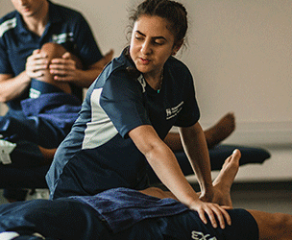
Discussion of findings – lit review
Sports therapists key areas are:
    Prevention
    Recognition and evaluation
    Management, treatment, and referral
    Rehabilitation
    Education and professional practice issues.
Notes:
(11).
This suggest that sports therapist have to be with a governing body in order to practice, and must be educated to a certain standard, at least degree level.

Slide 12
Discussion of findings – lit review
In summary, sports therapy is a constantly changing area, especially in the current pandemic, as some patients cannot go to see their therapists.
Therapists are at the front of sports injuries and need the qualifications to diagnose and treat the correct injuries to get their patients back to optimum health.
The client will need to be with a governing body that will help the business, and in order to be qualified, complete a degree to be accepted into the governing body.

Slide 13
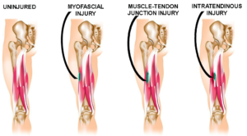
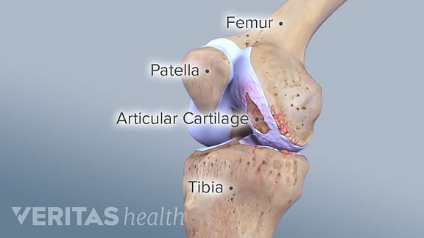
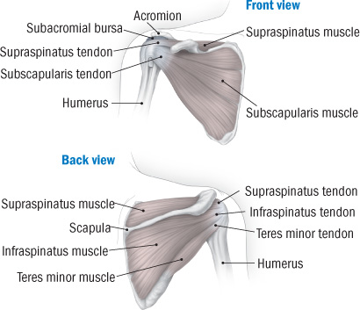
Discussion of findings – lit review
Typical injuries include:
Muscular:
  Hamstring injuries are the most common.
Joint:
  Knee injuries are the most common, this being cartilage injuries.
Shoulder:
  Rotator cuff tears are the most common shoulder injuries
Notes:
(12). Hamstring image
(13.) Knee image
(14). Shoulder image

Slide 14
Discussion of findings – lit review
Injury treatments/recovery include:
Muscular:
  Rest
  Ice
  Compression
  Elevation
Shoulder:
  The therapist should start moving the shoulder as early as possible, to prevent stiffness and give full range of motion back to the client.
Joint:
  Rest
  Ice
  Compression
  Elevation
  After this has been completed, the patient then moves onto proprioceptive treatment

Slide 15
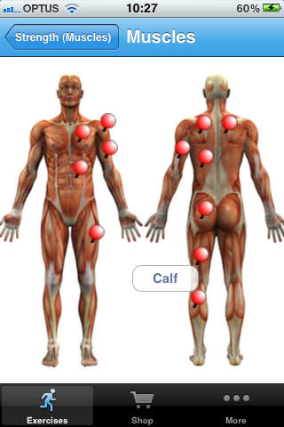
Existing tools – Physio adviser
After some research into the existing tools, three applications were found. The first was called ‘Physio Adviser.’
It shows a simple application that shows exercises for rehabilitation.
It pinpoints the major muscles that will be subject to normal injuries.
When the body part is clicked on the image, it goes into more detail on how to begin rehabilitation on the given muscle.
Notes:
(8).

Slide 16
Existing tools – Physio adviser
Positives
  Shows major muscle groups
  Informative for the everyday user
  Well laid out and displayed
Negatives
  Outdated application
  Generic for everyone, not focused on one user
  Costs £2.99
Considerations for build:
  Using the skeleton for the user to navigate
  Make it easier to navigate
Notes:
(8).

Slide 17
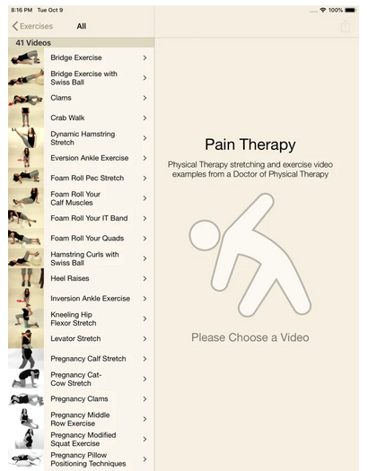
Existing tools – Pain Therapy
This application is only available on iOS.
Better navigation compared to physio adviser app.
List of different exercises available.
Provides videos to show you how to do each exercise.
Pregnancy therapy which involves more complex levels of therapy.
Notes:
(9).

Slide 18
Existing tools – Pain Therapy
Positives
  Shows a lot of exercises
  Informative for the everyday user
  Shows pregnancy exercises
  Video examples of exercise
Negatives
  Cluttered application
  Generic for everyone, not focused on one user
  Hard to navigate
  Does not say what you would do each exercise for
Considerations for build:
  Use examples for each exercise
  Make it easier to navigate
  Say what exercise is used for and name specific exercise
  Declutter the application
Notes:
(9).

Slide 19
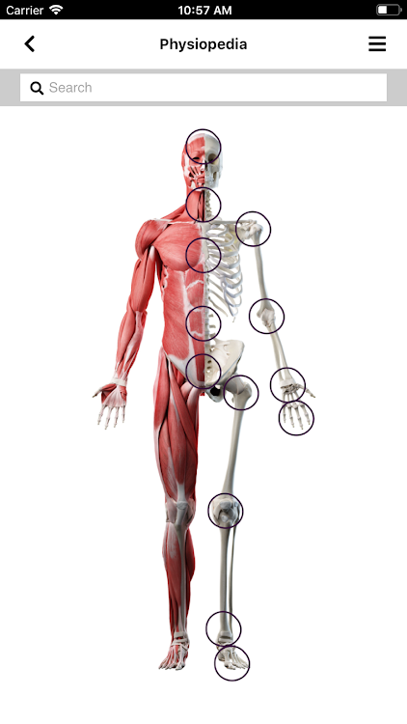
Existing tools - physiopedia
Physiopedia is an application that brings all sports therapy together without having to go and see a physiotherapist
Does not have a booking option
Generic application for everyone
It has an image of a skeleton/muscles on the homepage, and you can select what part of the body that is required
gives a list of each injury and a video to recover
Notes:
(10).

Slide 20
Existing tools - physiopedia
Positives
  Easy to navigate
  Informative for the everyday user
  Decluttered
  Video examples of exercise
Negatives
  Basic interface
  Generic for everyone, not focused on one user
  Can click the wrong muscle group easily
Considerations for build:
  Use examples for each exercise with videos
  Make it easier to navigate
  Say what each exercise is used for
  Use the skeleton as a UI design application
Notes:
(10).

Slide 21
Discussion of findings – Apps found
It was found that all the applications were generic, and not subject to one client.
the application could be based off ‘pain therapy’, as this had all the information that the client would need, and then add a booking system at the back end of the application
A better layout will be made using the skeleton UI design from the other two apps.
That way the patient could research and look at the injury diagnosis, and then decide whether they would like to book in or not.

Slide 22
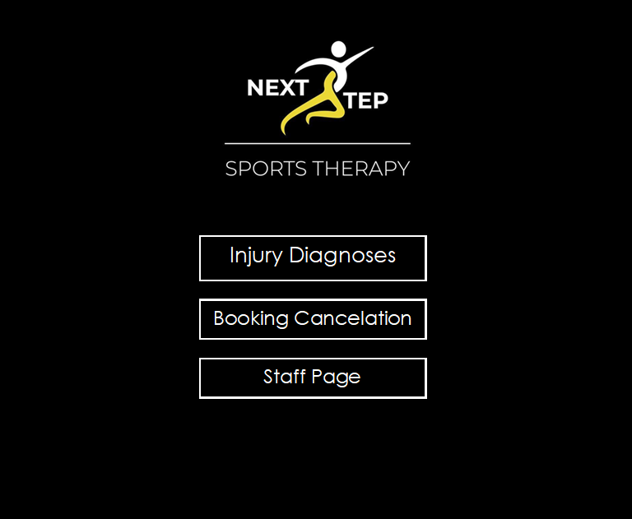
Code Examples/Prototypes
Main menu page
3 buttons to navigate through the app
Next step logo at the top

Slide 23
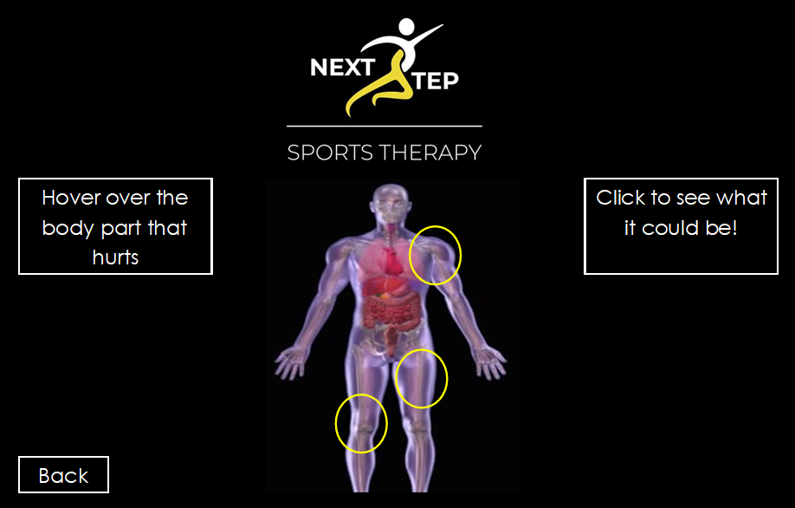
Prototypes
Injury diagnoses page
Next step logo at the top of the page
Instructions
Back button
Circles highlight what can be clicked

Slide 24
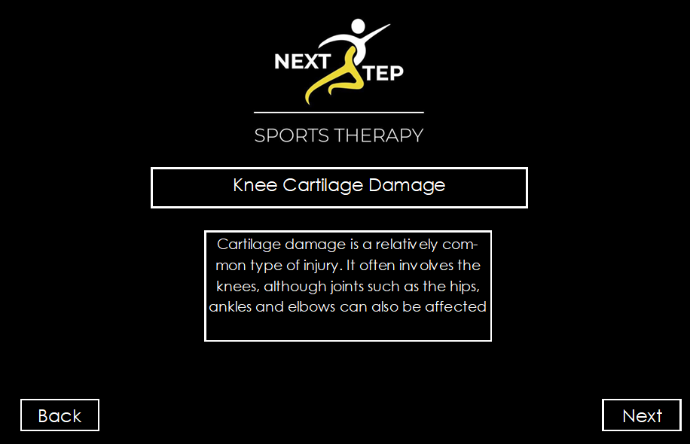
Prototypes
After the knee button has been clicked it will take you to this page
Describes the injury
Navigation buttons at the bottom of the page

Slide 25
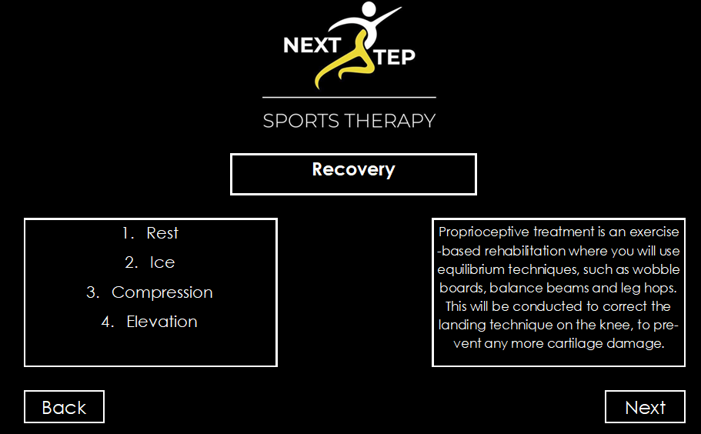
Prototypes
Logo top of page
Recovery page after the next button has been clicked
Two buttons bottom of the page
Recovery techniques

Slide 26
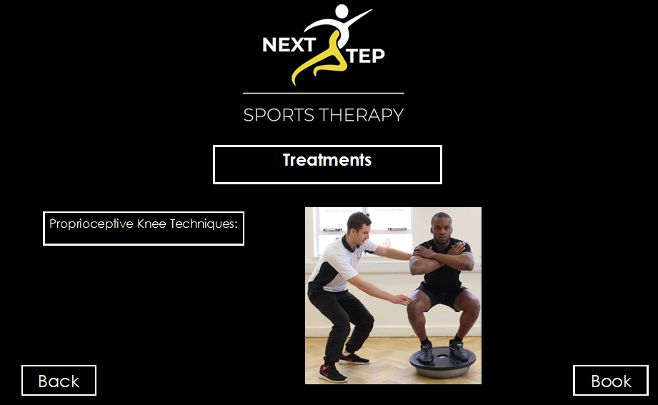
Prototypes
Logo top of page
Two buttons bottom of page
Treatment techniques shown
Videos will be added on the finished app
Booking button at the bottom if they want to book in

Slide 27
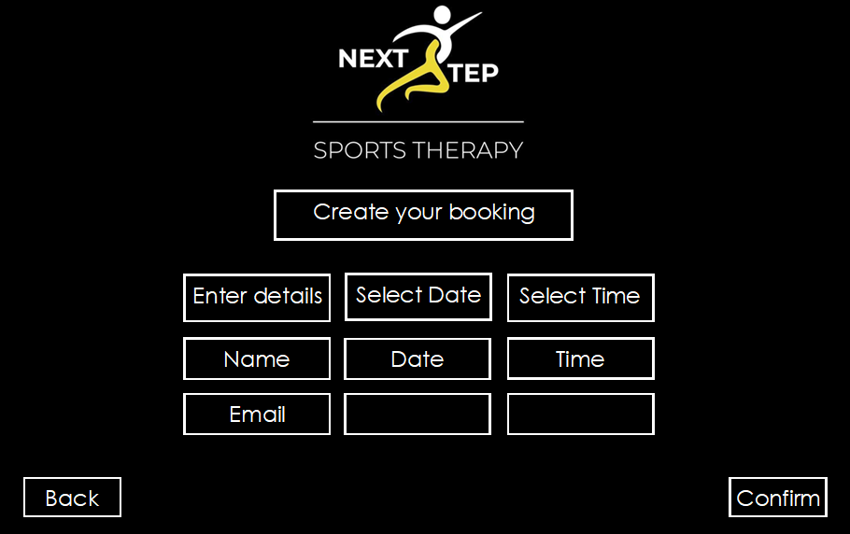
Prototypes
Booking page (data driven)
User enters details (validation will be used)
Date drop down menu enables
If date is free, it will be selected on menu
Time drop down menu enables if date is free
User clicks confirm when booking is complete

Slide 28
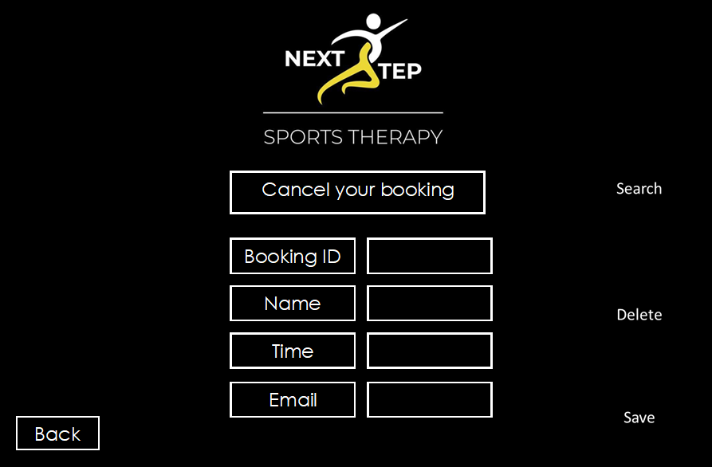
Prototypes
Cancel booking page
User enters details, then clicks search
If data matches, details will come back
User clicks delete button
Data gets removed, then user clicks save so the deletion is confirmed

Slide 29
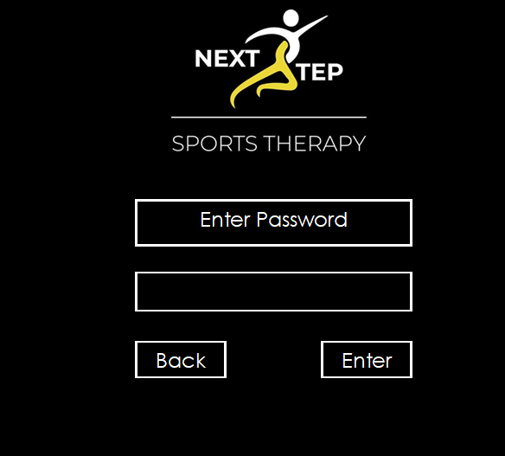
Prototypes
Staff menu page
Staff need to enter the password to proceed
If password is correct, they click enter then go to the next page
If incorrect, they do not proceed
If you navigate to the page incorrectly, back button will take you back to the main menu

Slide 30
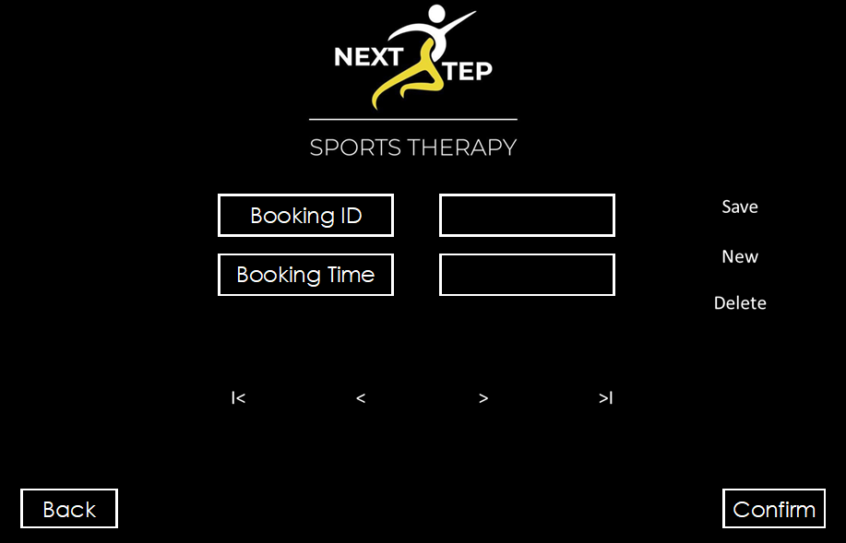
Prototypes
Staff menu page
This is where staff update booking slots
Staff delete slots once completed
Click save button once completed, then confirm
Buttons in the middle can navigate to the next/previous or the last/first booking

Slide 31
Project Plan
A project plan has been implemented throughout the whole project, including the research proposal and this will be updated after every task that has been completed.
The gaps have been added as it will be running throughout Christmas and new year.
Any problems that have occurred, extra time will be allocated for these.
https://plan.tomsplanner.com/#doc=xRJoTGGUIhWZuJcZGPwo

Slide 32
References
Sports therapist governing body. Society of sports therapist. [Online]. Available from: https://society-of-sports-therapists.org/public-information/what-is-sports-therapy/ [Accessed 15 December 2020].
Eduard nikolayevich bezuglov. Using platelet-rich plasma in treating muscular injuries in professional football. [Online]. Available from: [Accessed 15 December 2020].
NHS. Cartilage damage. [Online]. Available from: https://www.nhs.uk/conditions/cartilage-damage/ [Accessed 5 January 2021].
Harvard medical school. Rotator Cuff. [Online]. Available from: https://www.health.harvard.edu/a_to_z/rotator-cuff-injury-a-to-z [Accessed 5 January 2021].
NHS. Cartilage damage. [Online]. Available from: https://www.nhs.uk/conditions/cartilage-damage/ [Accessed 5 January 2021].
Kerry Nicholas. Proprioceptive treatment. An interview with proprioceptive treatments [Masters level]. Next Step Sports Therapy Owner and College Lecturer; 2020.
Harvard medical school. Rotator Cuff. [Online]. Available from: https://www.health.harvard.edu/a_to_z/rotator-cuff-injury-a-to-z [Accessed 5 January 2021].
Mas. MAS Medical. [Online]. Available from: https://www.masmedicalstaffing.com/2018/03/01/physical-therapy-apps-for-patients/ [Accessed 5 January 2021].
Mas. MAS Medical. [Online]. Available from: https://www.masmedicalstaffing.com/2018/03/01/physical-therapy-apps-for-patients/ [Accessed 5 January 2021].
Mas. MAS Medical. [Online]. Available from: https://www.masmedicalstaffing.com/2018/03/01/physical-therapy-apps-for-patients/ [Accessed 5 January 2021].
Bca. BCA Health . [Online]. Available from: https://www.bcu.ac.uk/health-sciences/students/employability/sport/sports-therapy picture [Accessed 5 January 2021].
Tracy ward. Hamstring injuries: why location and anatomy matters! [Online]. Available from: https://www.sportsinjurybulletin.com/hamstring-injuries-why-location-and-anatomy-matters/ [Accessed 15 December 2020].
Sports health. Cartilage damage. [Online]. Available from: https://www.sports-health.com/blog/can-damaged-cartilage-be-fixed [Accessed 5 January 2021].
Harvard medical school. Rotator Cuff. [Online]. Available from: https://www.health.harvard.edu/a_to_z/rotator-cuff-injury-a-to-z [Accessed 5 January 2021].

